Slide 1



Climate response to different freshwater release rates in the Mediterranean
Didier Swingedouw

Slide 2
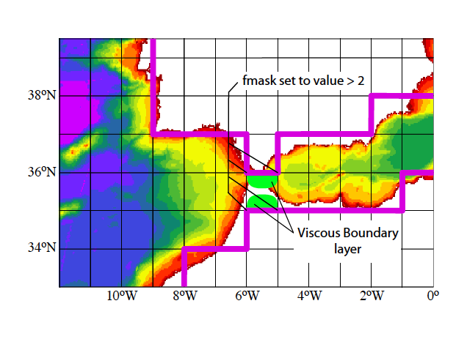
Experimental design
Objective: What is the impact of a MOW disappearance on large-scale ocean and climate in a state-of-the art climate model?
IPSL-CM5A-LR:
  Ocean-atmosphere GCM (2° resolution)
  Representation of Gibraltar by enhancing number of grid points there and playing with viscosity for having coherent transport (modelled MOW=2.2 Sv, obs.≈1.8 Sv)
100 mSv of freshwater put homogenously over the Mediterranean area for 300 years (HosMed)
(Nil=3 mSv ; Amazon=200 mSv)
Longer simulation (600 years)
Sensitivity test to the rate : 200 mSv, 50 mSV
Notes:
Nil : 2 830 m3/s = 0.003 Sv
Amazone 209 000 m3/s = 0.2 Sv
Facteur 100…

Slide 3
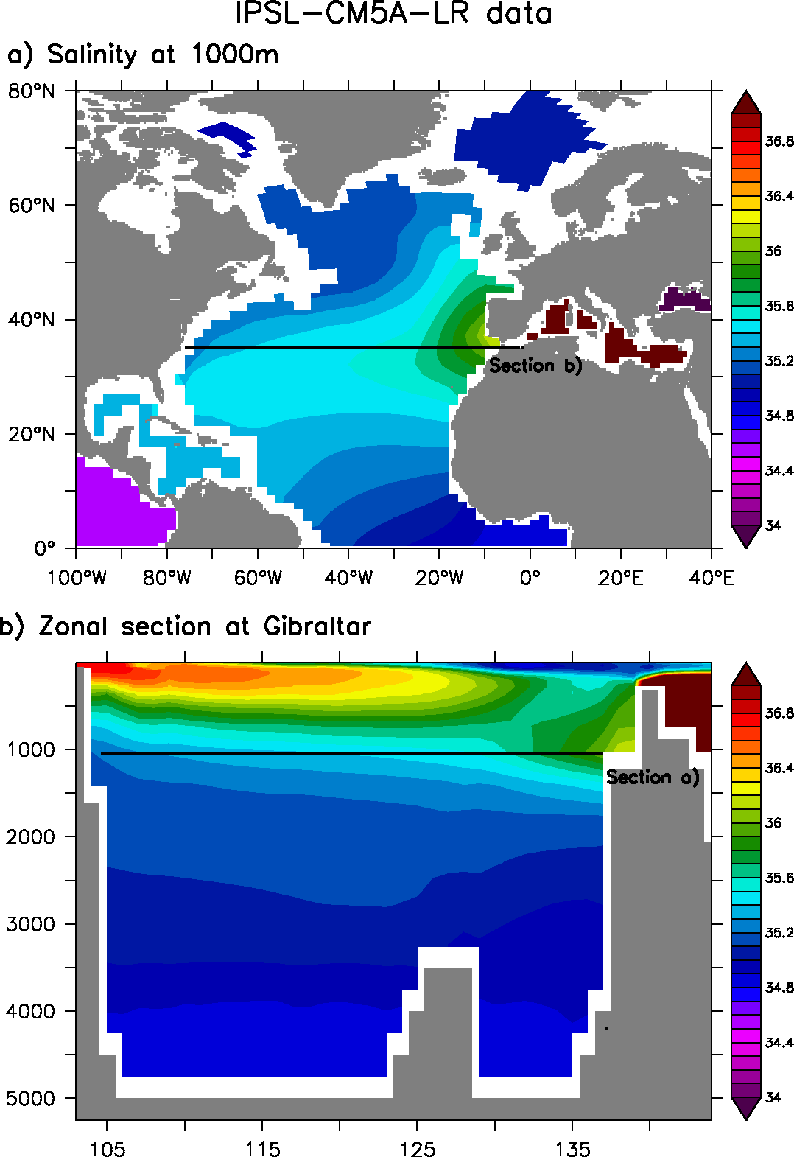
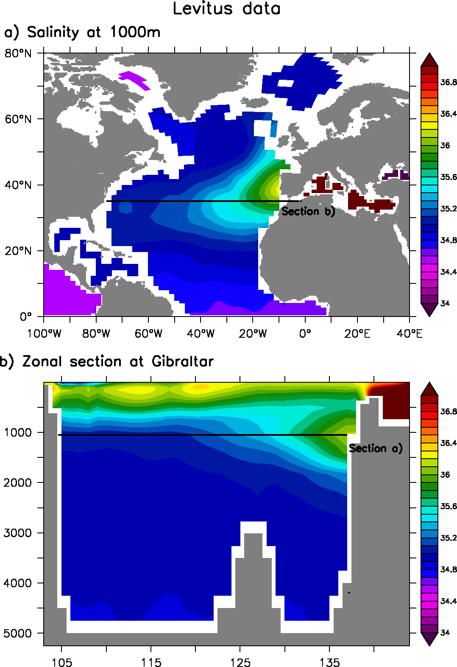
MOW within IPSL-CM5A-LR
Control simulation IPSL-CM5A-LR
E-P-R=0.13 Sv
Profondeur (m)
Profondeur (m)
8O°W
O°
Longitude
Longitude
8O°W
O°
Notes:
Value of flows ? Obs vs data
GLORYS: outflow= 1.91 Sv in 5 yr => 0.46 south; 1.26 North
Model outflow = 2.20 Sv => 1.56 South ; 0.17 North
Issue with model pathway?

Slide 4
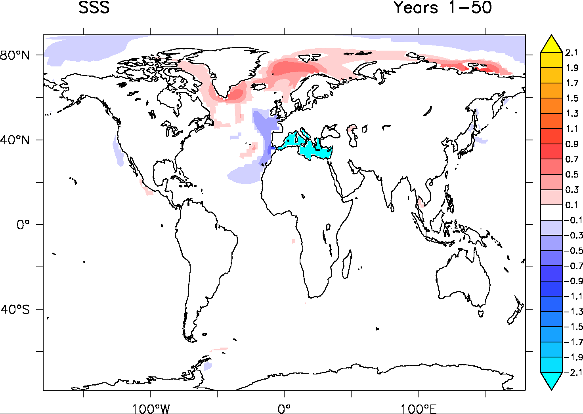
Freshwater release in the Mediterranean
SSS: Hosing Med -control
Only a small propertion of the freshwater released leaves the Mediterranean
Increase of SSS in the North Atlantic!

Slide 5
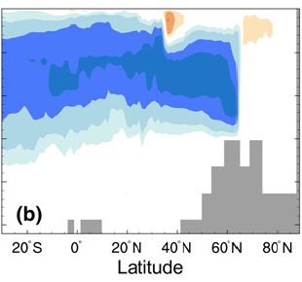

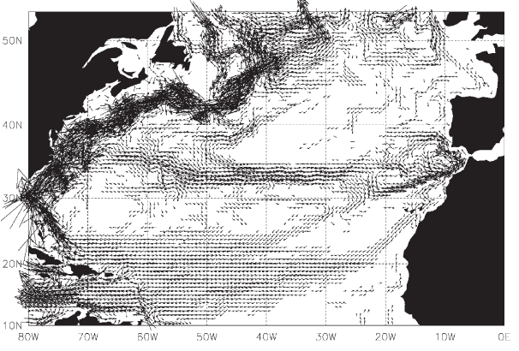
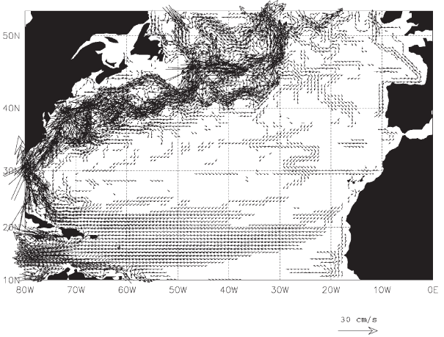
Two opposing mechanisms for the AMOC
Ivanovitch et al. 2013 (HadCM3)
Depth (m)
1) No MOW: direct impact on density distribution in the ocean
Lower zonal density gradient at depth (≈500-1500m)
Thermal wind relationship: weakened AMOC at depth
2) No MOW: impact on subtropical gyre geometry
Increased subtropical surface water transport in the North Atlantic
Increased surface salinity and convection in the North Atlantic
Increased AMOC and subpolar gyre
Active MOW
No MOW
New et al. 2001

Slide 6
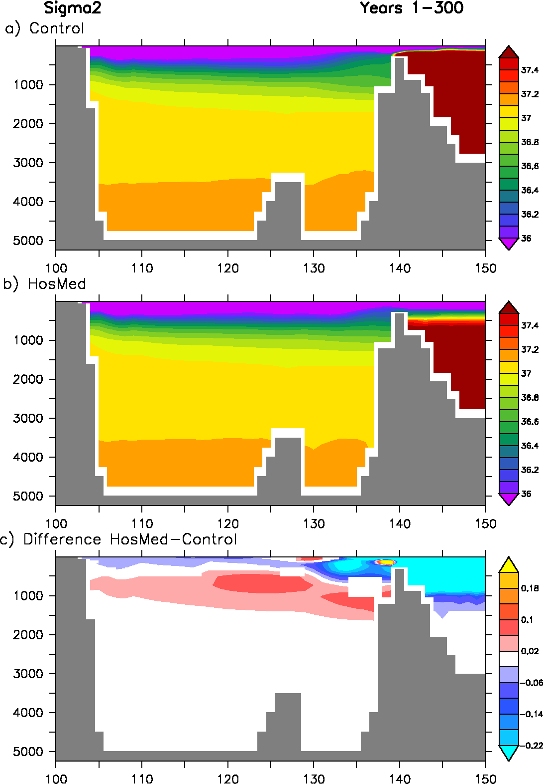
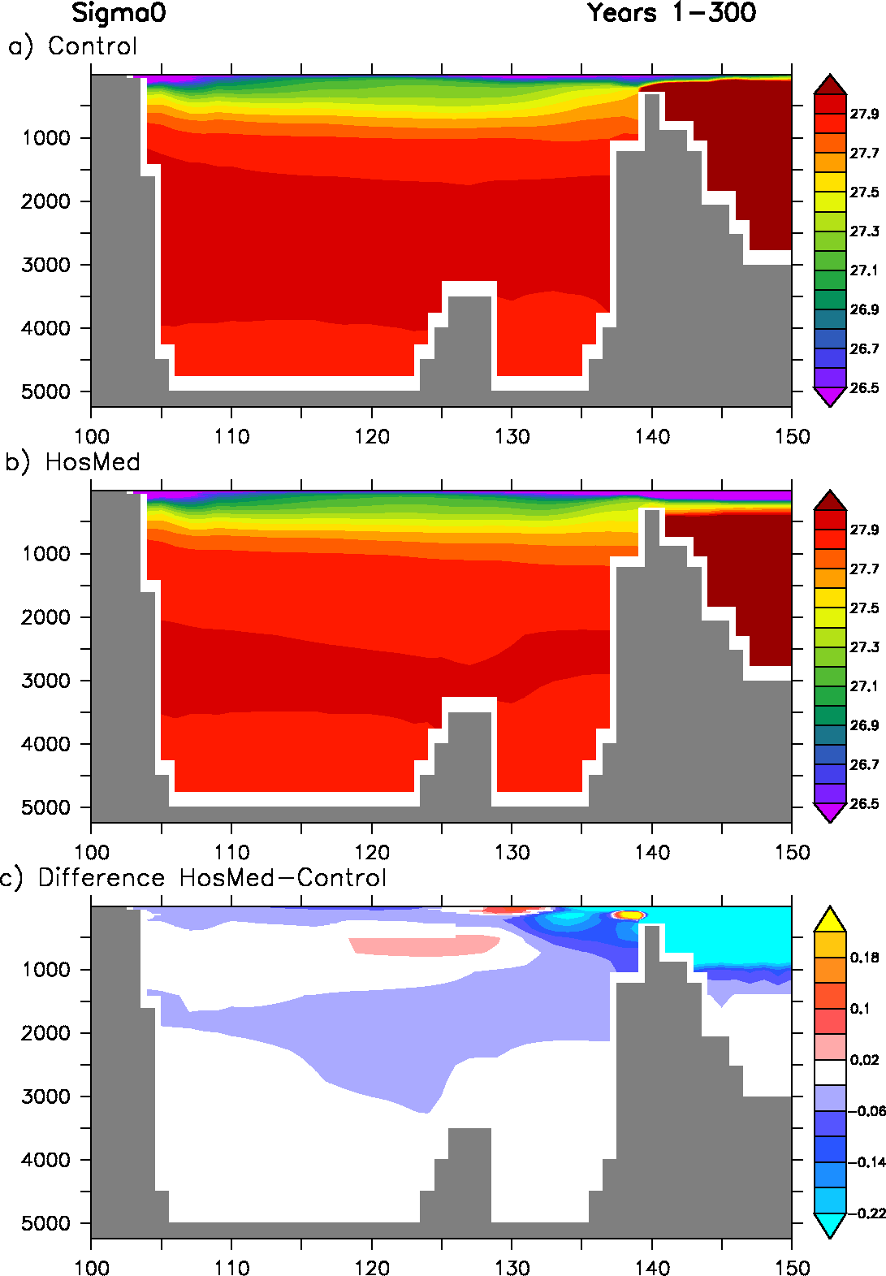
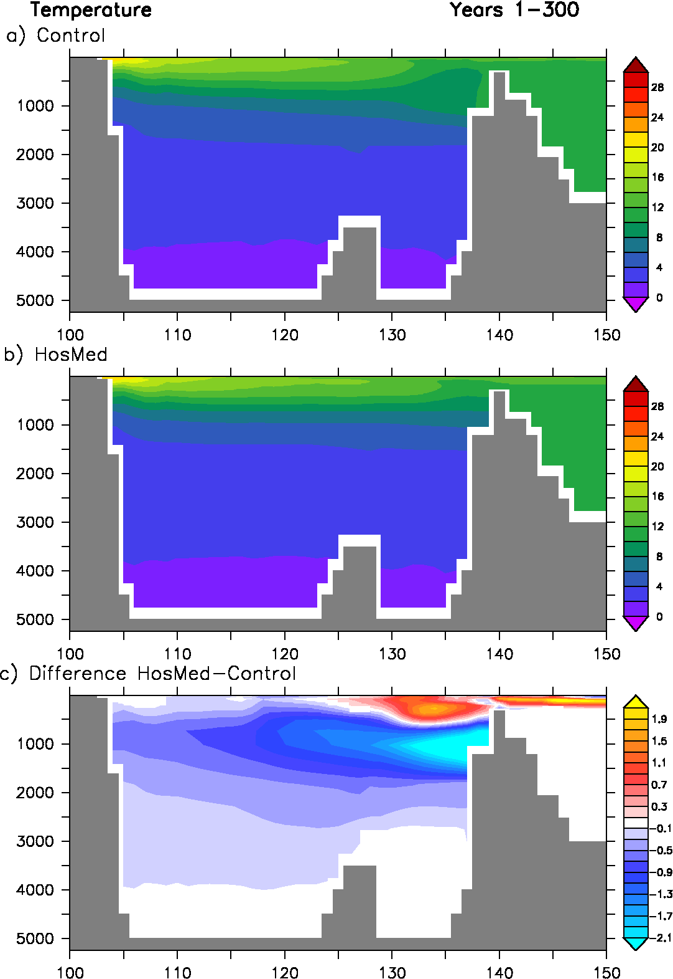
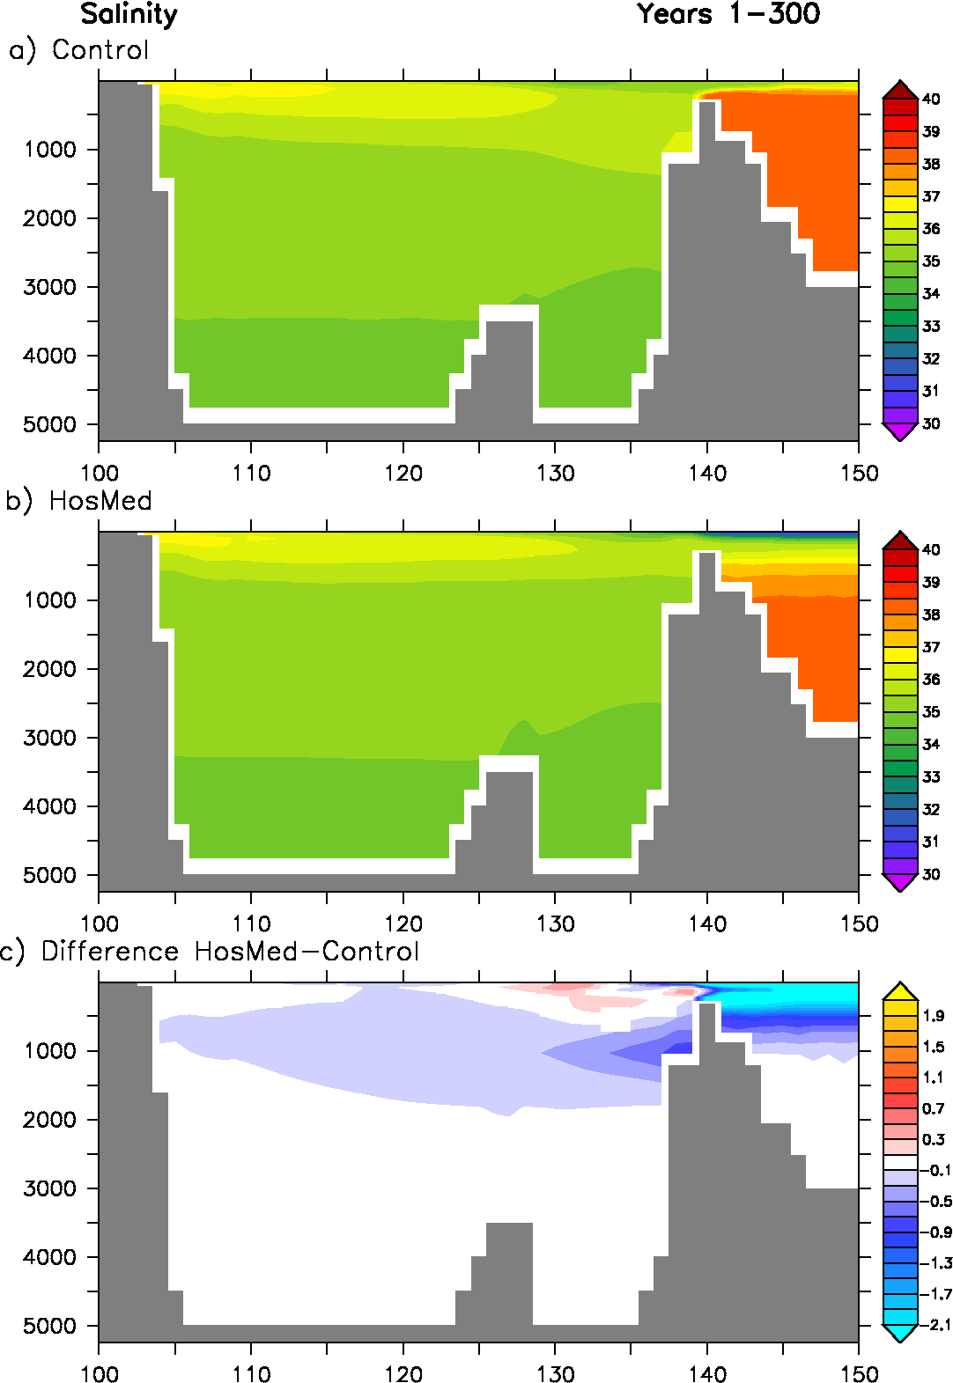
Understanding the thermal wind changes
Is the density along the iberian margin increasing or decreasing when the MOW ceases?
If it decreases below 1000m, then the lower limb of the AMOC should increase…

Slide 7
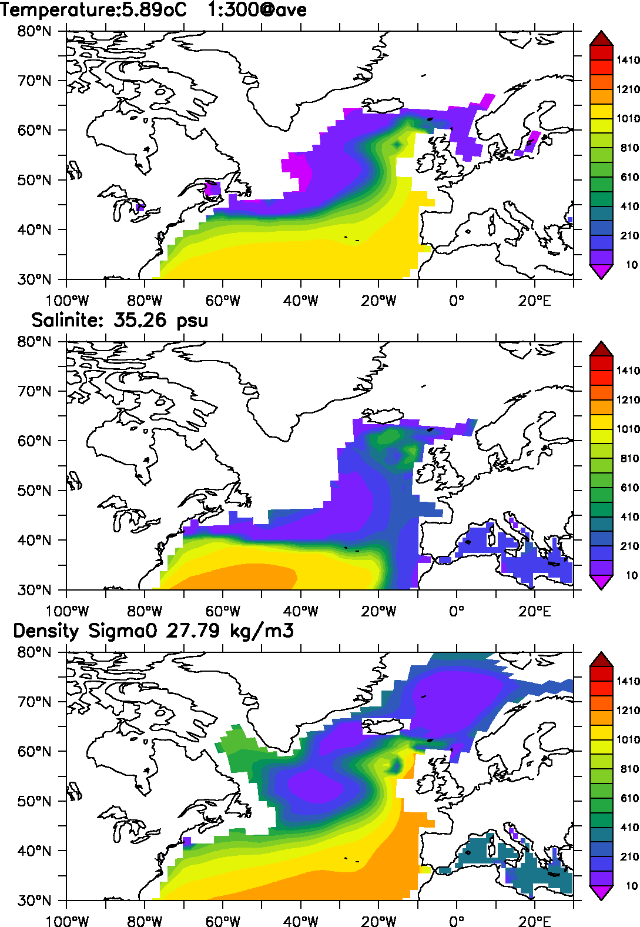
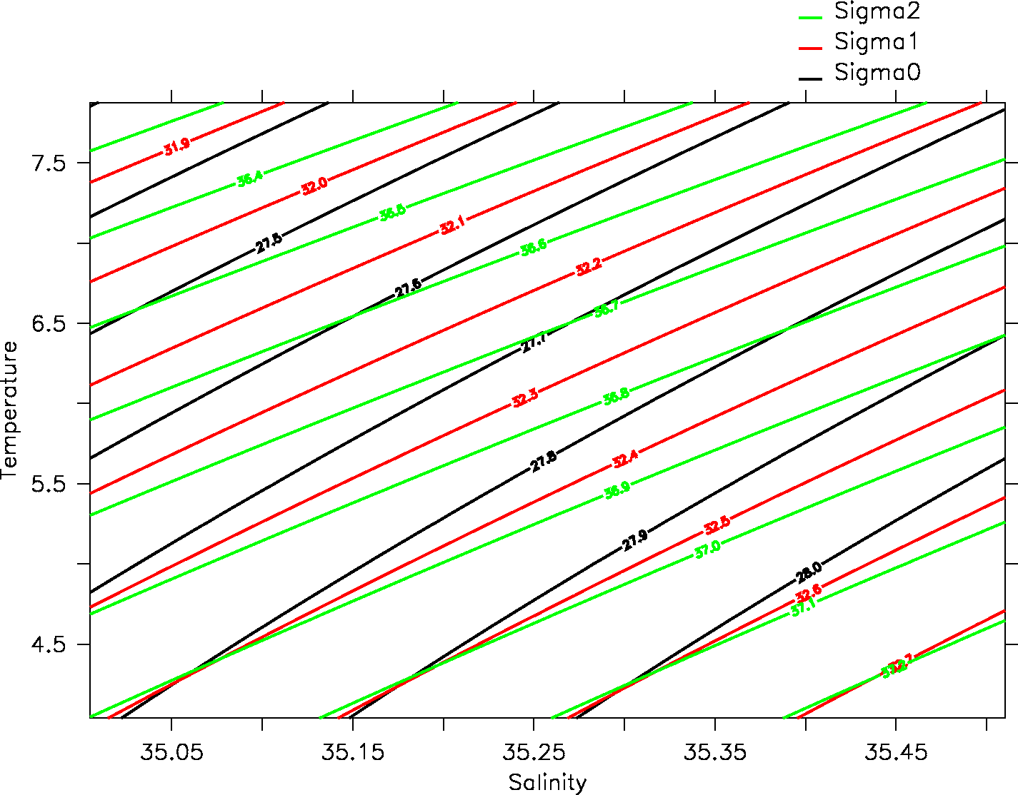
Effect of depth
Origin of the water mass replacing the MOW?
Density changes with depth
It has a strong impact here concerning our experiments

Slide 8
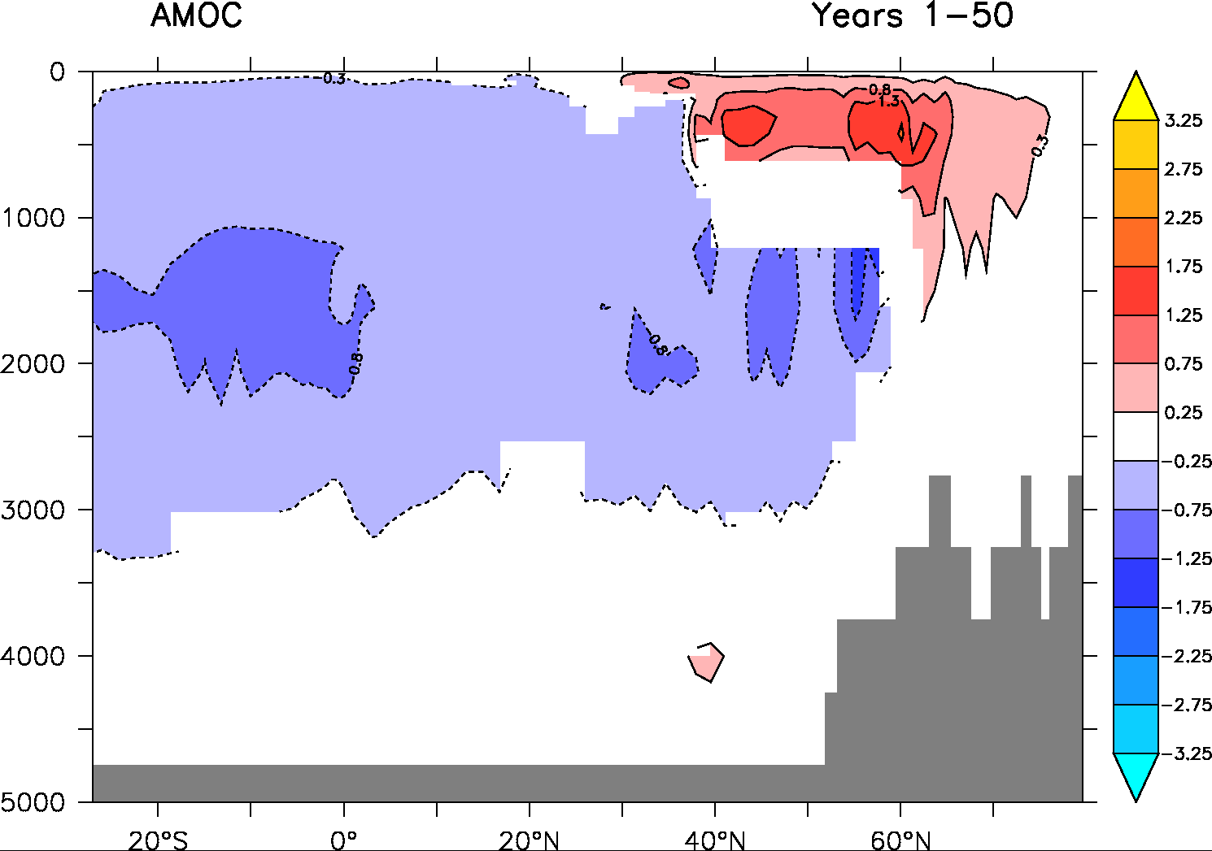
Who wins in the long term?
First effect wins (thermal wind changes at depth) over the second (Azores current changes) after a few centuries
The AMOC globally weakens by up to 5 Sv at the end of the 600 years of hosing in the Mediterranean

Slide 9
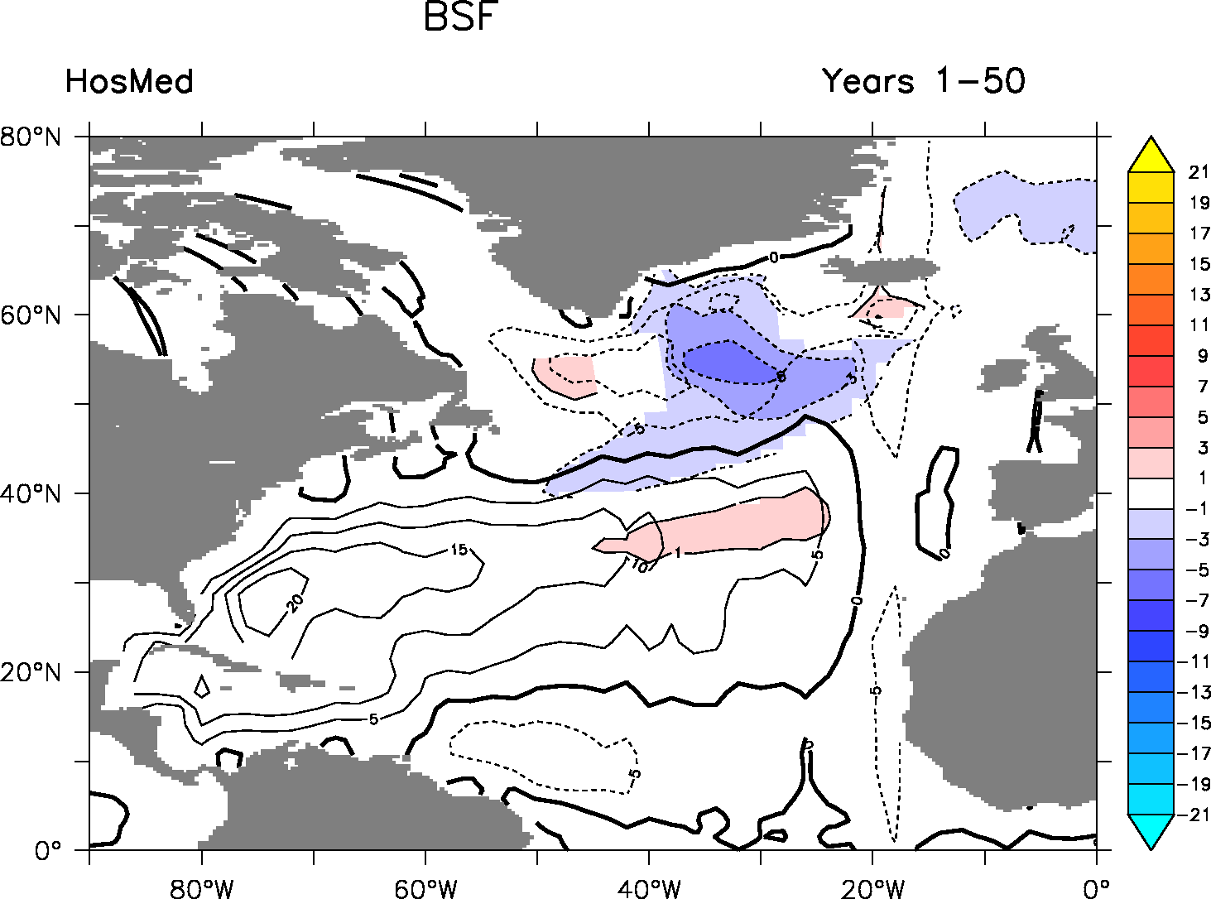
Impact on barotropic circulation (gyres)
Changes in eastern subpolar gyre remains quite robust!
Thus, we have this surprising result: increase in the subpolar gyre and decrease in the AMOC

Slide 10
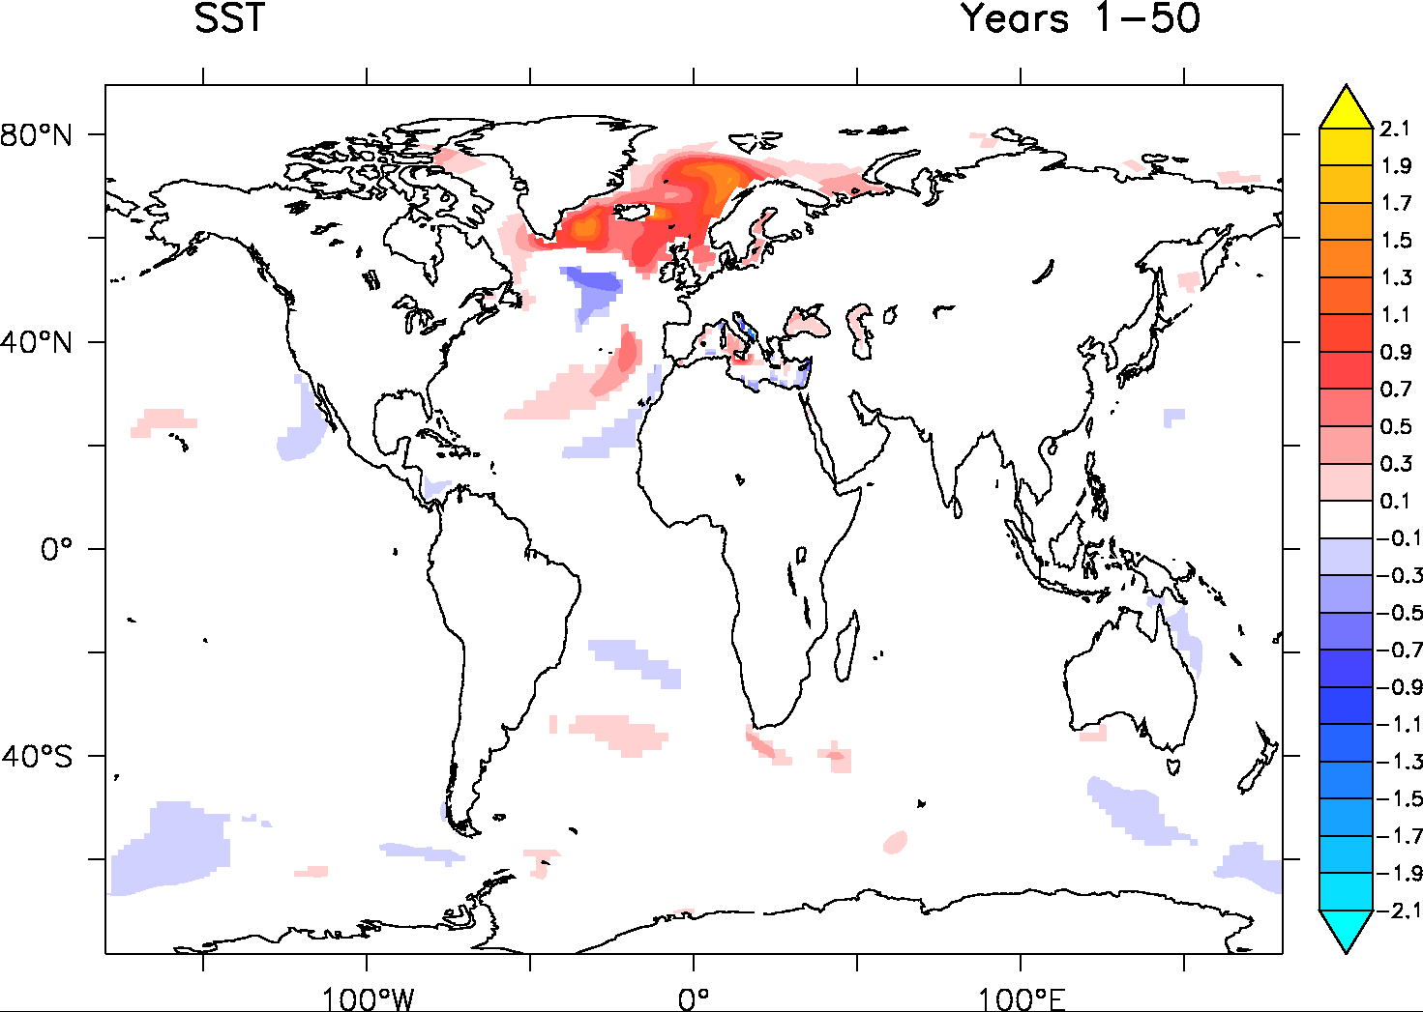
SST impact

Slide 11
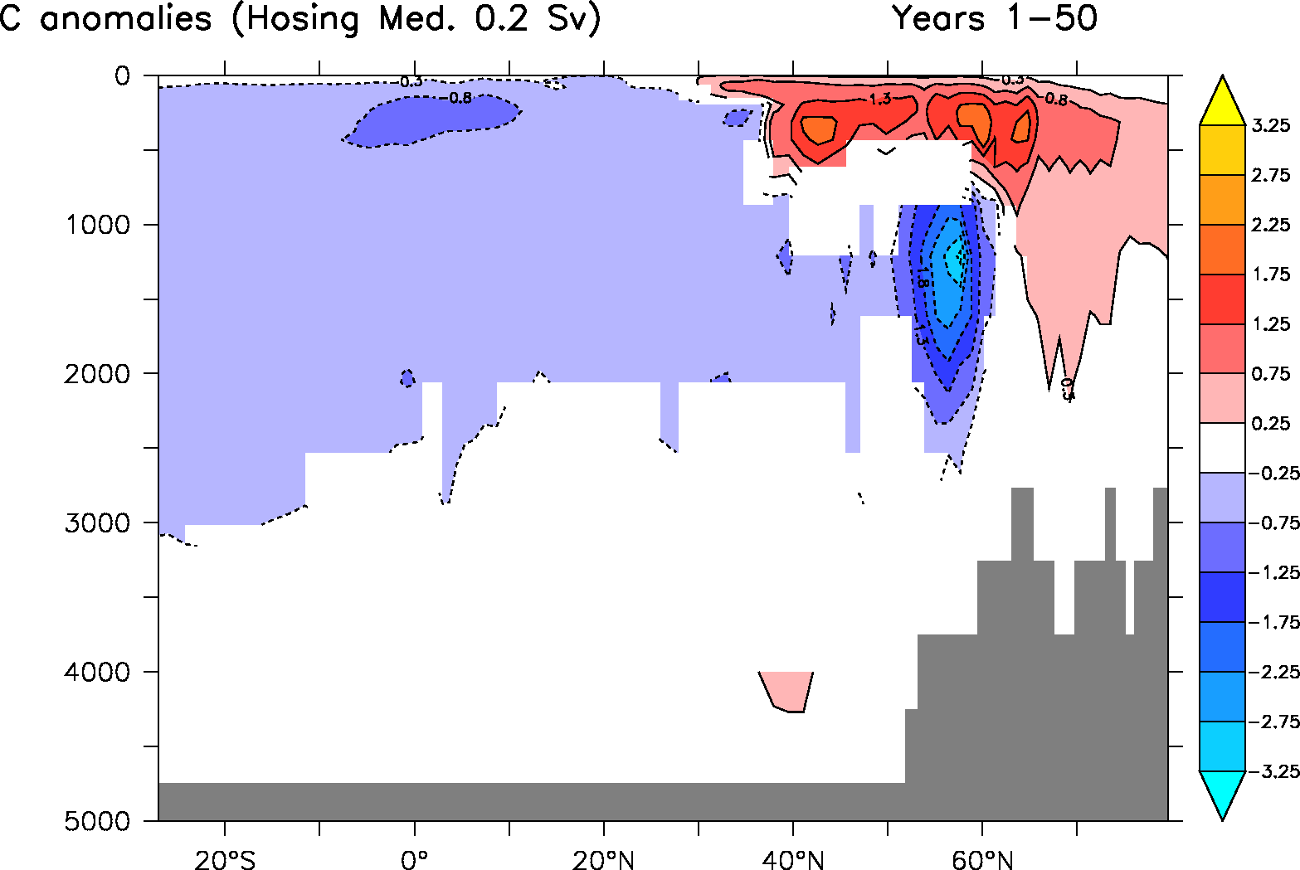
Influence of the rate?
AMOC anomalies for 0.2 Sv in the Med.
Stronger impact on the AMOC weakening with 0.2 Sv

Slide 12
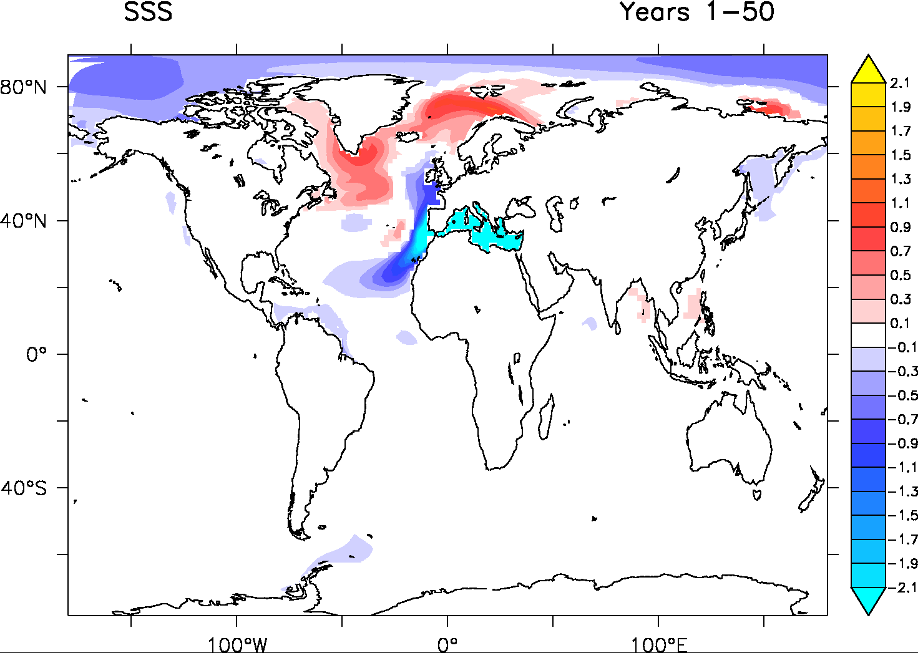
Influence of the rate
Due to larger release of salinity anomalies at the surface: At 0.2 Sv, the flow is dominated by export from the Mediterranean towards the Atlantic (still not the case at 0.1 Sv).

Slide 13
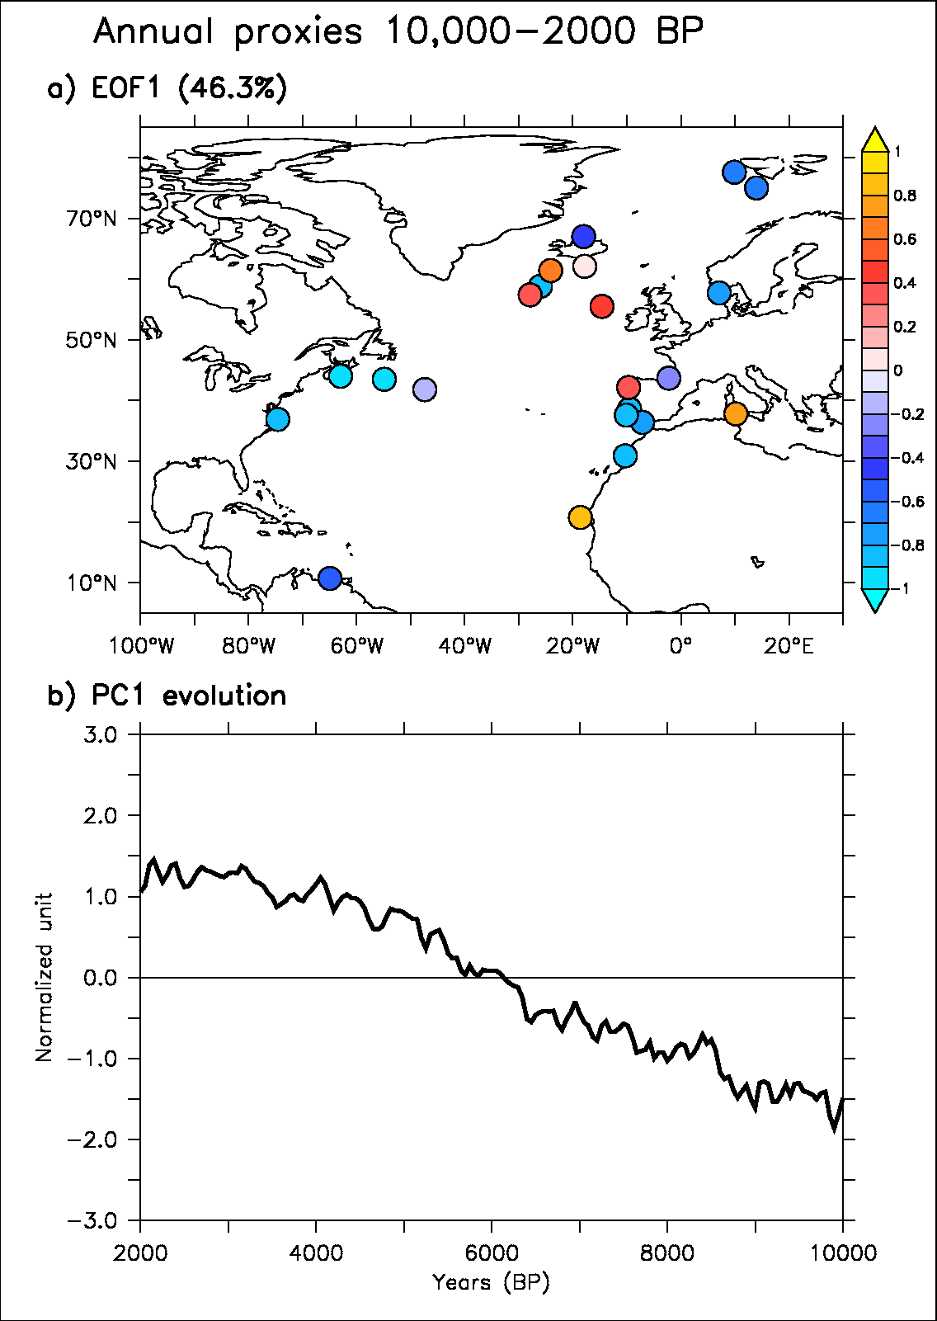
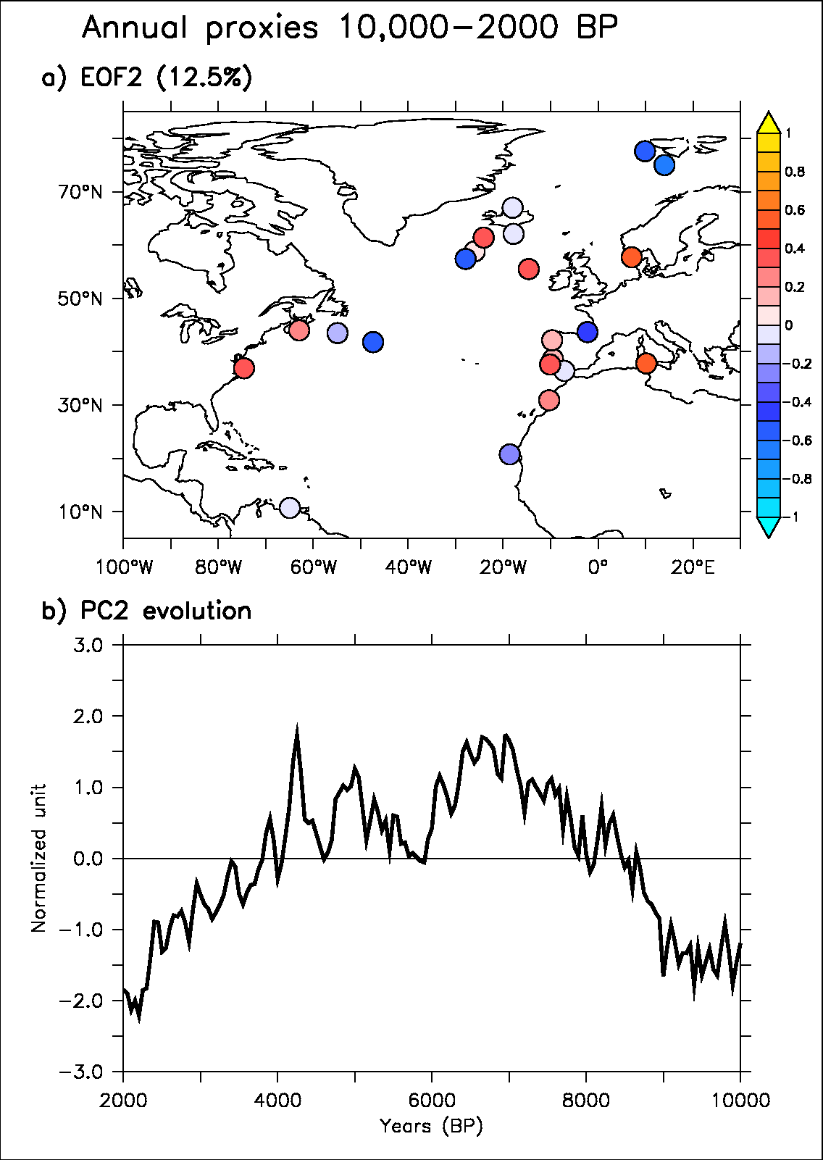
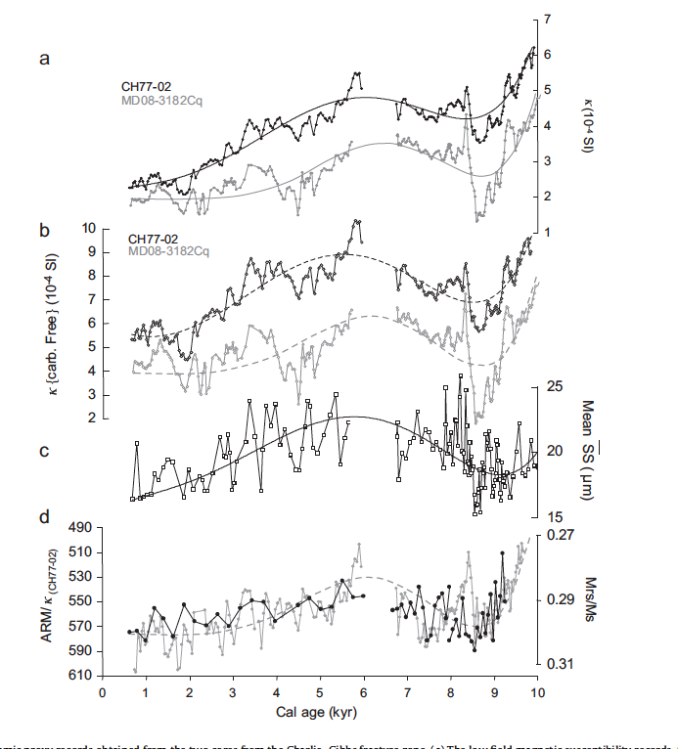
Implications
Time and rate dependent response! i.e. the size matters a lot.
Can it have played a role in AMOC variability over the Holocene? For rate larger or equal than 0.1 Sv, clearly not (e.g. reconstruction from Kissel et al. 2013 + on-going analysis from Yannick Mary database)
First mode from SST proxies
Second mode from SST proxies
Deep flow dynamics proxy records from Kissel et al. (2013)
Sapropel era

Slide 14
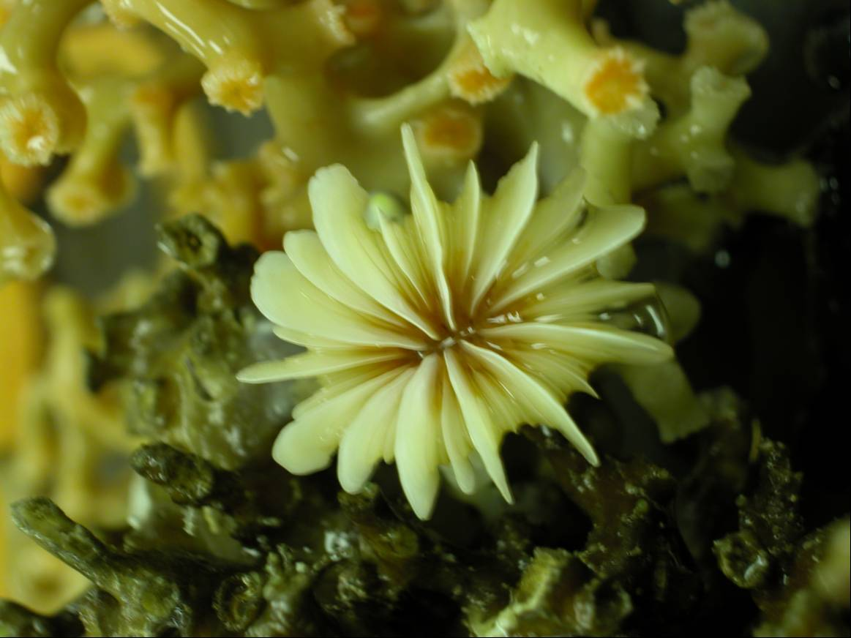
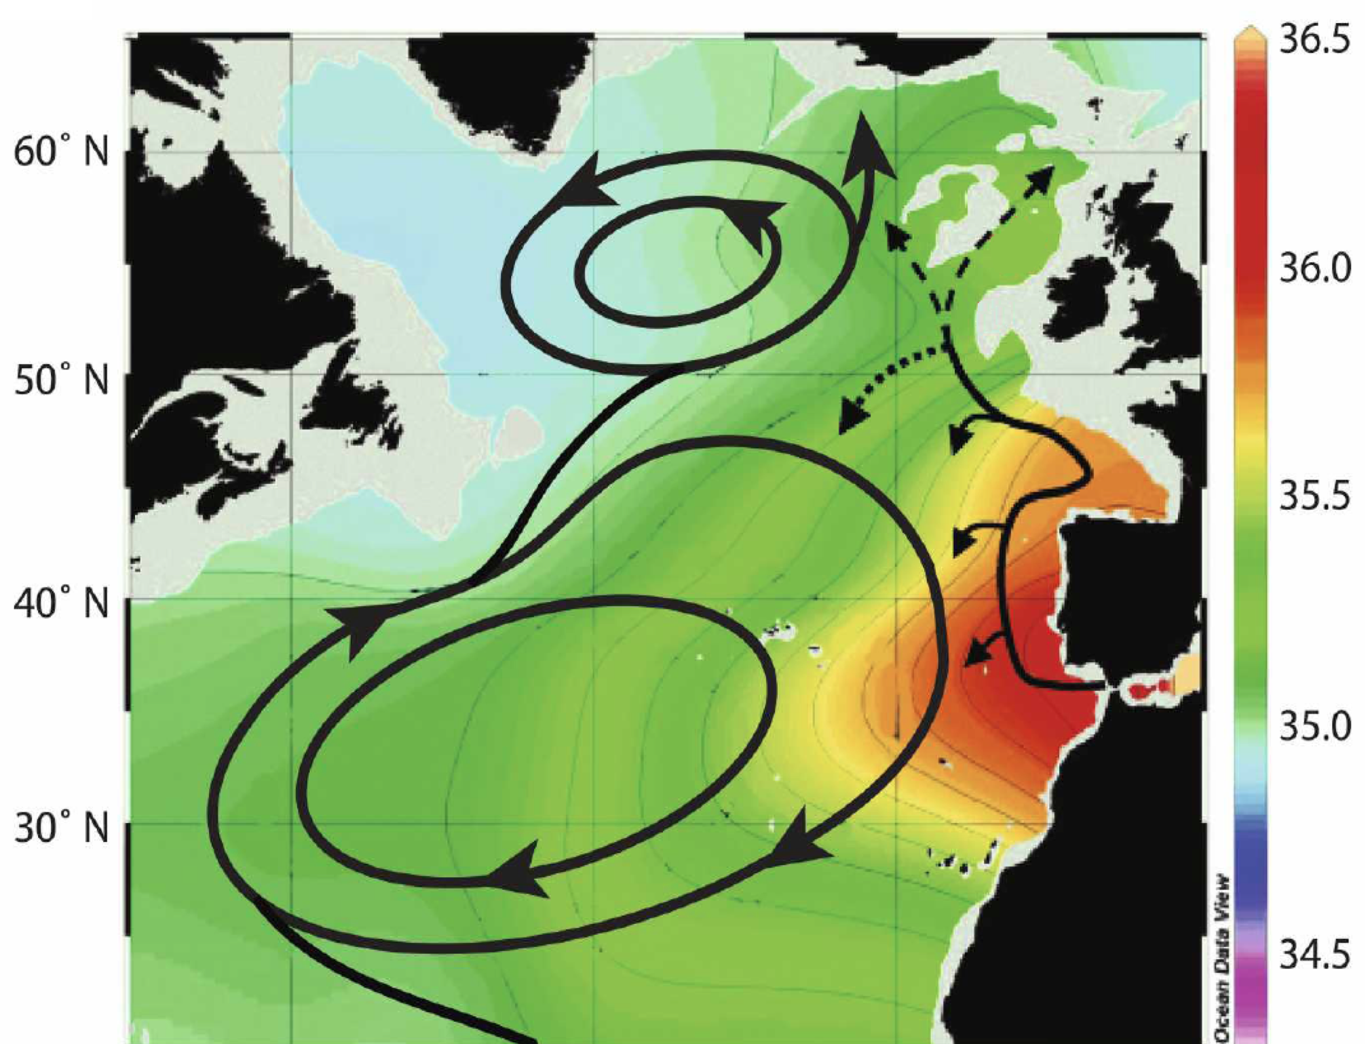
Perspective: Mohamed arrival!
Rockall coral ε_{Nd} data
Plateau de Rockall
LIA
Comparison with new data
Off-line simulation including tracers (ε_{Nd}, δ¹³C ) to allow better comparison with available data (in collaboration with ?)
Pursue analyse from Yannick Mary database to reconstruct AMOC and/or SPG over the Holocene: pseudo-proxy using perfect model approach (PMIP3)
Analysis of Holocene simulation from P. Braconnot (THROL project)
-11
STG
ε_{Nd}
-13
-15
Climatic Optimum
SPG
MCA
-17
10000
8000
6000
4000
2000
0
Age (ans) cal BP
8O°W
Colin et al. (2010); Copard et al. (2010, 2011, 2012); Montero-serrano et al. (2013)

Slide 15
Thank you!

Slide 16
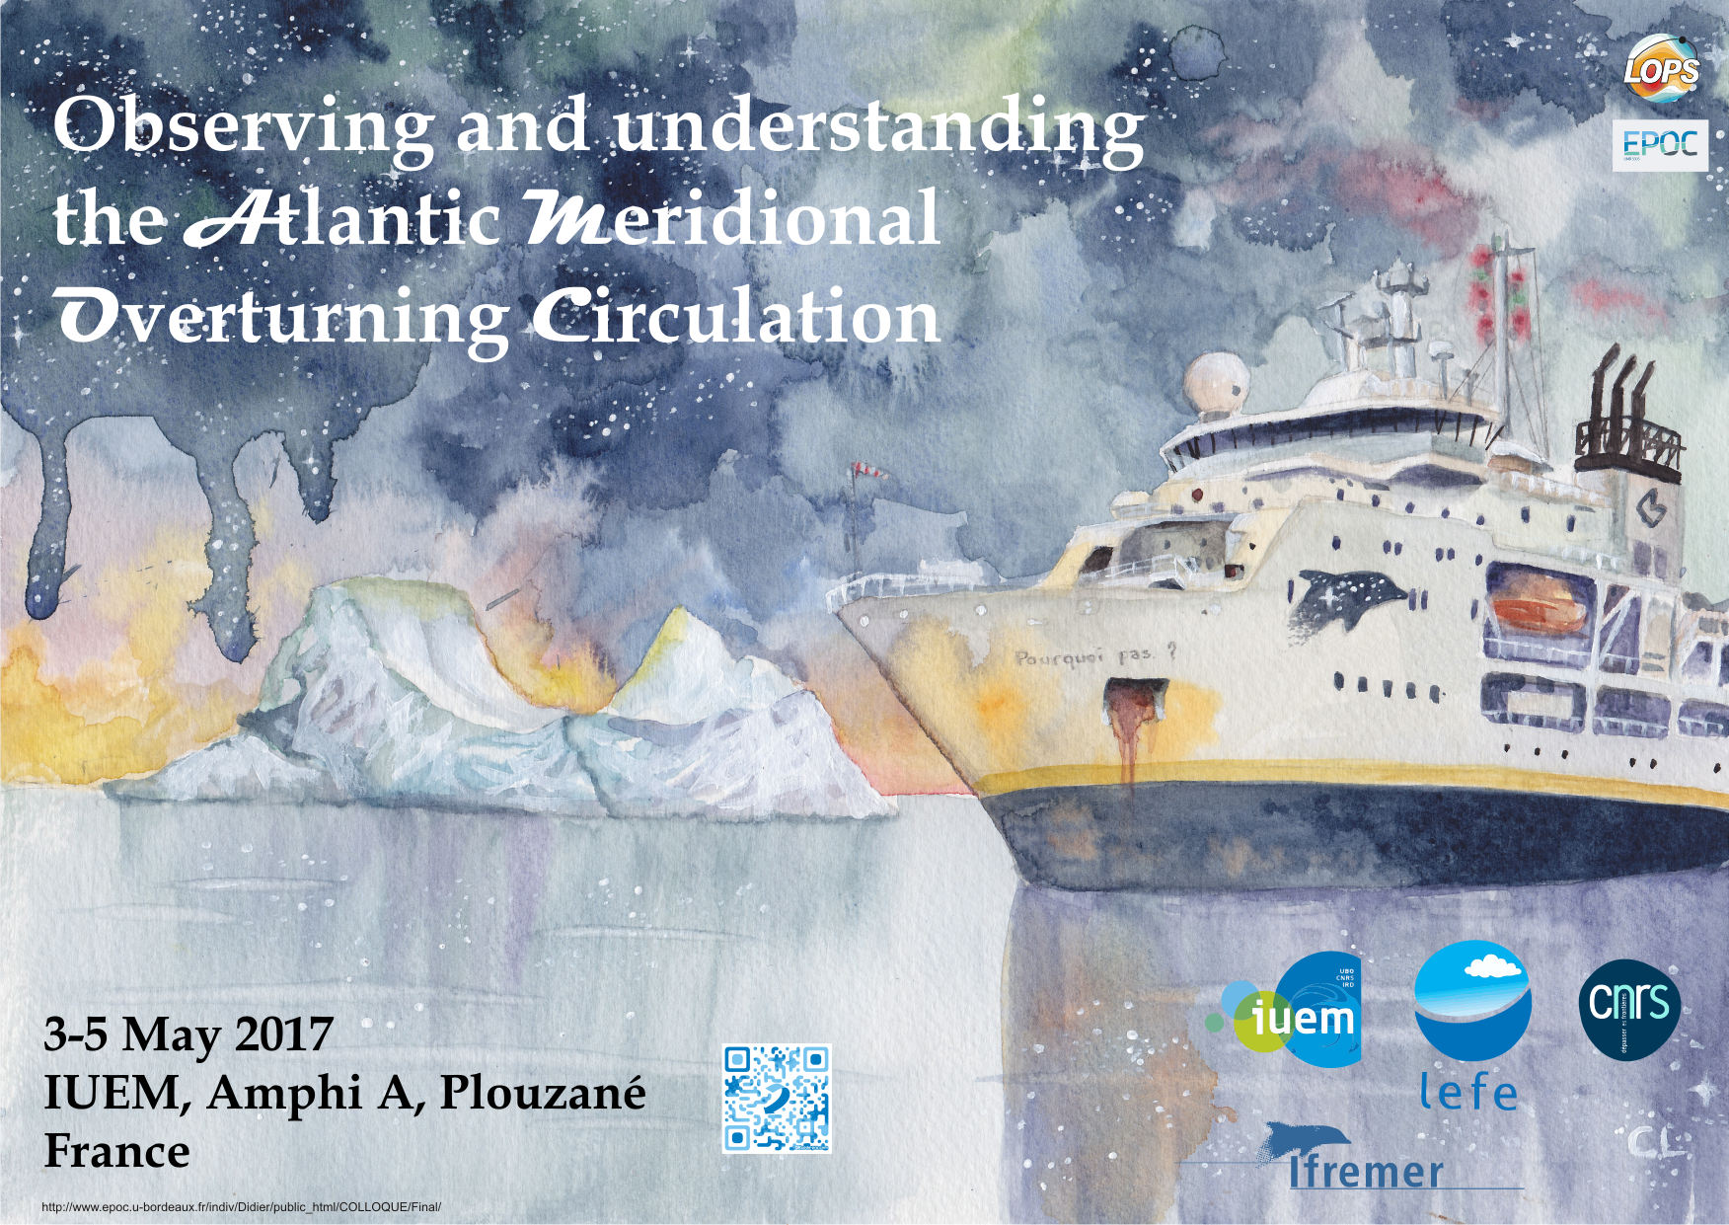

Slide 17
Concept of pseudo-proxy
Ortega et al (Nature 2015) : evaluate the representativeness of different location for NAO reconstruction
Swingedouw et al. (in prep.): analysis of Yannick database representativeness for main modes of SST variability

Slide 18
NAO reconstruction
(Ortega et al. 2015)
Evaluation of the best useful proxies to reconstruct a given indices

Slide 19
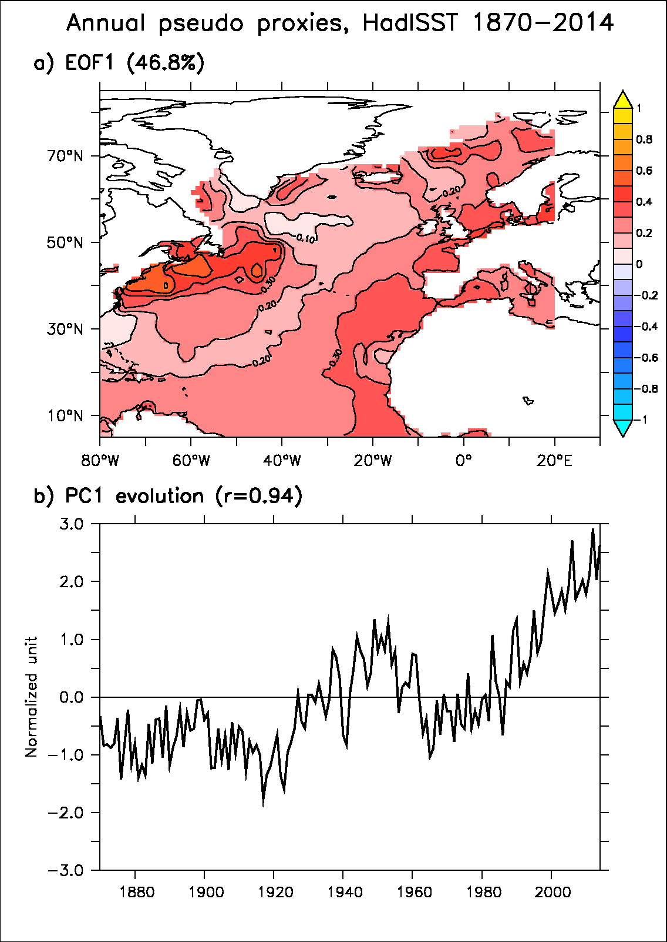
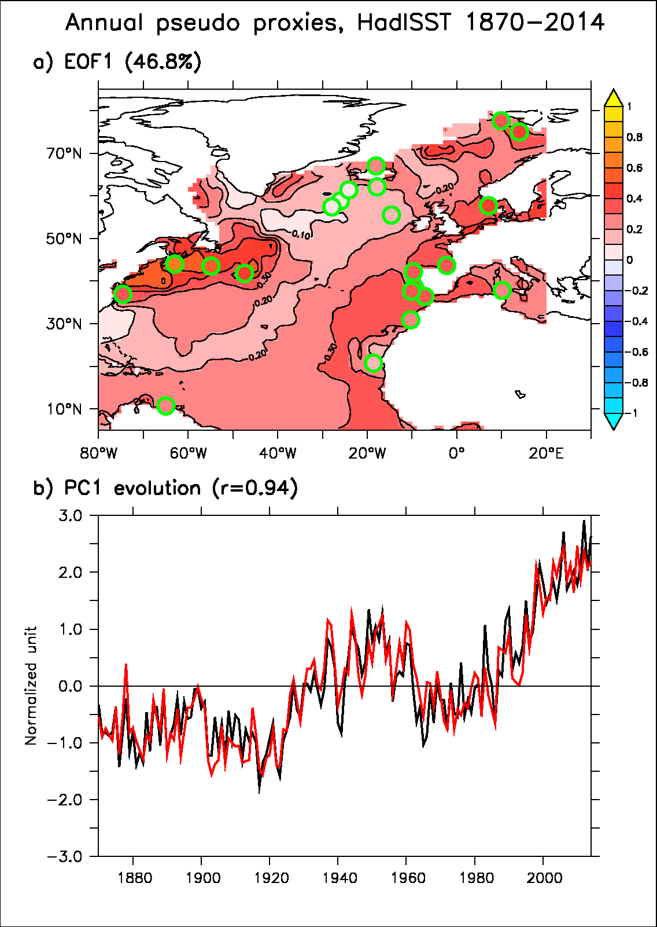
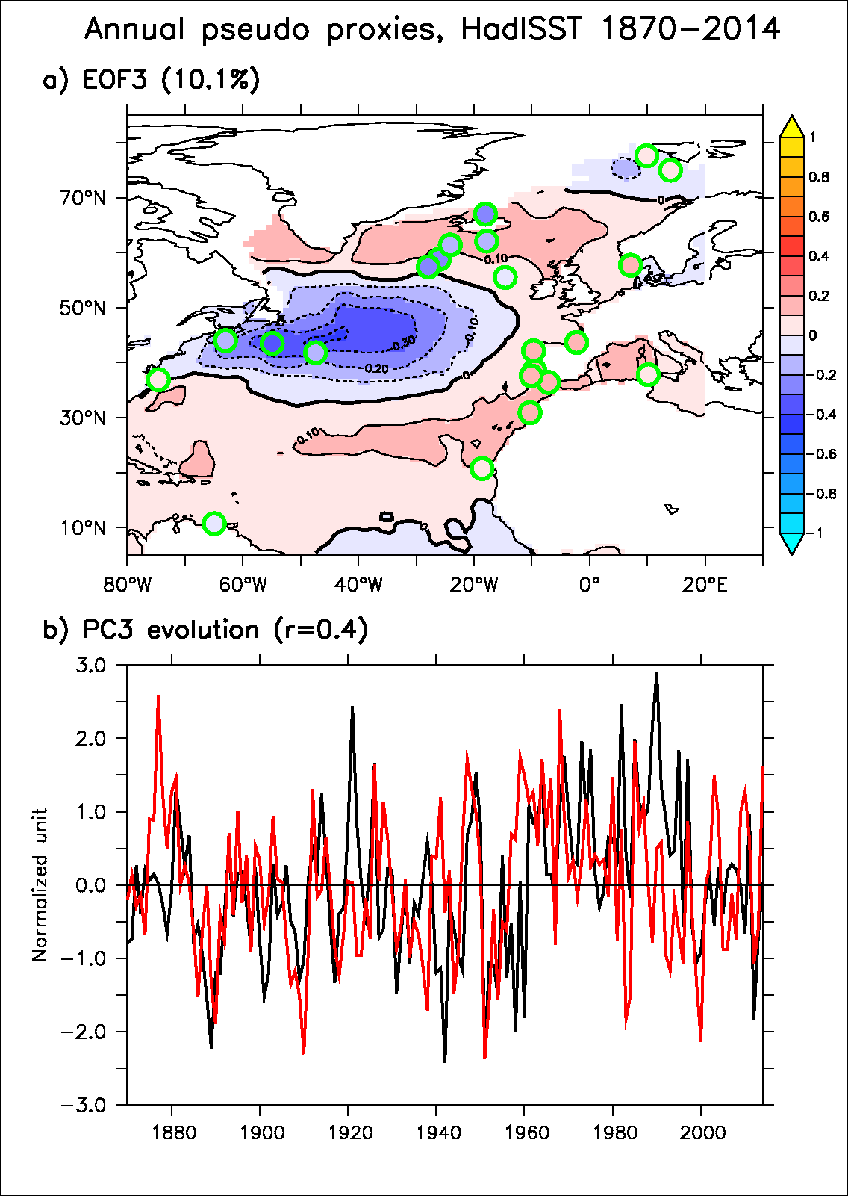
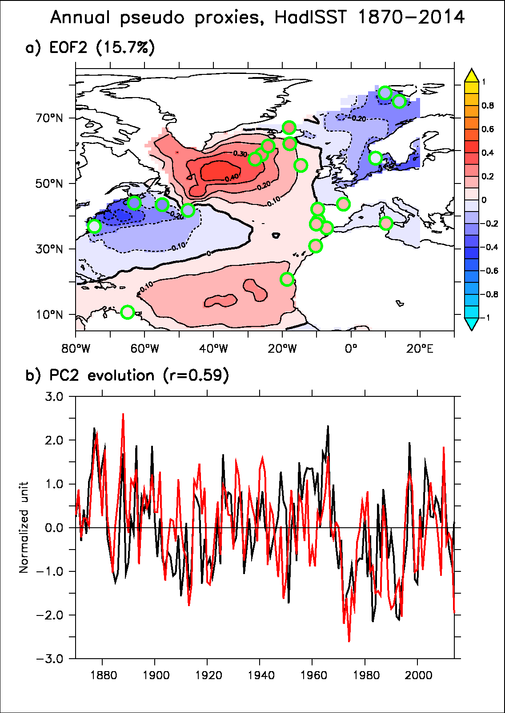
Pseudo-proxy
Validation de la méthode et du sampling spatial avec les données HadISST (1870-2014)
Les deux premières EOF semblent plutot bien reproduites, un peu moins la troisième

Slide 20
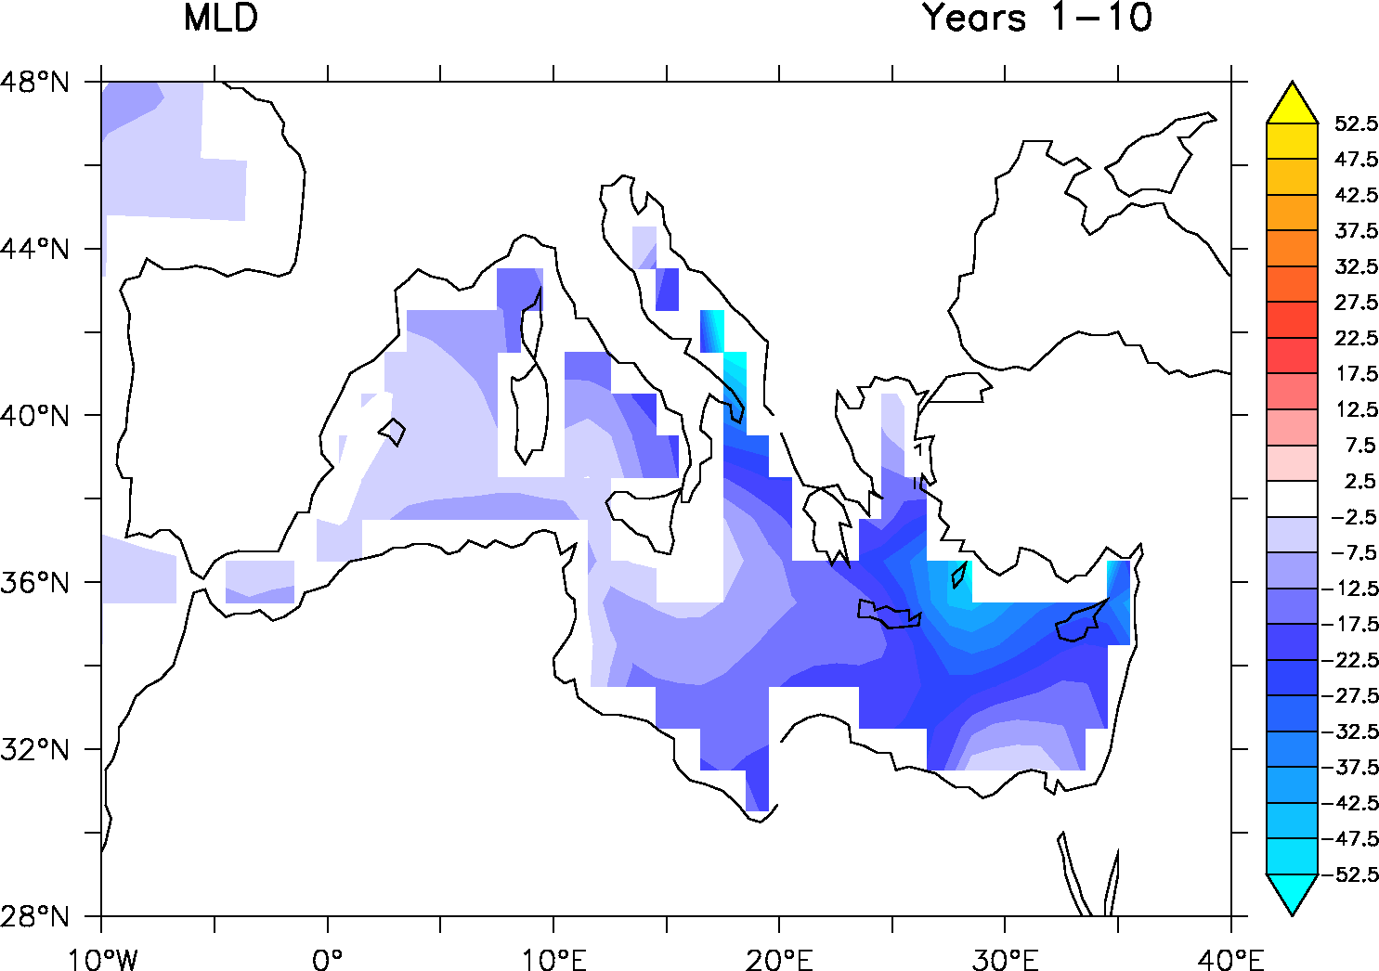
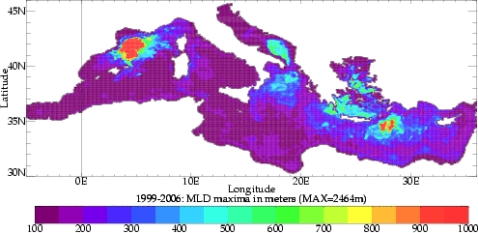
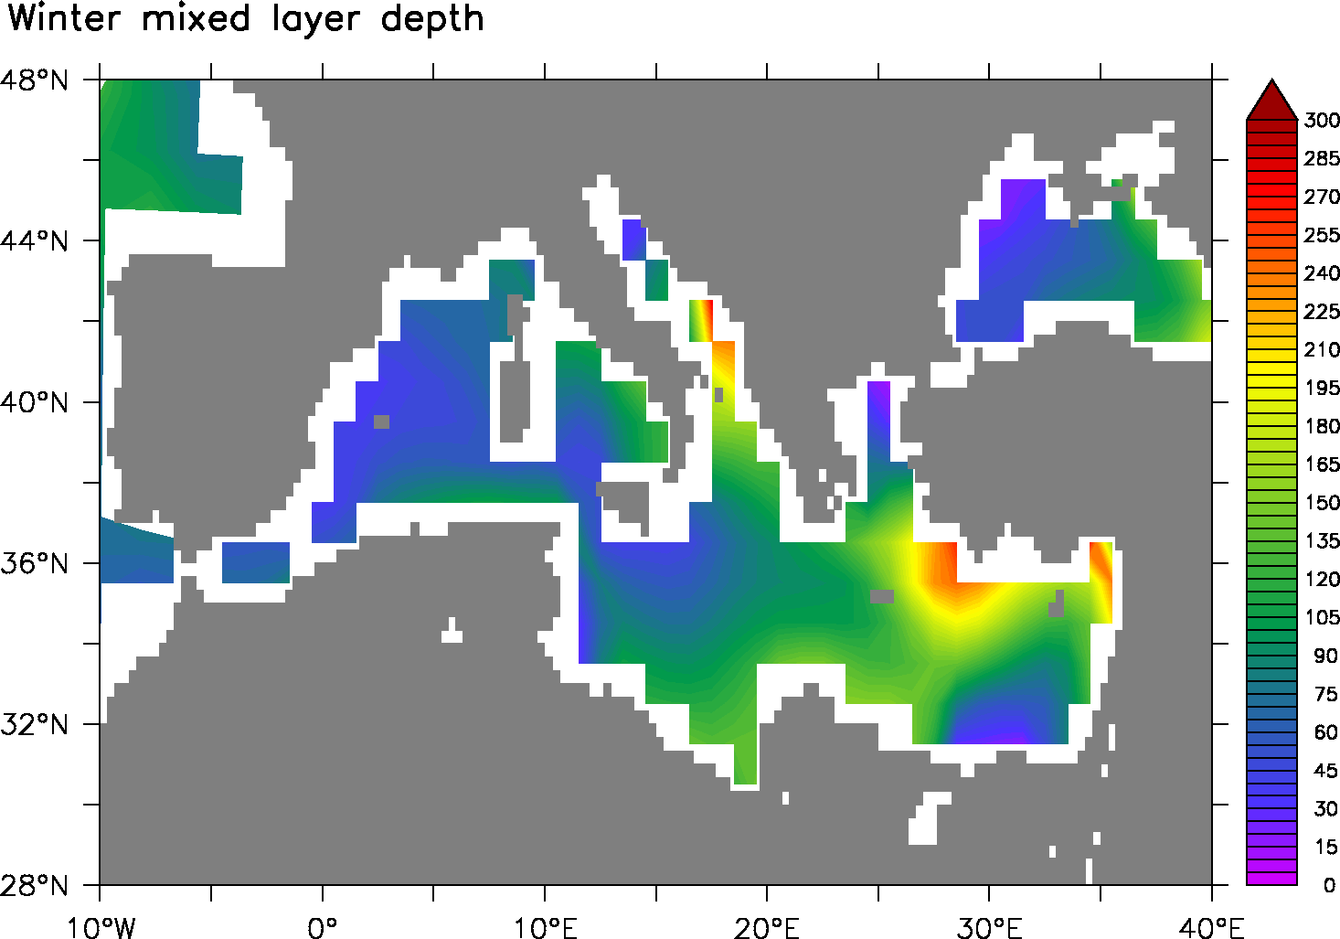
Mediterranean convection

Slide 21
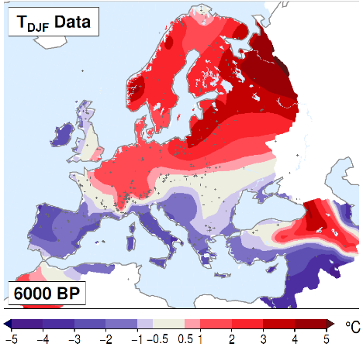
Analyse base de données PMIP3 sur l’Atlantique pour 6k
Reponse climat il y 6000 ans dans PMIP3 : analyse de Alina Gainusa Bogdan pour le projet Milex (PI : Pascal Yiou)
Motivation : NAO+ à 6K dans les obs ? (Mauri et al. 2014)

Slide 22
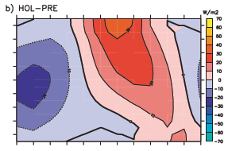
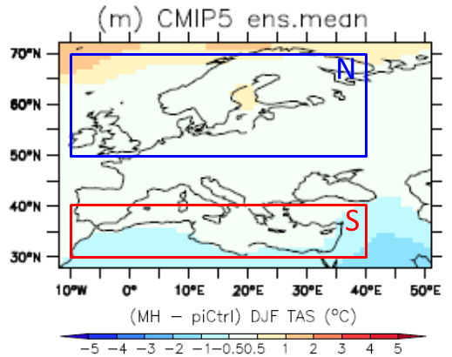


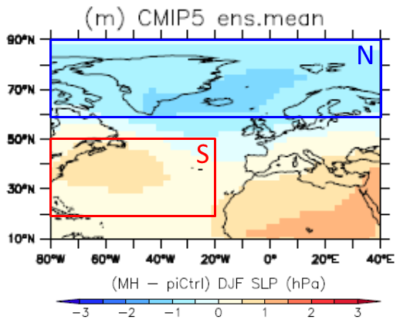
Analyse base de données PMIP3 sur l’Atlantique pour 6k
radiative forcing 6K-0K
Δ temperature
Δ sea ice cover

Slide 23
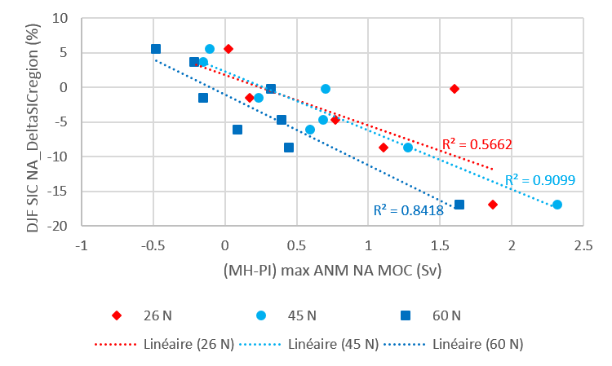
Analyse base de données PMIP3 sur l’Atlantique pour 6k

Slide 24
Impact
Explain E-P actual + value and import of water in the Med.
Explain MOW + density value
Explain AMOC + thermal wind blance and PARADOX : it is only in sigma1 that you loose density…
Remind what I show before : two effects etc.
Longer term : the second effect wins.
Compare different rate of export (link with upper ocean export FW) : a third effect = export of freshwater at the surface in the NA.
Implications : cannot explain the potential return of AMOC, nor it sdecrease from 6K… except if very small rate...

