Slide 1
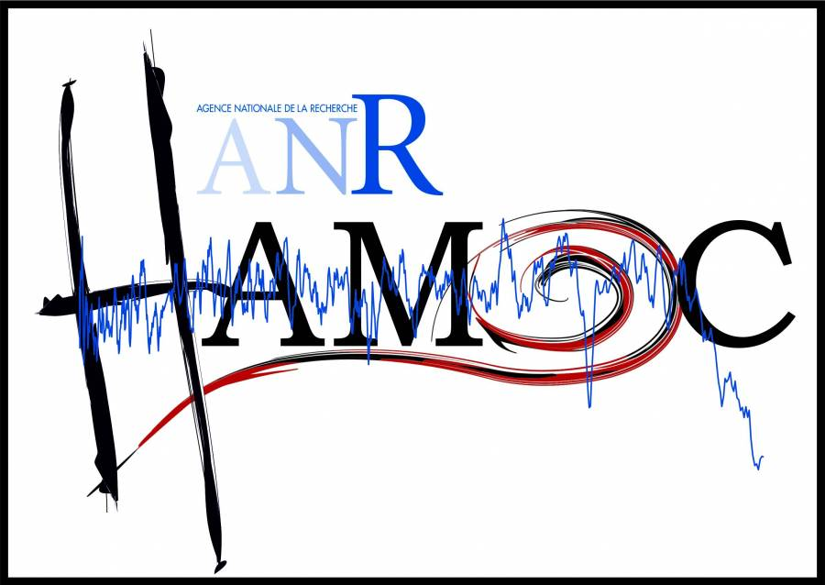
Comprendre la variabilité Holocène : apport de l’outil modélisation du climat
WP5
Didier Swingedouw, Olivier Marti, Pascale Braconnot, Jean-Claude Dutay, Pierre Sepulchre, Yannick Mary, Frede Eynaud
Postdoc à embaucher en 2016

Slide 2


Chantiers en cours
Simulation de sensibilité “Hosing Mediterranée” ☑
Analyse statistique de la compilation Holocene produite par Yannick Mary et Frede Eynaud ☑
Comparaison simulations de Olivier Marti avec données Xavier Crosta et Julien Crespin sur tout l’Holocène : papier en cours d’écriture
Analyse simulations PMIP3 mid-Holocene sur l’Atl. Nord (Milex project)

Slide 3
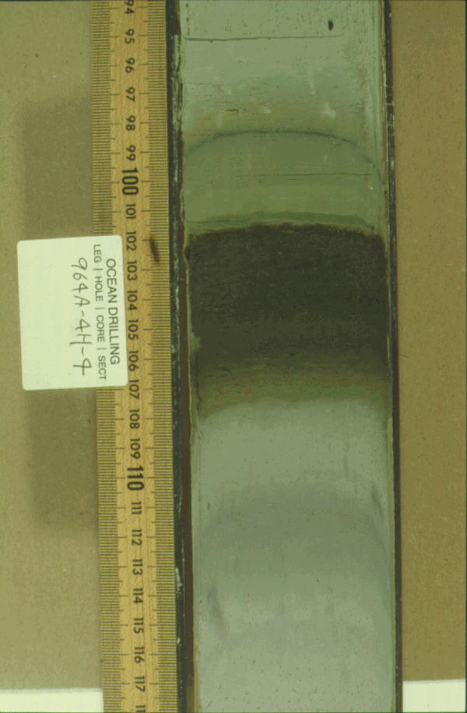
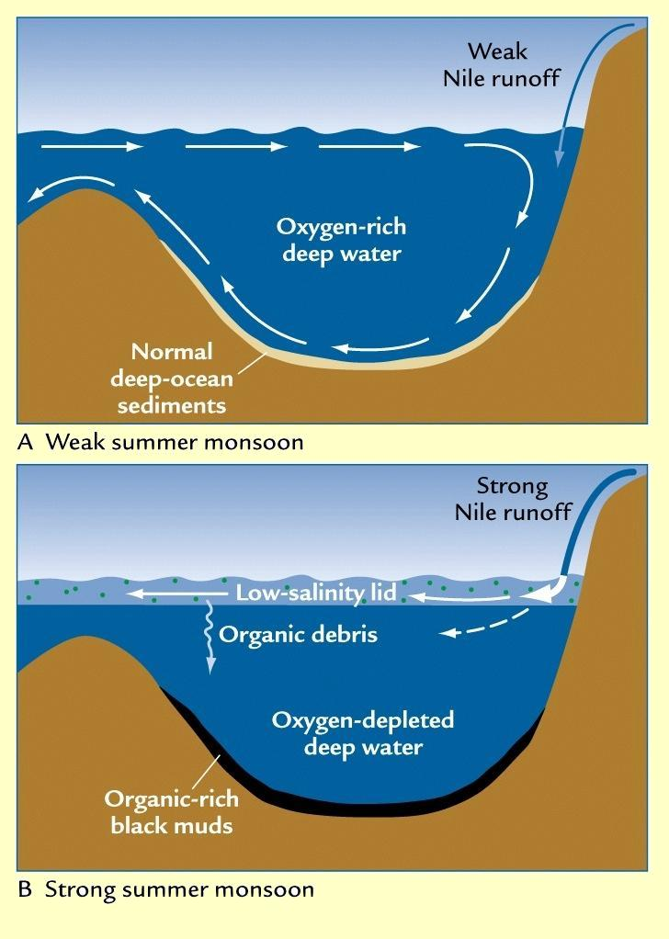
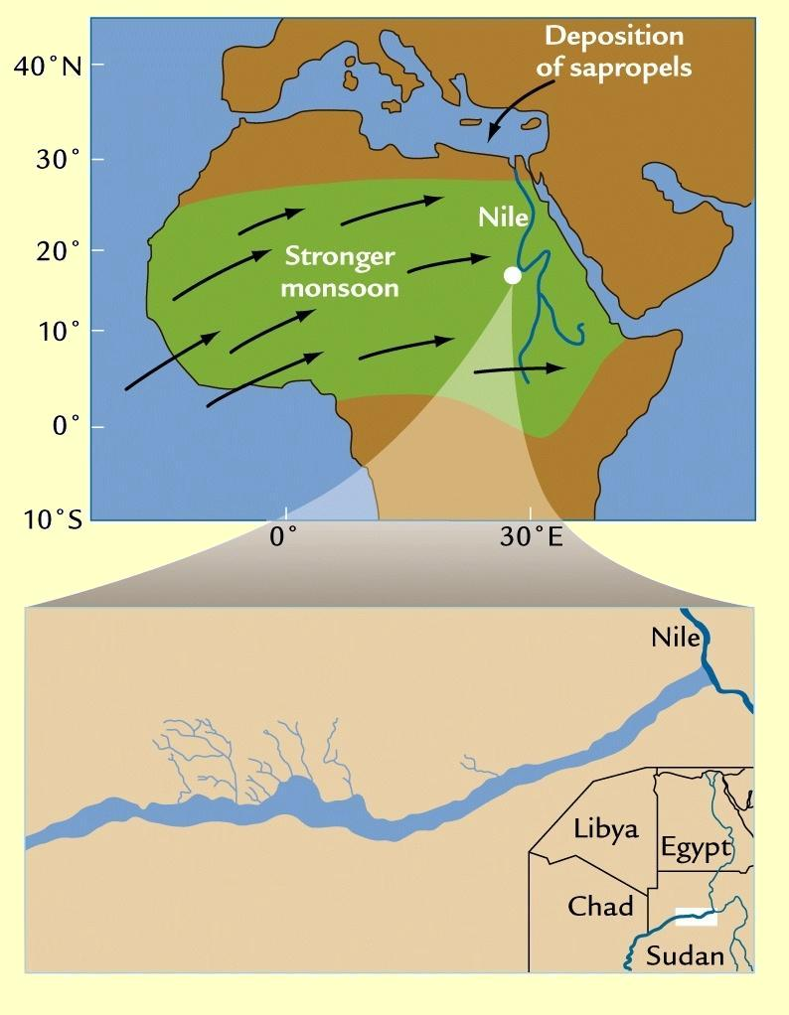
Holocene Sapropel event
Marine sediment cores from the Mediterranean indicate large sapropelic deposit during early Holocene (10-6 kyr BP) (Bethoux and Pierre 1999, Delange et al. 2008)
Such Sapropelic deposit may be related with fresh surface water in the Mediterranean, potentially related with large increase of River Nile flow, in link with Green Sahara at the same period.
Notes:
Sapropels are sediment layers with high concentrations of organic carbon,

Slide 4
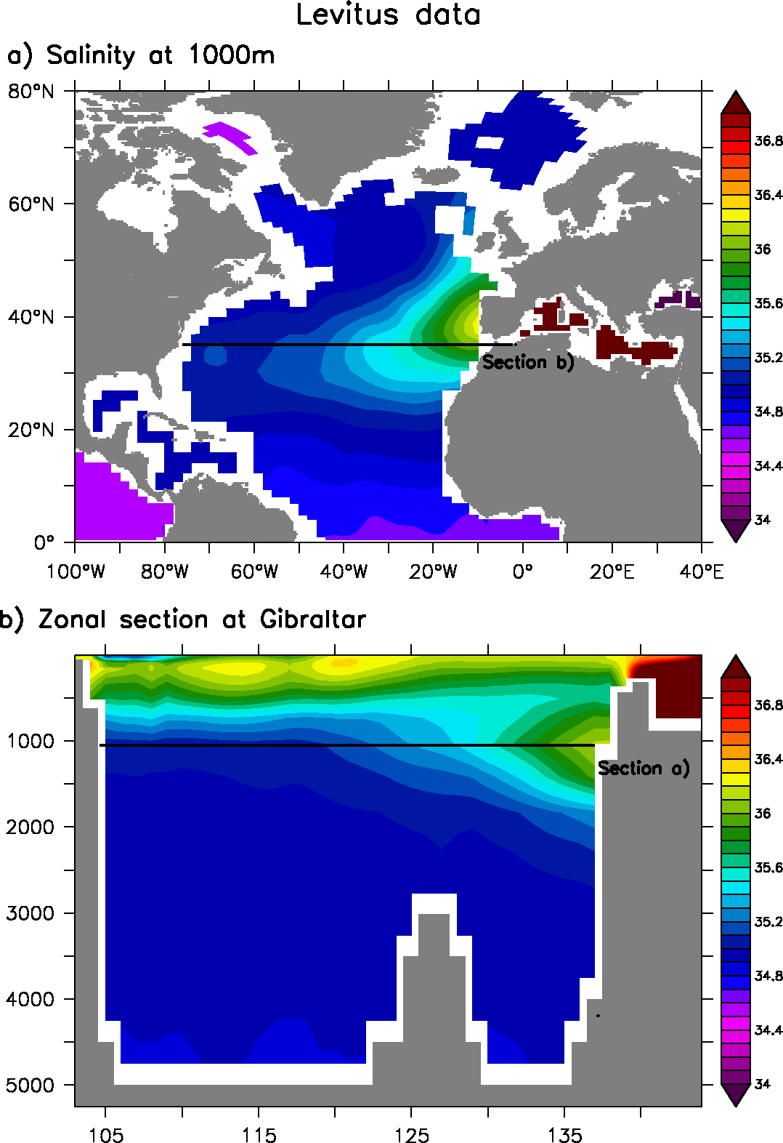
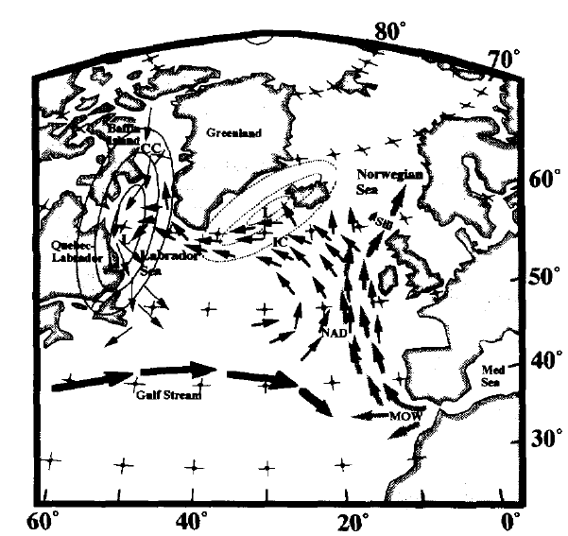
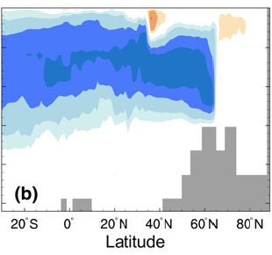
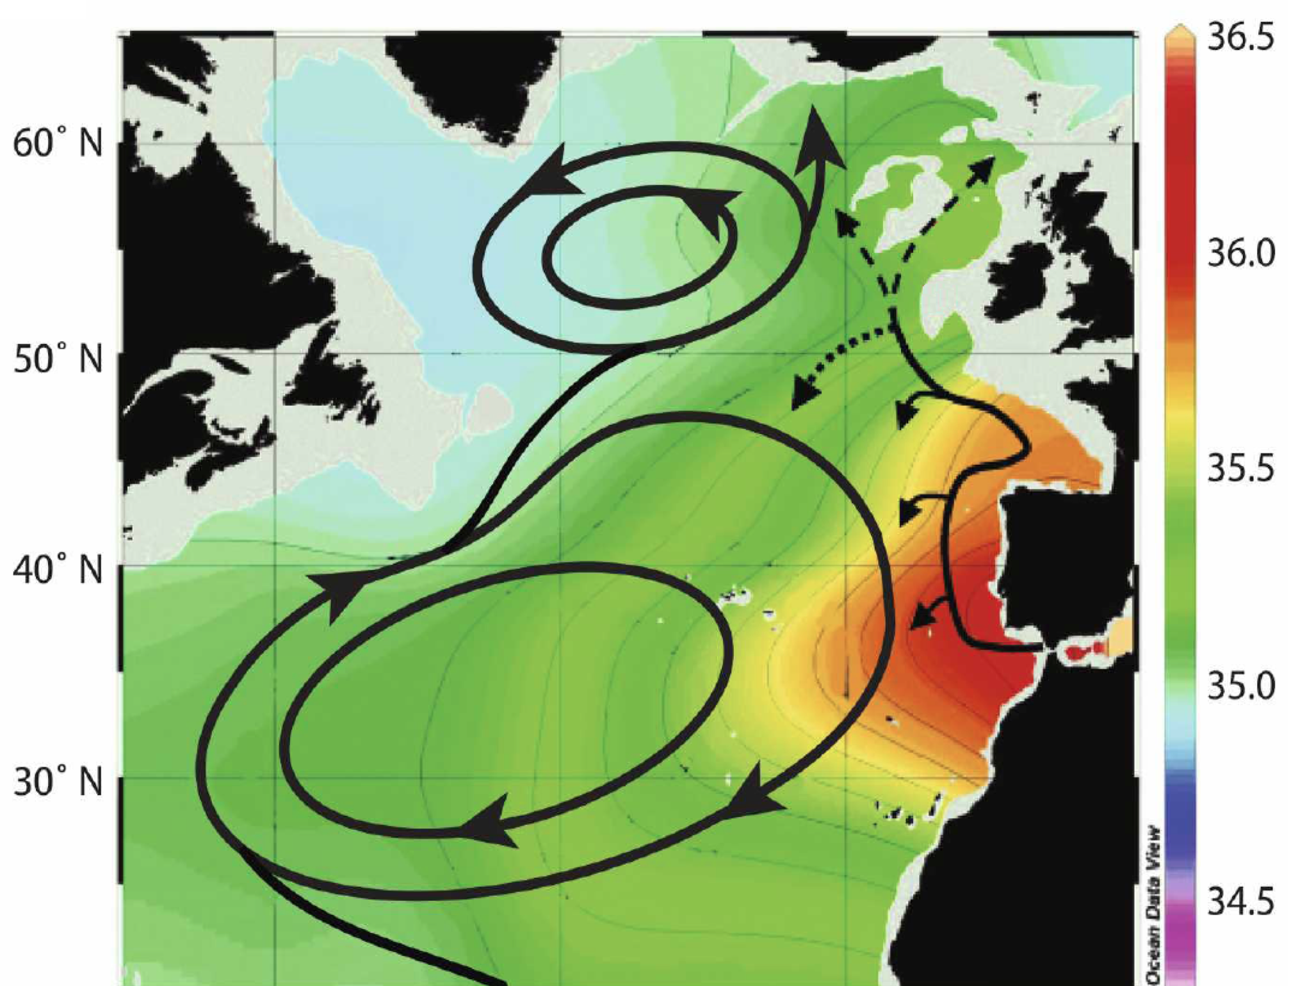

MOW impact on the AMOC?
Johnson (1997) process
Such changes in surface may strongly affect the Mediterranean outflow (MOW) and potentially the Atlantic Meridional Overturning Circulation (AMOC)
Johnson (1997) using qualitative arguments: Aswan Dam ➔ reduced Nil flow ➔ increased MOW ➔ increased AMOC ➔ increased evaporation in Labrador ➔ new ice age!
Rahmstorf (1998) using simple climate model: salty Med ➔ increased AMOC
Ivanovitch et al. (2013) using HadCM3: still a decrease of AMOC, except at the surface…
Ivanovitch et al. 2013 (HadCM3,
Halving Med salinity)
Depth (m)
Depth
Latitude
Lozier and Stewart2008
8O°W
O°
Longitude
Notes:
Lozier & Stewart JPO (2008): “The impacts of an intermittent penetration of MOW into the subpolar gyre, including the possible effect on water mass transformations, remain to be investigated.”

Slide 5
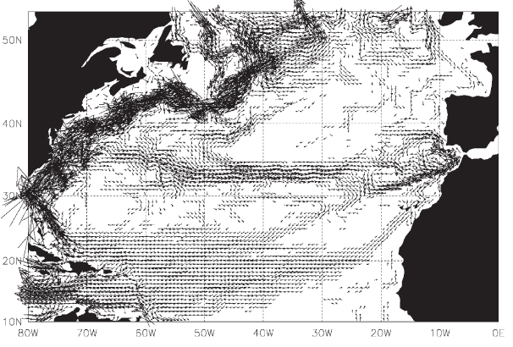
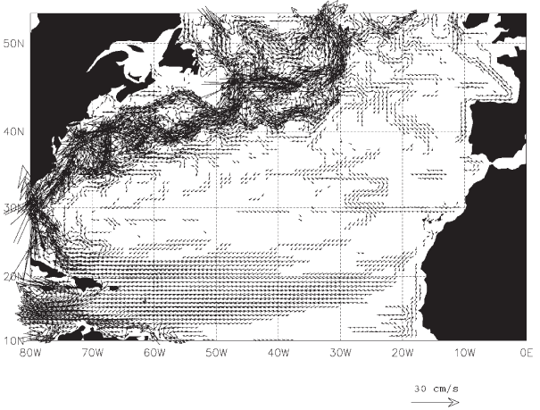
Effect of MOW on surface ocean circulation
Jia (2000), New et al. (2001) using of high-resolution (<0.5°) ocean GCMs, one with active MOW, the other without MOW
With active MOW, there is clear branch of surface water going towards the Mediterranean
Without any MOW, this branch disappears
What could the impact of these 3D large-scale circulation changes on tropical salinity transport, and then AMOC and climate?
Active MOW
No MOW
New et al. 2001
Notes:
Impact of MOW on Azores current

Slide 6
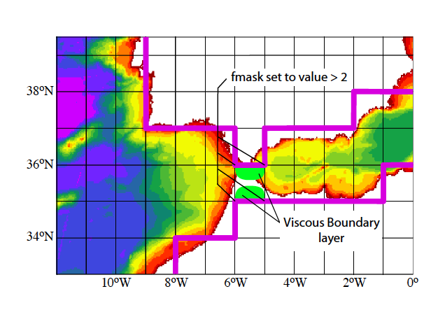
Experimental design
Objective: What is the impact of a MOW disappearance on large-scale ocean and climate in a state-of-the art climate model?
IPSL-CM5A-LR:
  Ocean-atmosphere GCM (2° resolution)
  Representation of Gibraltar by enhancing number of grid points there and playing with viscosity for having coherent transport (modelled MOW=2.2 Sv, obs.≈1.8 Sv)
100 mSv of freshwater put homogenously over the Mediterranean area for 300 years (HosMed)
(Nil=3 mSv ; Amazon=200 mSv)
Notes:
Nil : 2 830 m3/s = 0.003 Sv
Amazone 209 000 m3/s = 0.2 Sv
Facteur 100…

Slide 7
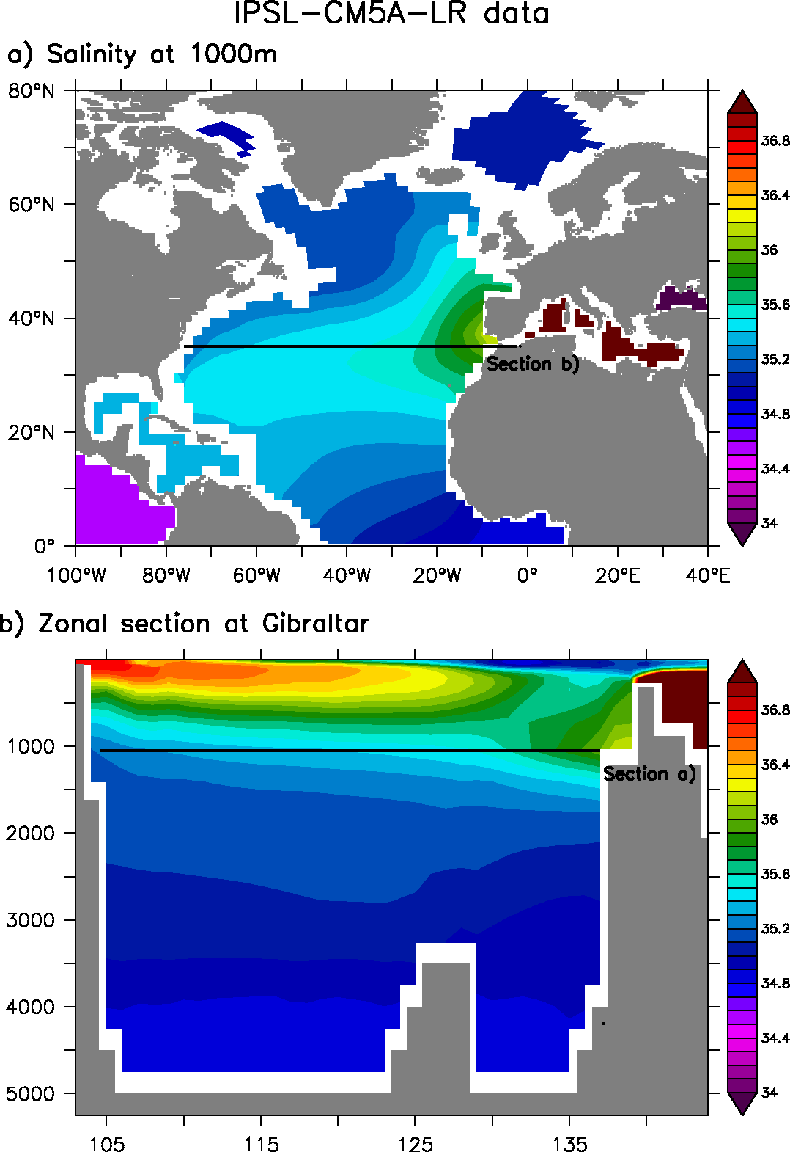
MOW within IPSL-CM5A-LR
Control simulation IPSL-CM5A-LR
Profondeur (m)
Profondeur (m)
8O°W
O°
Longitude
Longitude
8O°W
O°
Notes:
Value of flows ? Obs vs data
GLORYS: outflow= 1.91 Sv in 5 yr => 0.46 south; 1.26 North
Model outflow = 2.20 Sv => 1.56 South ; 0.17 North
Issue with model pathway?

Slide 8
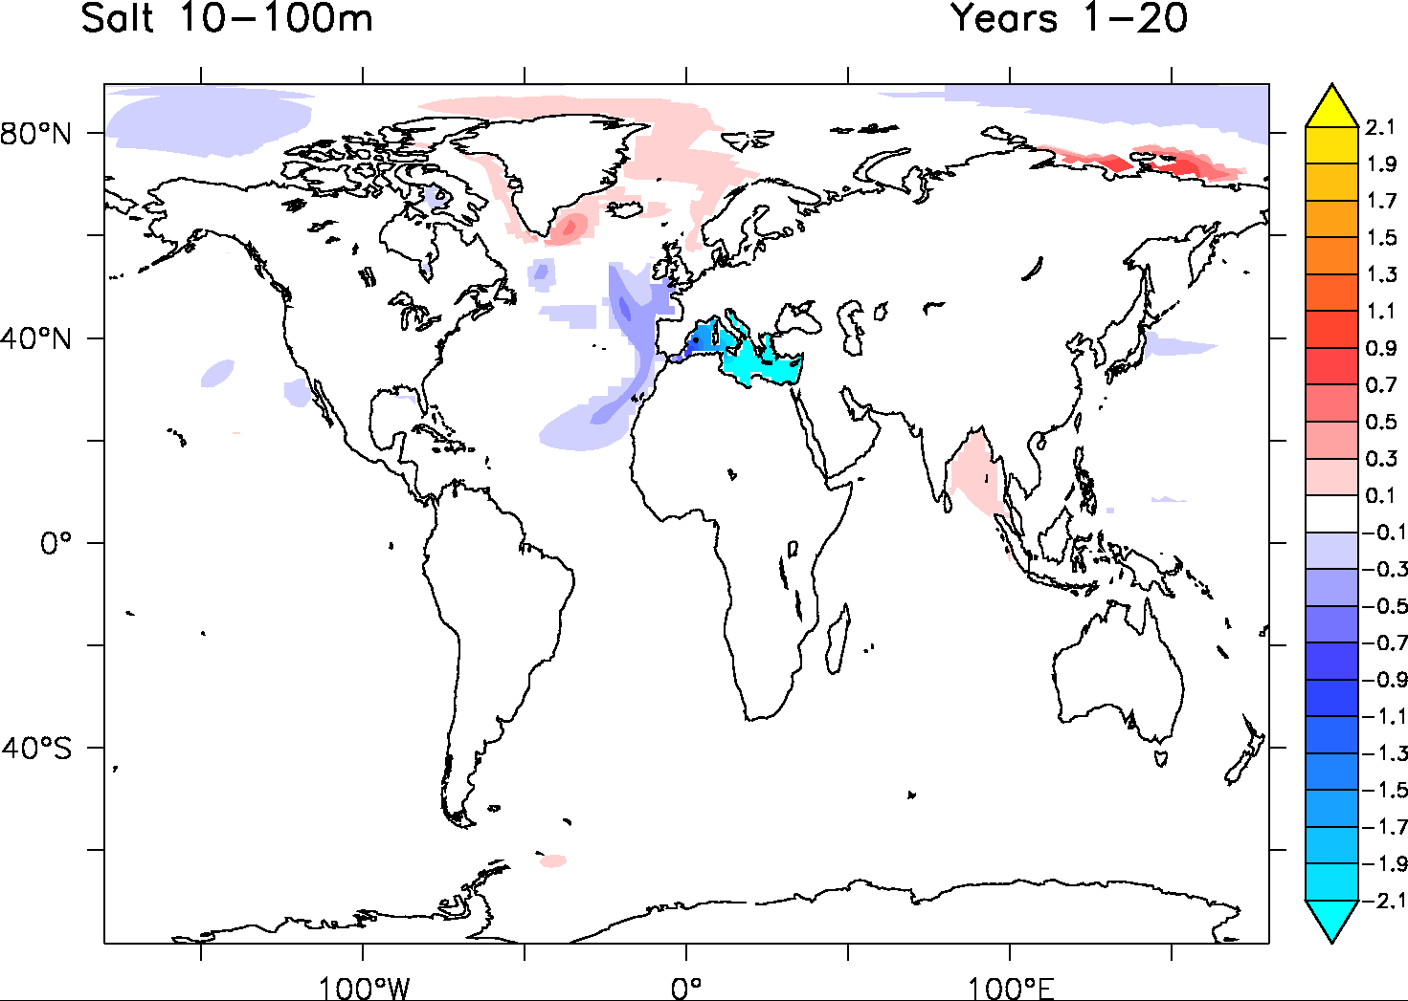
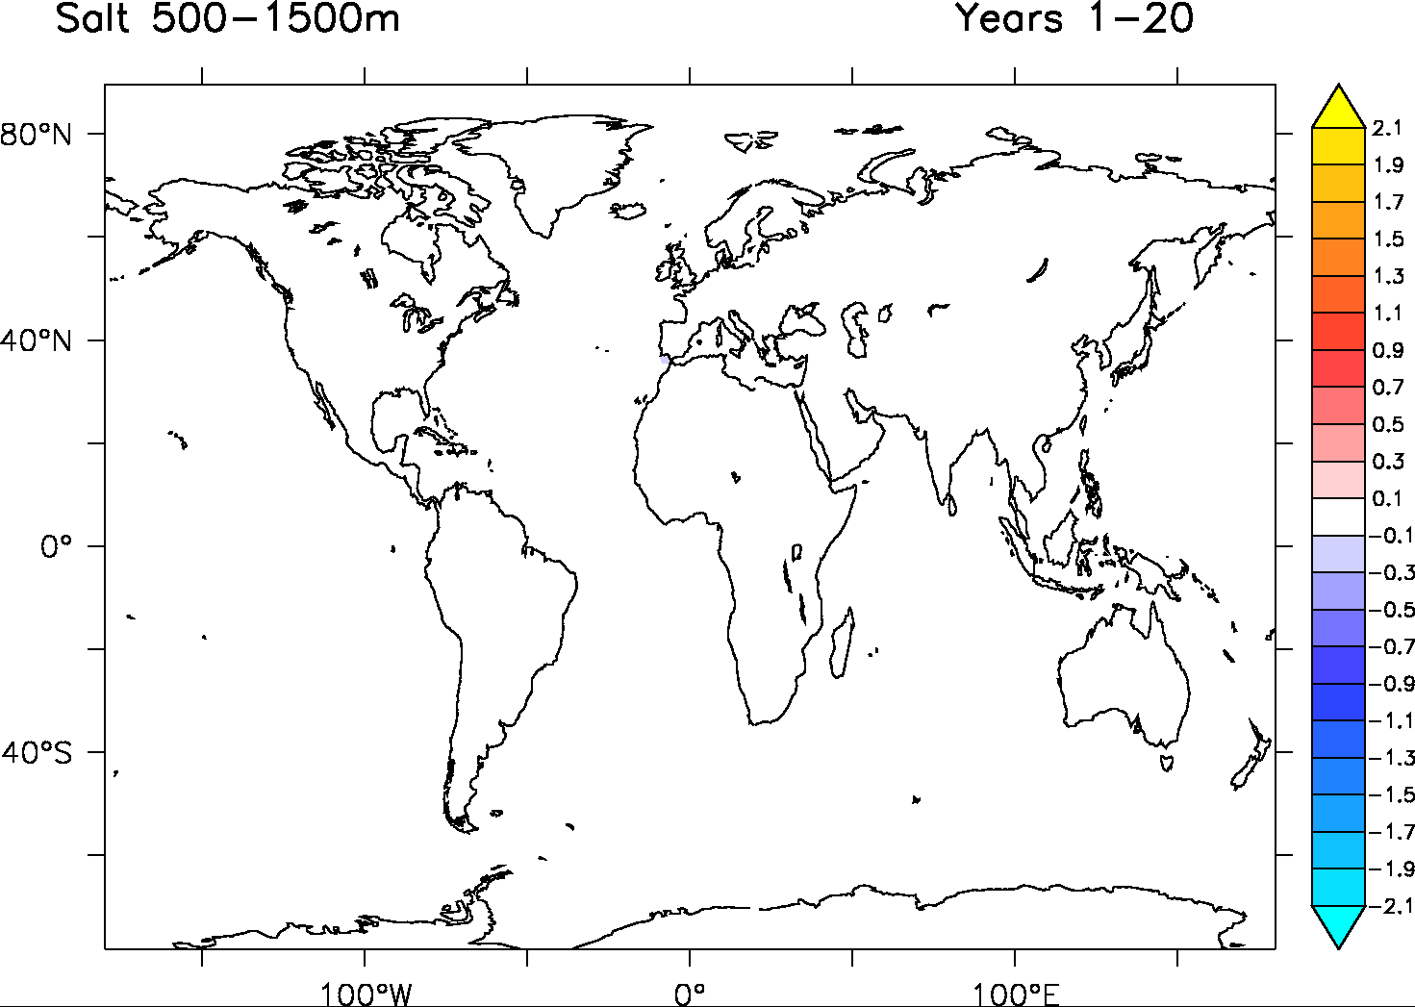
Salinity response
SSS: HosMed-Control
Freshwater leakage

Slide 9
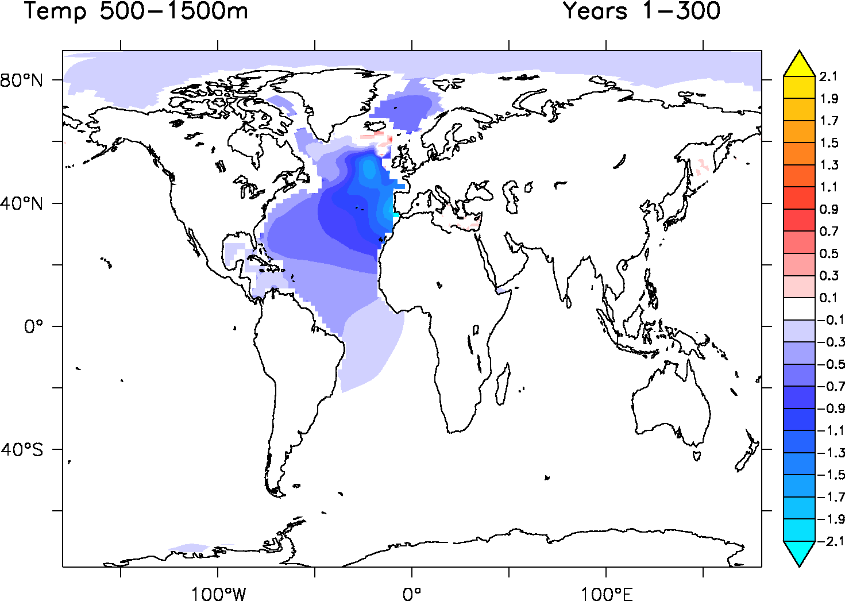
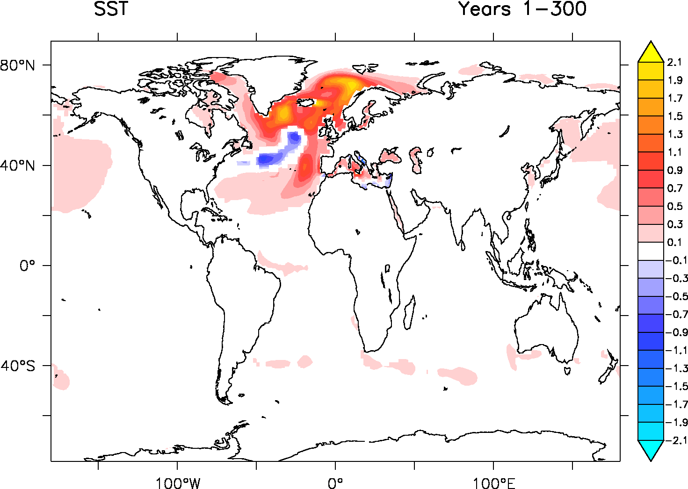
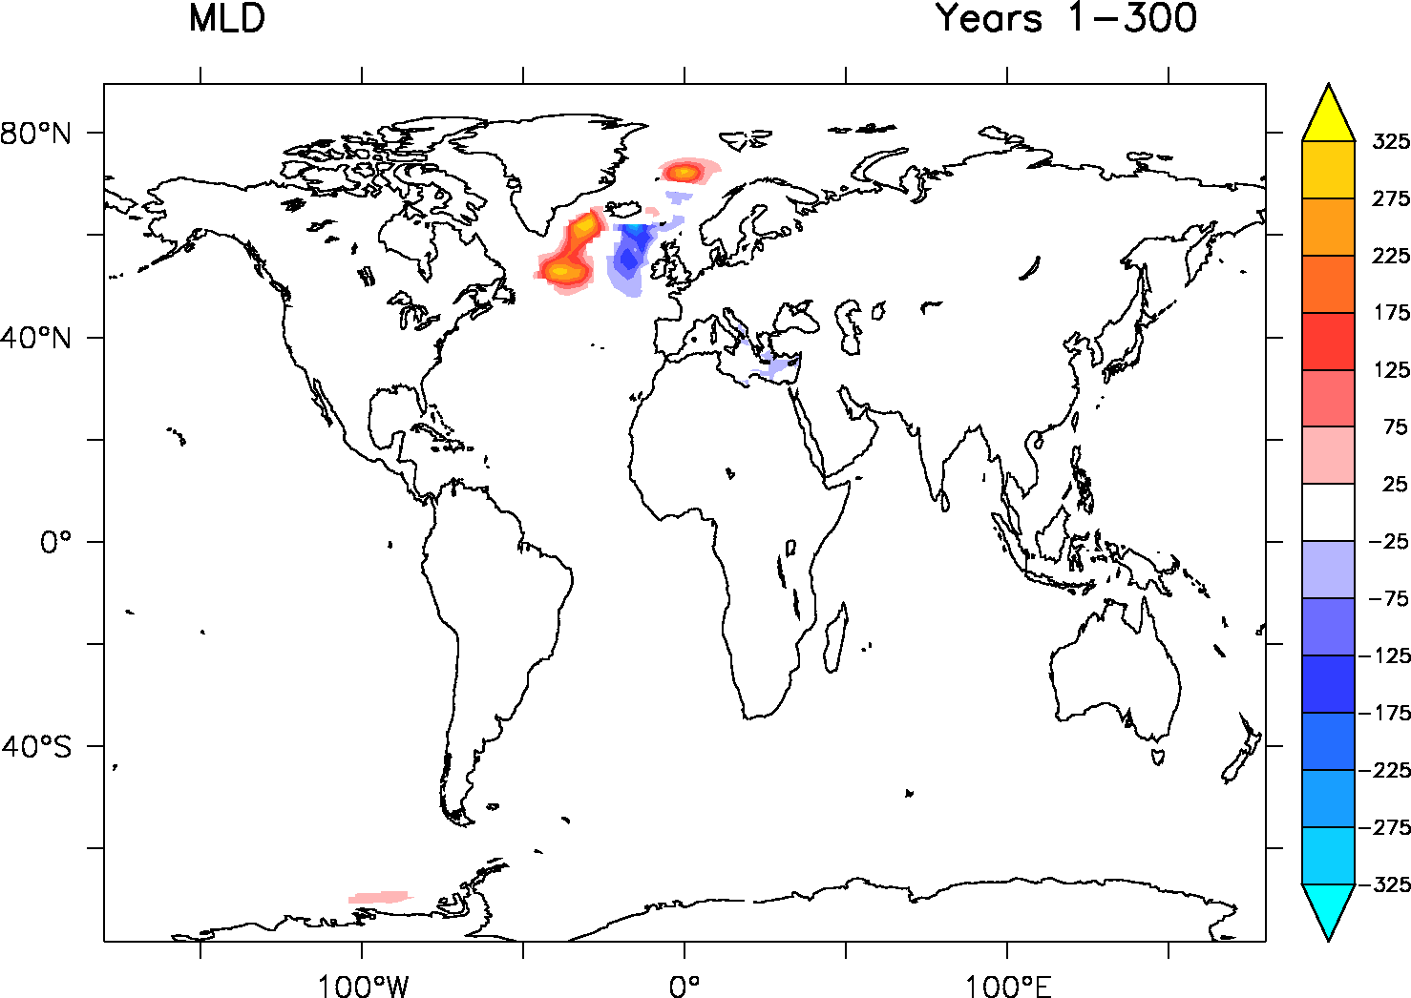
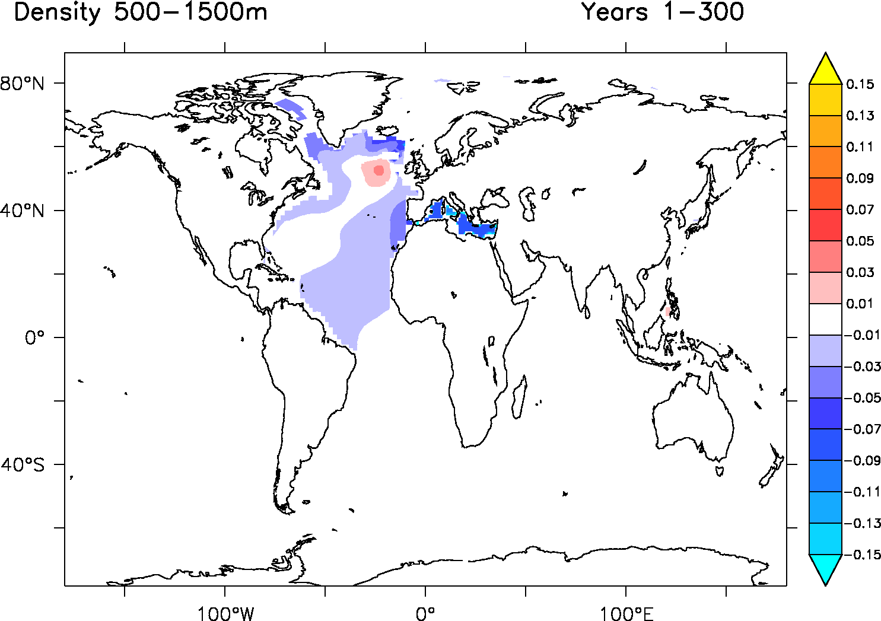
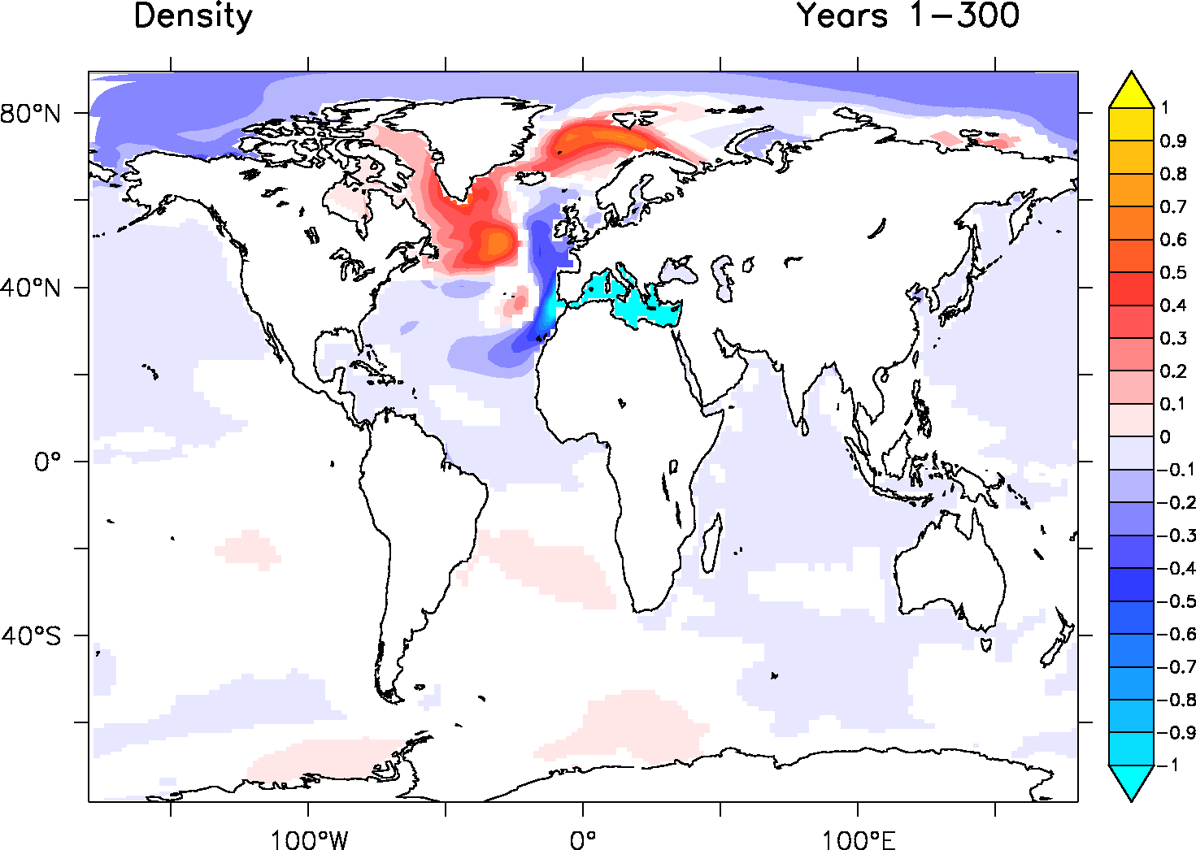
Oceanic response
Surface Density
Thermal wind balance

Slide 10
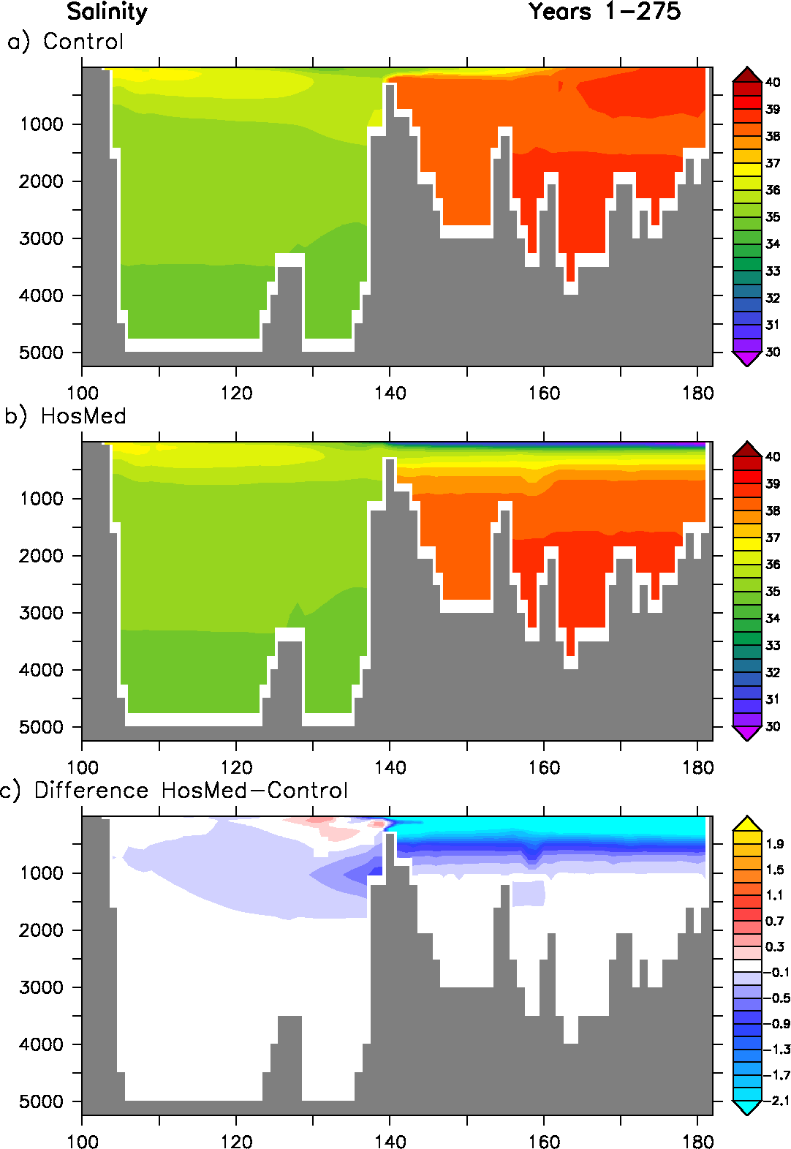
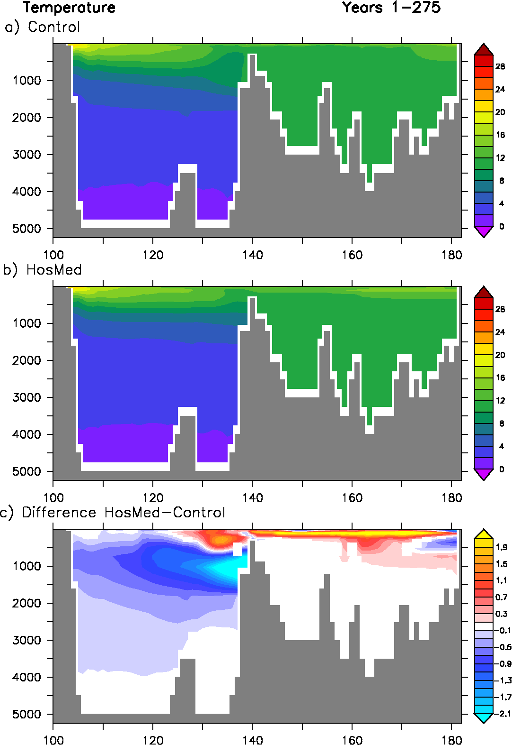
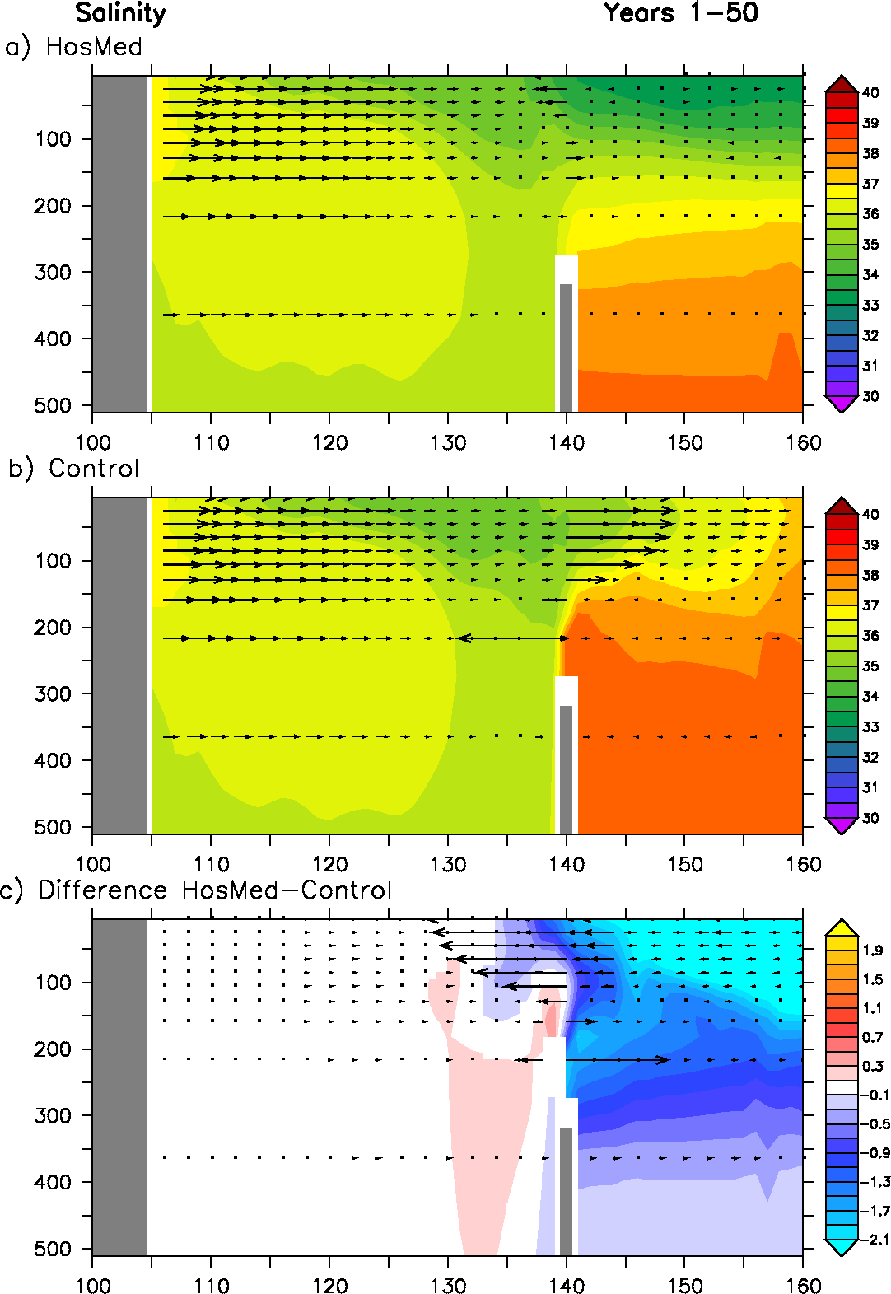
Zonal section along Gibraltar
Gibraltar
America
Méditerranean
Longitude
Longitude

Slide 11
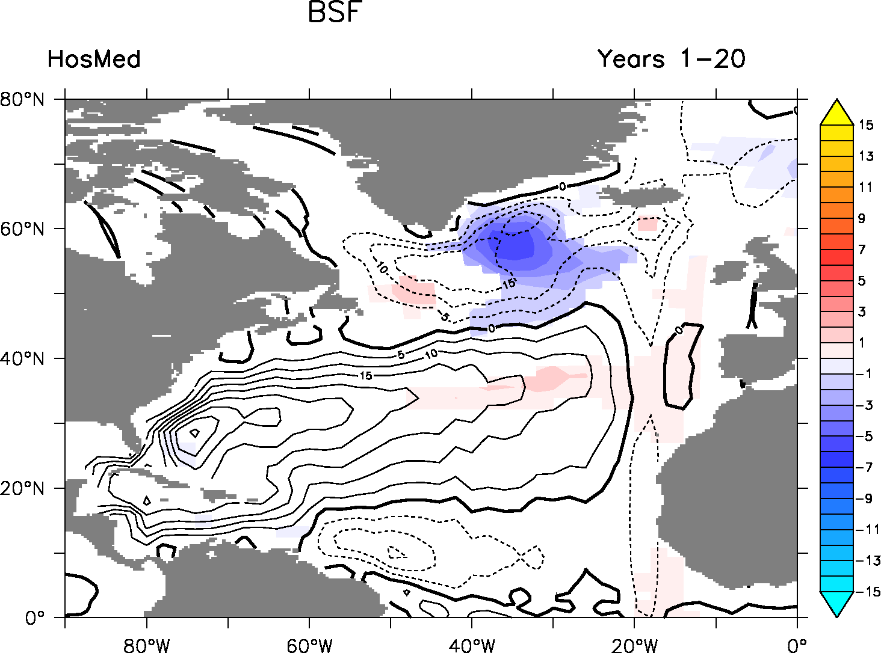
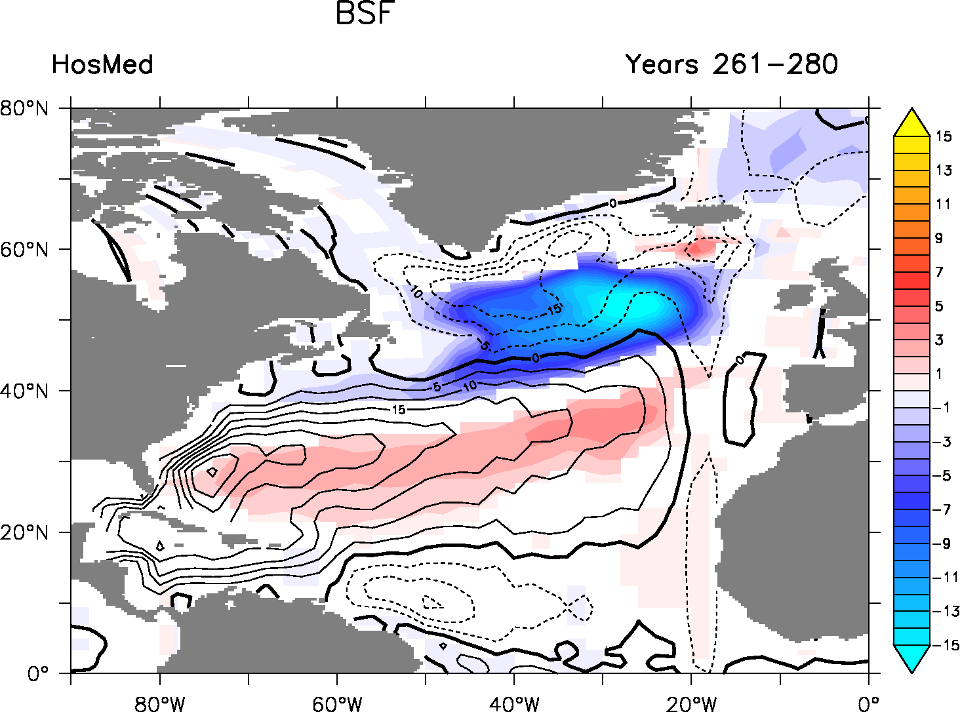
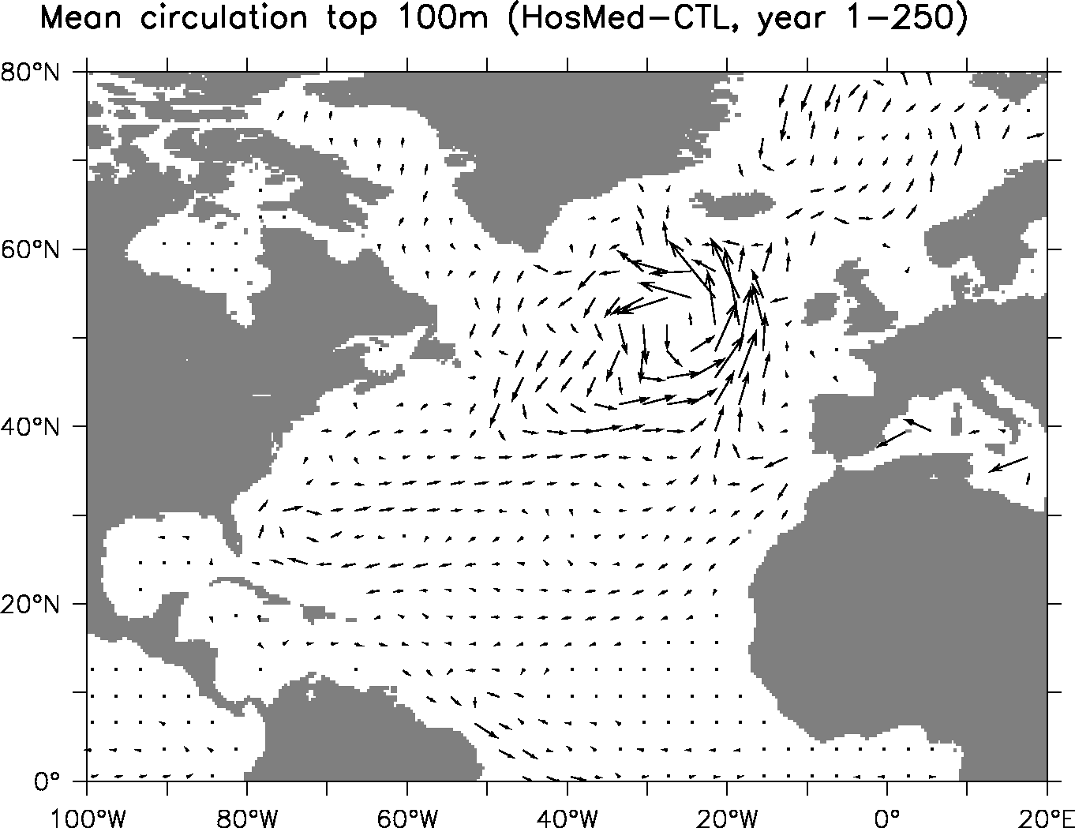
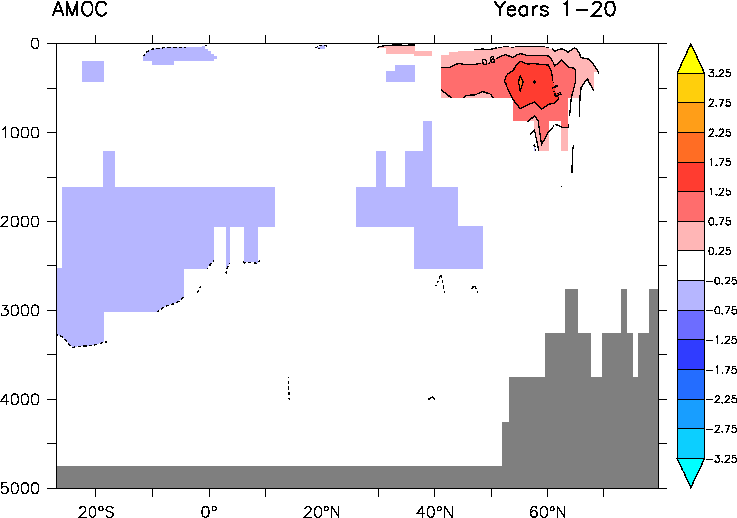
Ocean circulation changes
Barotropic streamfunction
Subpolar gyre is intensified
AMOC is increased in surface decreased in subsurface
Mean circulation top 100m (HosMed-CTL, year 1-300)

Slide 12
Two opposing mechanisms for AMOC
1) No MOW: direct impact on density distribution in the ocean
Lower zonal density gradient at depth (≈500-1500m)
Thermal wind relationship: weakened AMOC at depth
2) No MOW: impact on subtropical gyre geometry
Increased subtropical surface water transport in the North Atlantic
Increased surface salinity and convection in the North Atlantic
Increased AMOC and subpolar gyre

Slide 13
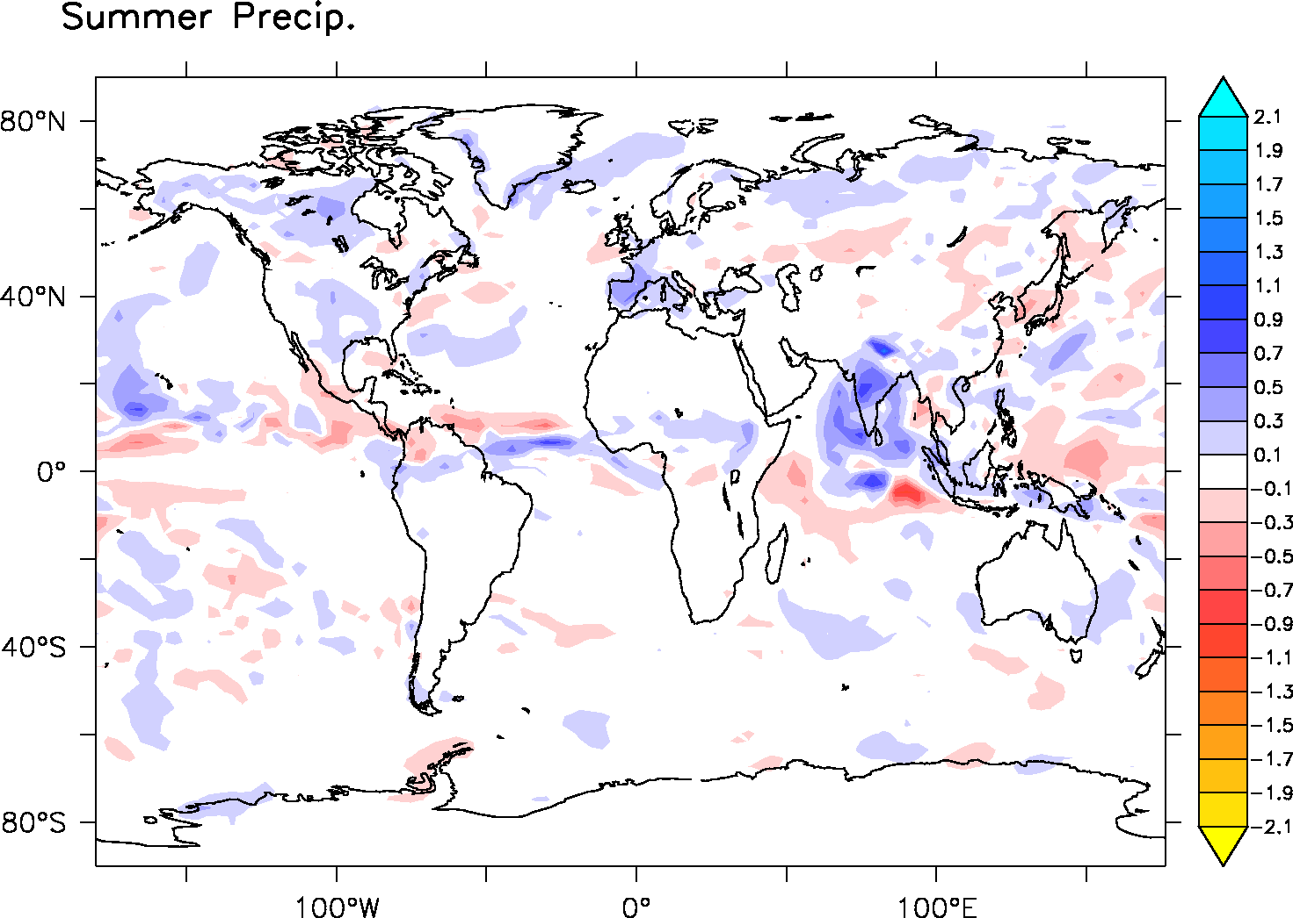
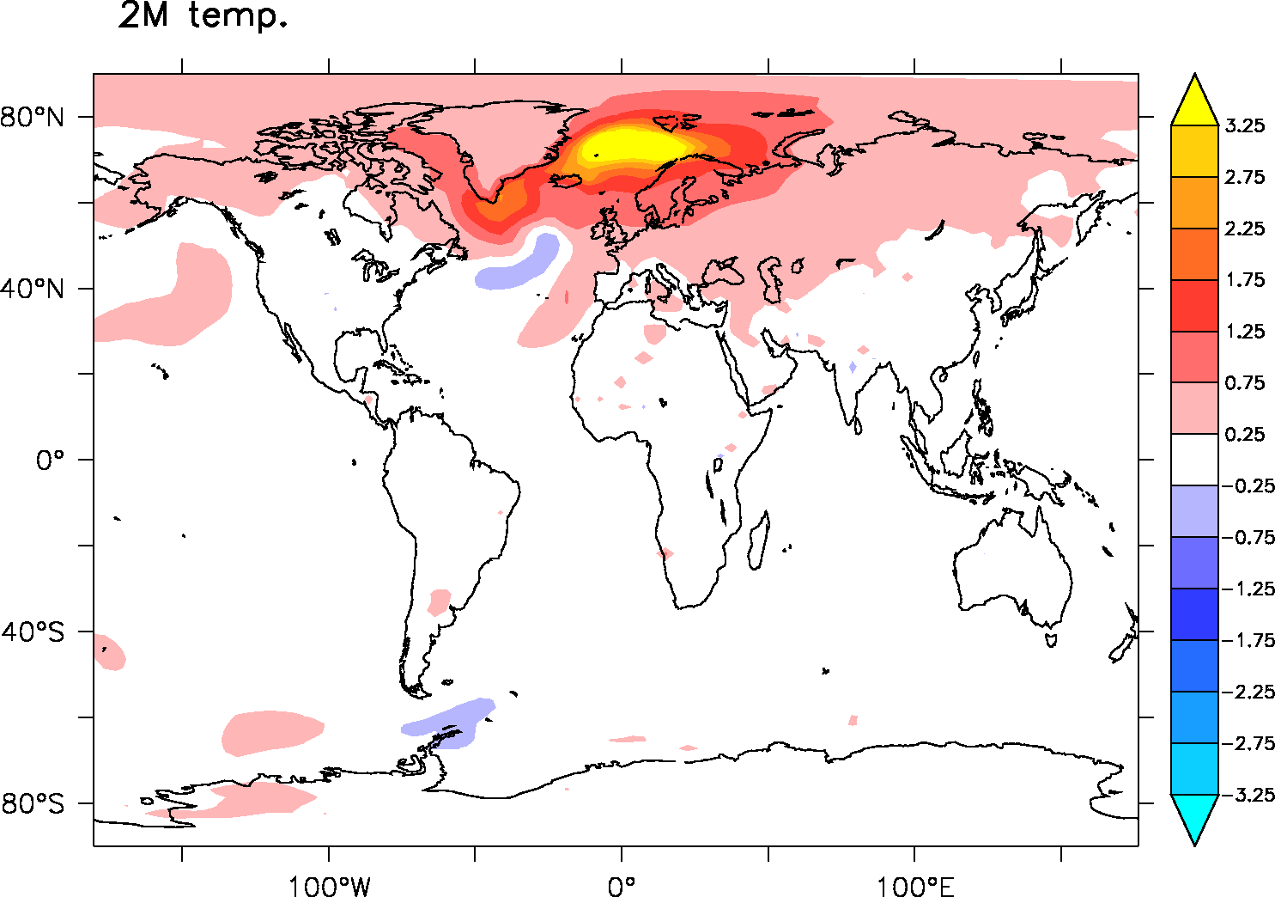
Climatic impact
HosMed – Control (Years 1-300)
+2%

Slide 14
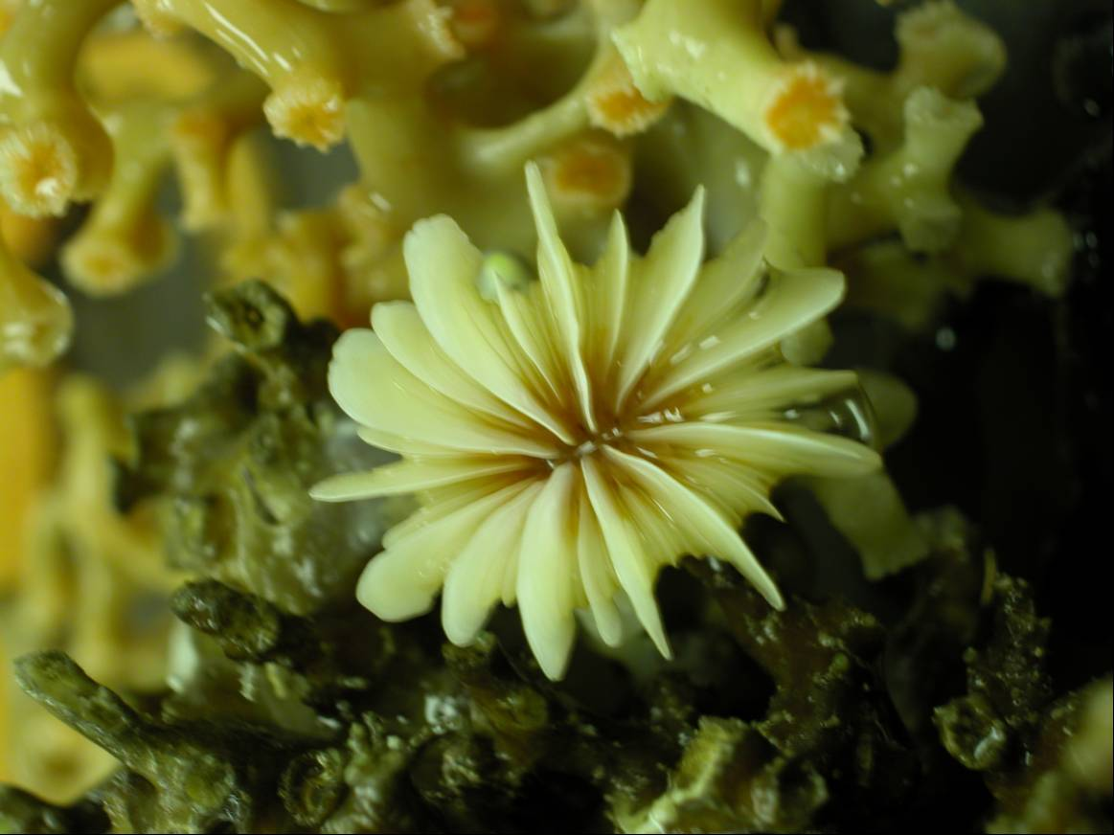
Perspective
Rockall coral ε_{Nd} data
Plateau de Rockall
LIA
Comparison with new data
Off-line simulation including tracers (ε_{Nd}, δ¹³C ) to allow better comparison
-11
STG
ε_{Nd}
-13
-15
Climatic Optimum
SPG
MCA
-17
10000
8000
6000
4000
2000
0
Age (ans) cal BP
8O°W
Colin et al. (2010); Copard et al. (2010, 2011, 2012); Montero-serrano et al. (2013)

Slide 15
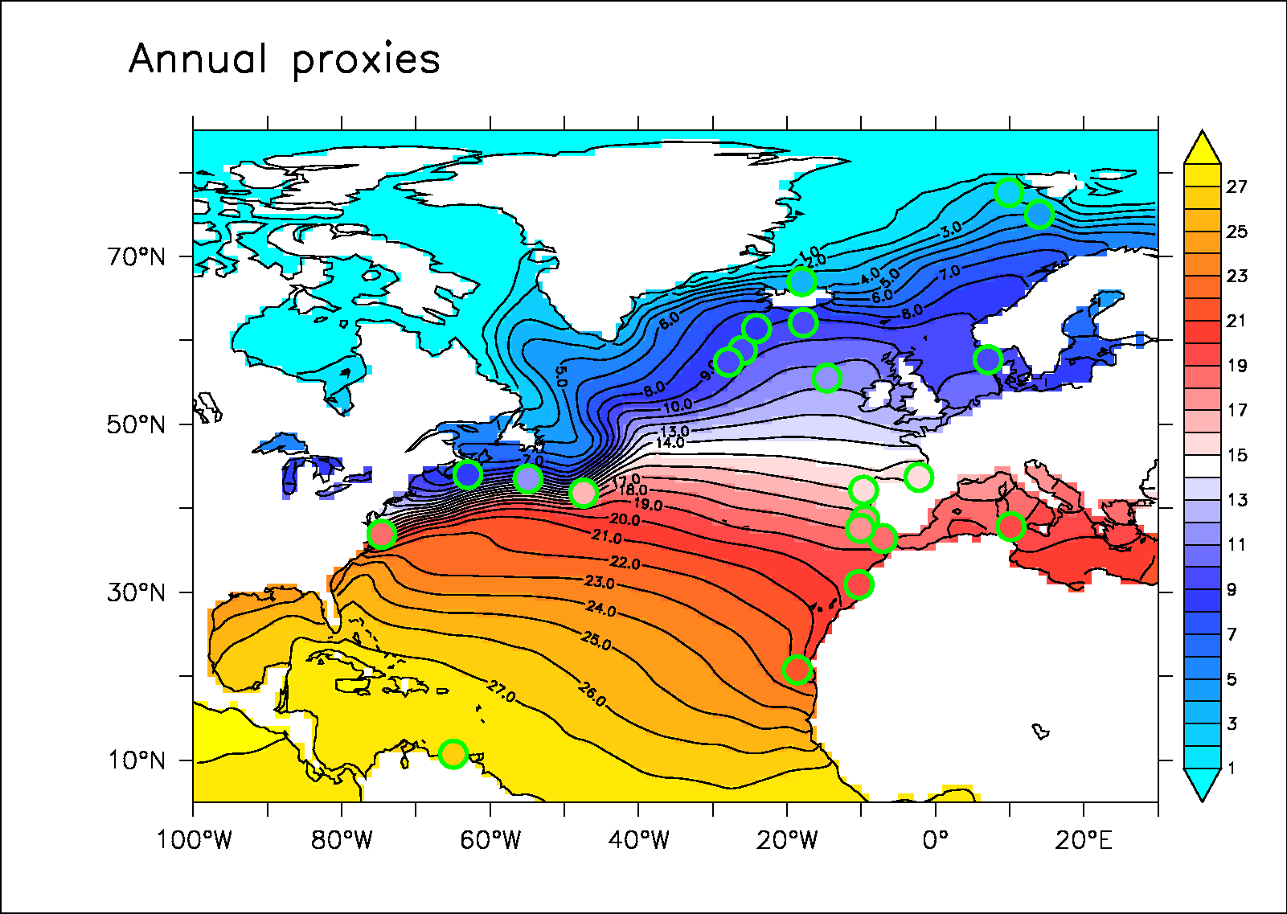
Reconstruction Holocene
Objectif : Identifier les signaux communs dans la compilation Holocene
Annual data from Mg/Ca, Alkenone (etc.) covering the period 2000-10,000BP
Analyse EOF de la reconstruction de Yannick
Pseudo proxy

Slide 16
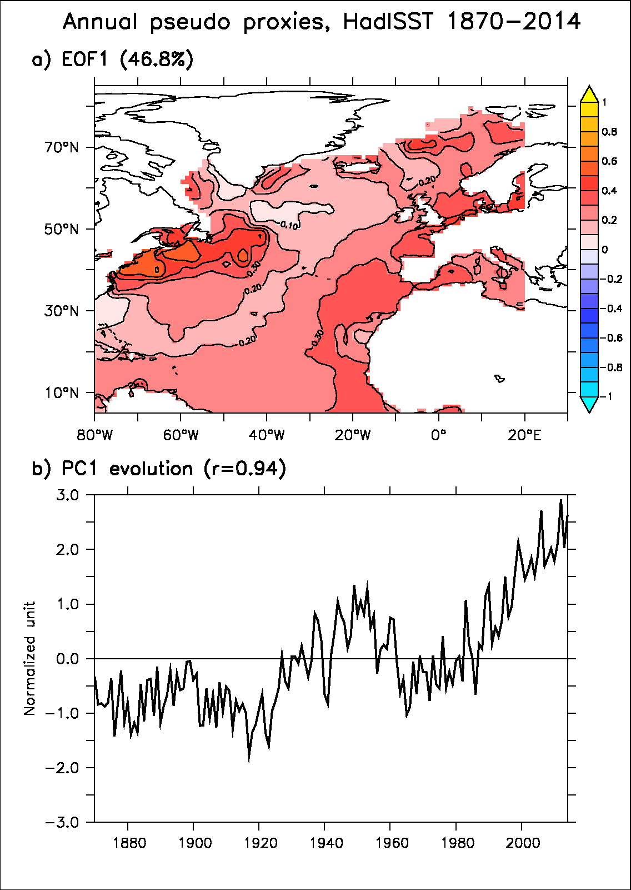
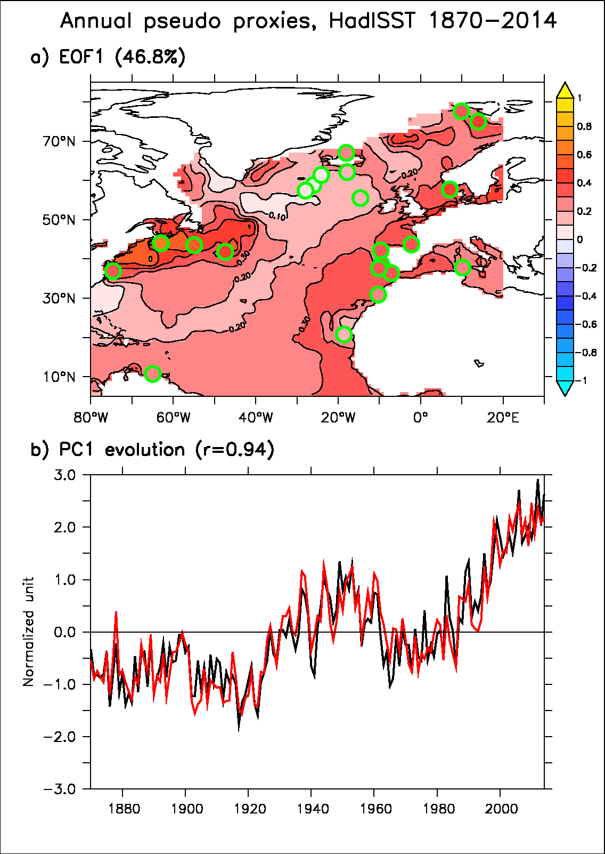
Pseudo-proxy
Validation de la mtéhode et du sampling spatial avec les données HadISST (1870-2014)
Les deux premières EOF semblent plutot bien reproduites

Slide 17
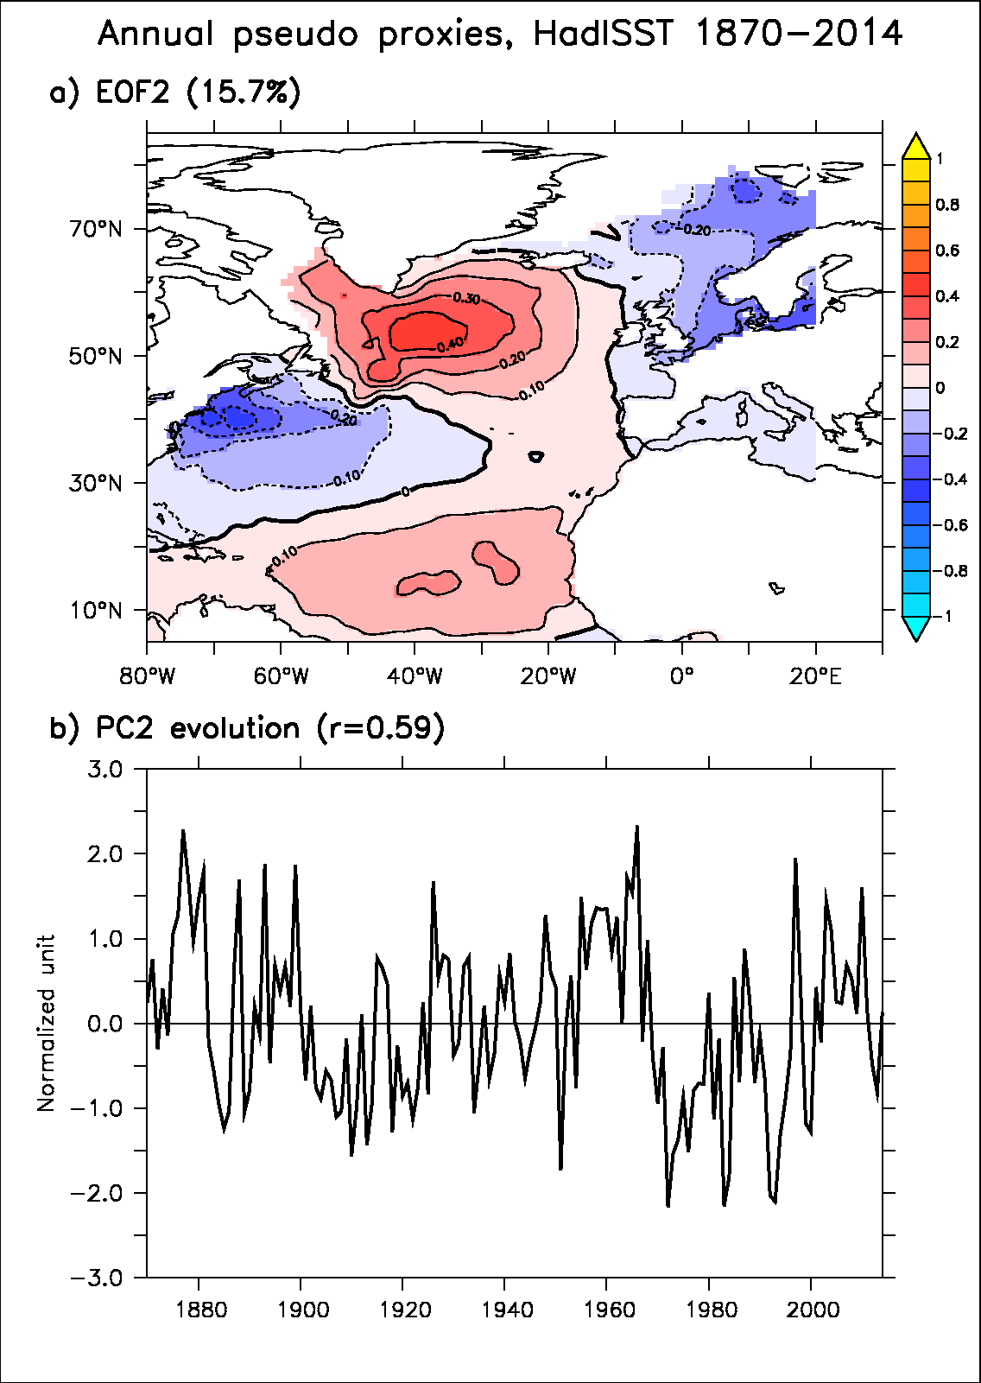
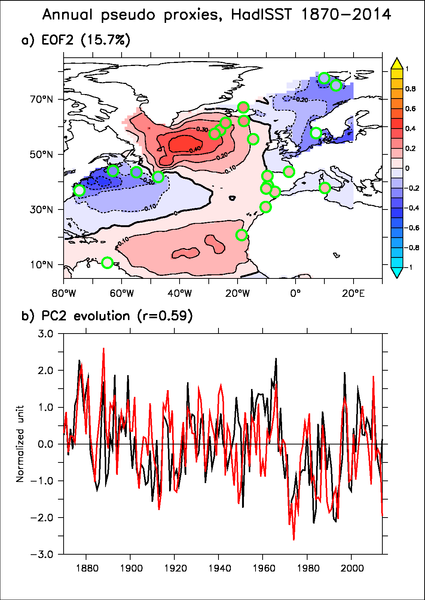
Pseudo-proxy
Validation de la mtéhode et du sampling spatial avec les données HadISST (1870-2014)
Les deux premières EOF semblent plutot bien reproduites

Slide 18
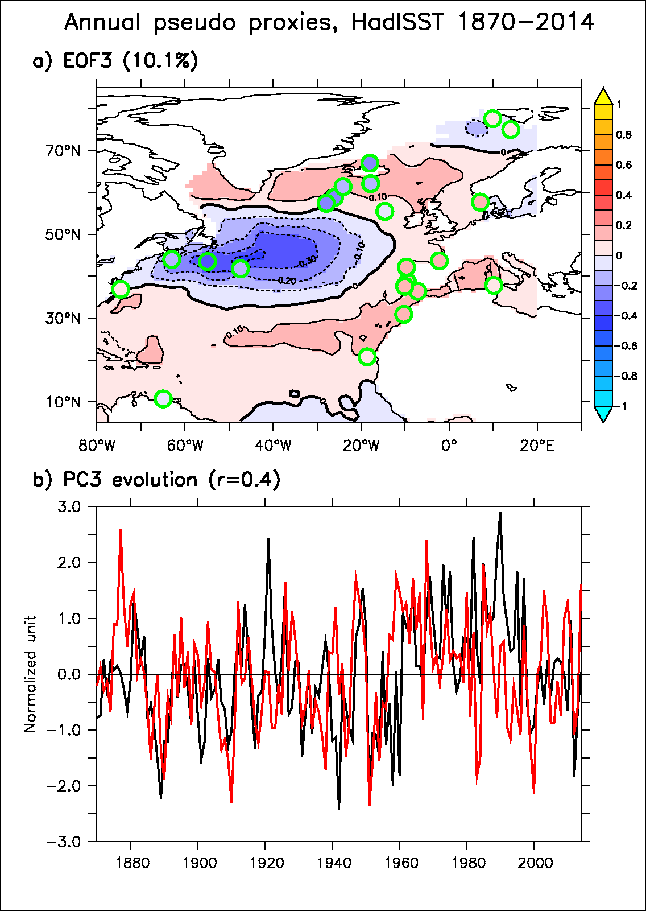
Pseudo-proxy
Validation de la mtéhode et du sampling spatial avec les données HadISST (1870-2014)
Les deux premières EOF semblent plutot bien reproduites

Slide 19
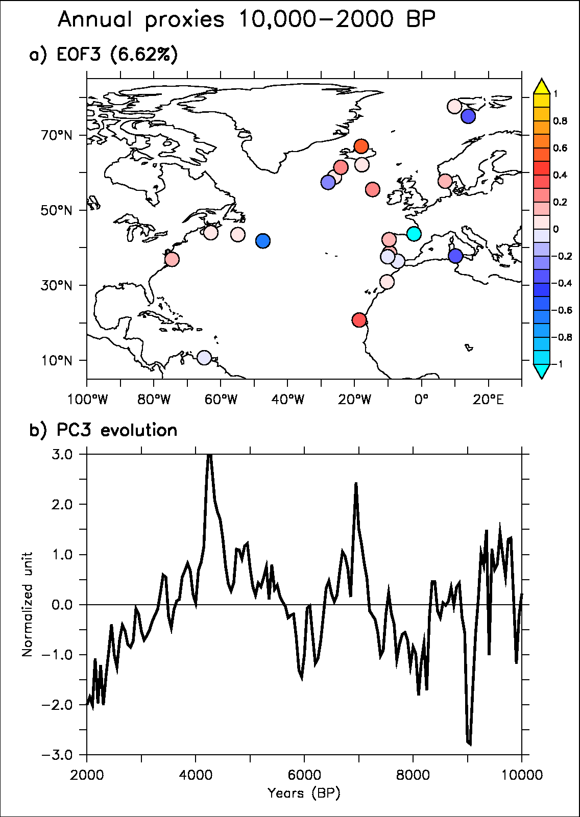
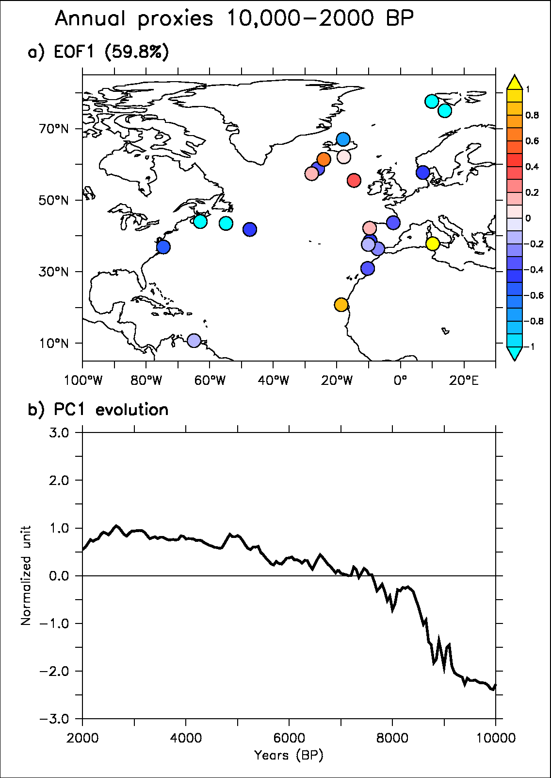
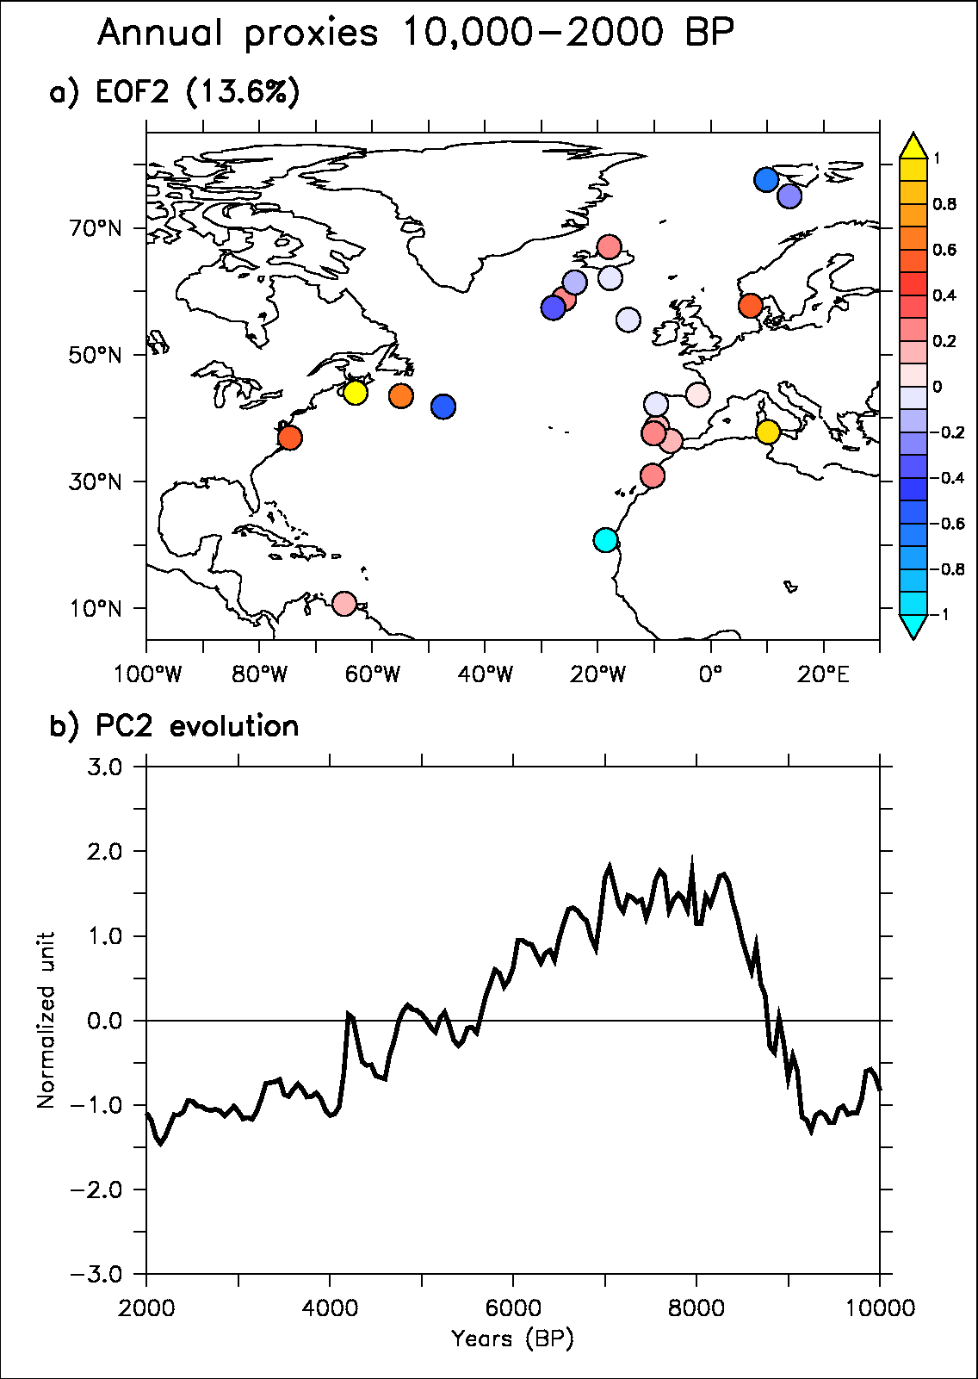
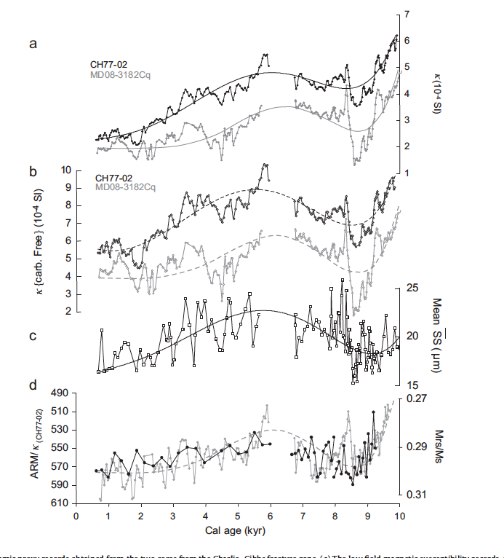
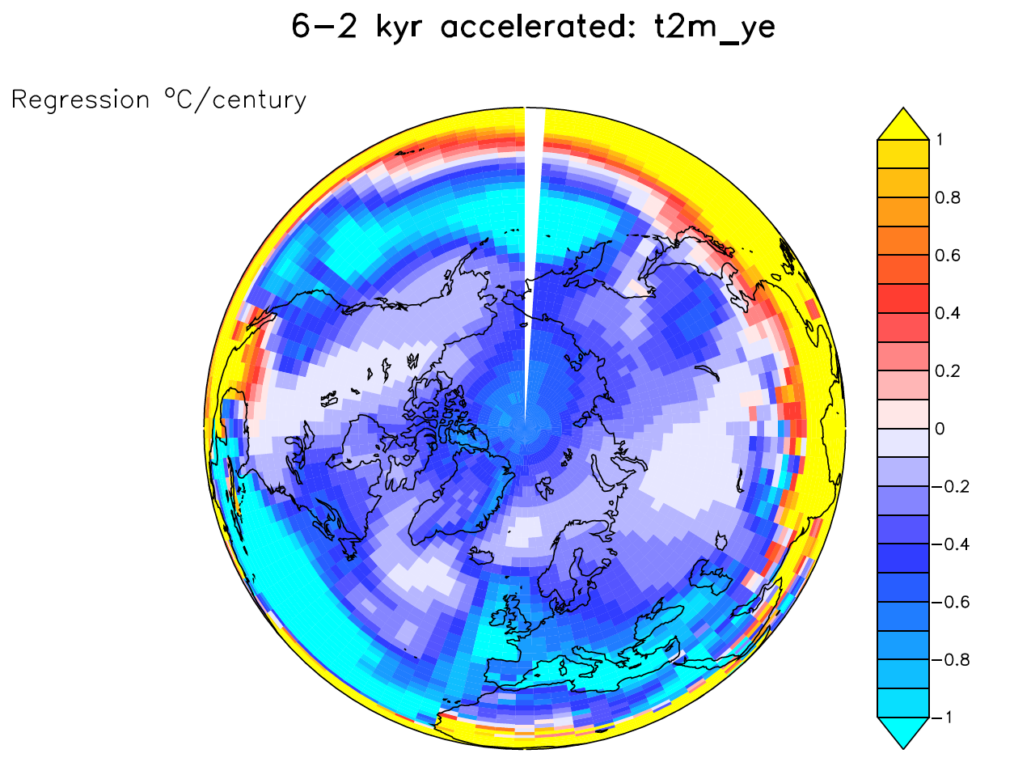
Application to Yannick database
Temporal interpolation
Use of EOF analysis to find out the most similar signal in all theses 22 cores (removing local noisy signal)
Kissel et al. 2013

Slide 20
Conclusions
Une AMOC plus forte pendant le Sapropel dans modele IPSL-CM5
Compilation Yannick :
  Refroidissement sur Atlantique Nord sur la periode 10-2 kyrs BP
  Max AMOC de l’Holocene 6000-8000 BP (?)
Un lien entre ces deux etudes ? Suppression MOW peut elle expliquer le max AMOC sur l’Holocene ?
Comparaison obs. => Traceurs Nd dans modèle + lien avec gyres

Slide 21
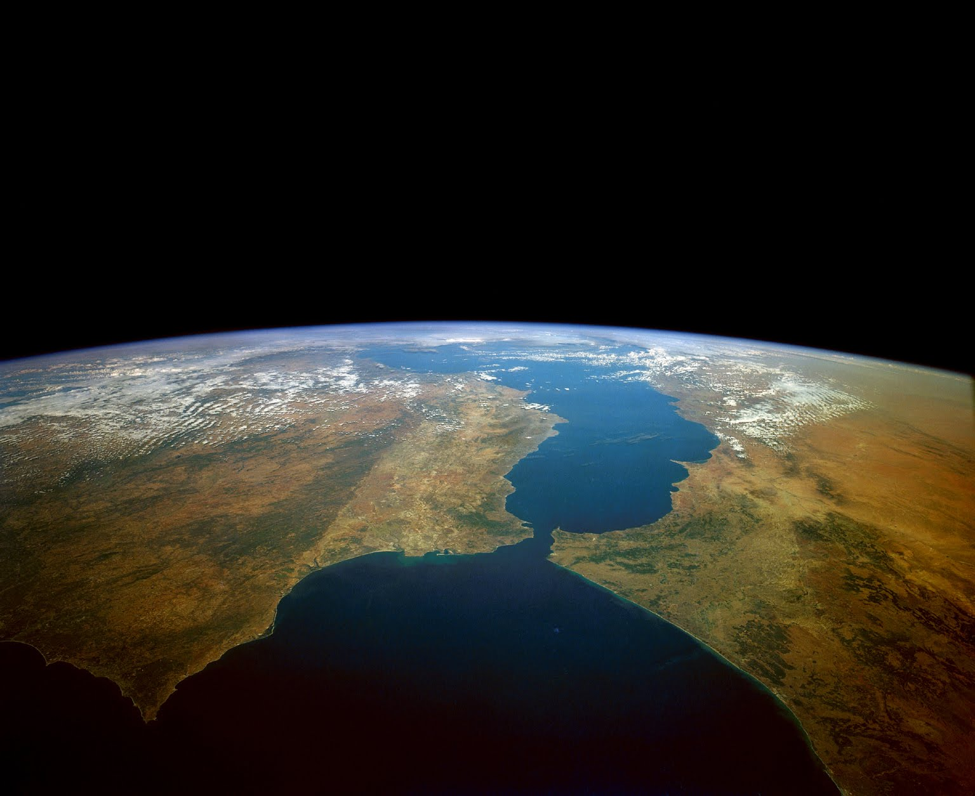
Thank you! didier.swingedouw@u-bordeaux1.fr

Slide 22
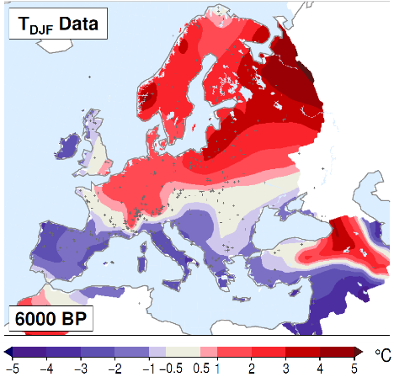
Analyse base de données PMIP3 sur l’Atlantique pour 6k
Reponse climat il y 6000 ans dans PMIP3 : analyse de Alina Gainusa Bogdan pour le projet Milex (PI : Pascal Yiou)
Motivation : NAO+ à 6K dans les obs ? (Mauri et al. 2014)

Slide 23
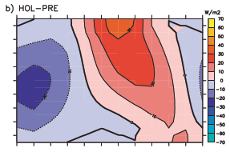
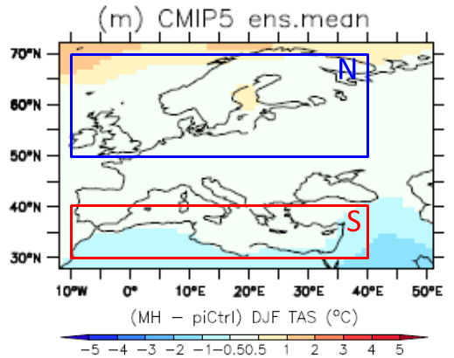


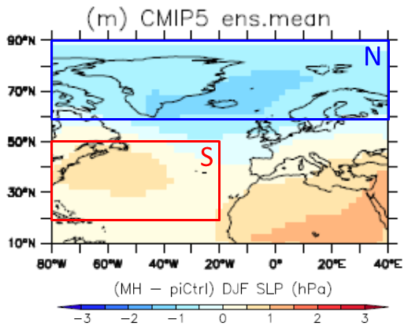
Analyse base de données PMIP3 sur l’Atlantique pour 6k
radiative forcing 6K-0K
Δ temperature
Δ sea ice cover

Slide 24
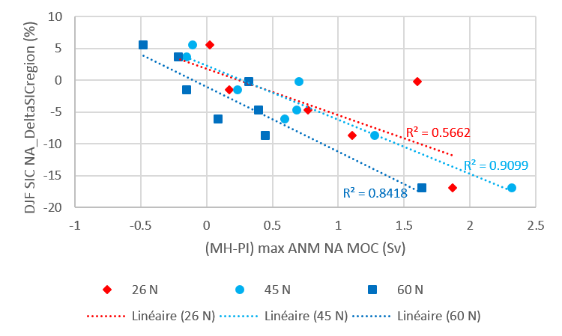
Analyse base de données PMIP3 sur l’Atlantique pour 6k

Slide 25
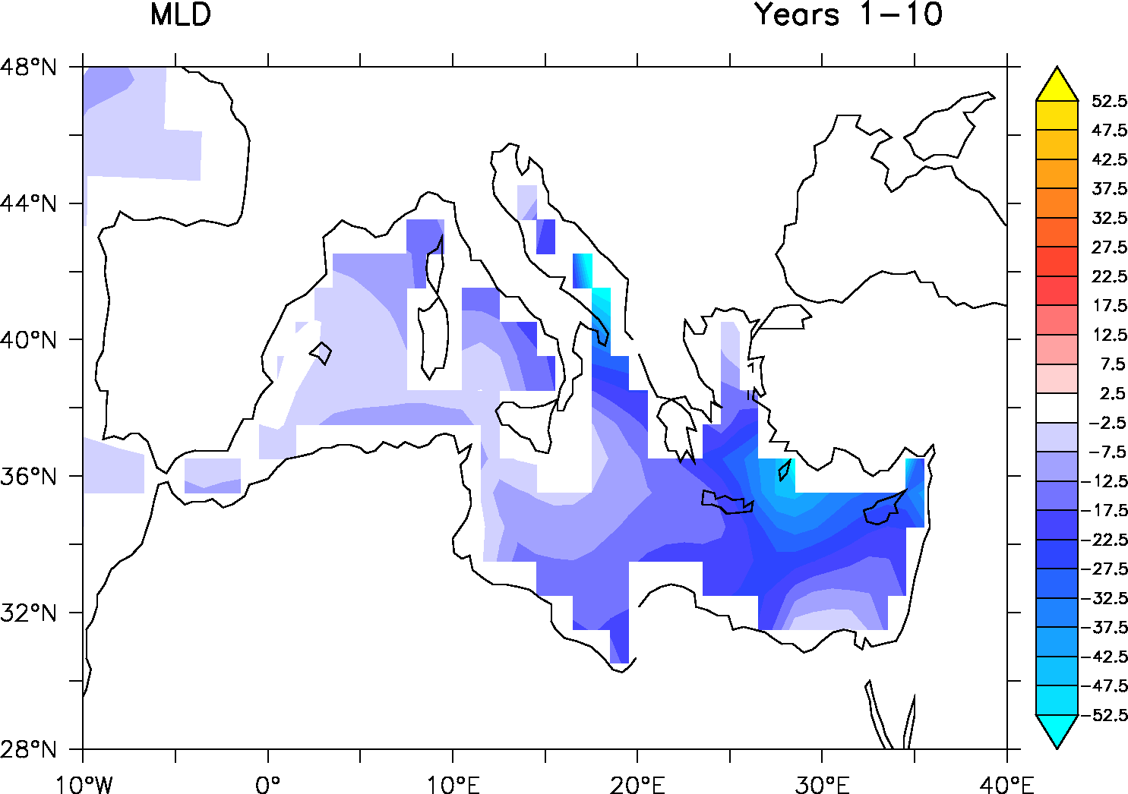
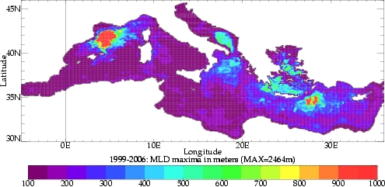
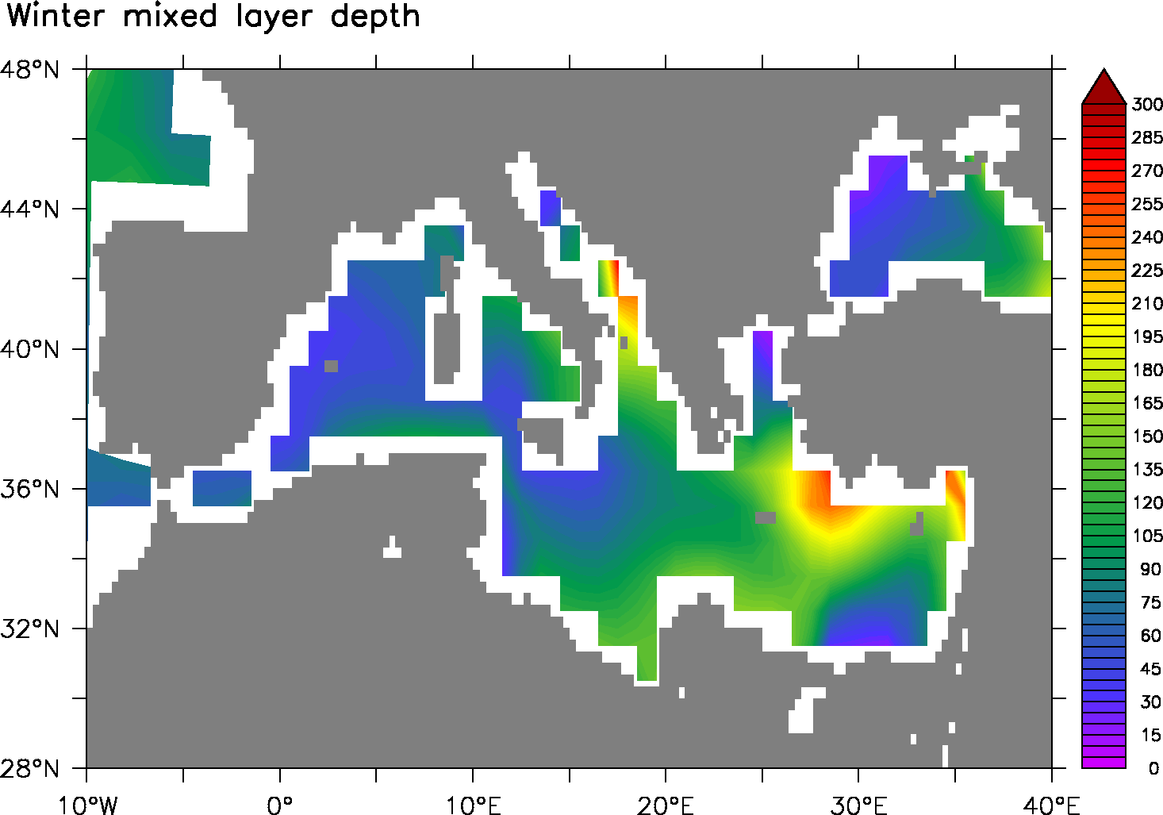
Mediterranean convection

Slide 26
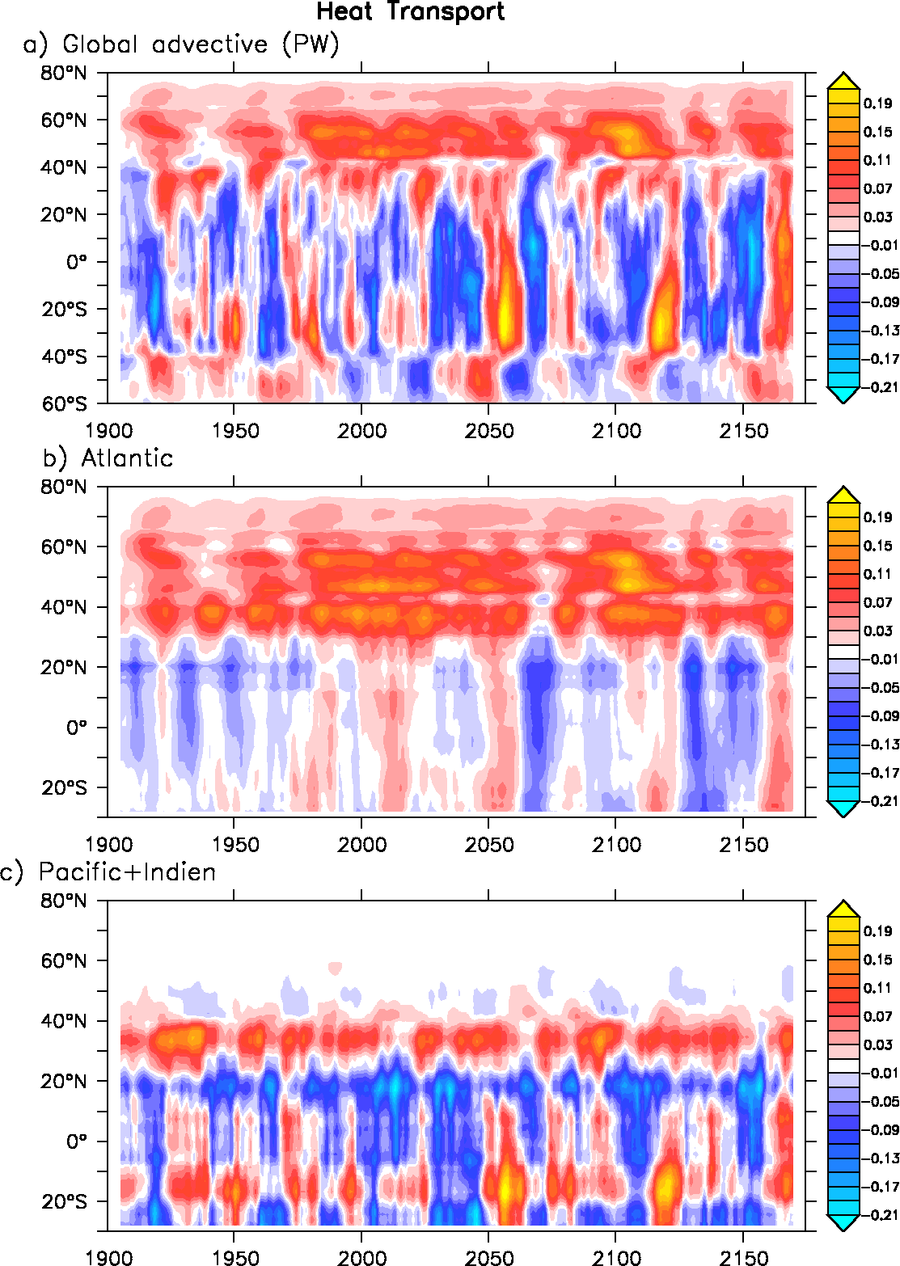
Heat transport changes

