Slide 1





Skill in temperature over Europe in the IPSL-CM5A-LR decadal prediction system
Didier Swingedouw, Giovanni Sgubin, Juliette Mignot, Eric Guilyardi
Harilaos Loukos, Thomas Noel, Matthieu Vrac

Slide 2
IPSL-EPOC decadal prediction system
Observations (ERSST)
Nudged simulation
Hindcast LT 2-5 years
Historical simulation
CMIP5 version
Starting 1st January every year from 1961 to 2015
3 members
Initialised through nudging in SST (Reynolds et al. 2013) anomalies
Reasonable predictability of the AMV (r ≈ 0.6)
AMV (detrended Atlantic SST 0-60°N)
Mignot et al., Clim. Dyn., 2016

Slide 3
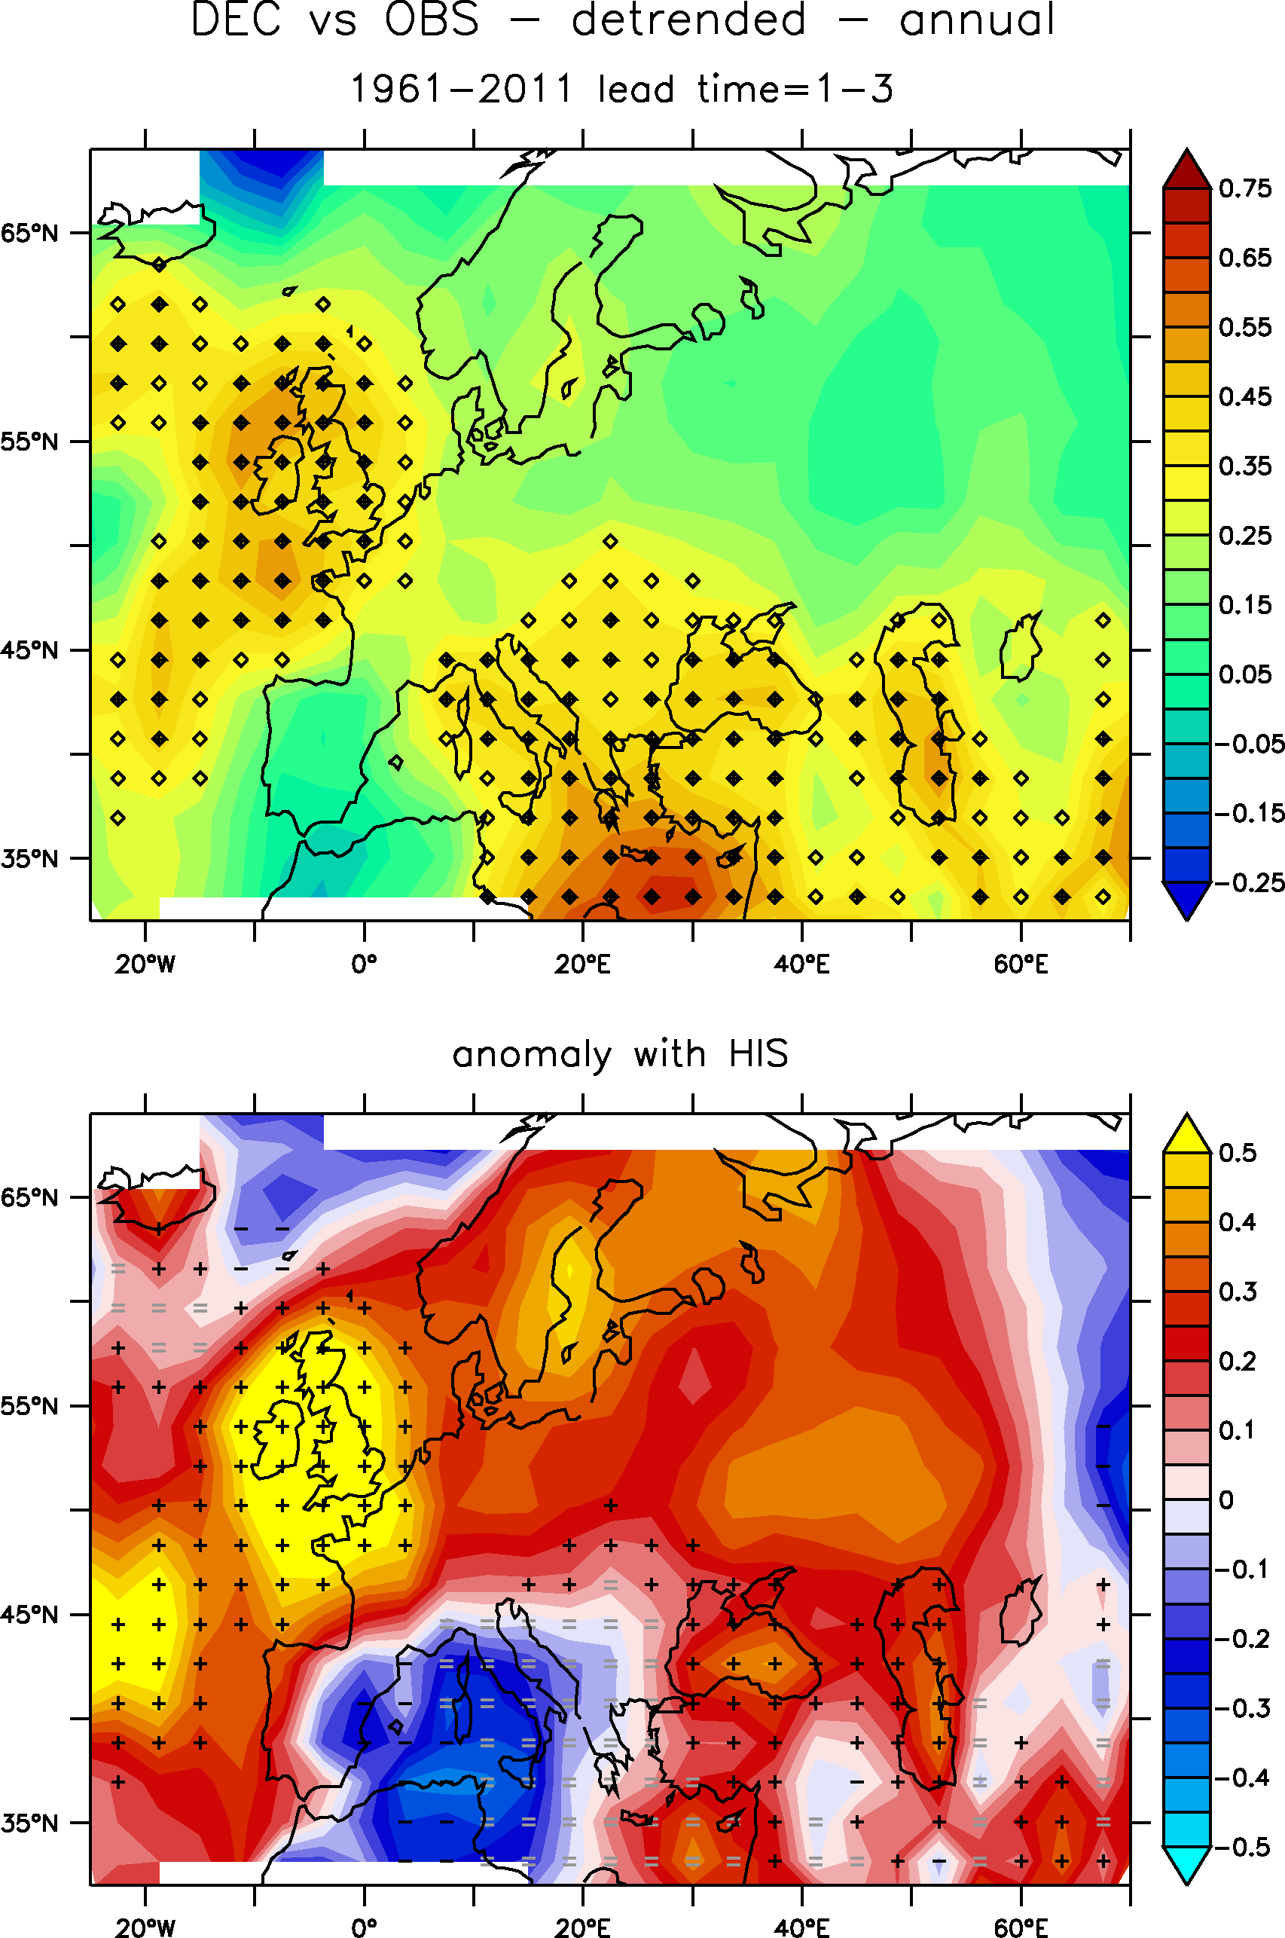
Skill over Europe
ACC for detrended annual mean T2M, LT 1-3 yrs vs. HadCRUT4
On-going analysis of the performance of our decadal prediction system over Europe
Some further skill over Europe as compared to historical for 2-meter temperature, although it remains small and mainly over the UK
ACC anomalies as compared to historical simulations

Slide 4
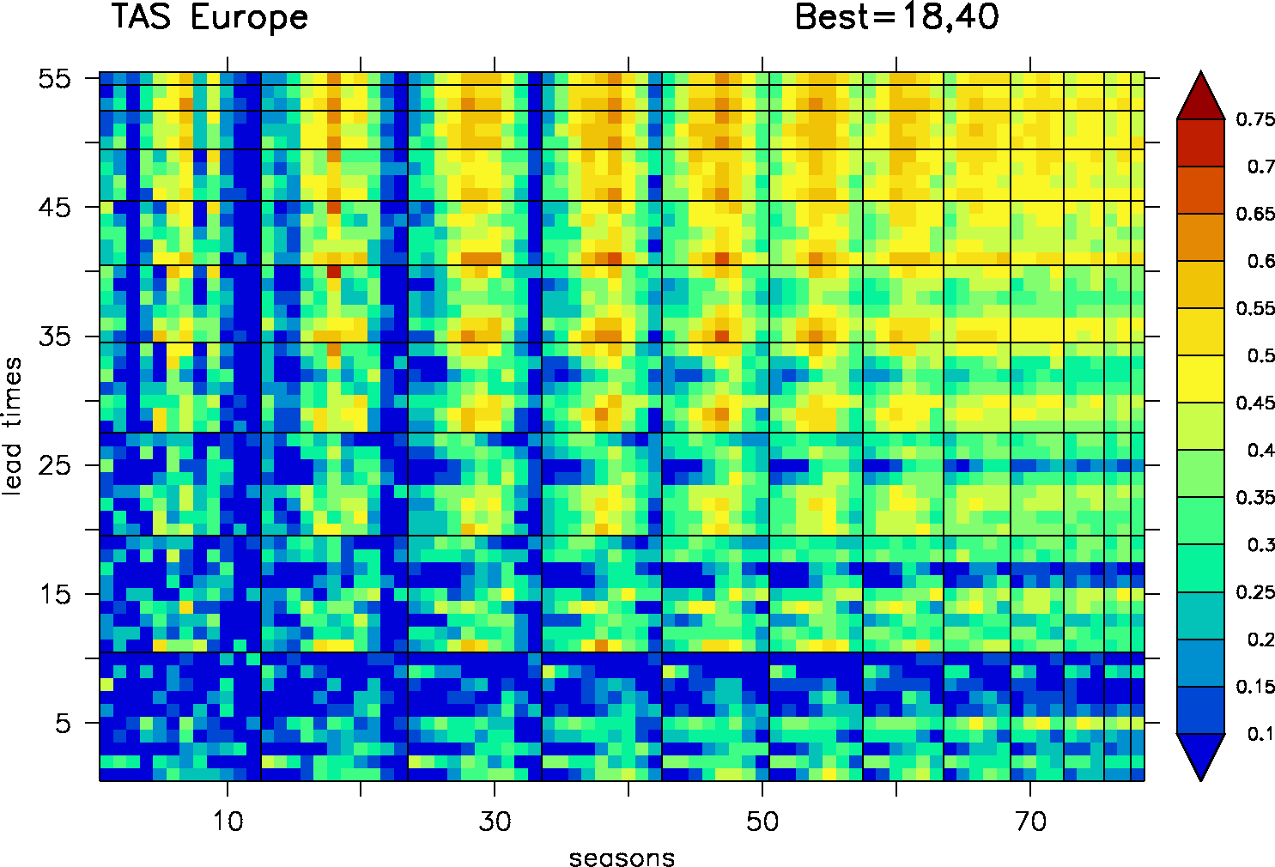
Windows of opportunity
Lead time
Season
Time window
Evaluation of differences in skill for different seasons at the decadal time scale
Analysis of “windows of opportunity” i.e. best period for the skill over 1961-2015
And the winner is (for the moment): MAMJJAS over the period 1975-2011
But need to be performed in a more systematic manner (exploring phase space depending on months/seasons, lead times, time windows)
Detrended ACC (ref HadCRUT4) for MAMJJAS temperature, 1975-2011, Lead Time=1-3 yrs
Sgubin et al., in prep.

Slide 5
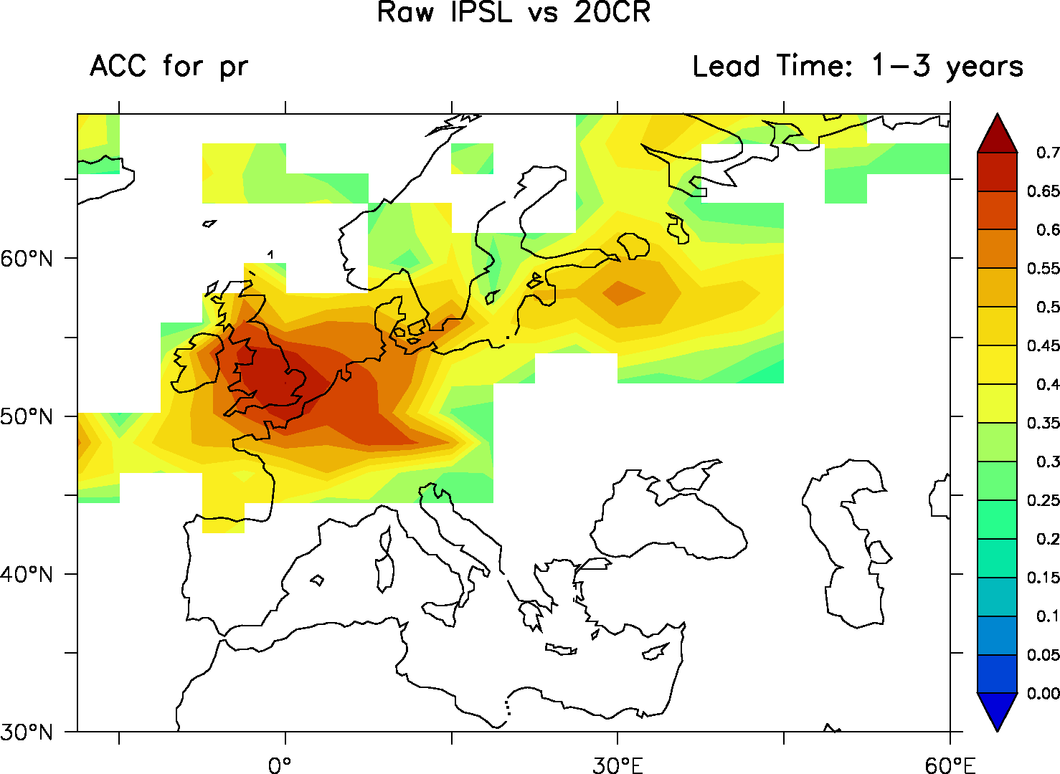
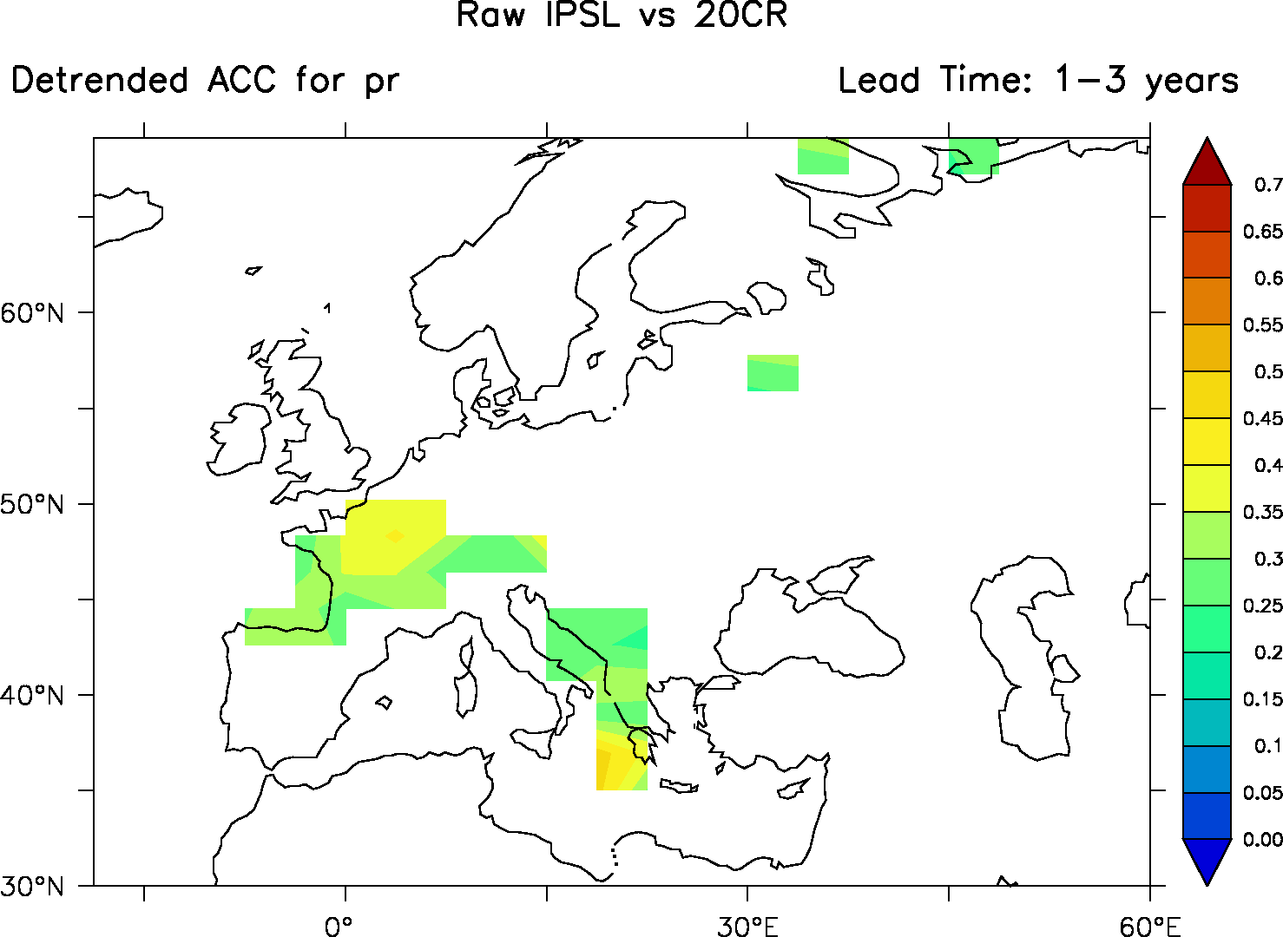
Skill for precipitations
ACC for annual mean precipitation with trend LT 1-3 years as compared with NOAA-20CR
Is there any skill in precipitation over Europe?
A little bit over France and the Balkans
Surprising given the low number of members (only 3)
Improvements through debiasing techniques? => to be evaluated soon
Same diag but for detrended data

Slide 6
“Quantile-quantile”-like methods
Classical approach: Quantile-mapping
  Gridcell G; X_{G} ~ F_{G} ; Station S; X_{S} ~ F_{S}
You want this
You know this
You obtain this
You know this
One gridcell
Reference
Equality of distributions
X_{G}
X_{S}
~ F_{G}
~ F_{S}

Slide 7
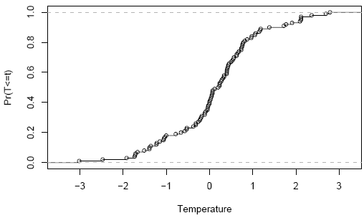
“Quantile-quantile”-like methods
Classical approach: Quantile-mapping
  Gridcell G; X_{G} ~ F_{G} ; Station S; X_{S} ~ F_{S}
  Visual interpretation: QQplot (between F_{S} and F_{G})
Model
Observations
proba α
proba α
Bias corrected data
New data x_{G}

Slide 8
“Quantile-quantile”-like methods
Classical approach: Quantile-mapping
  Gridcell G; X_{G} ~ F_{G} ; Station S; X_{S} ~ F_{S}
  Visual interpretation: QQplot (between F_{S} and F_{G})
First paper(s): Panofsky and Brier (1958); Haddad and Rosenfeld (1997)
Many variants:
Non-param.: Wood et al. (2004); Déqué (2007)
Param.: Shabalova et al. (2003); Piani et al. (2010)
CDF-t: Michelangeli et al. (2009); Oettli et al. (2011); Kallache et al. (2011); Vigaud et al. (2012); Vrac et al. (2012); Vautard et al. (2012), etc.
Bias corrected value x_{S}
Station temperature
New data x_{G}
Gridcell temperature

Slide 9
Application to decadal predictions
Debiasing performed on « fake time series » (per lead time)
Lead Times
LT6…
LT4
LT3
LT2
LT1
1961
1962
2005
Start dates

Slide 10
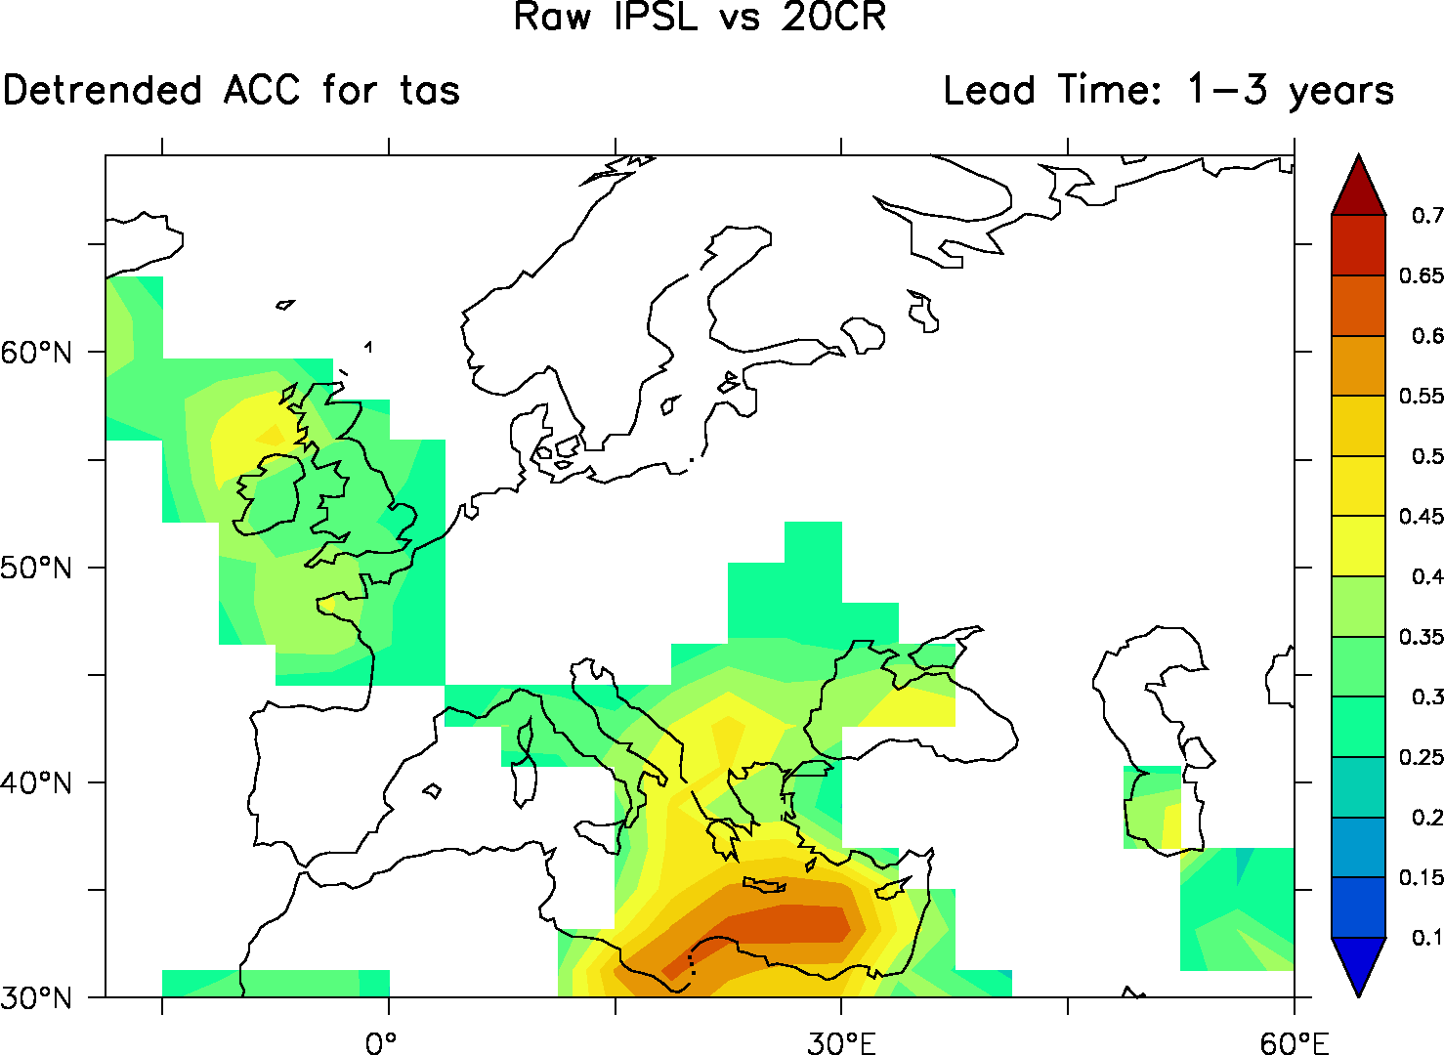


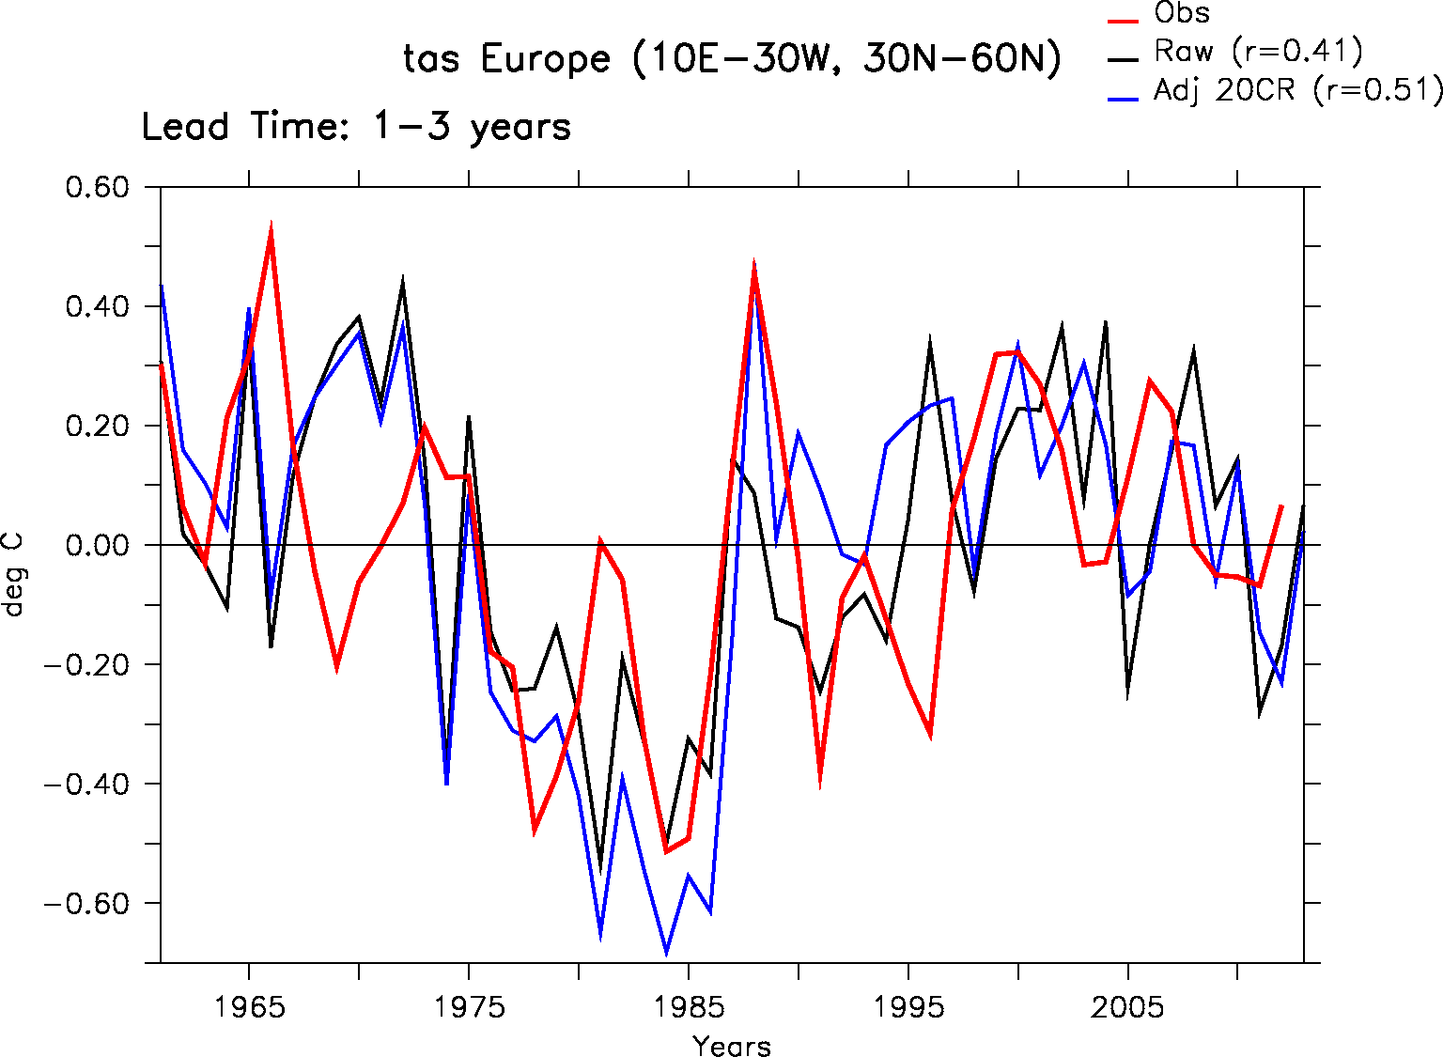
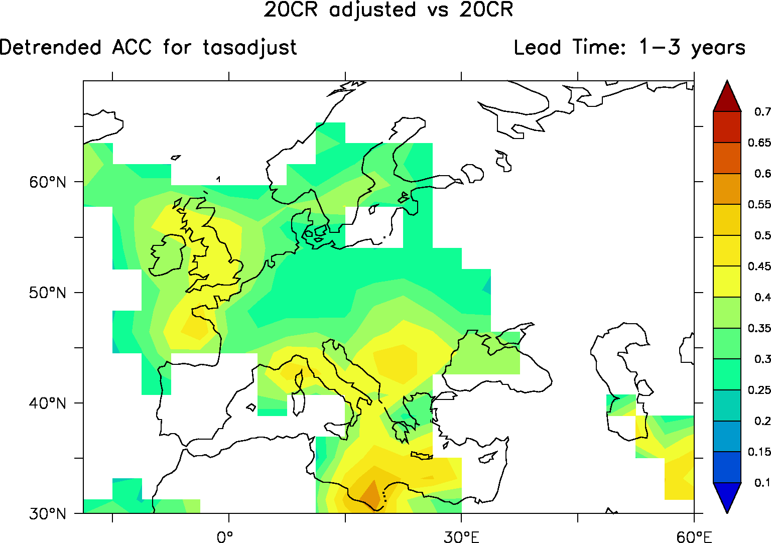
Comparison of debiased hindcasts
Detrended ACC for annual mean temperature
No debias, LT 1-3 yrs (ref. NOAA-20CR)
Use of CDF-t (cumulative distribution function - transform) statistical approach to debias the prediction
Use of NOAA-20CR and WATCH data (allowing a statistical downscaling at 50km resolution)
Slight improvements with NOAA-20CR for the predictability over Europe at the decadal time scale
=
CDF-t debias using 20CR, LT 1-3 yrs
10
10

Slide 11
Conclusions
Some skill over Europe both in temperature and precipitation
Slight improvements using CDF-t debiasing, but need to be confirmed
Outcomes for impact study: debiased hindcasts/forecasts for 1961-2025 downscaled at 50 km using debiasing technique with WATCH data
Outlook 1: systematic analysis of best windows of opportunity, seasons, lead times…
Outlook 2: further in depth analysis of debiased hindcasts with the arrival of Giovanni Sgubin as EUCP postdoc in August 2019
Outlook 3: Evaluation of the utility of downscaled hindcasts for viticulture by integrating vineyard phenological models
Outlook 4: New IPSL-decadal prediction system based on IPSL-CM6 model.
  Initialisation including SSS data from 1900 and variable surface restoring with MLD.
  10 members at least for each start date 1961-2018
  PRACE demand to increase size of ensemble, test different initialisation technique
  Start these DCPP-A simulations next week

Slide 12

Thank you!

