Slide 1


Bidecadal North Atlantic ocean circulation variability controlled by timing of volcanic eruptions
Didier Swingedouw, Pablo Ortega, Juliette Mignot, Eric Guilyardi, Valérie Masson-Delmotte, Paul Butler, Myriam Khodri

Slide 2
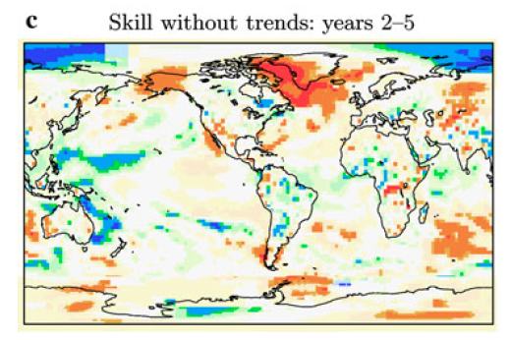
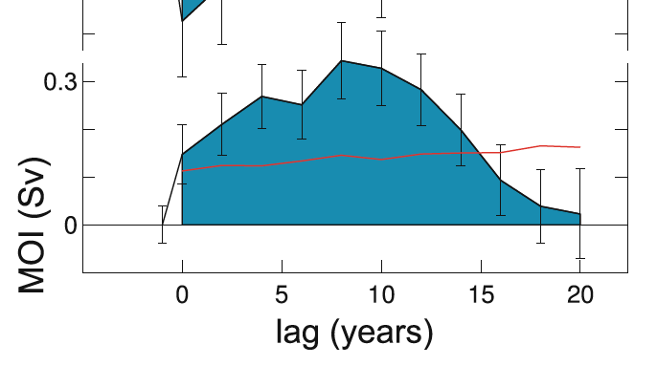
Background
t2m skill without trends: years 2-5
AMOC: a key player for decadal prediction
Volcanic impact on AMOC (Ottera et al. 2011, Iwi et al. 2010, Mignot et al. 2011…)
Bi-decadal variability in the North Atlantic:
  in several models (Frankcombe et al. 2010…)
  and in data (Chylek et al. 2011, Sicre et al. 2008, Divine & Dick 2006… )
Van Oldenborgh et al. 2012
Zanchettin et al. 2012

Slide 3
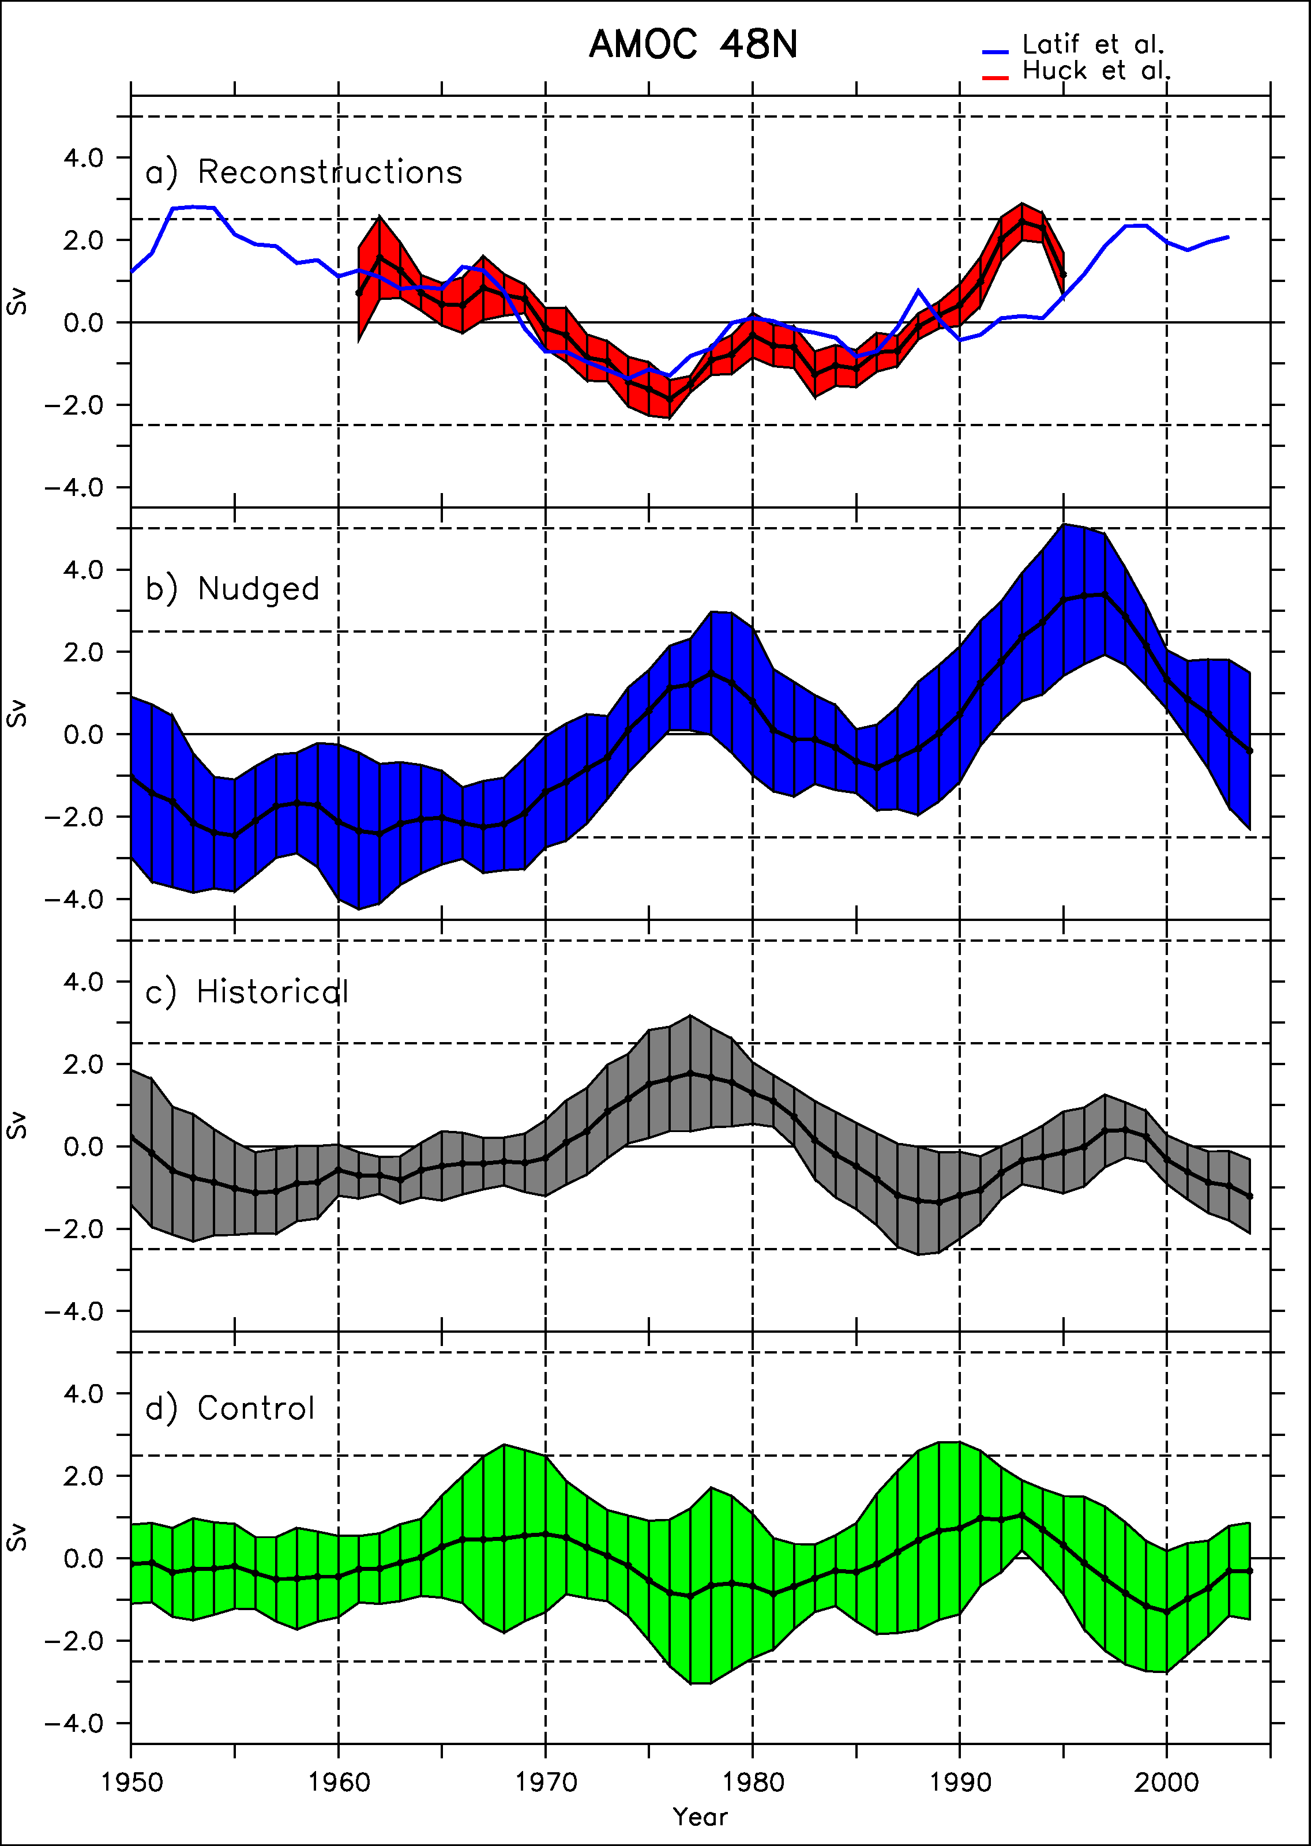
AMOC Initialisation
Reconstructions
Obs. (Huck et
IPSLCM5A-LR simulations nudged or free (with observed external forcings)
Two reconstructions of the AMOC
Agreement between nudged and reconstructions
Synchronisation also in the historical simulations
Nudged
Historical
Control
Swingedouw et al., Clim. Dyn. 2013

Slide 4
20-yr cycle in IPSL-CM5A-LR
Sea ice cover -,
SLP-
negative delayed feeedback
EGC +
10
yrs
3yrs
5yrs
T,’ S’ +
convection +
2yrs
9yrs
AMOC +
Escudier et al. Clim. Dyn. 2013
Notes:
Virer ?

Slide 5
20-yr cycle in IPSL-CM5A-LR
Sea ice cover -,
SLP-
negative delayed feeedback
EGC +
10
yrs
3yrs
5yrs
T,’ S’ +
convection +
2yrs
Mt Agung eruption
9yrs
AMOC +
Escudier et al. Clim. Dyn. 2013

Slide 6
Impact of volcanic forcing
Climatic index
Agung
15 yrs
Model free
1963
1982
1991
Time
2006

Slide 7
Impact of volcanic forcing
Climatic index
El Chichon
Agung
15 yrs
1963
1982
1991
Time
2006

Slide 8
Impact of volcanic forcing
Destructive interference?
Climatic index
El Chichon
Agung
Pinatubo
15 yrs
1963
1982
1991
Time
2006

Slide 9
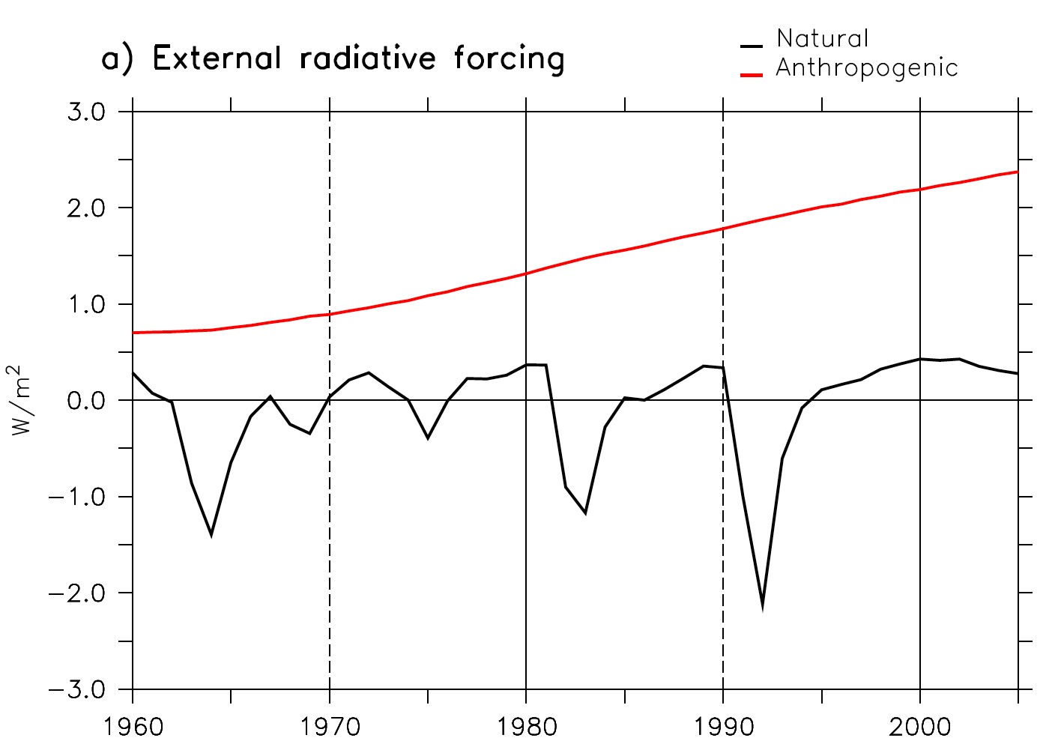
Experimental design
IPSL-CM5A-LR climate model
5-member historical ensemble (natural and anthropogenic forcing)
5-member initialised ensemble nudged with SST anomalies
5-member sensitivity ensemble without Pinatubo
CMIP5 ensemble
Comparison with existing in situ SSS data
Paleo-climate support
O
Agung
Pinatubo
El Chichon

Slide 10
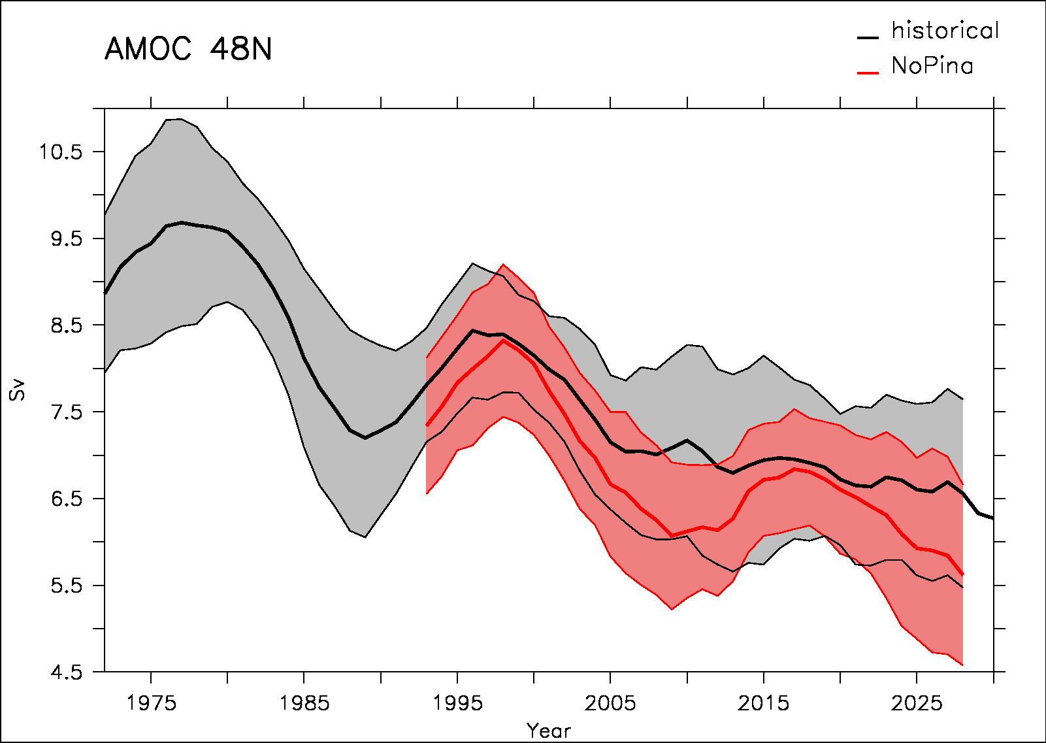
AMOC response in the IPSL-CM5A-LR model
Historical
No Pinatubo
The sensitivity ensemble without Pinatubo shows a larger decrease in the early 2000’s as compared to historical ensemble
Then a partial recovery in the late 2010’s

Slide 11
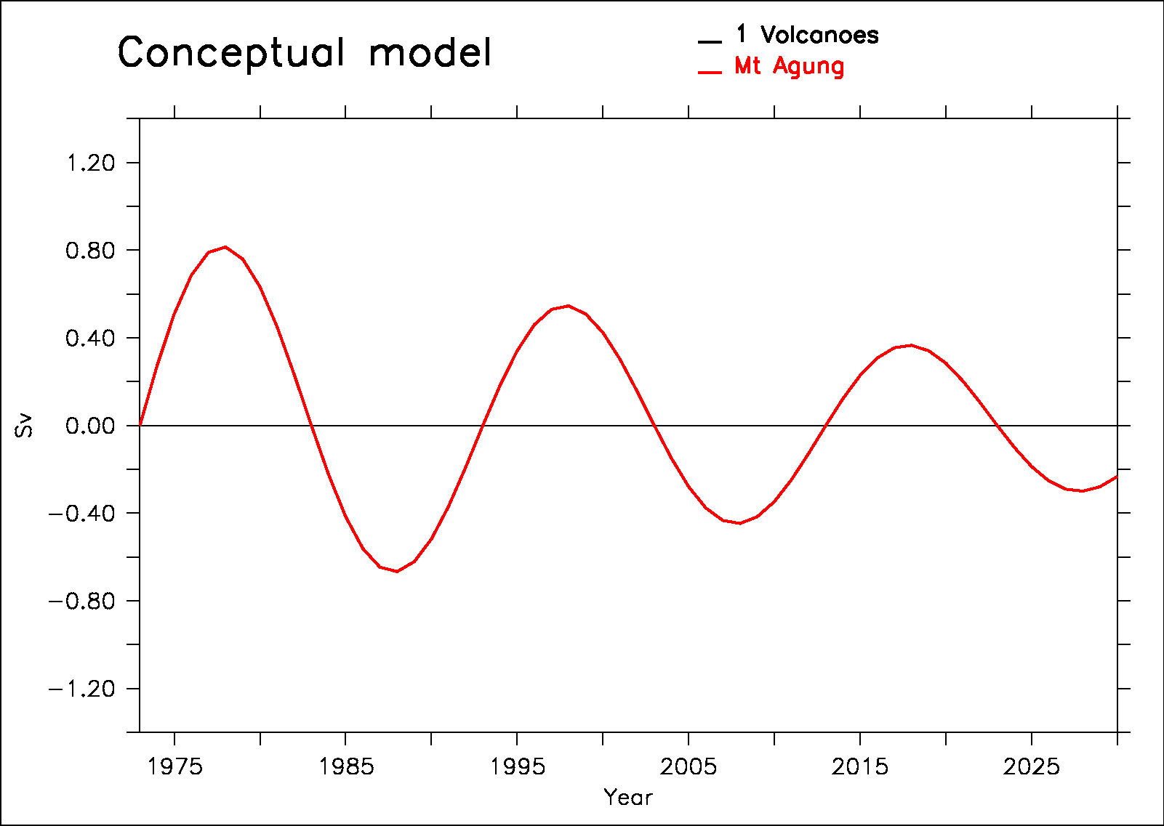
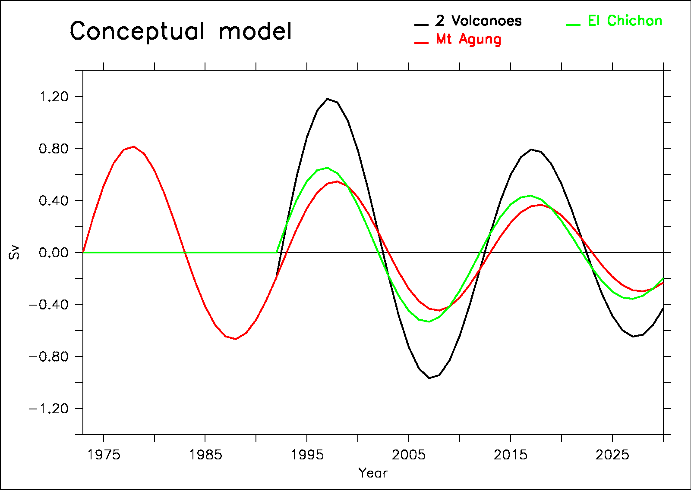
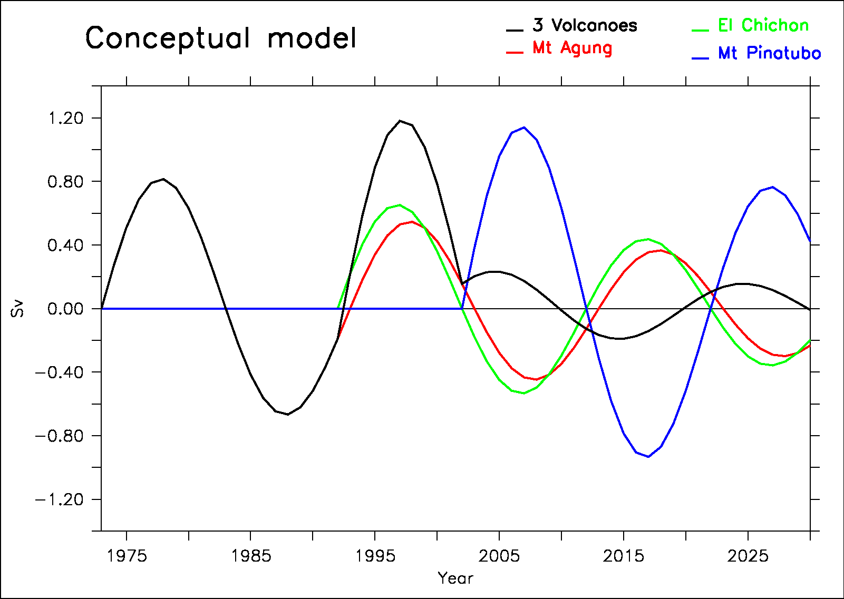
A conceptual model to explain AMOC variability in the model
We propose a conceptual model based on:
harmonic response to volcanoes
Linear response to radiative forcing (GHG)
Notes:
Mettre la somme en gras niveau 3 (le noir…)

Slide 12
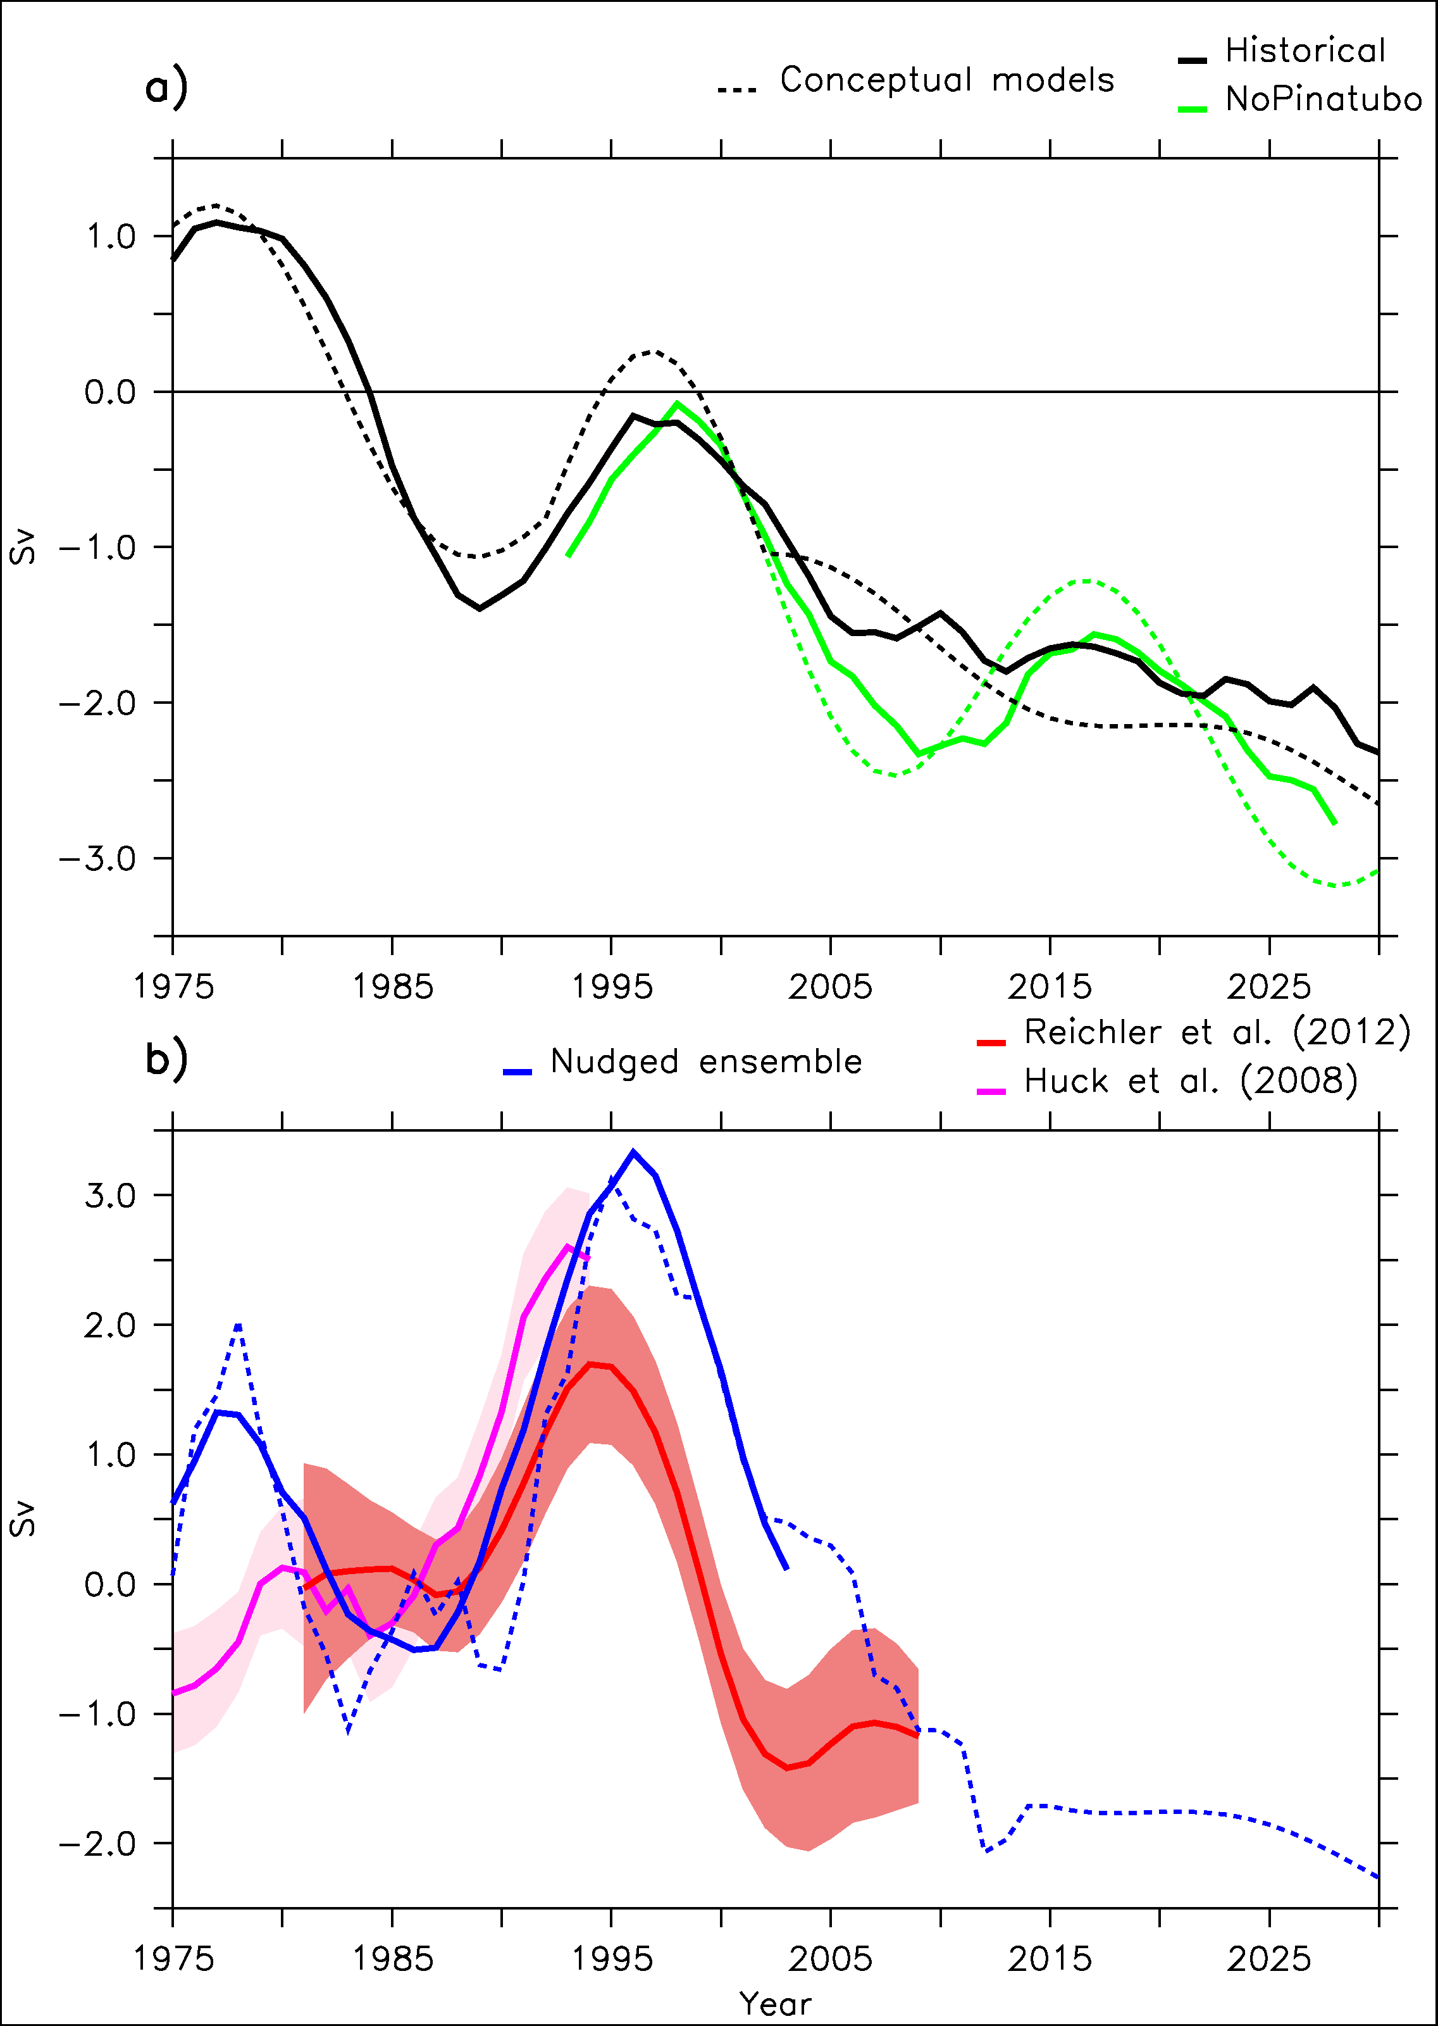
AMOC response in the IPSL-CM5A-LR model

Slide 13
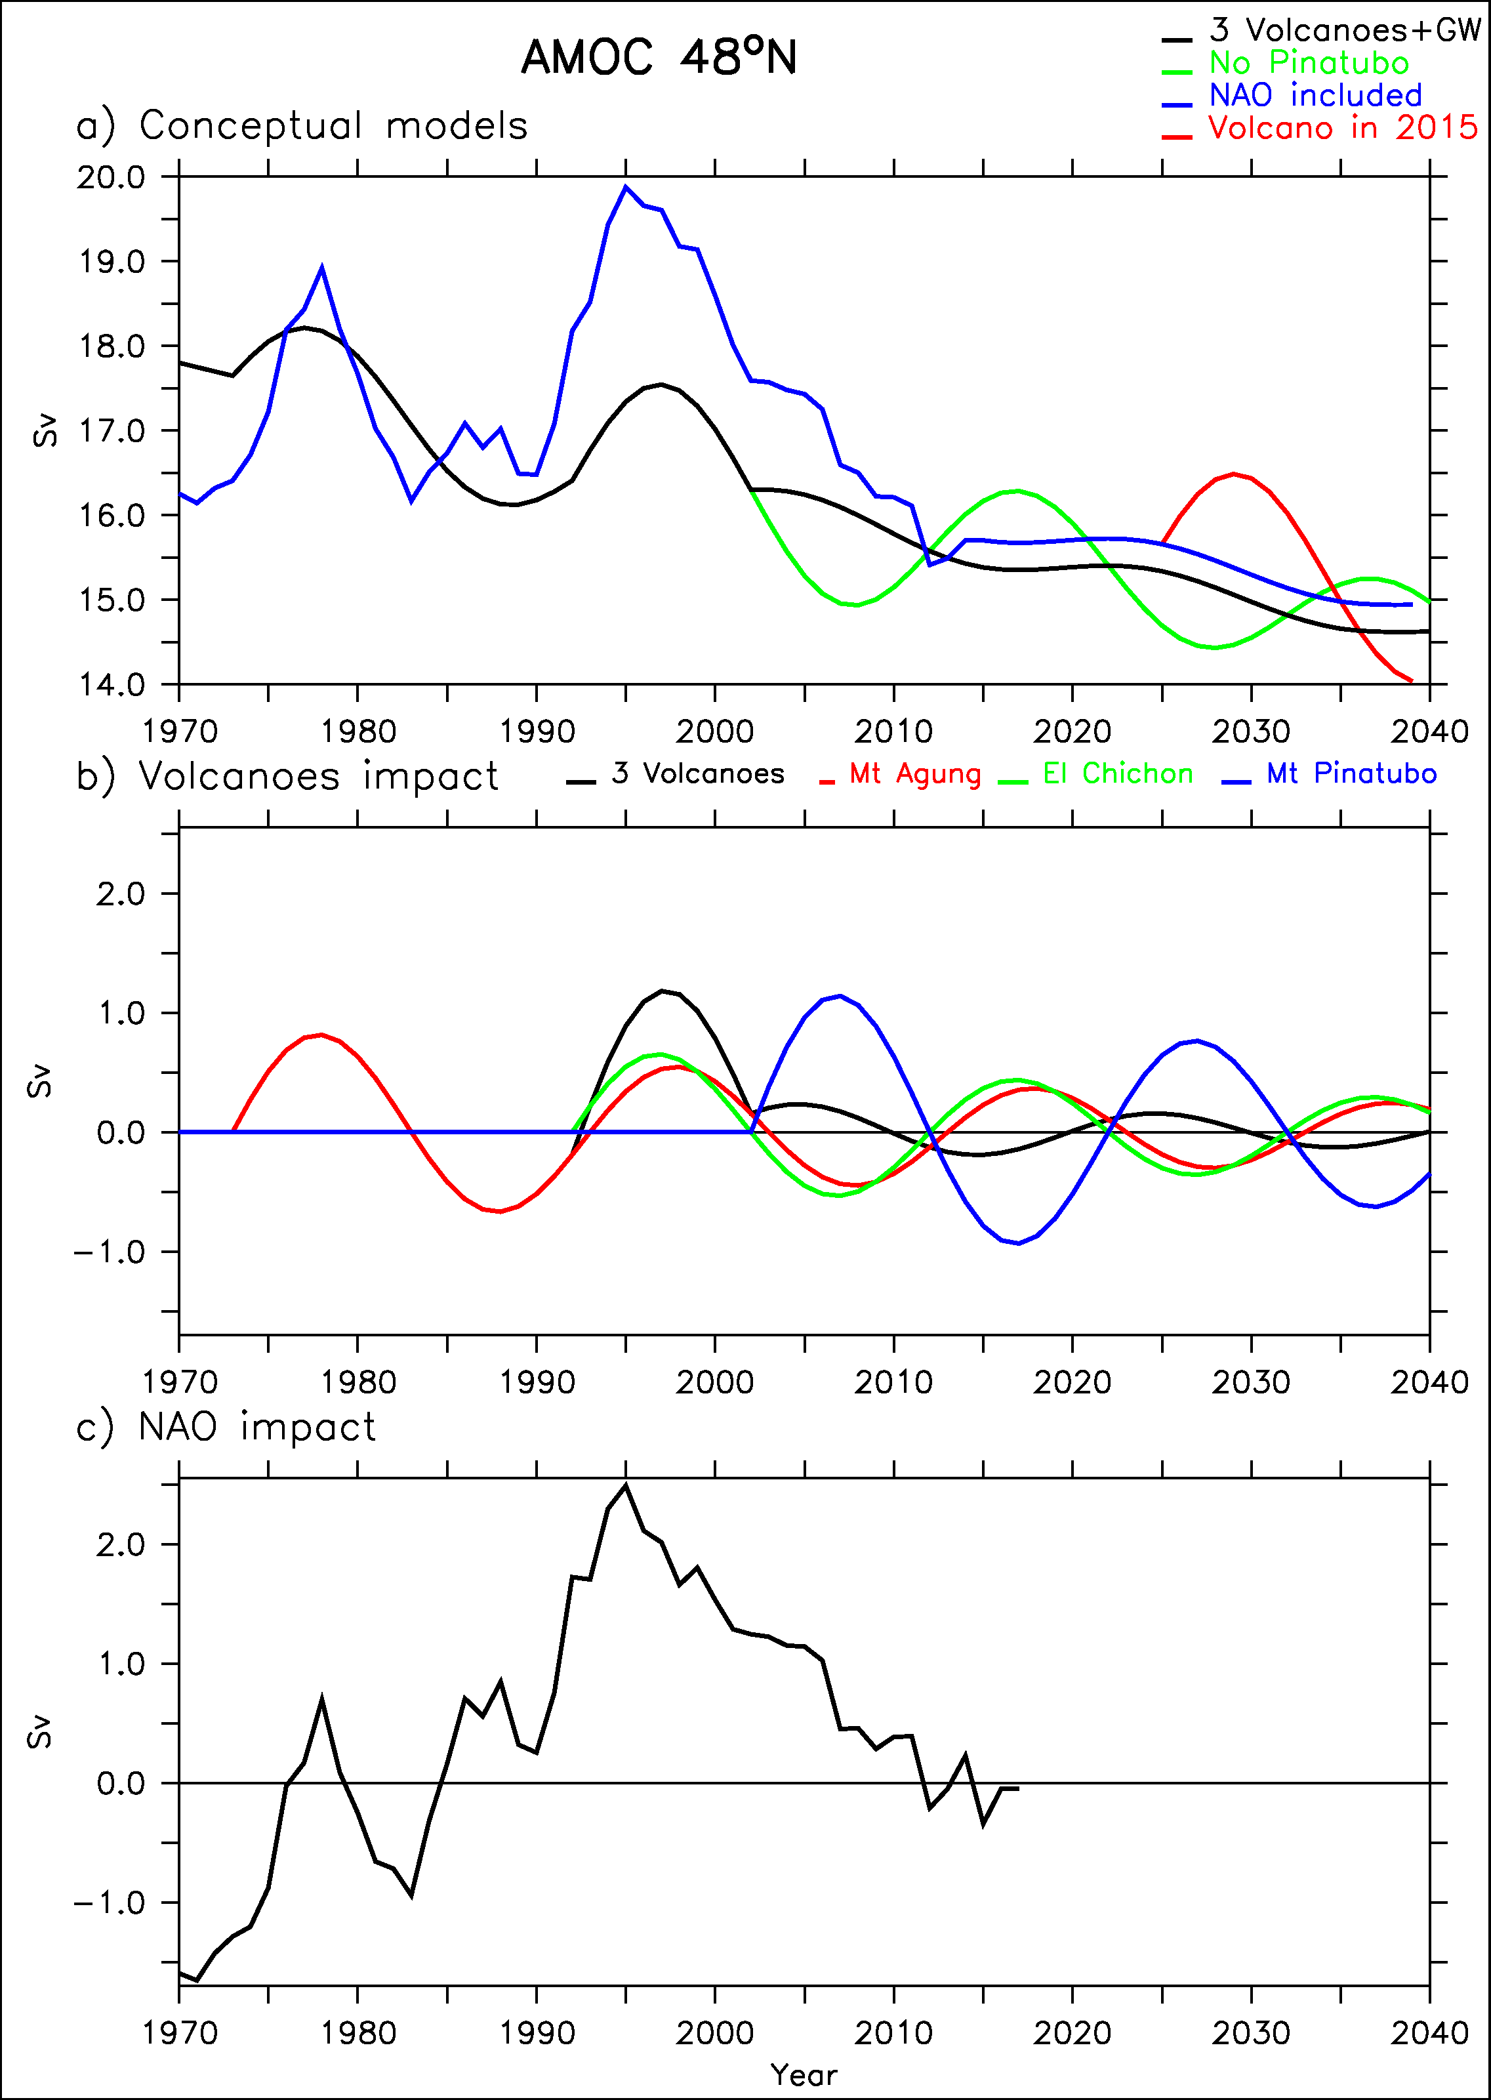
Comparison of the AMOC forcings
NAO forcing is larger than that from volcanoes
Over the period 1973-2018:
  Std volcanoes =0.54 Sv
  Std NAO = 0.93 Sv

Slide 14
Is it real?
Model dependent
Need for other lines of evidences (observations!)
AMOC response 15 years after the eruption is the key assumption that needs to be tested!

Slide 15
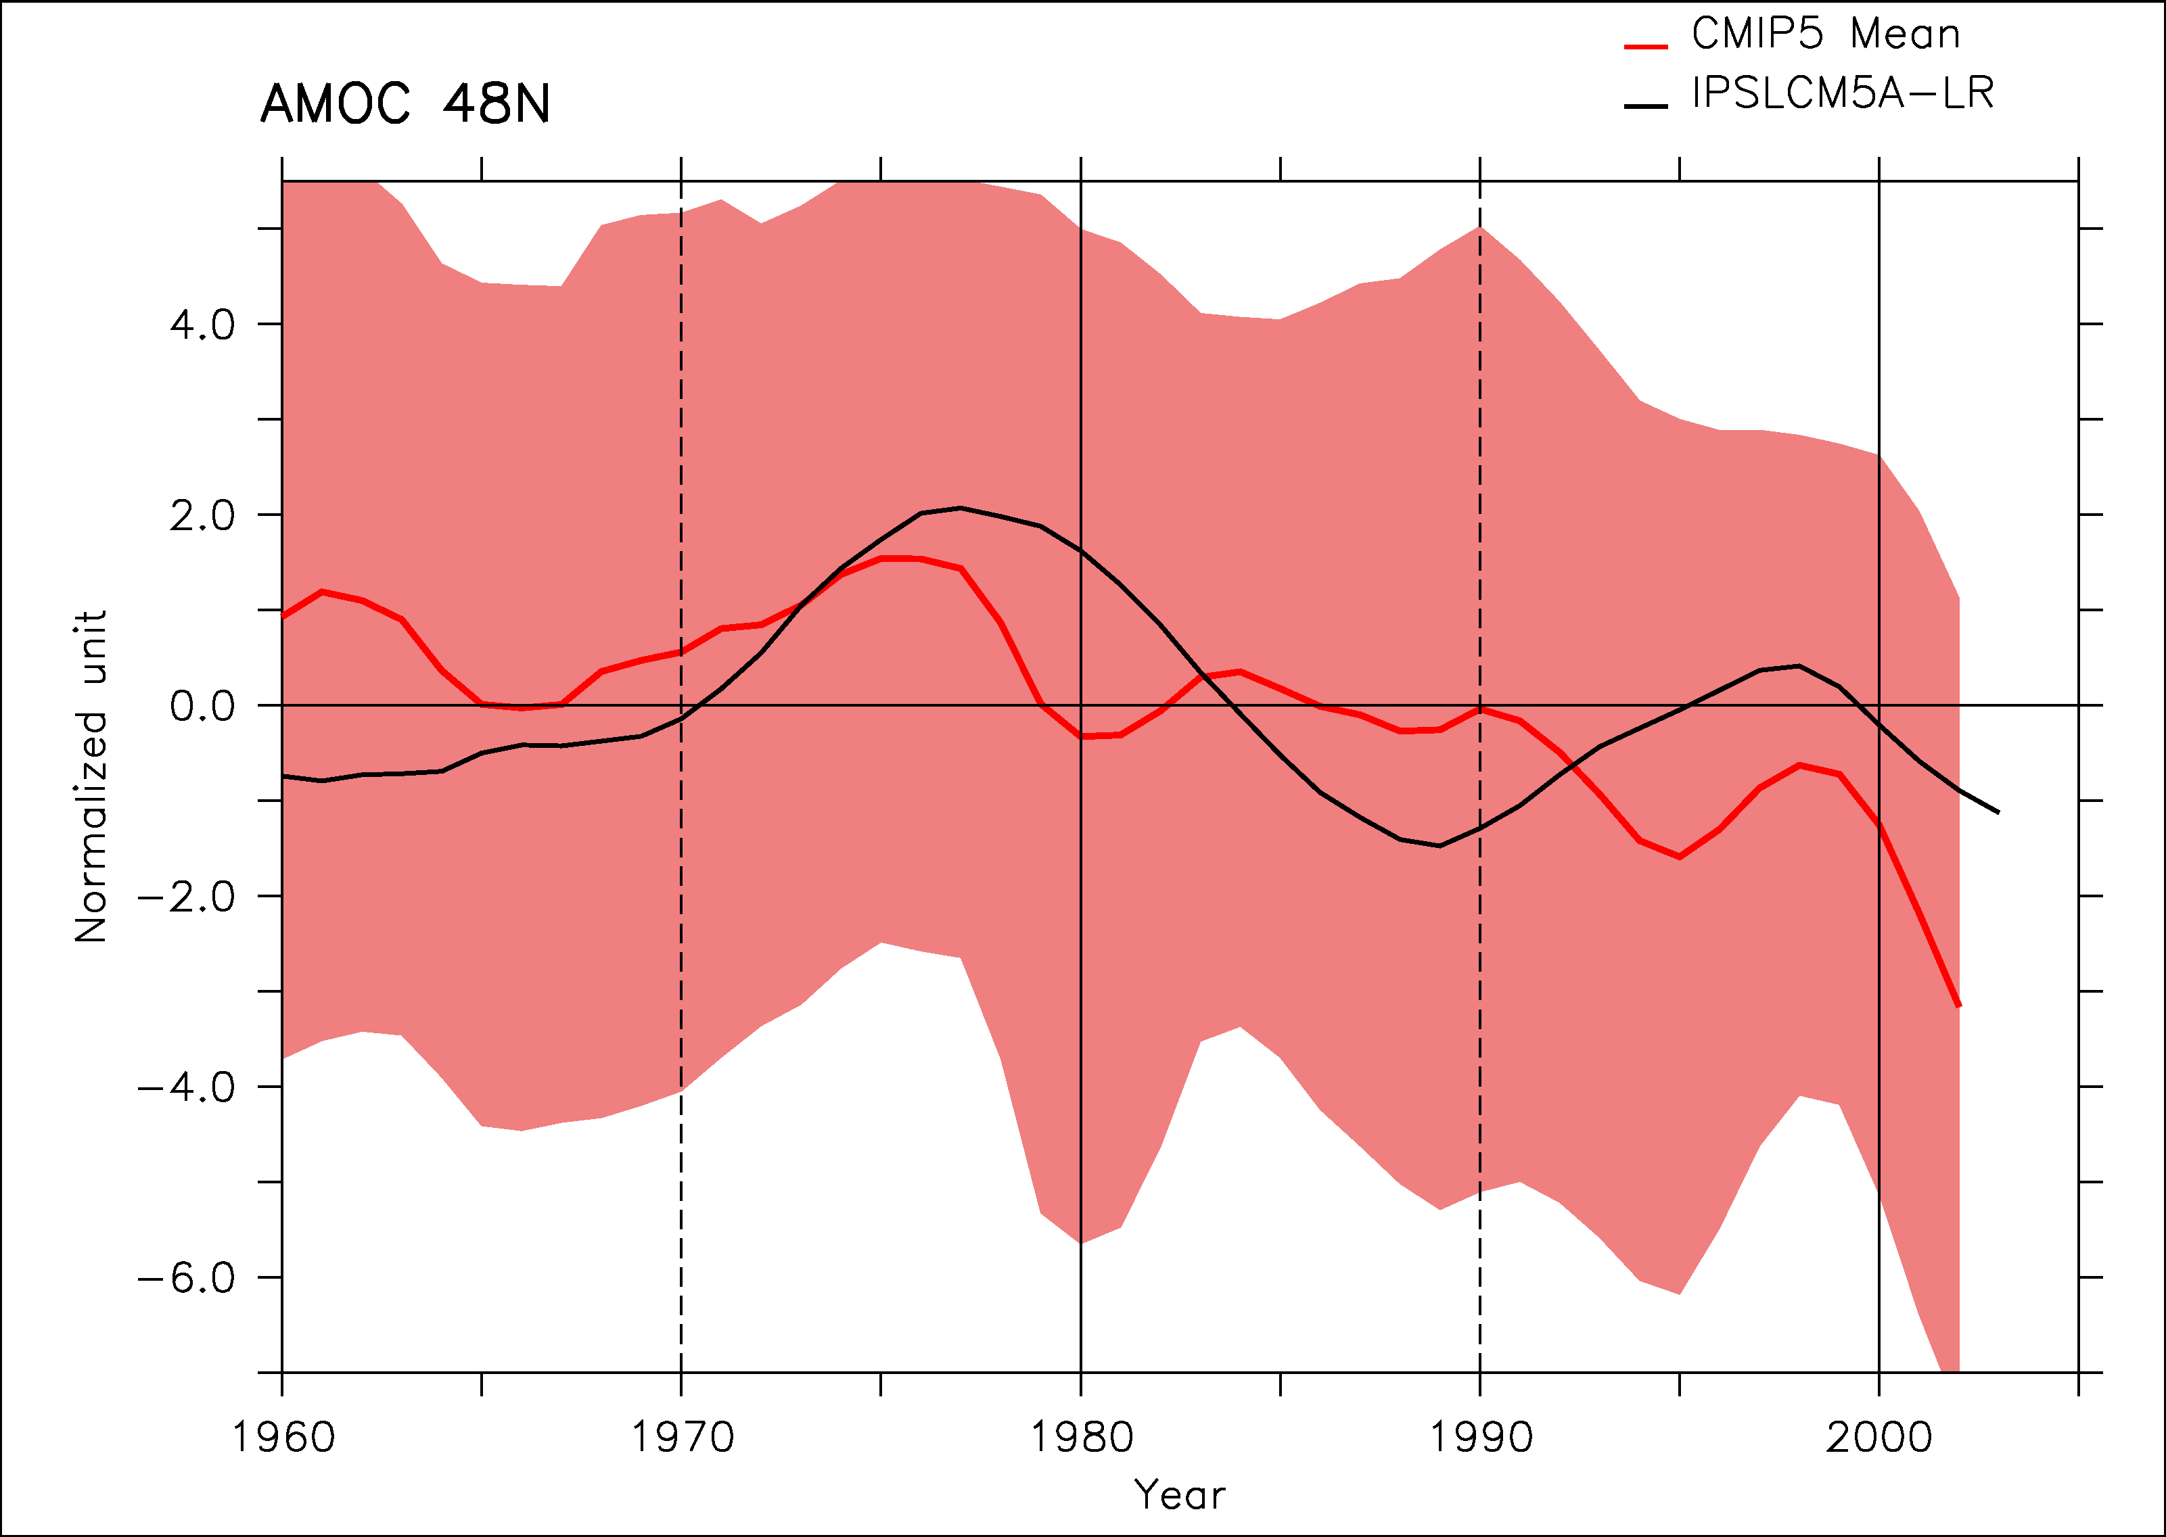
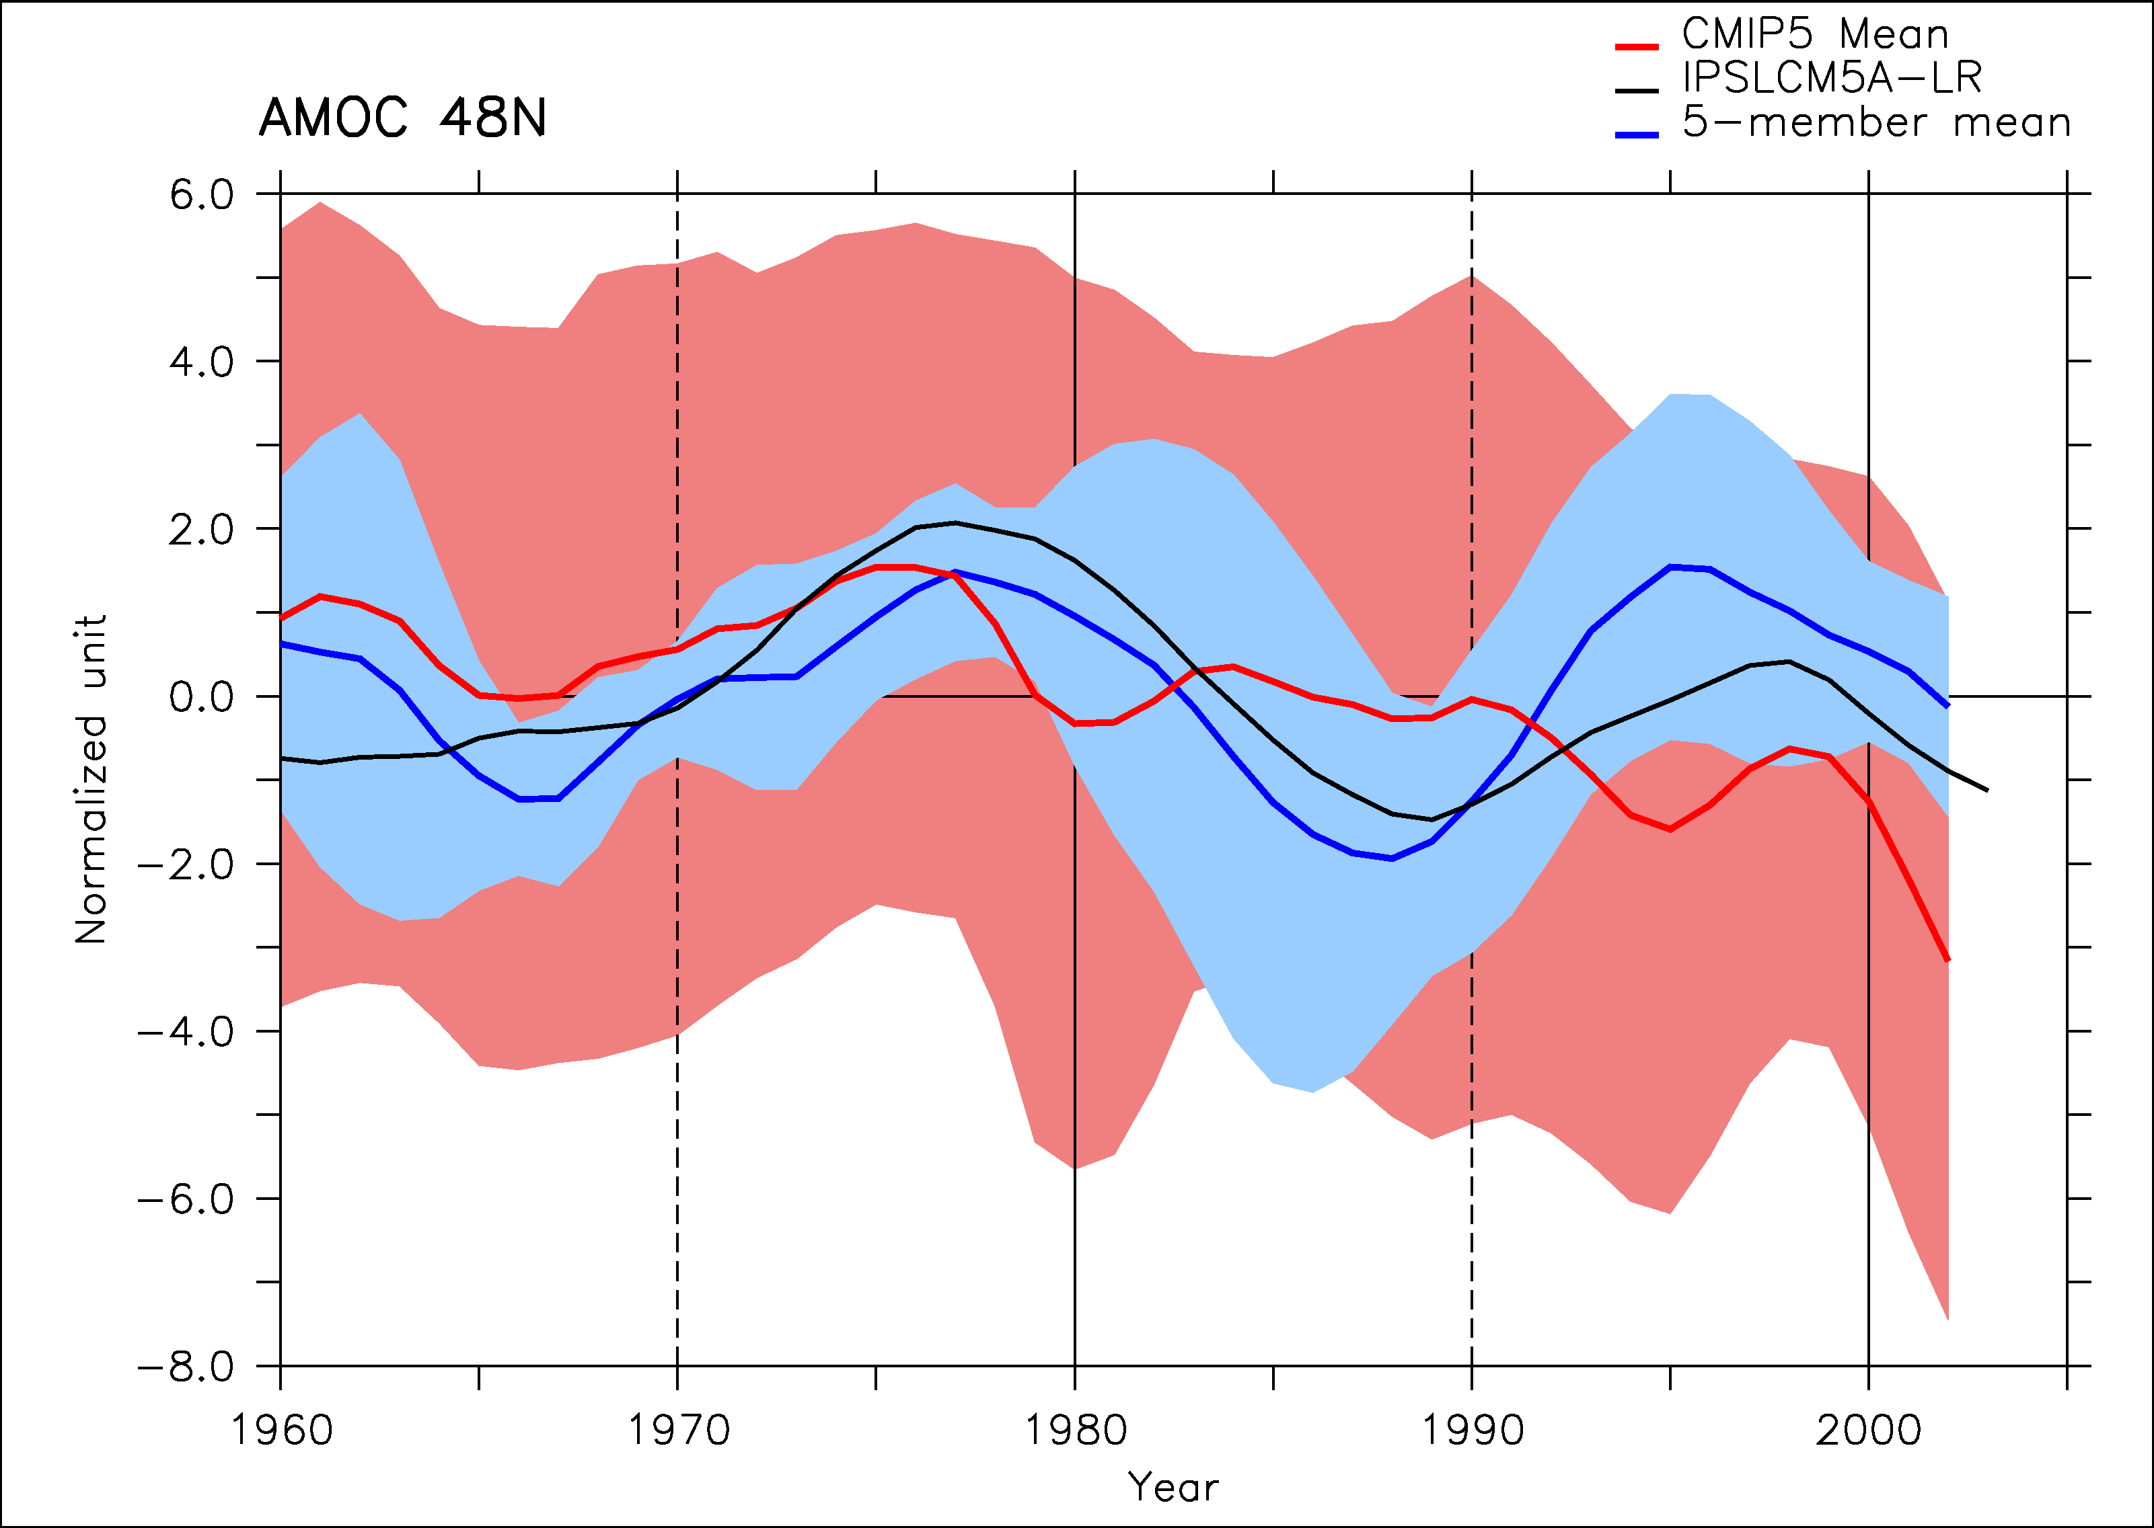
CMIP5 multi-model confirmation?
11 individual modelsfrom CMIP5 WITHOUT IPSLCM5A
The ensemble mean shows a maximum in AMOC just before 1980 as in IPSLCM5A
Large spread
5 models show a maximum of energy in the 12-30 yrs spectral band. Strong similarity of the response in these 5 models

Slide 16
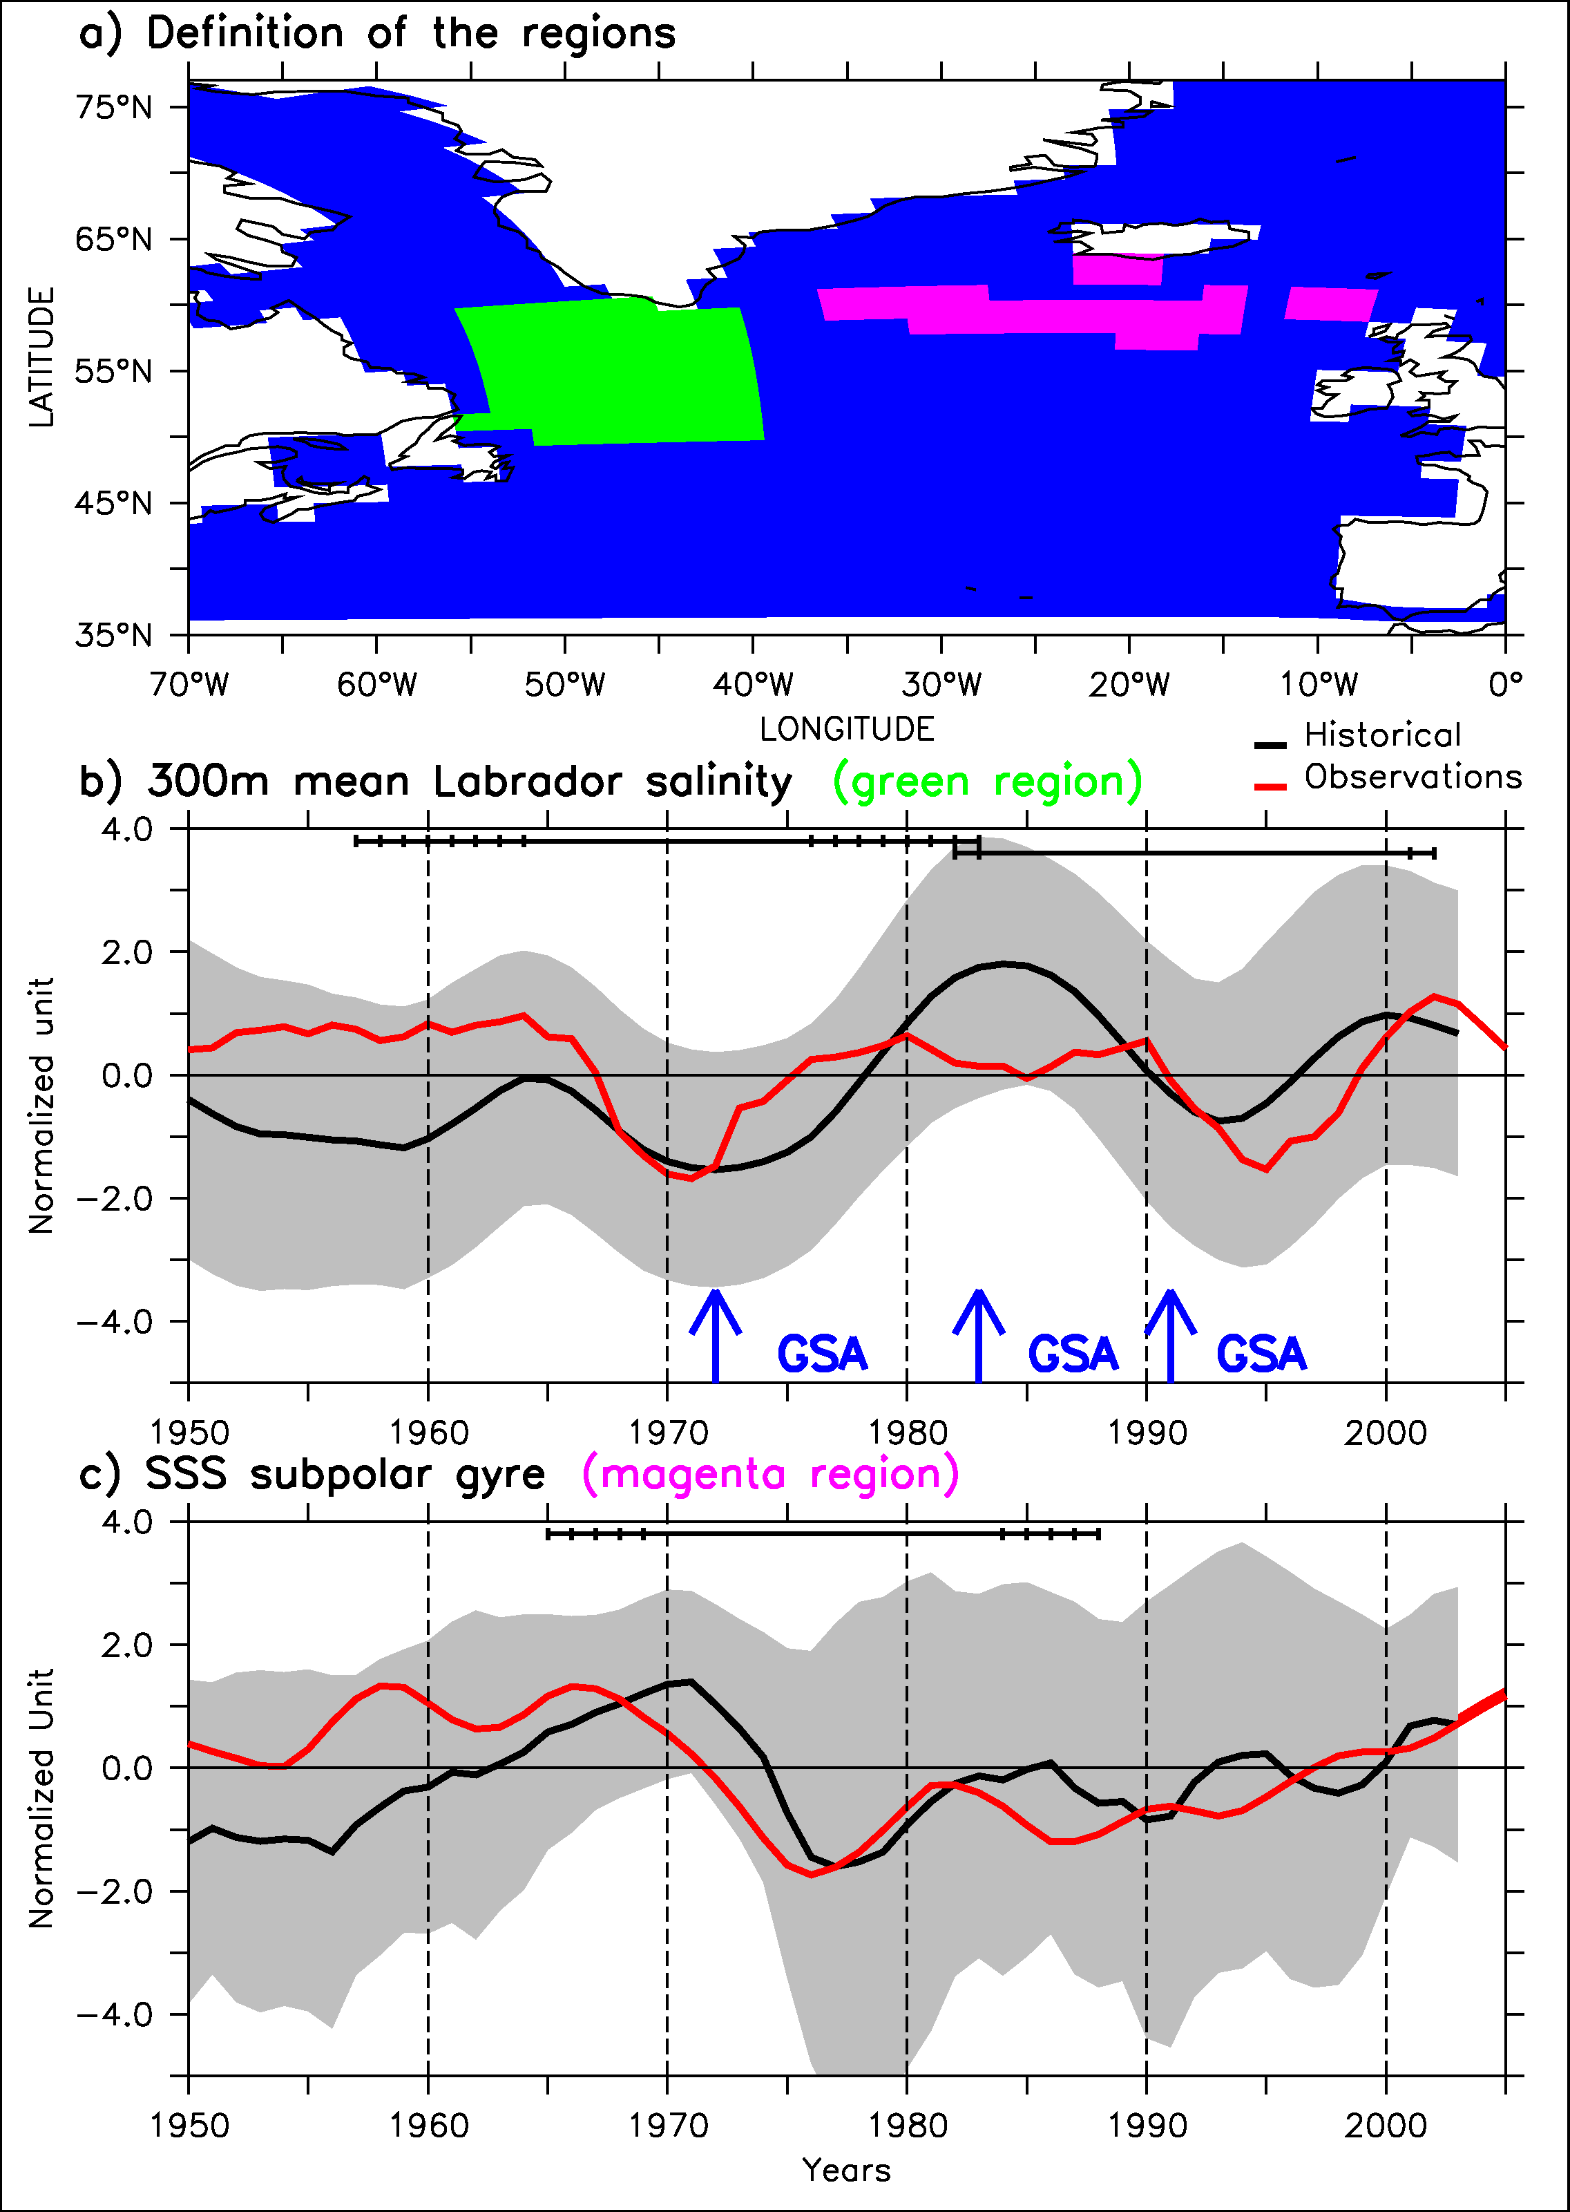
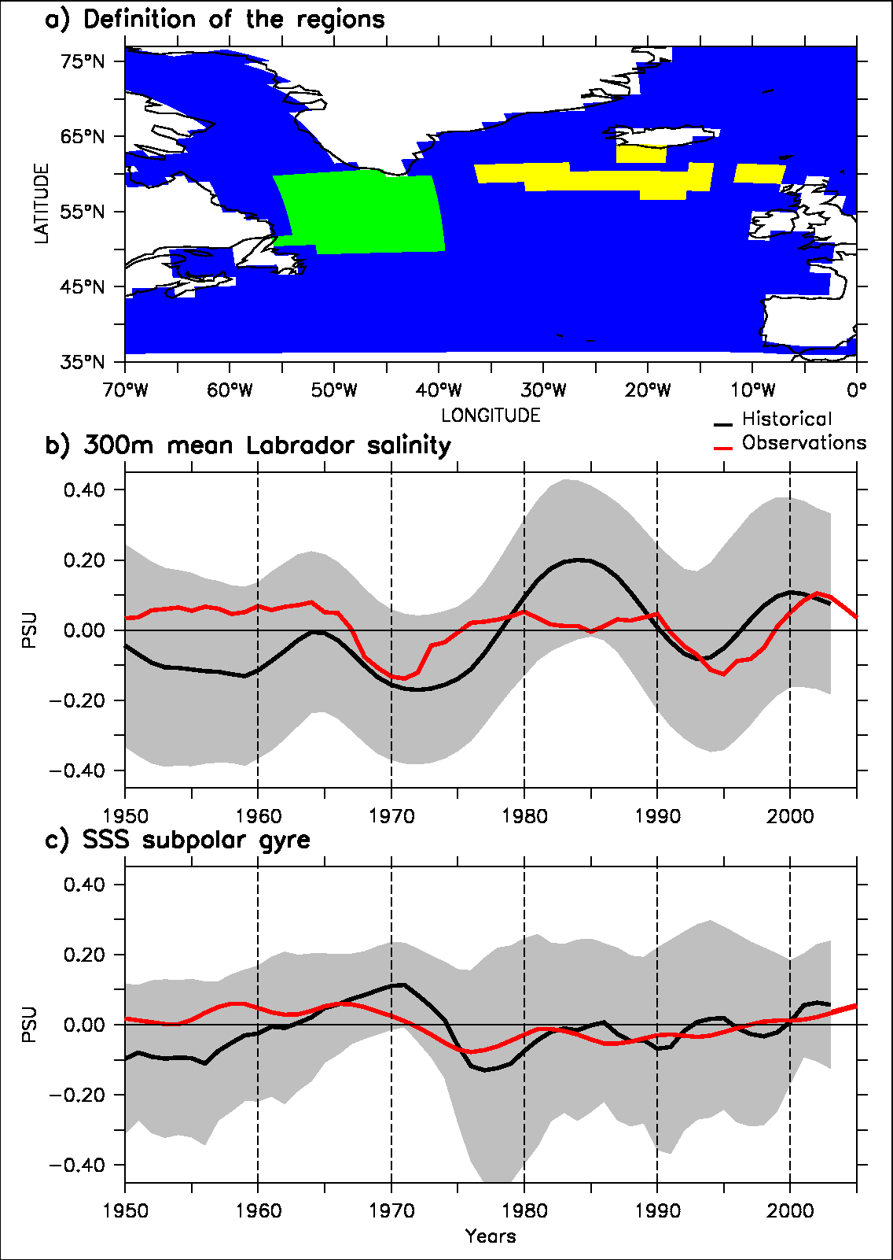
Comparison with in situ salinity data
Labrador data available from Canadian Bedford Institute of Oceanography
Reconstruction of SSS variability over the east subpolar gyre (Reverdin 2010)
Agreement between historical and data (20-yr sliding window correlation, p<0.1)
An explanation for two GSAs!

Slide 17
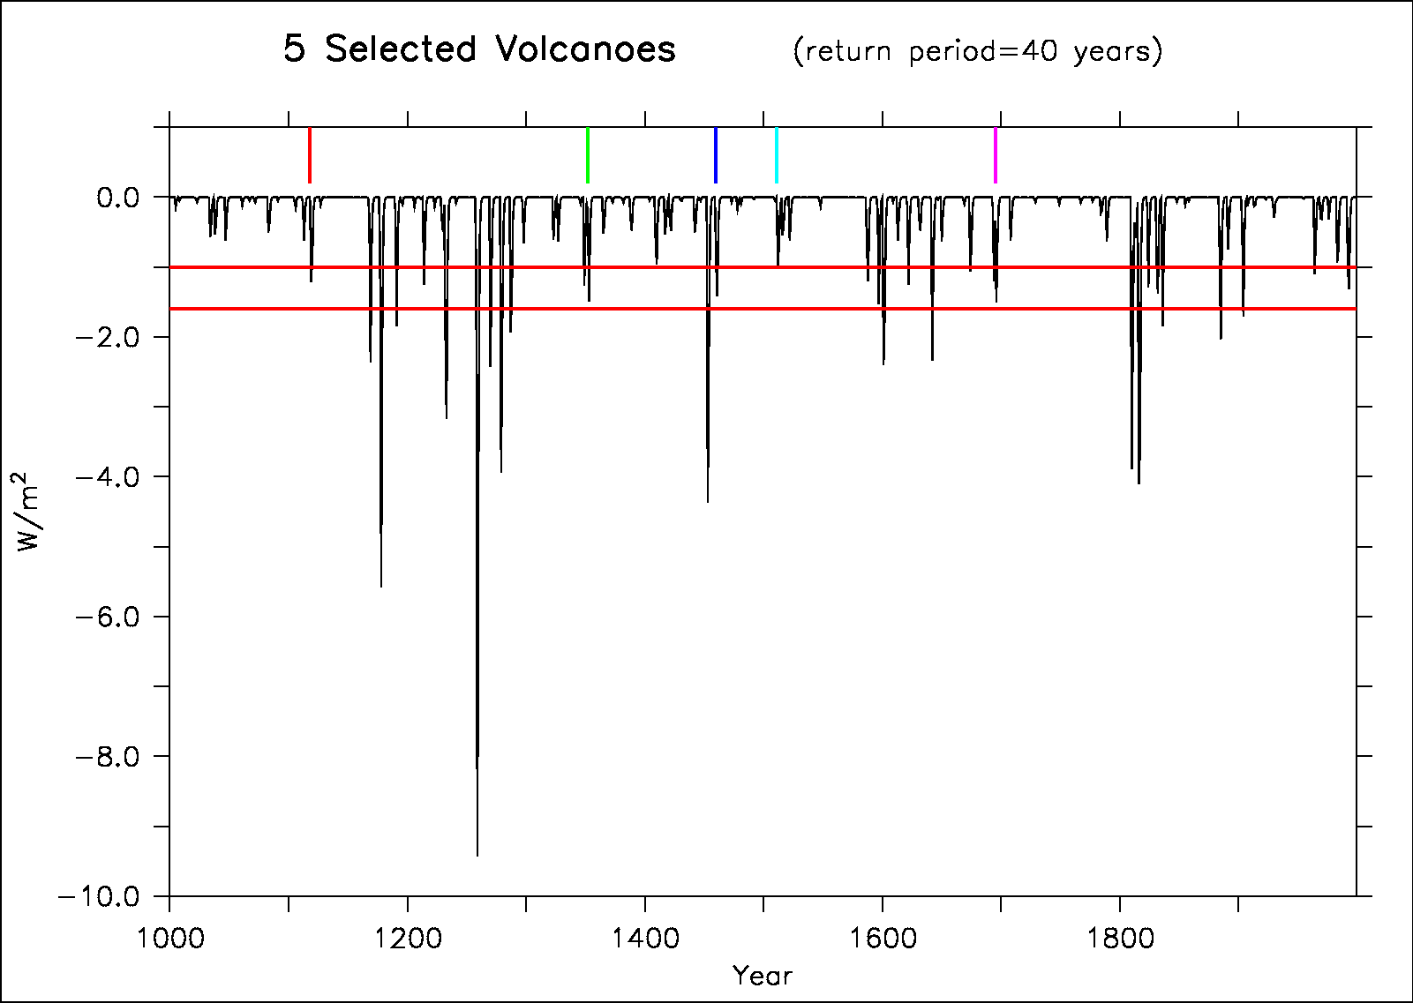
A last millennium perspective
Last millennium simulation from IPSLCM5A-LR (Khodri et al. in prep.)
We select all the volcanoes from preindustrial era that are larger than Agung but not too large
5-member ensemble

Slide 18
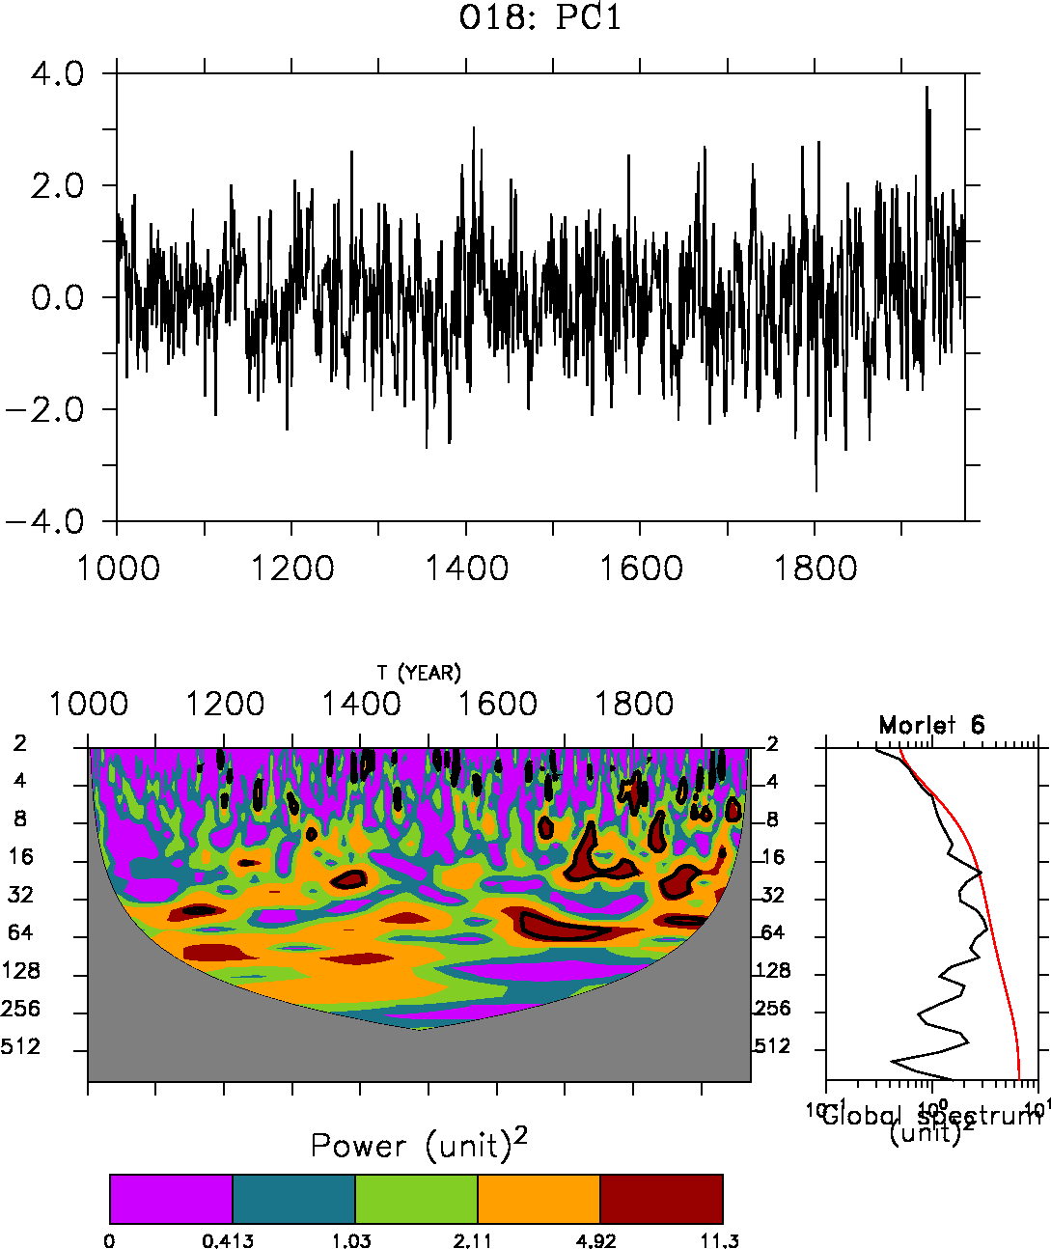
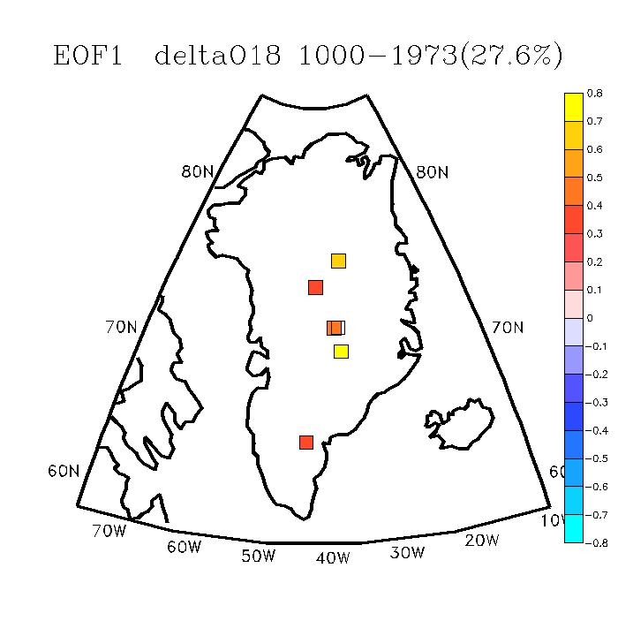
Greenland data
20-yr preferential variability in the PC1
EOF1 of a compilation of 6 ice cores reconstructing Greenland δ¹⁸O over the last millennium (Ortega et al. 2014)
EOF1 δ¹⁸O ice cores
Notes:
Explain better the link AMOC temperature: bring warm water in Nordic Seas after a delay of 5-7 years
Faire PC1-HadISST in supplementary

Slide 19
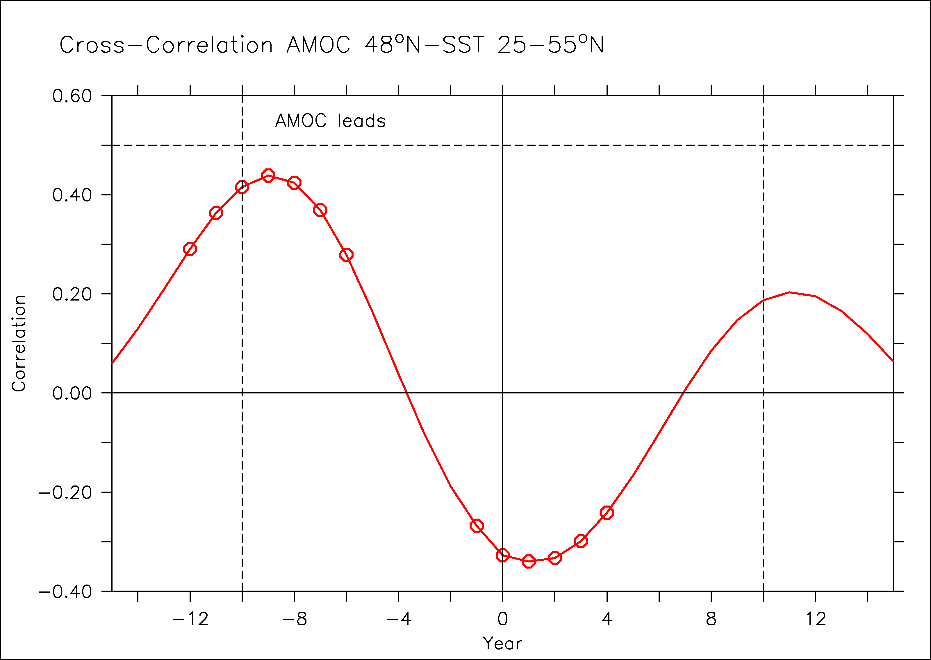
Link Greenland-AMO
Greenland as high-resolution proxy of the AMO?
AMOC leads AMO in the model by 5-10 years

Slide 20
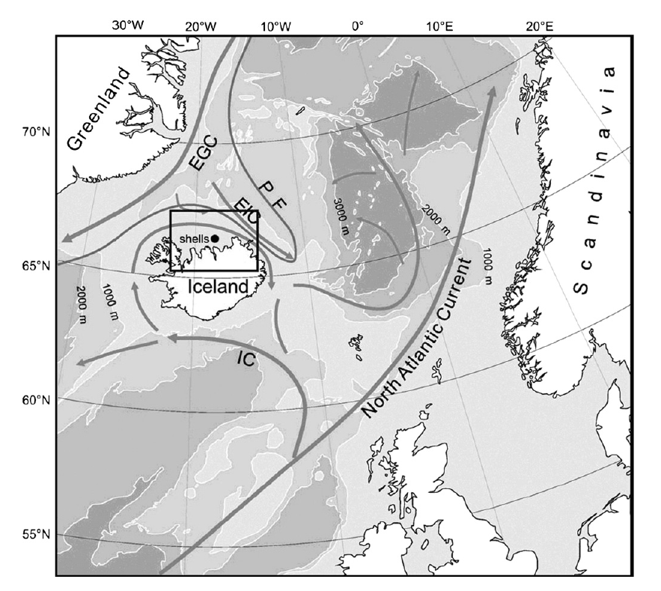
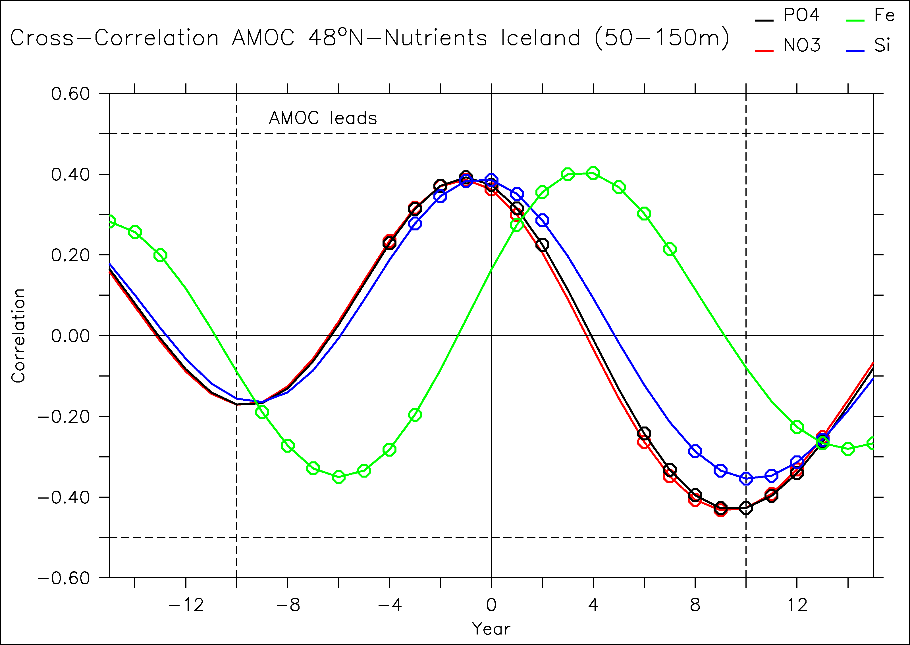
A paleo-indicator of the subpolar AMOC?
Butler et al. (2013): bivalve as a very high temporal resolution proxy
Not SST, rather related to nutrient supply
Pseudo-proxy approach: is there a link between nutrient and AMOC in the model north of Iceland?
AMOC leads nutrient supply north of Iceland by 1-3 years
Butler et al. 2013

Slide 21
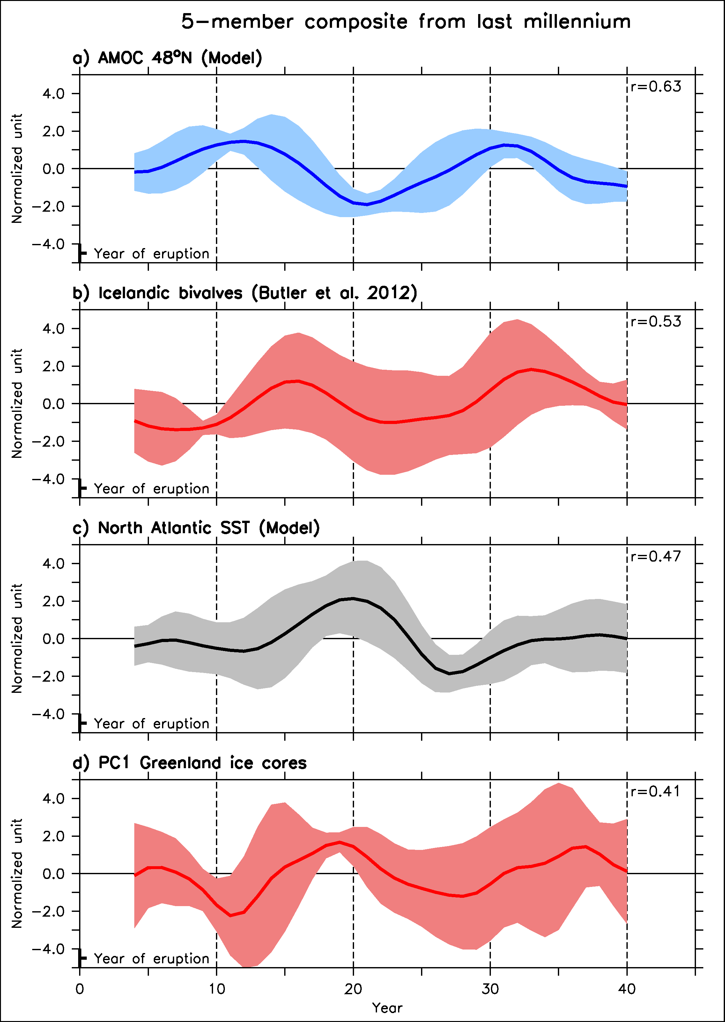
Last millennium perspective
We select the same timeseries following volcanoes in data and SST in the North Atlantic from the model
Significant correlation both in model and data, following AMOC variations by around 5 years
Notes:
Explain better the link AMOC temperature: bring warm water in Nordic Seas after a delay of 5-7 years
Faire PC1-HadISST in supplementary

Slide 22
Conclusions
Volcanic eruption precedes an AMOC maximum by around 10-15 years
Effect of Pinatubo: destructive interference!
NAO still explains large amount of variance as compared to this mechanism of 20-yr cycle excitation by volcanoes
Impact of volcanoes also very clear in a 5-member CMIP5 ensemble
Consistent with in situ salinity data in the subpolar gyre
And data of Greenland over the last millennium
large body of evidences confirming potential reality of these processes in response to volcanic eruptions

Slide 23

Thank’s!
didier.swingedouw@u-bordeaux1.fr

Slide 24
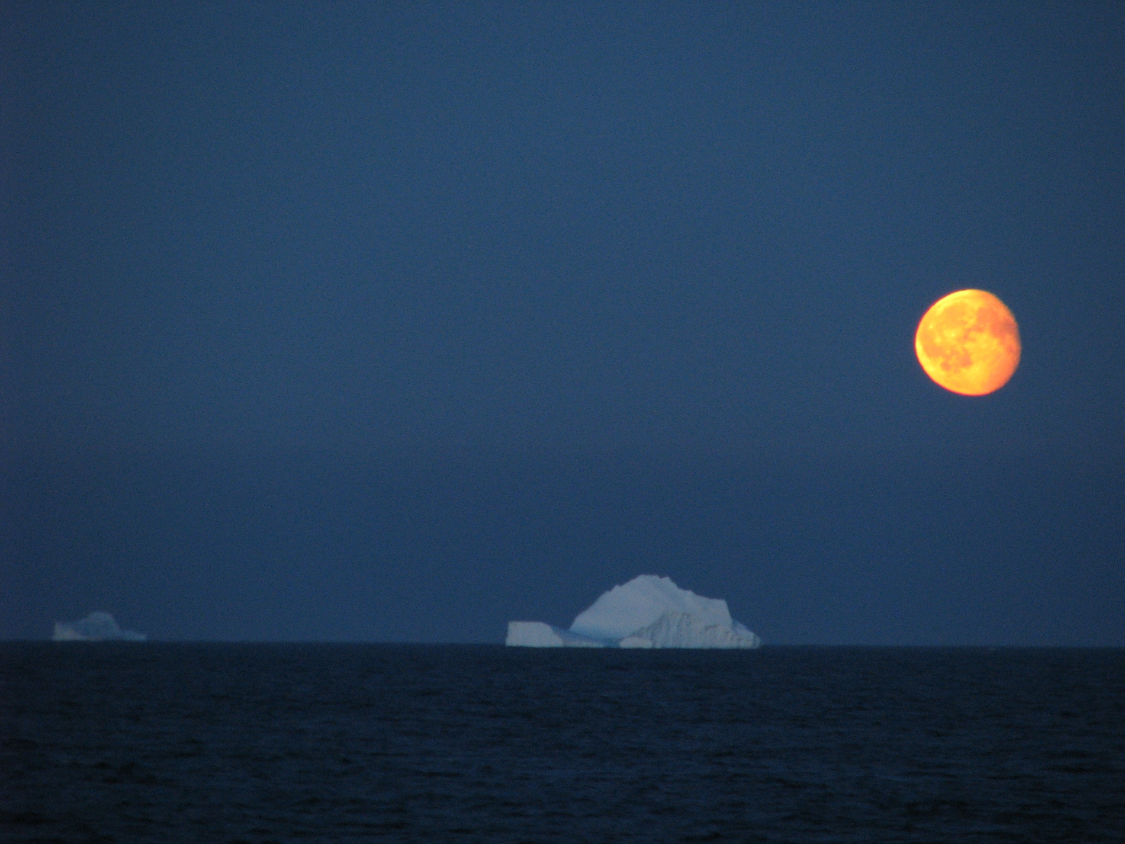
Thank you
Didier.Swingedouw@lsce.ipsl.fr
Courtesy of Bruno Ferron, OVIDE 2010

Slide 25
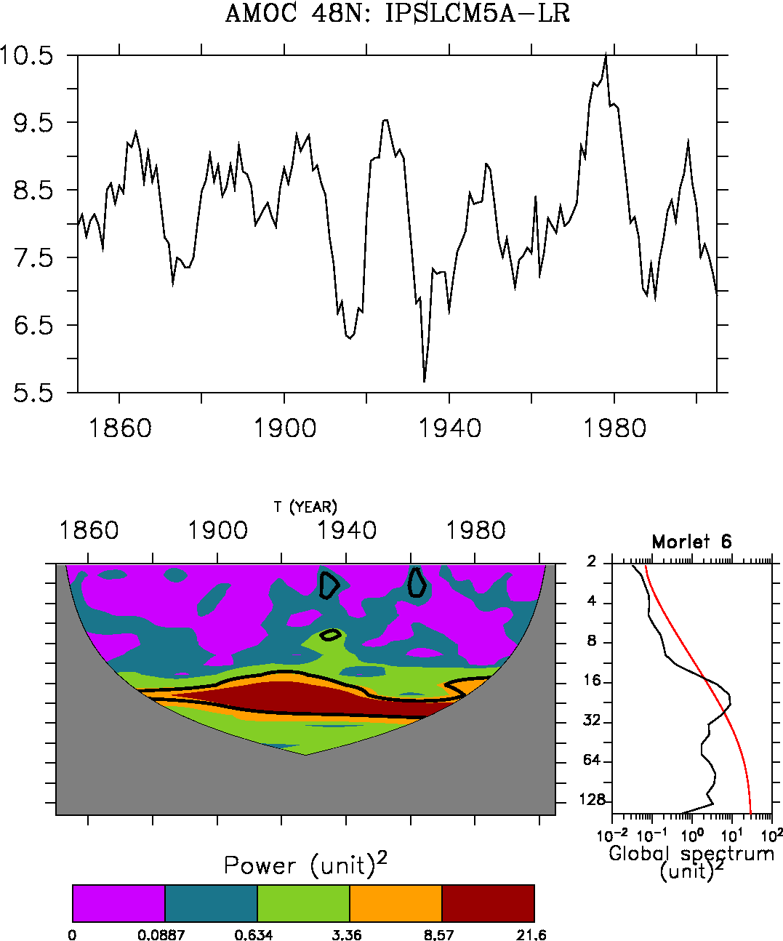
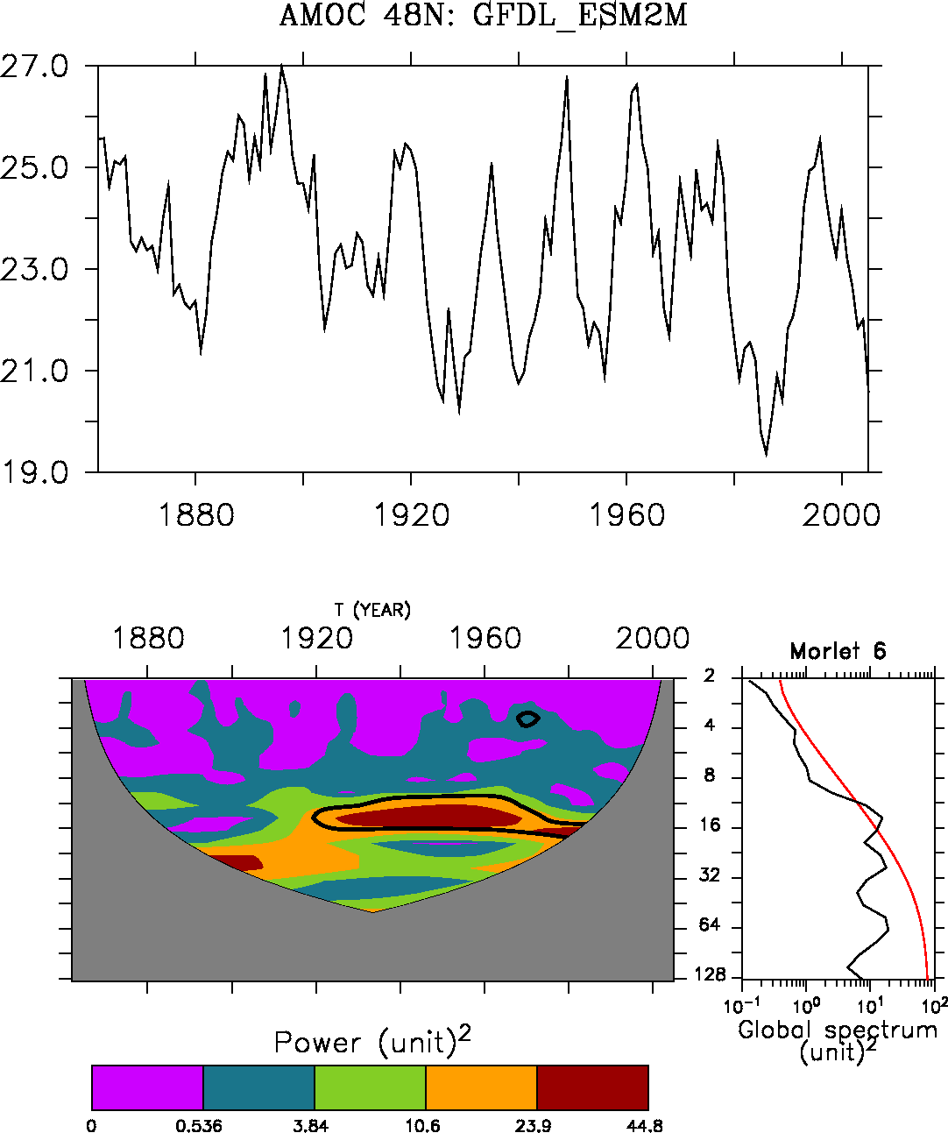
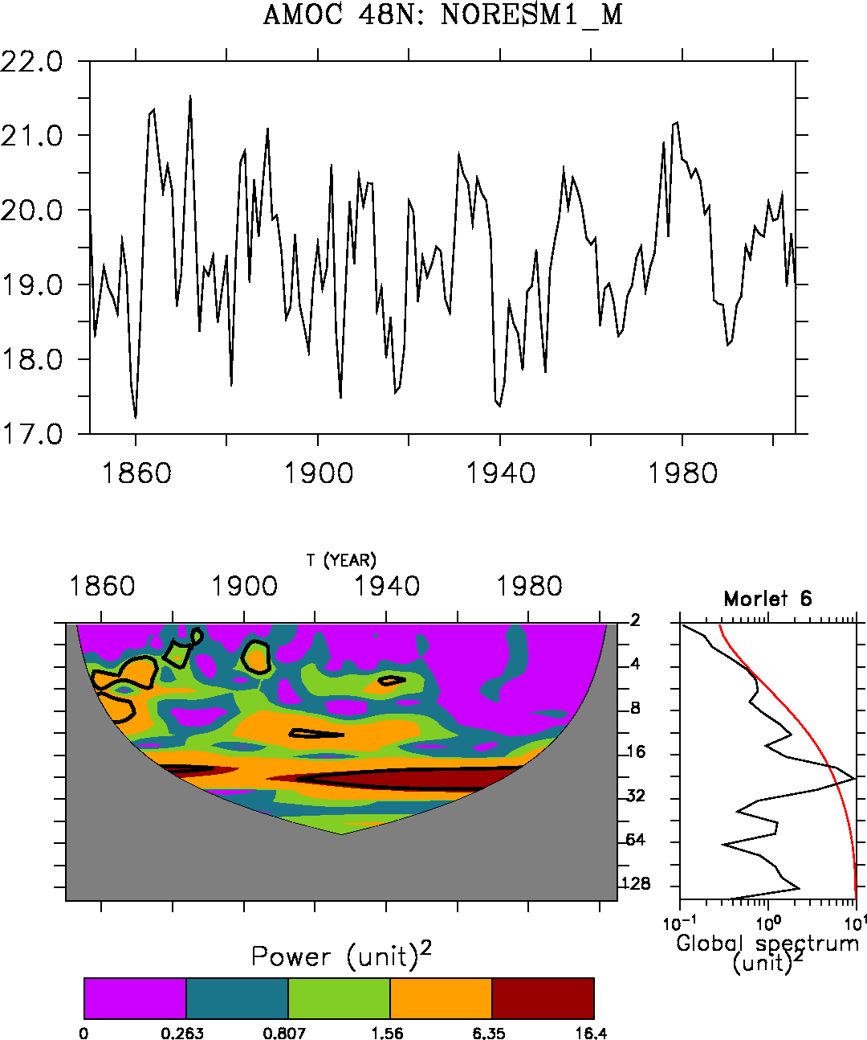
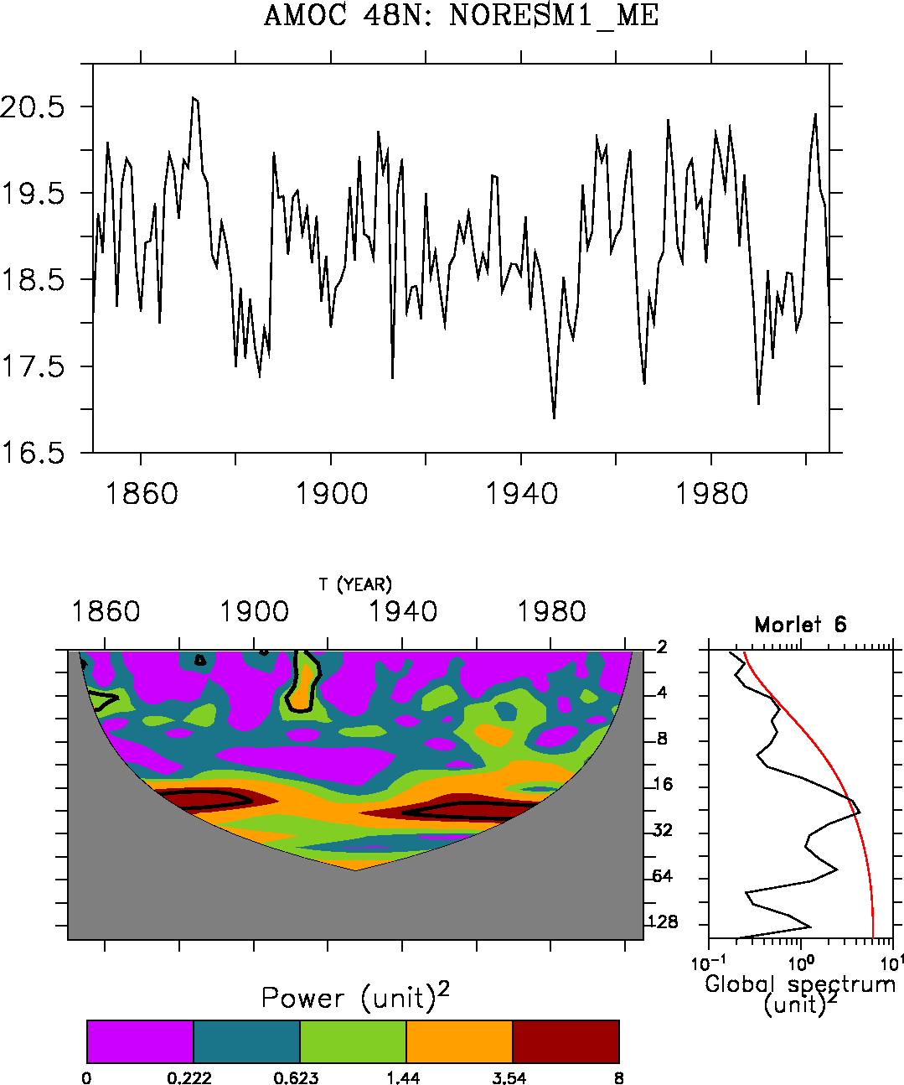
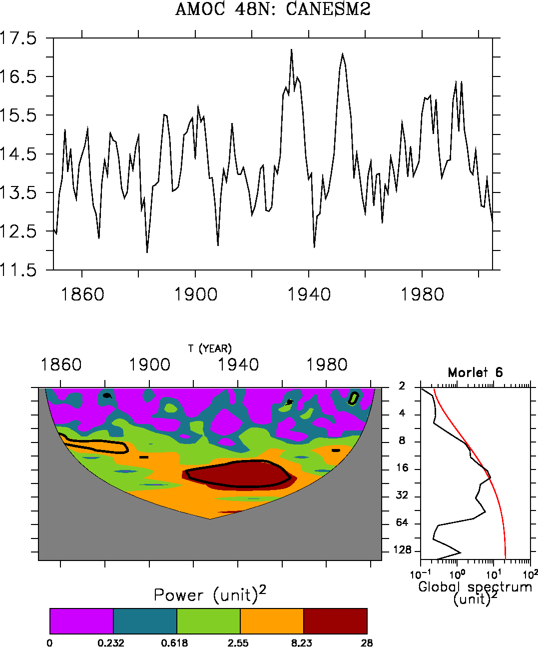
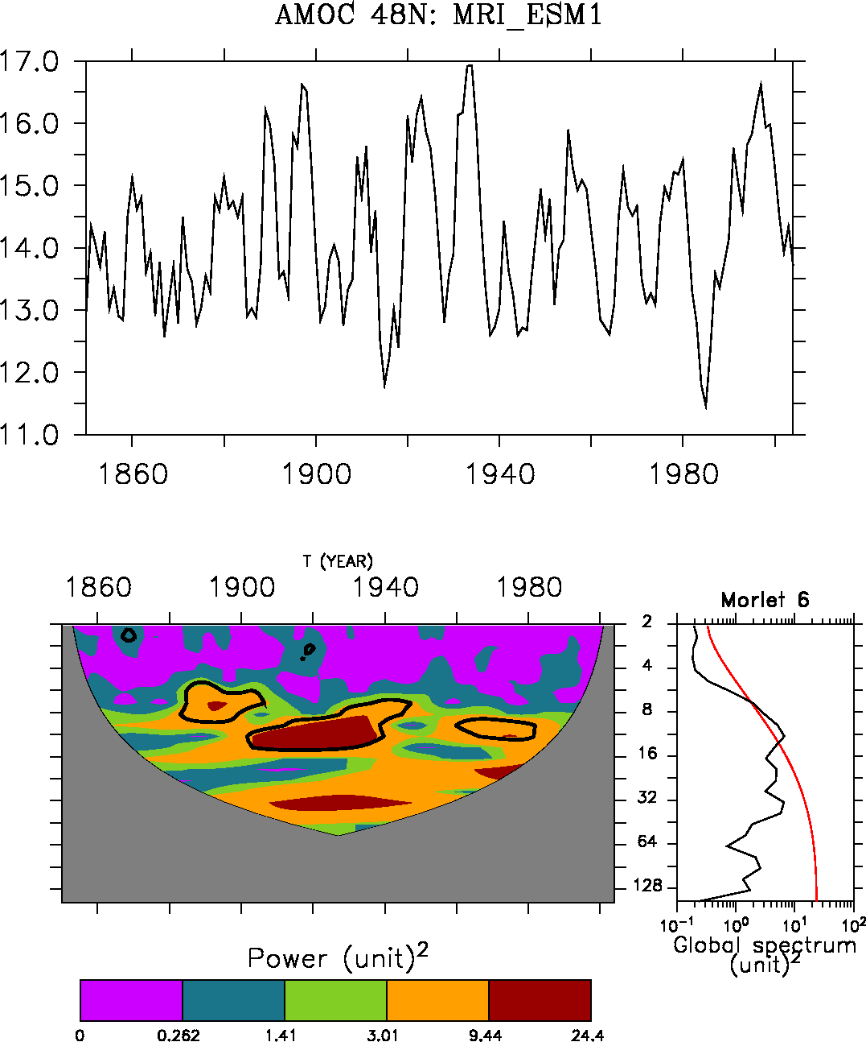

Slide 26
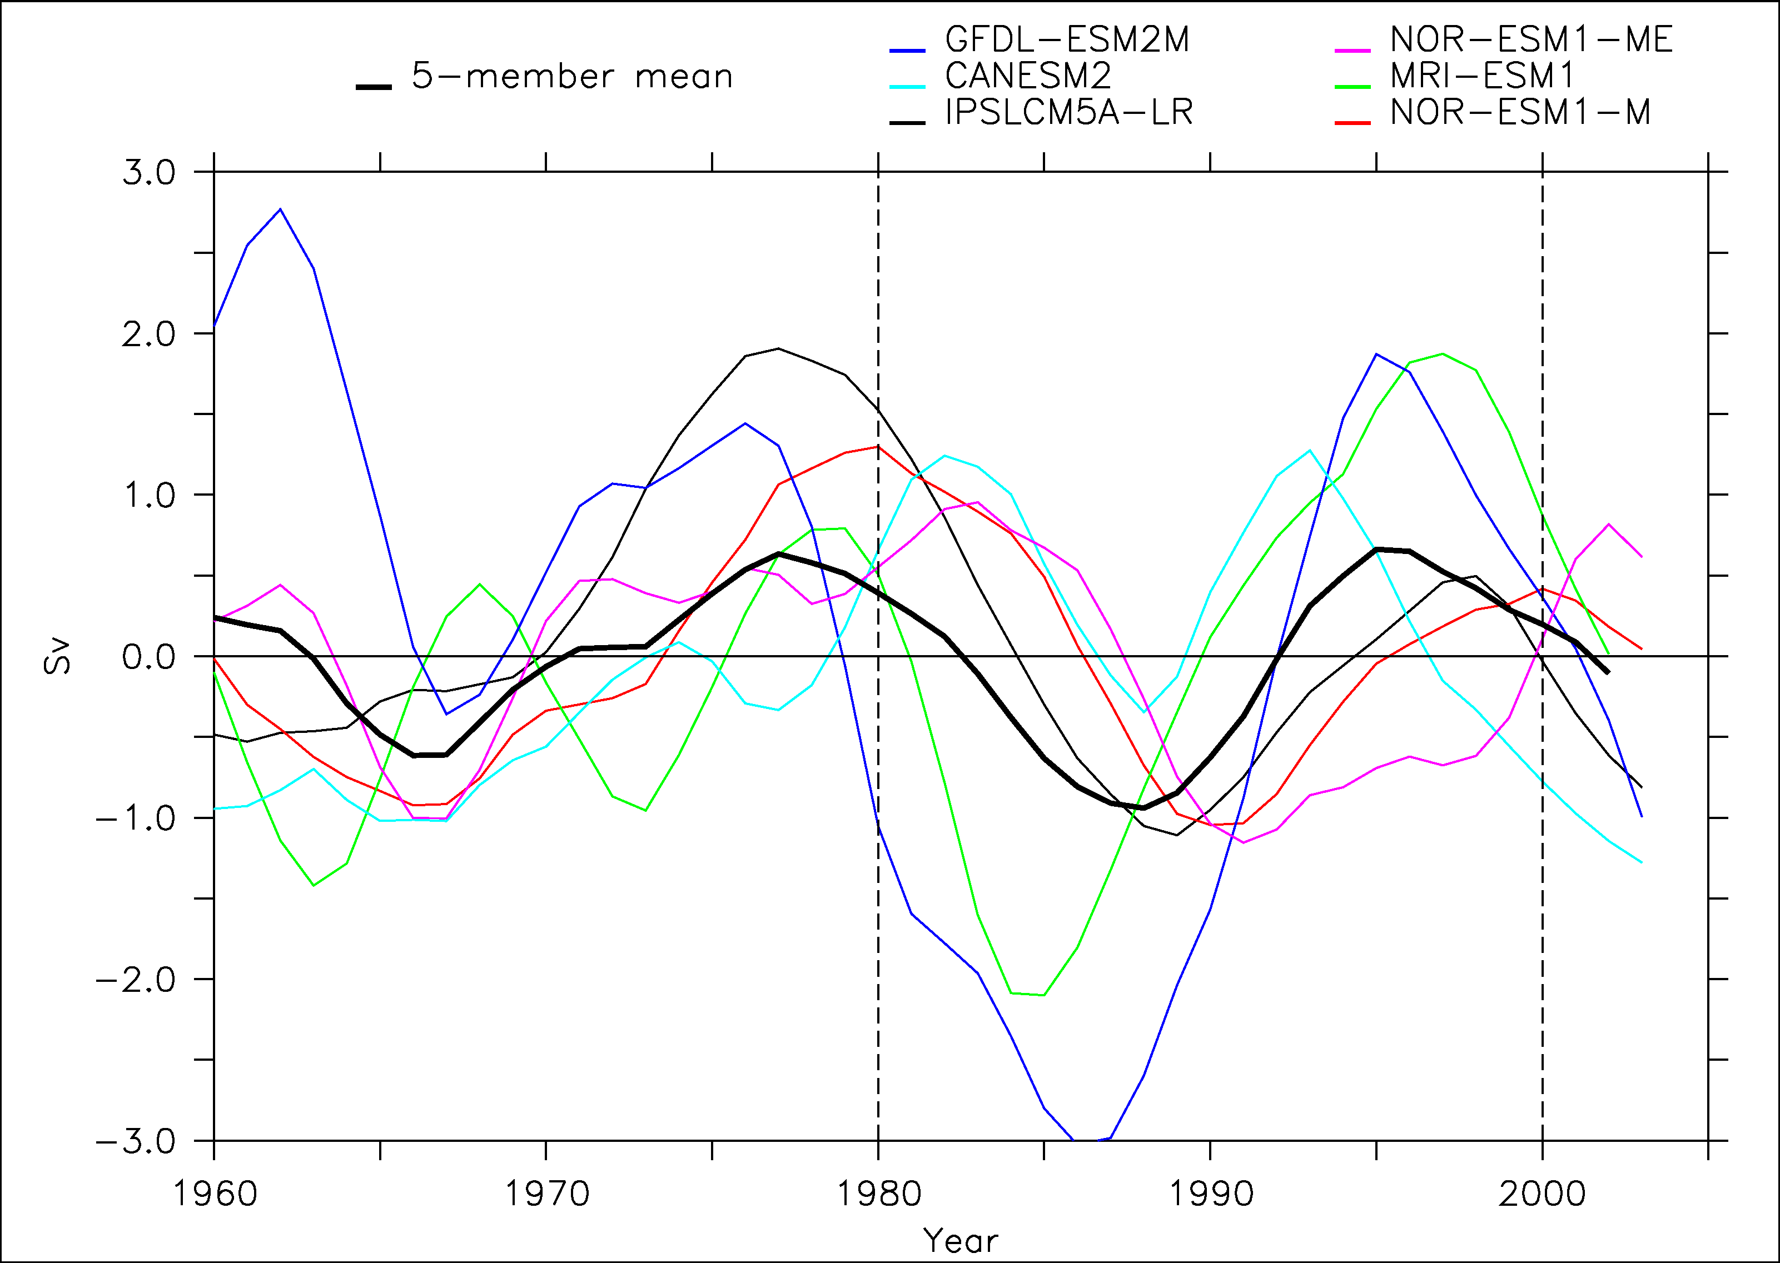
CMIP5 models

Slide 27
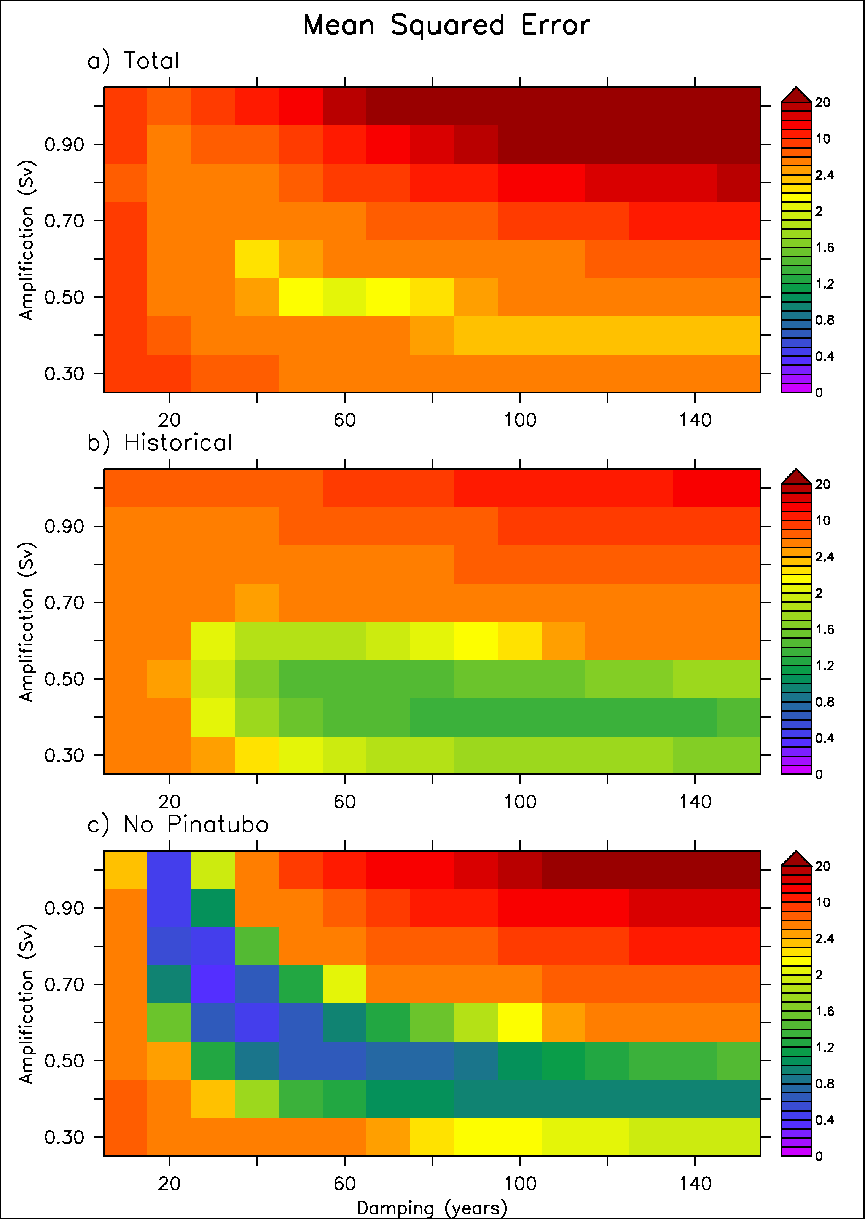
Scaling of the conceptual model
We use a cost function based on MSE between IPSL model and toy model

Slide 28
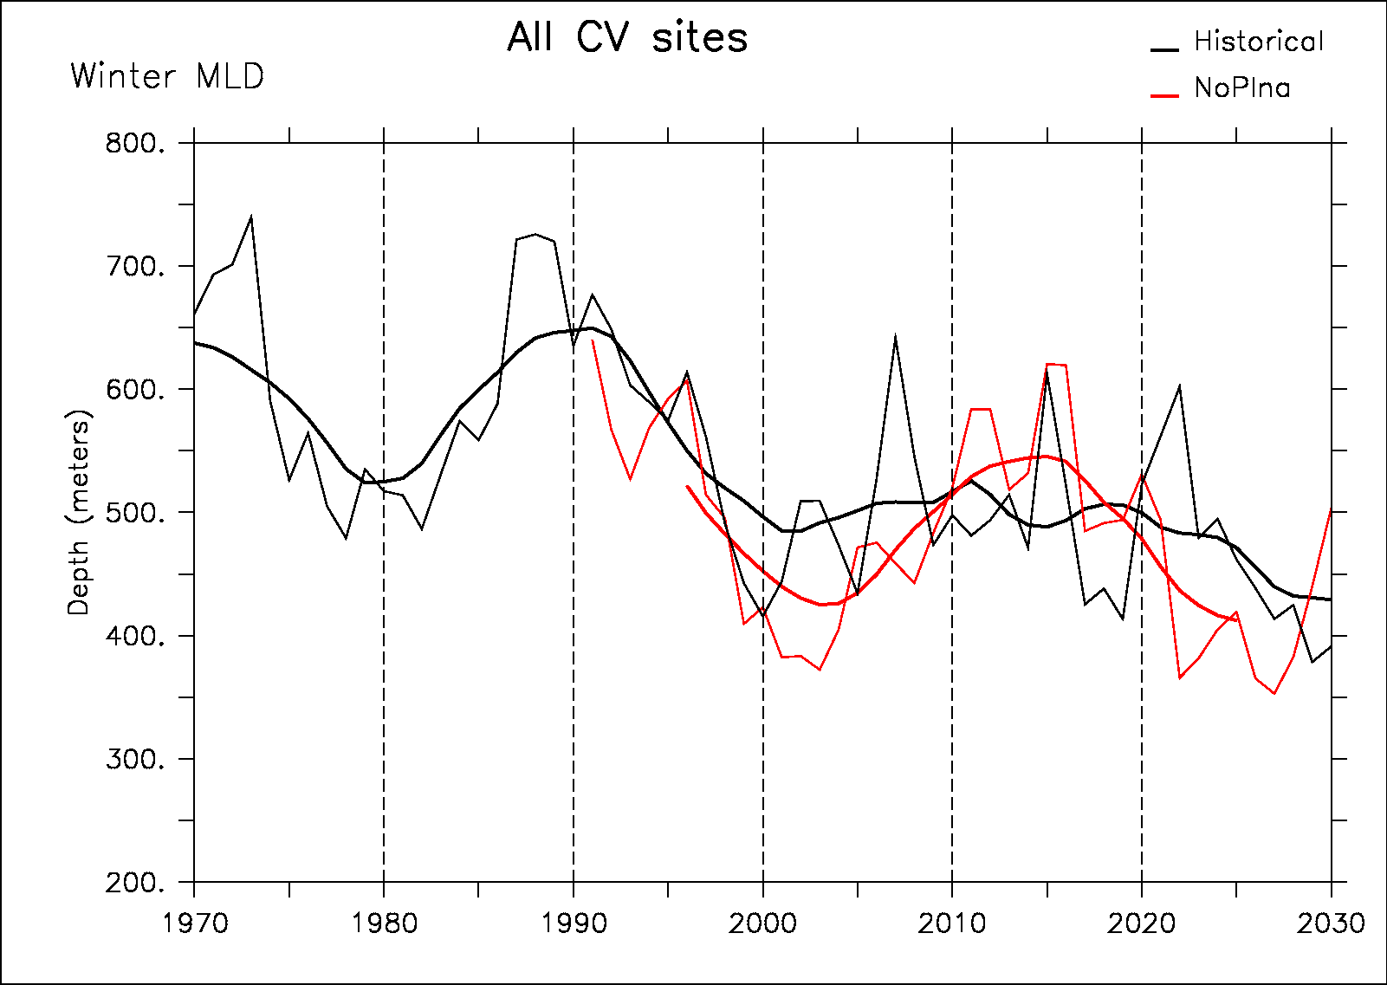
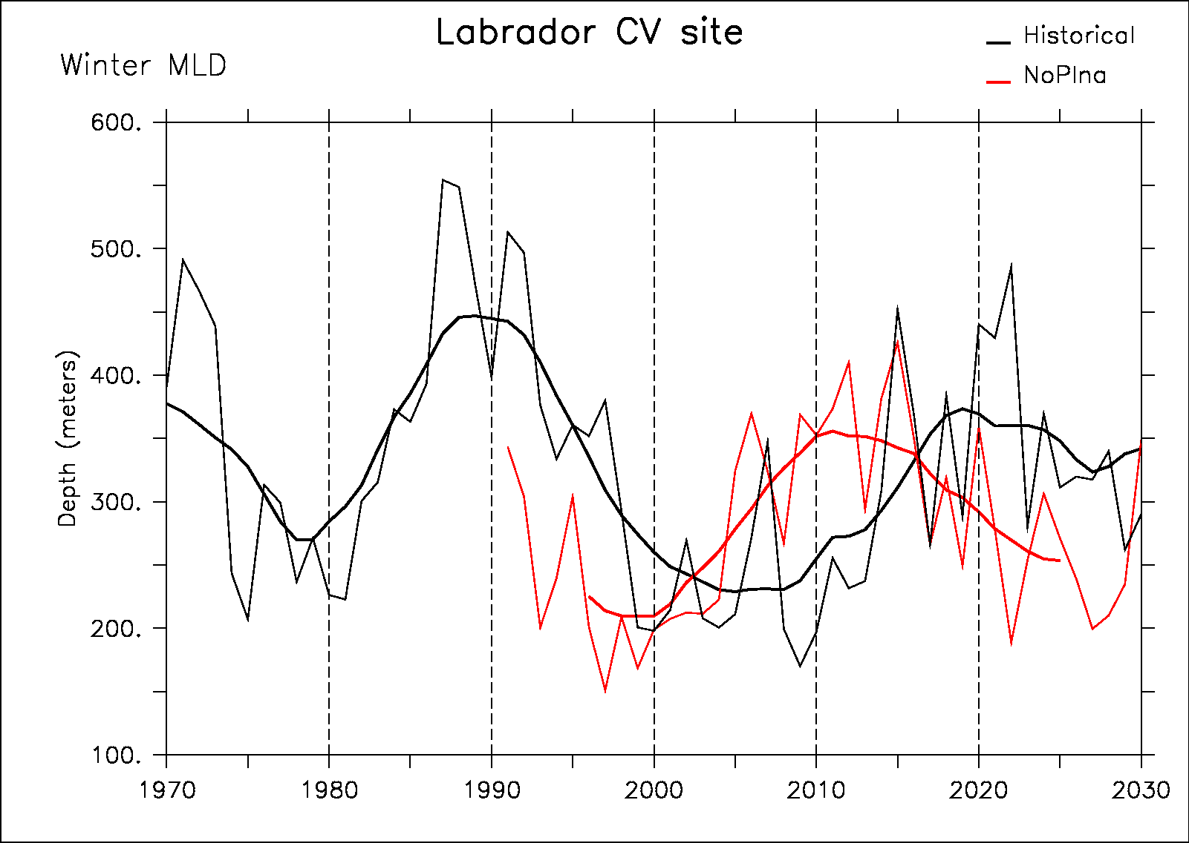
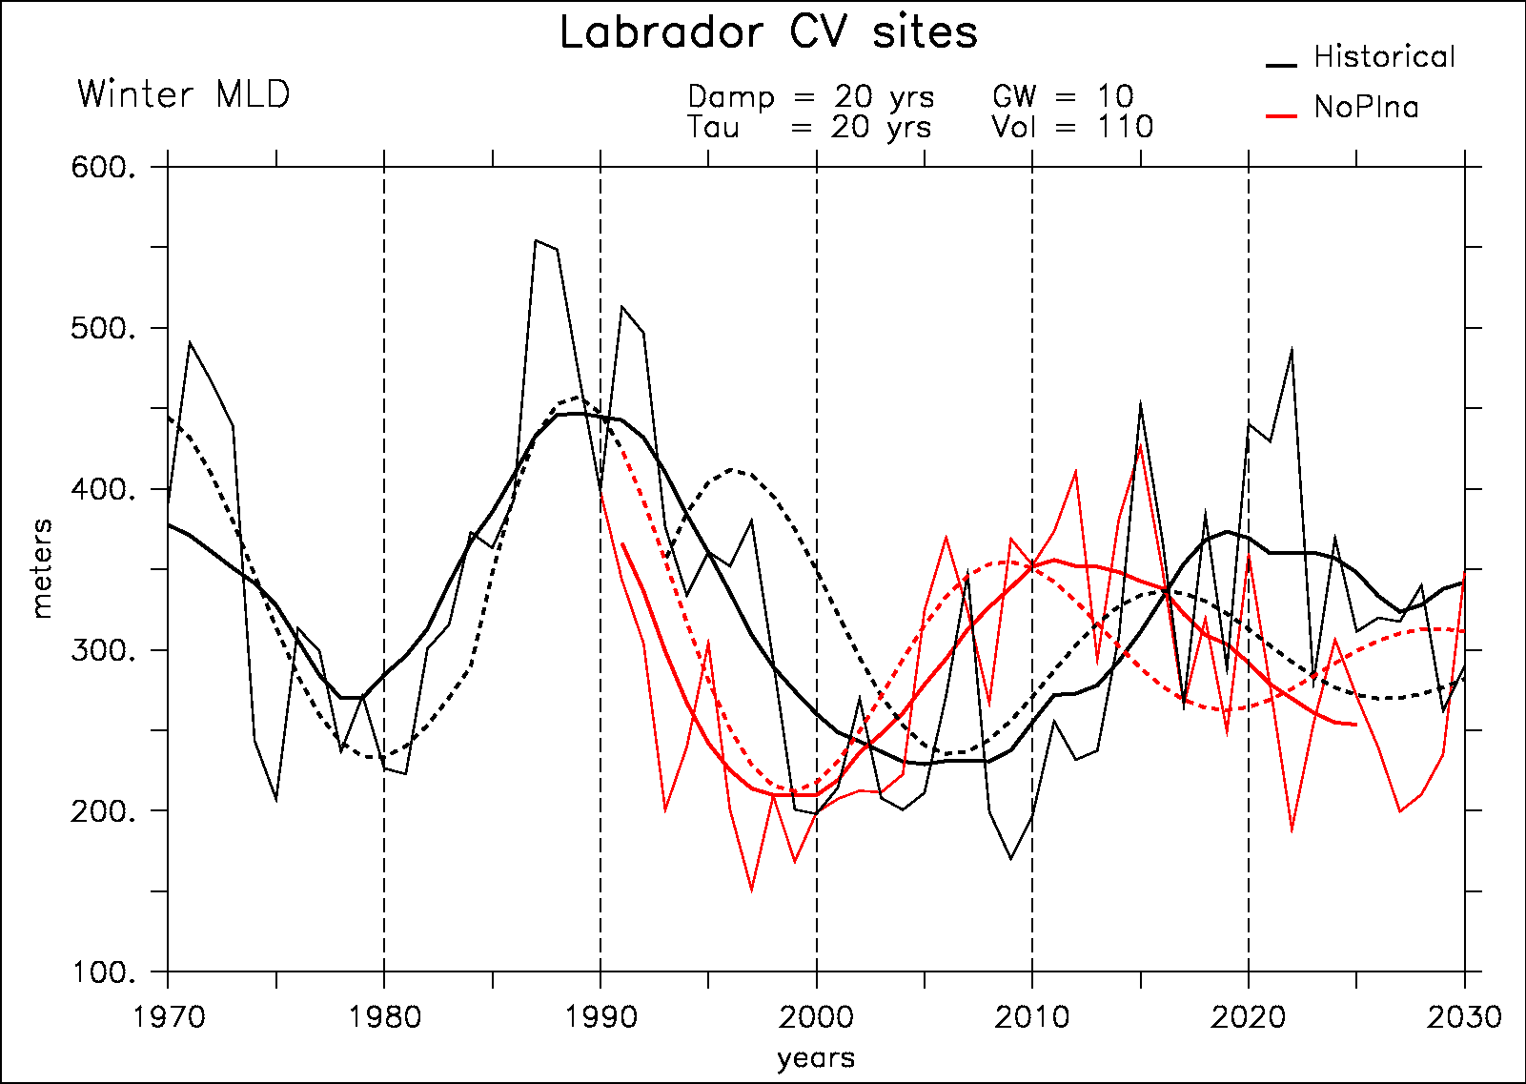
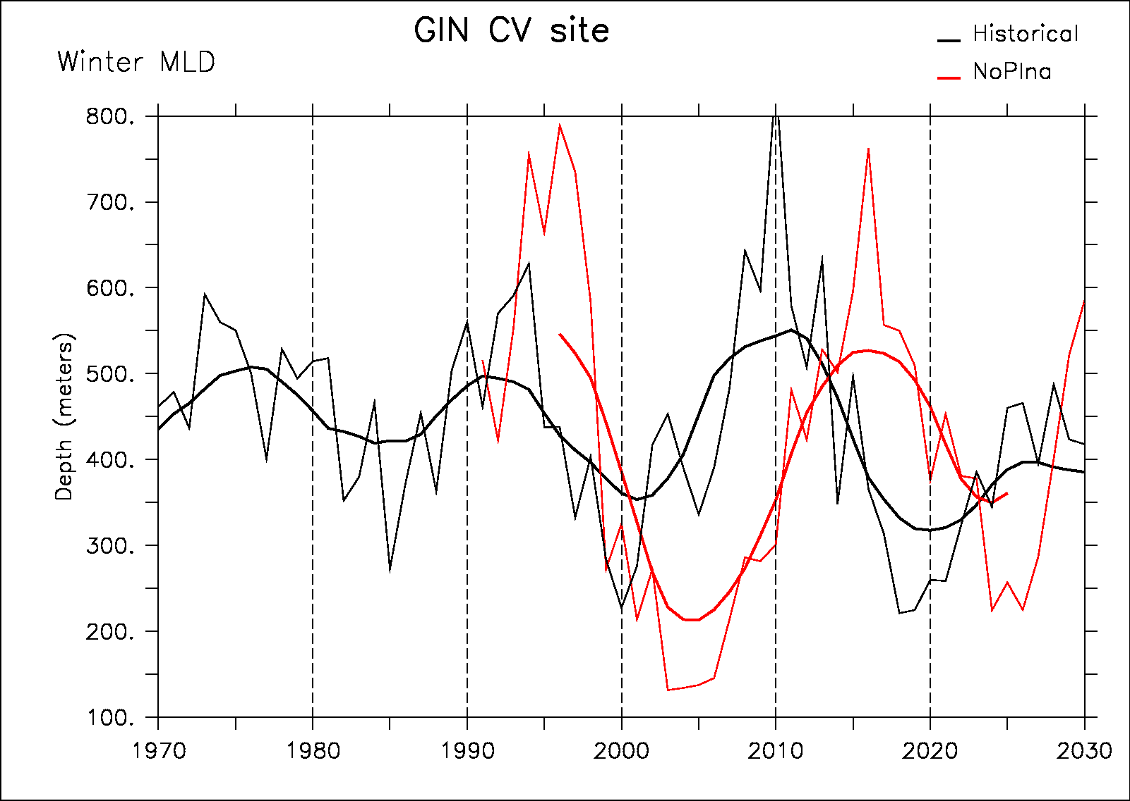
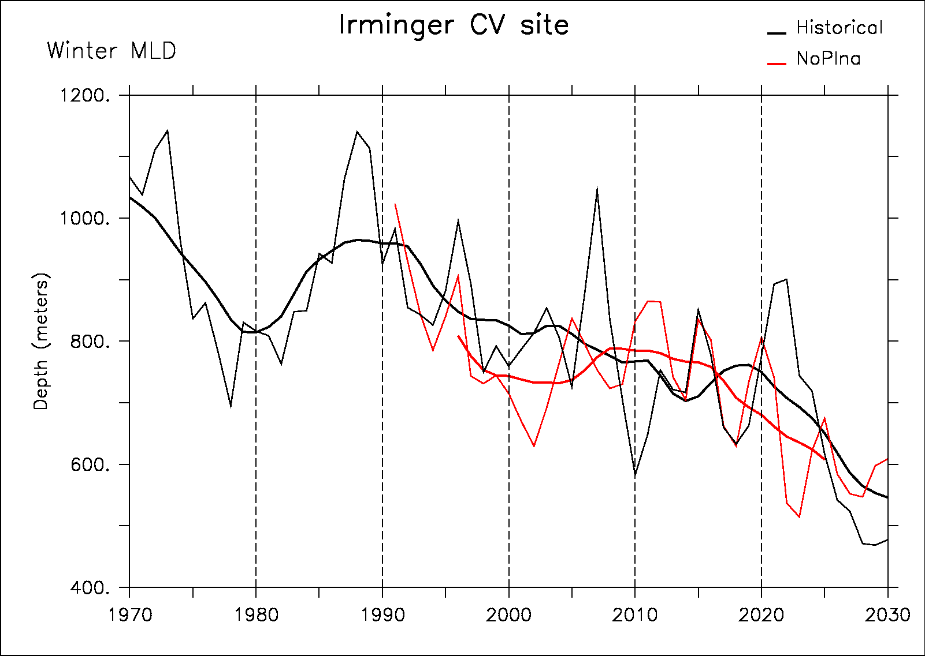
Convection sites response

Slide 29
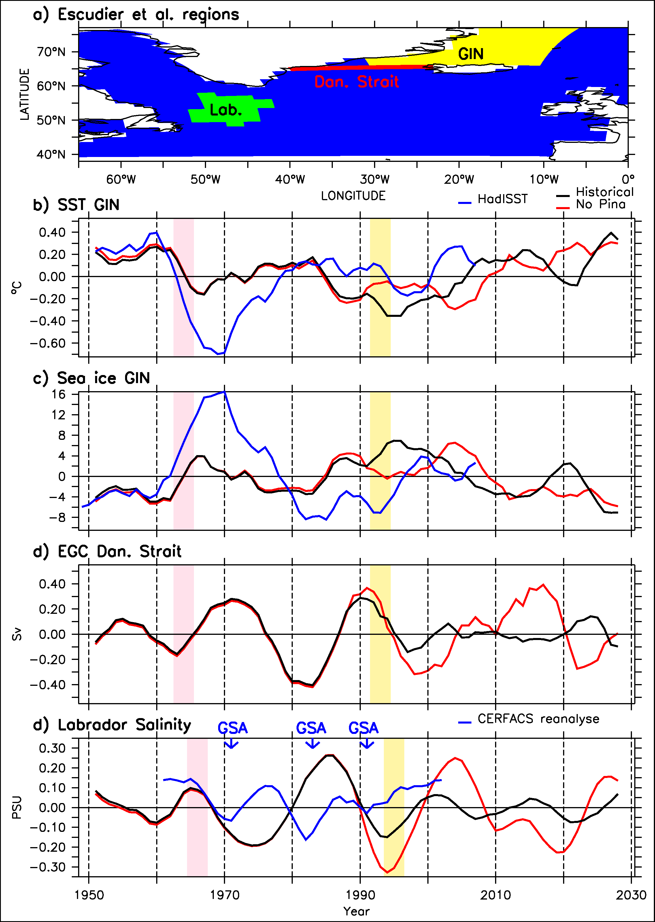
Mechanisms
Historical
No Pinatubo
HadISST
Pinatubo decreases SST and increases sea-ice cover in the GIN Seas
This interferes with variability of the EGC
This removes the salinity anomalies in the Labrador Sea
And then the convection and the AMOC variations

Slide 30
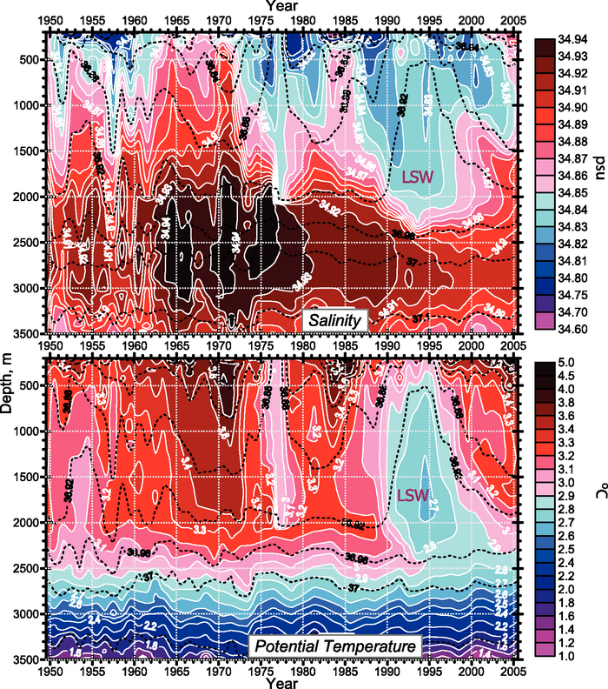
In situ Labrador Sea variation
GSA
GSA
GSA
The 1985 GSA is clearly different from 1972 and 1993 in the sense that there is a subsurface positive anomaly
Belkin et al. (1998): two modes of GSA, one remote (Artic) and one more local (1980s)
Central Labrador Sea from 1949 to 2005 (updated from Yashayaev et al., 2003)
Source IPCC 2007

Slide 31
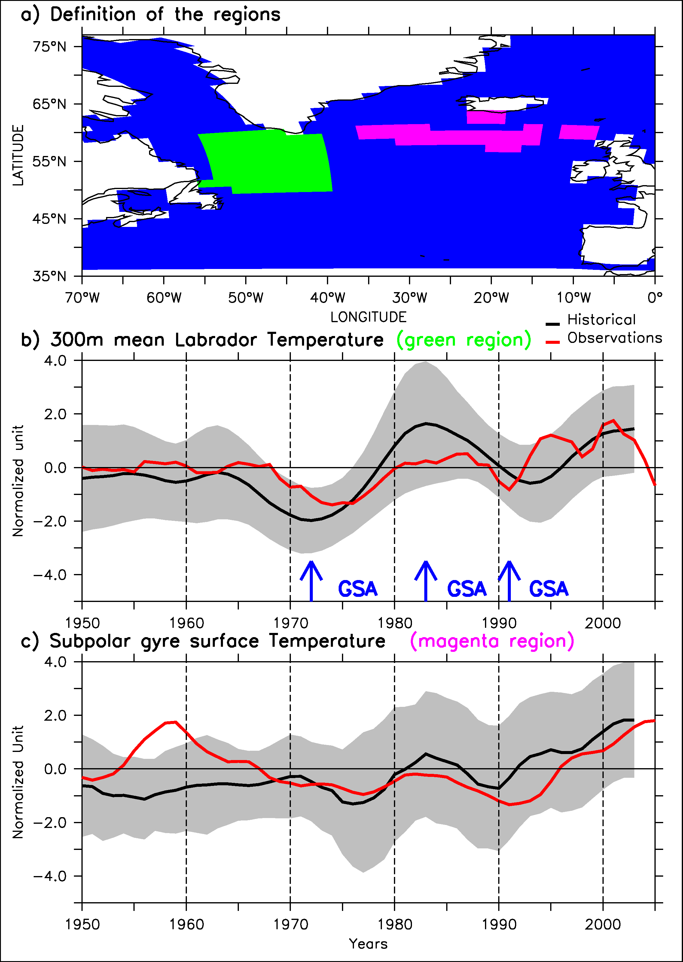
Temperature propagation

Slide 32
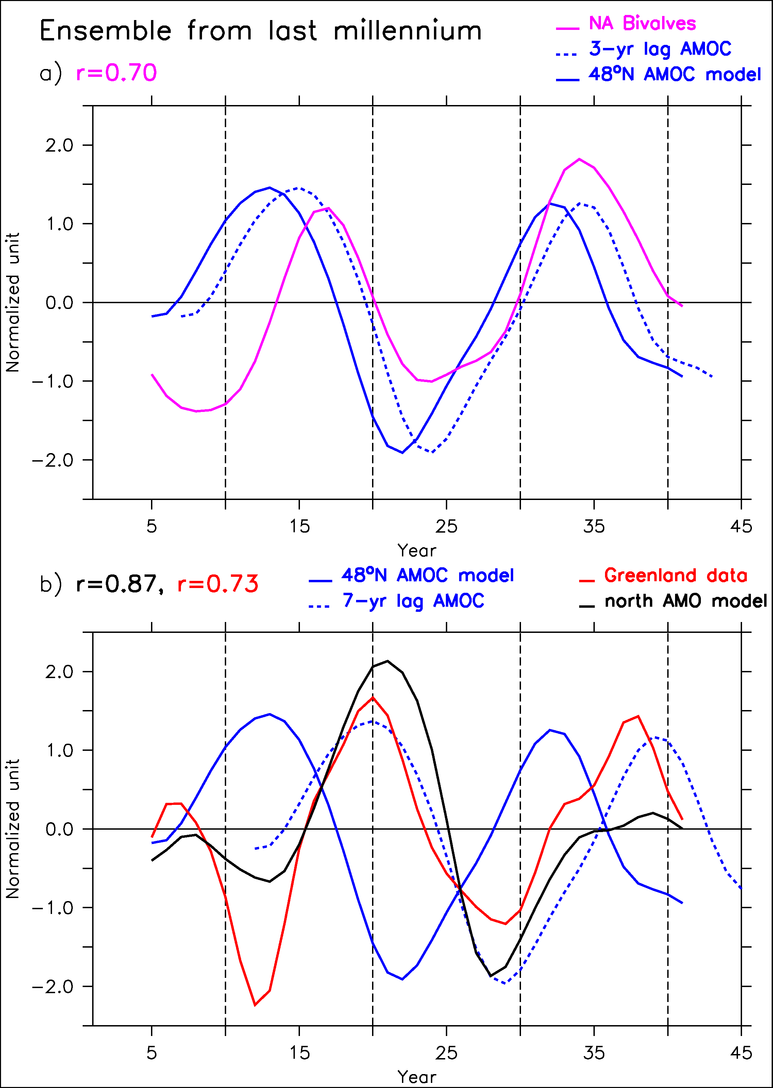
Comparison model-proxies
Pseudo-proxy approach: is there a link between nutrient and AMOC in the model?
AMOC leads nutirent supply with 1-3 years

Slide 33
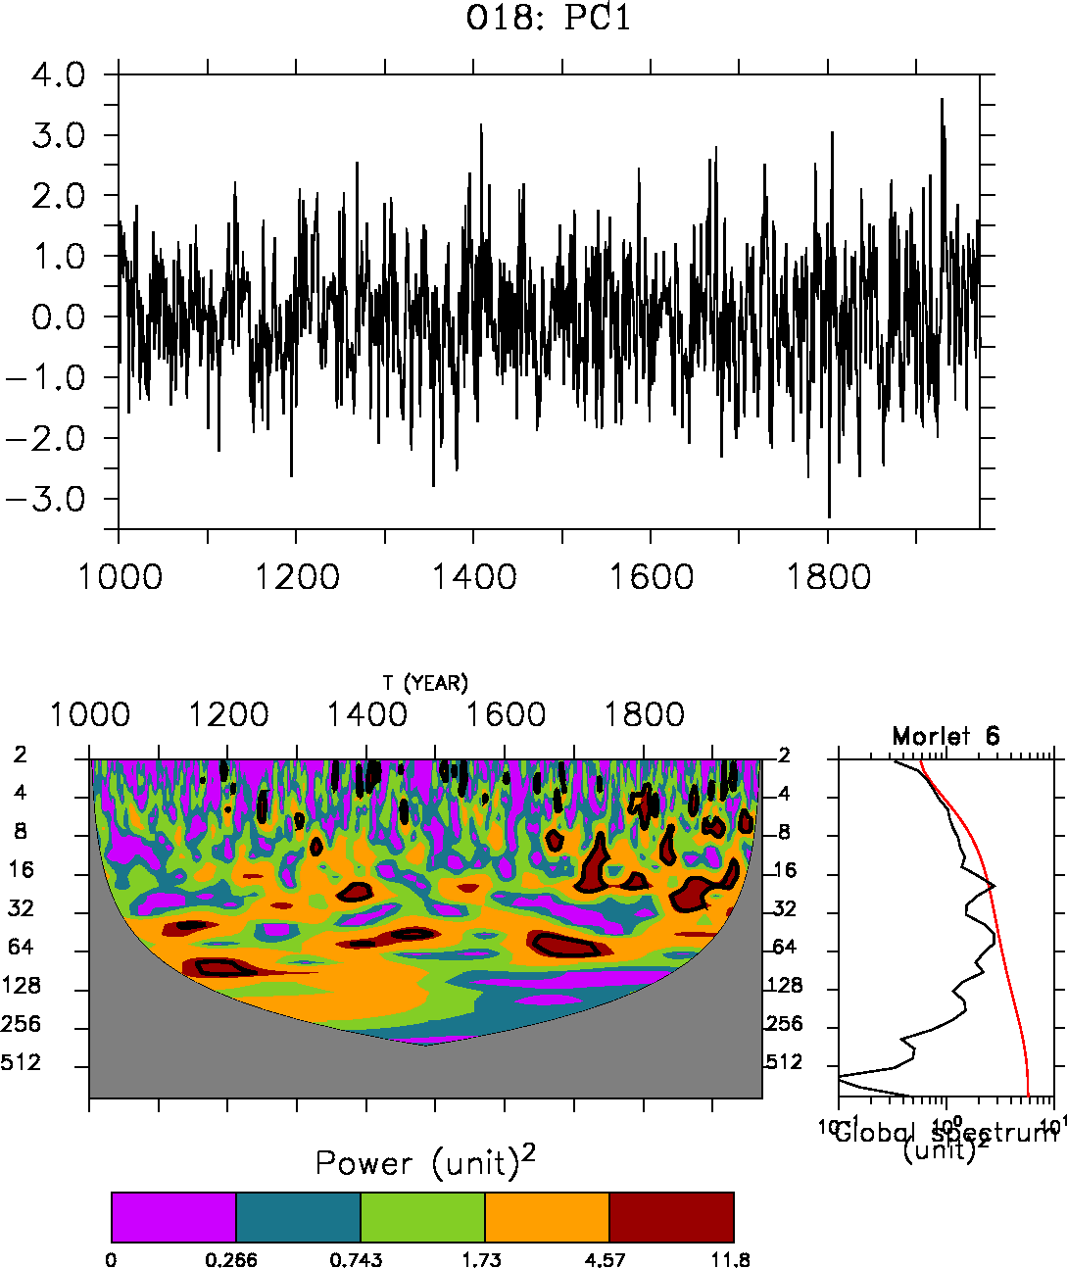
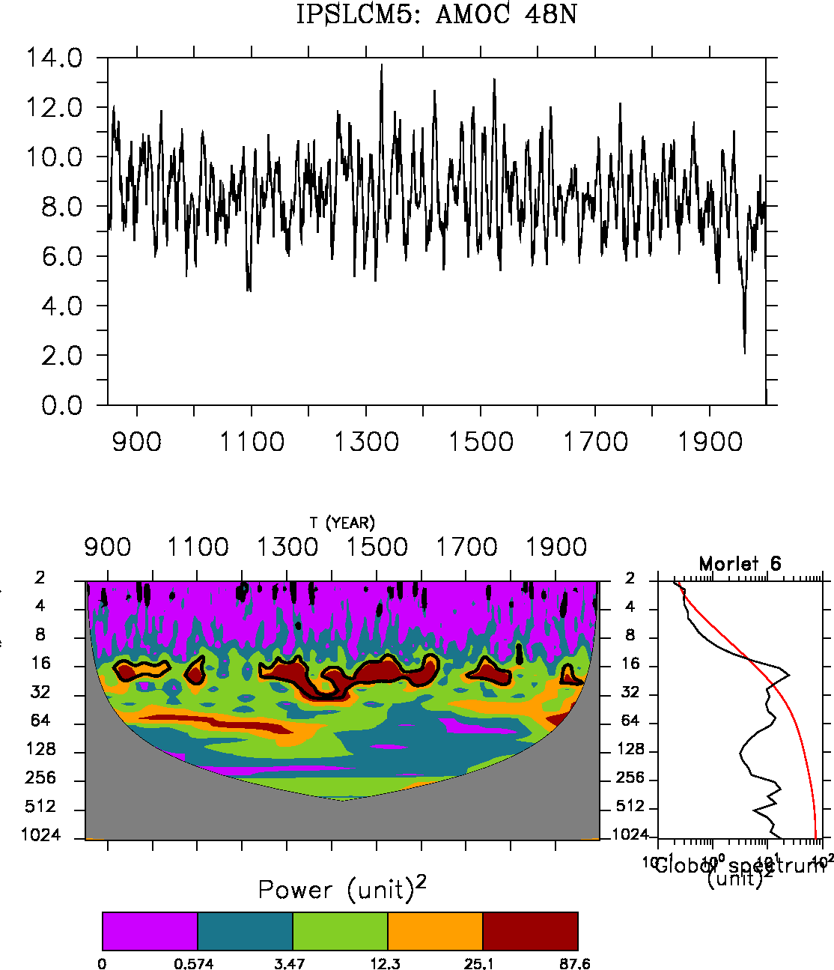
EOF1 δO¹⁸ ice cores

Slide 34
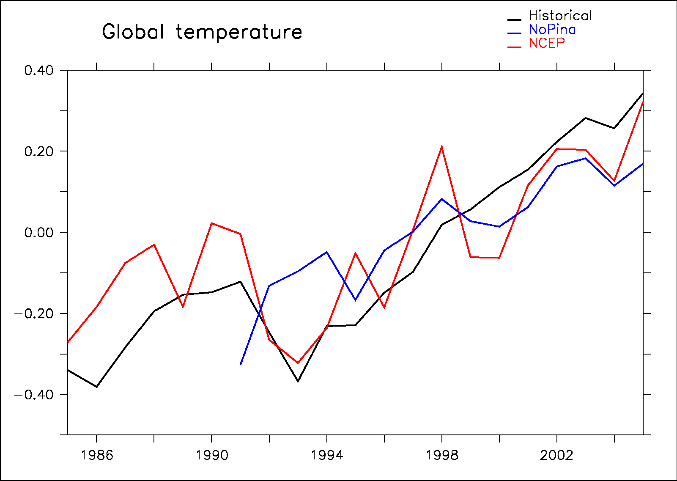
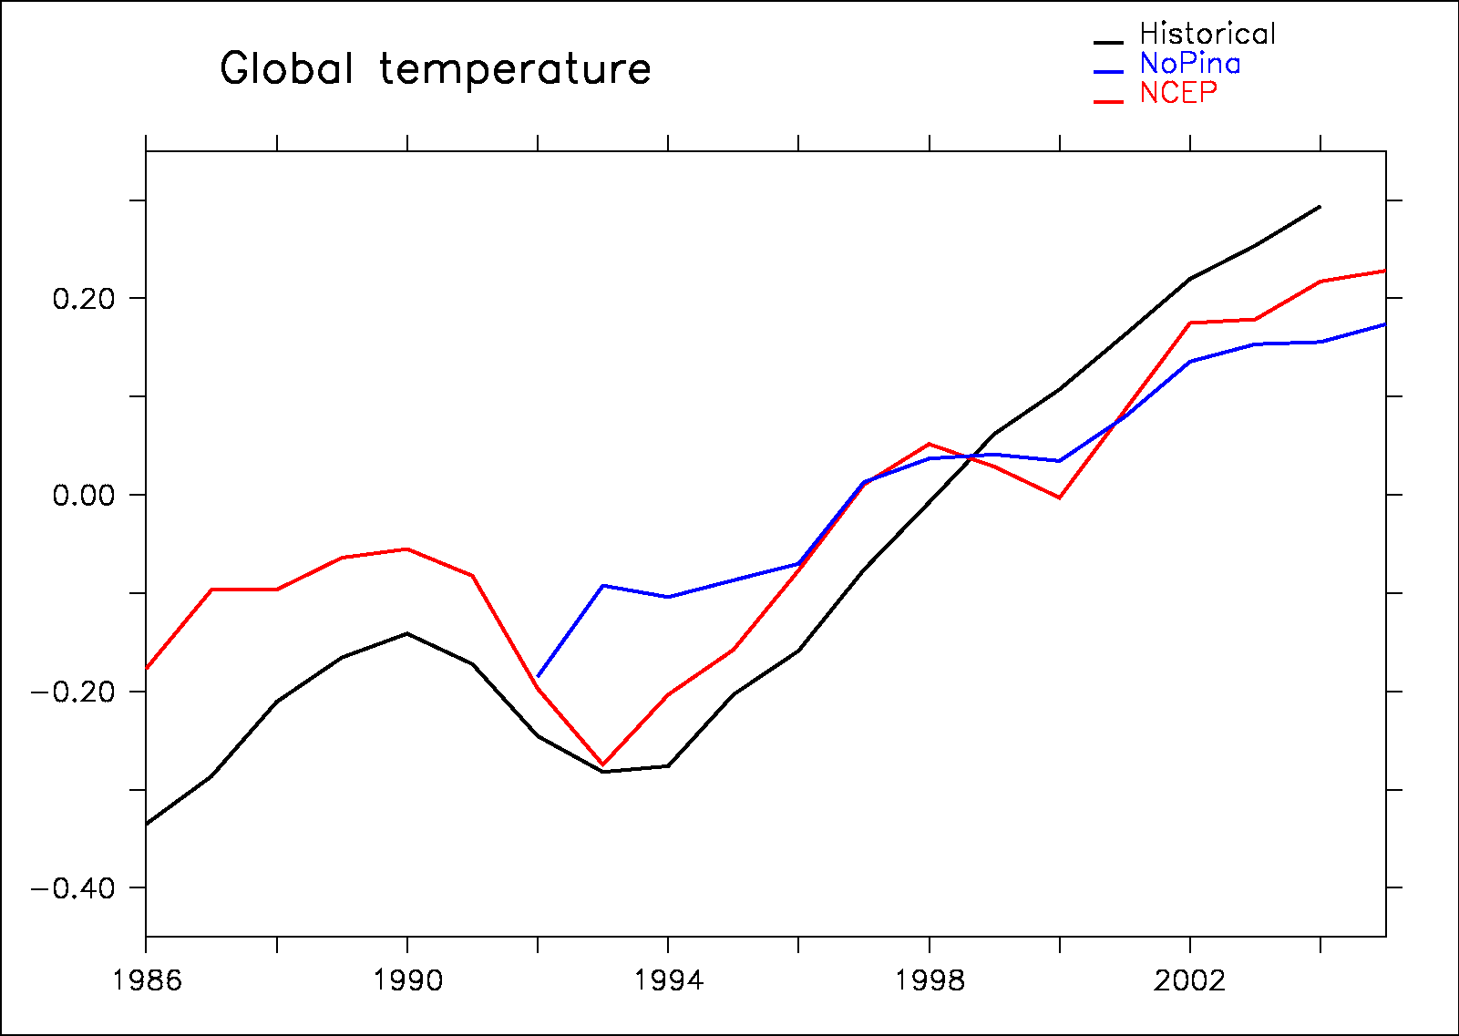
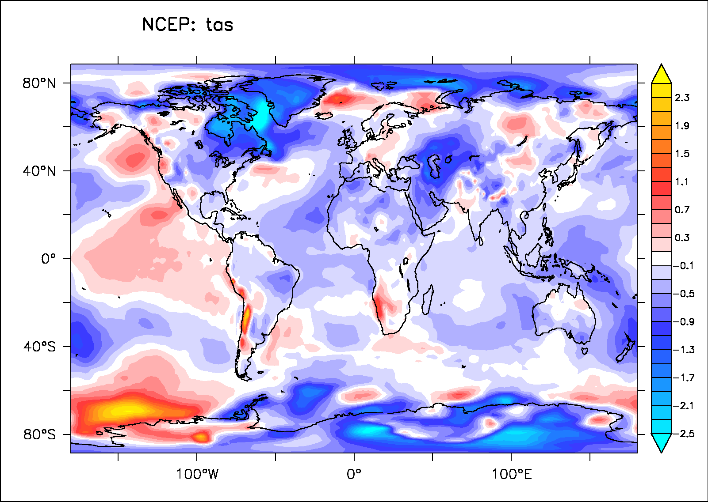
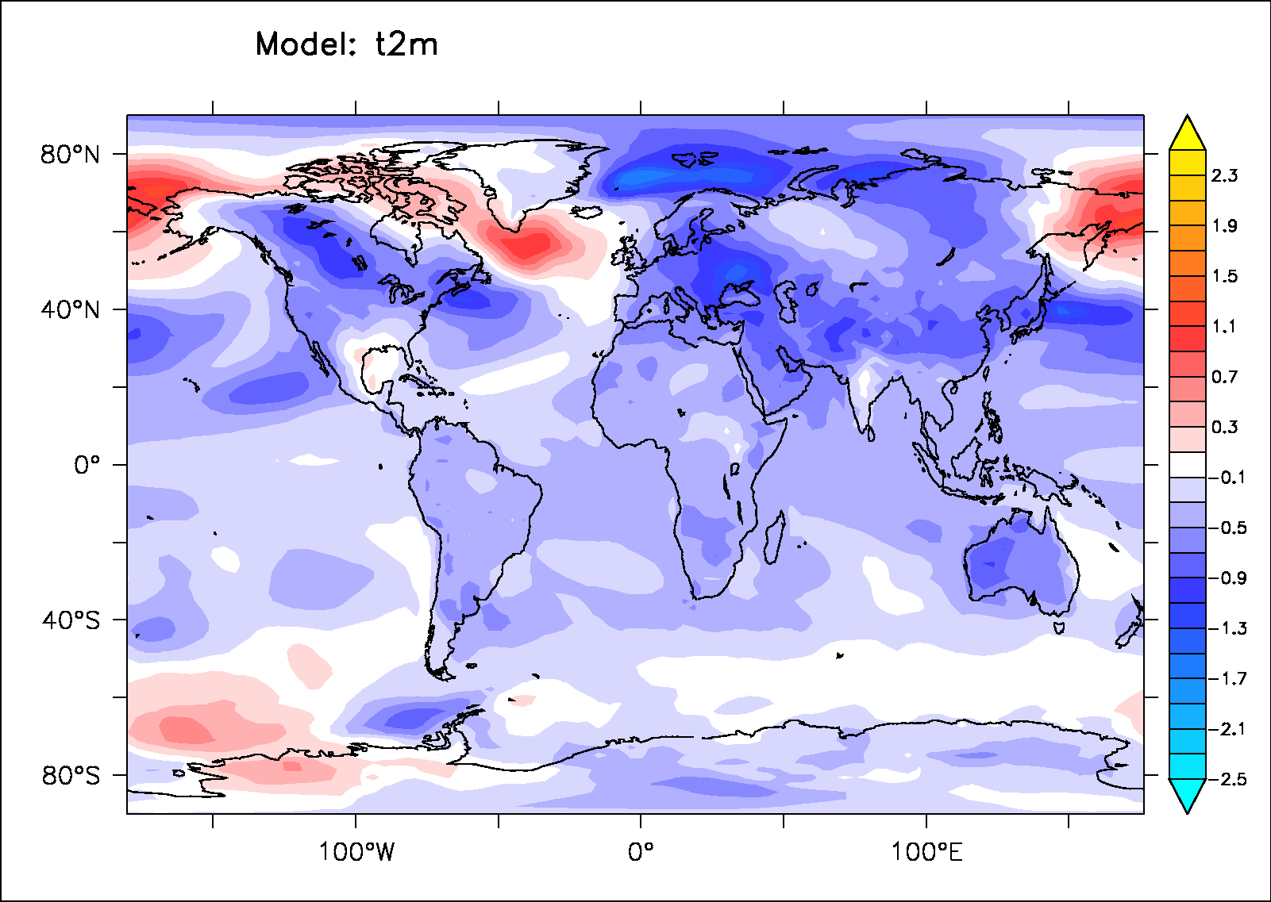
Pinatubo direct impact

Slide 35
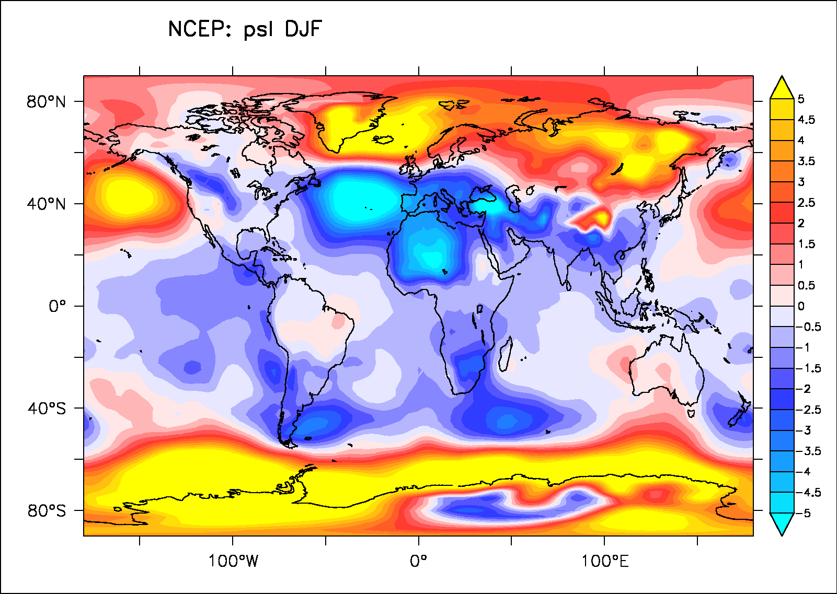
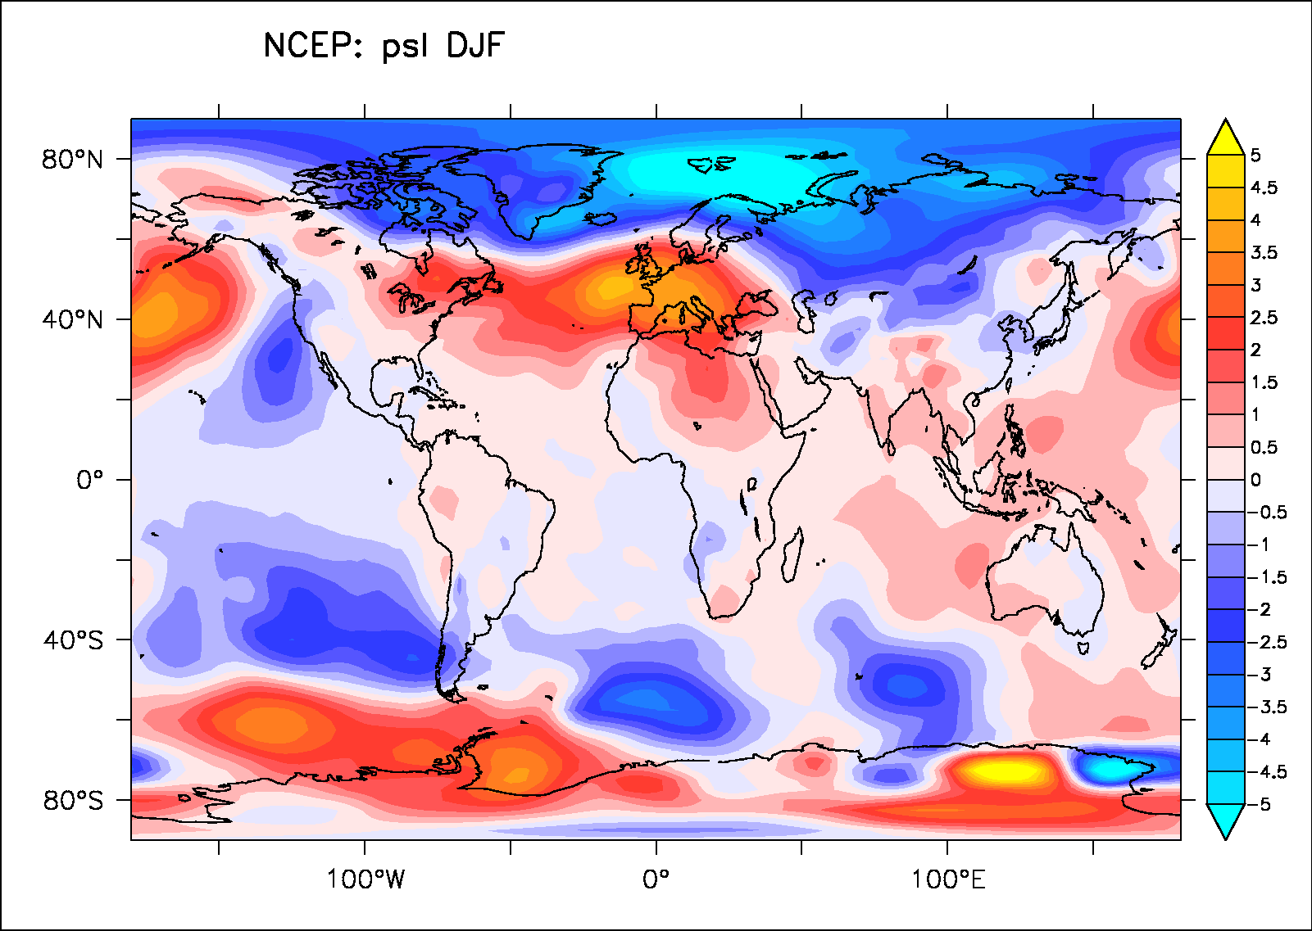
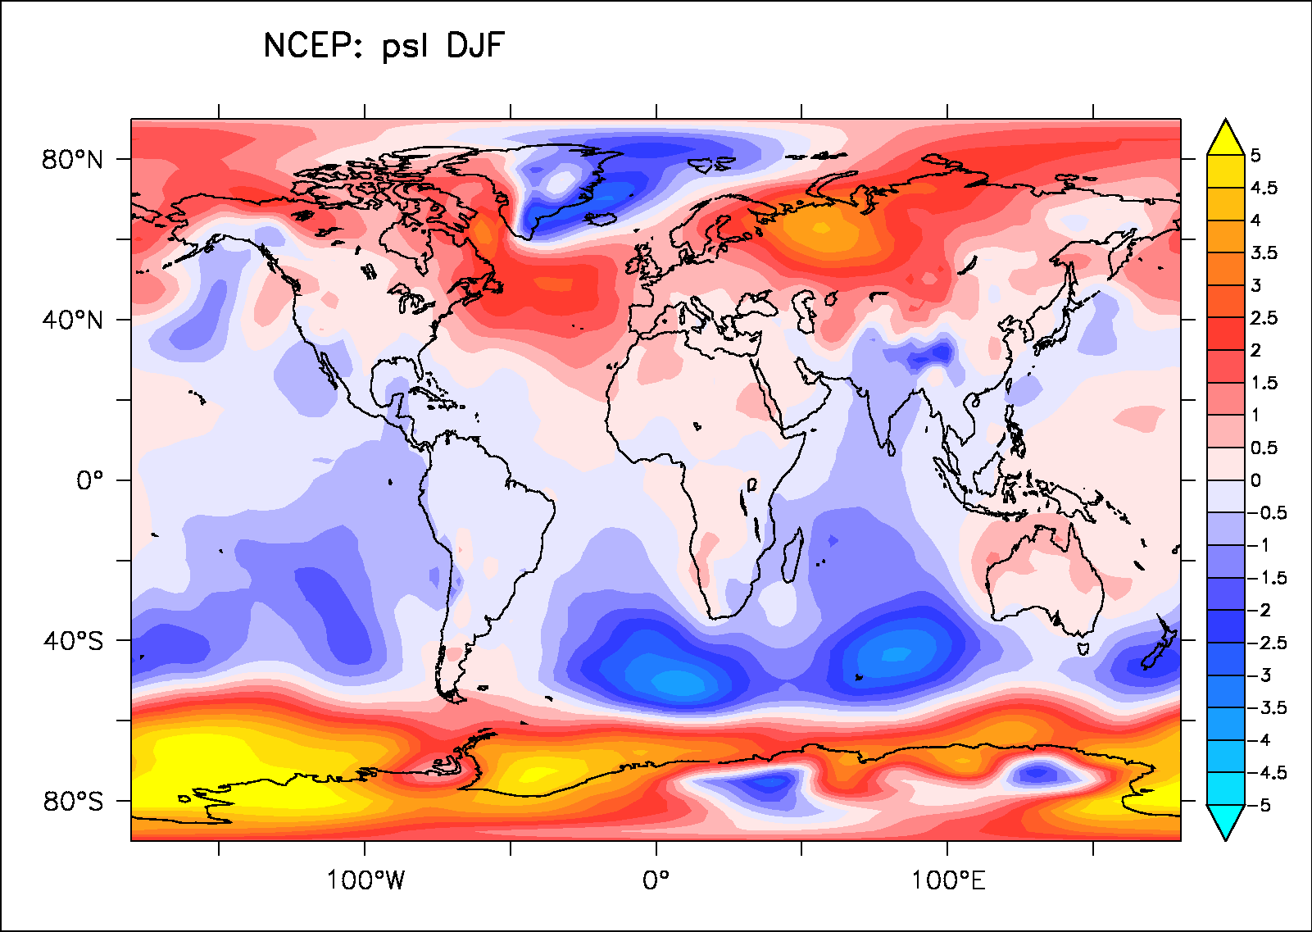
Is volcanic impact on the NAO so clear in data?
Agung: 1963-1965
Pinatubo: 1991-1993
El Chichon: 1982-1984

