Slide 1

WP5) Atlantic Ocean variability during the Holocène: model approach
D. Swingedouw (EPOC), J.-C. Dutay (LSCE), P. Braconnot (LSCE), O. Marti (LSCE), L. Bopp (LSCE), C. Colin (IDES), J. Mignot (LOCEAN), M. Khodri (LOCEAN).

Slide 2


WP5) Atlantic Ocean variability during the Holocène: model approach
D. Swingedouw (EPOC), J.-C. Dutay (LSCE), P. Braconnot (LSCE), O. Marti (LSCE), L. Bopp (LSCE), C. Colin (IDES), J. Mignot (LOCEAN), M. Khodri (LOCEAN).

Slide 3
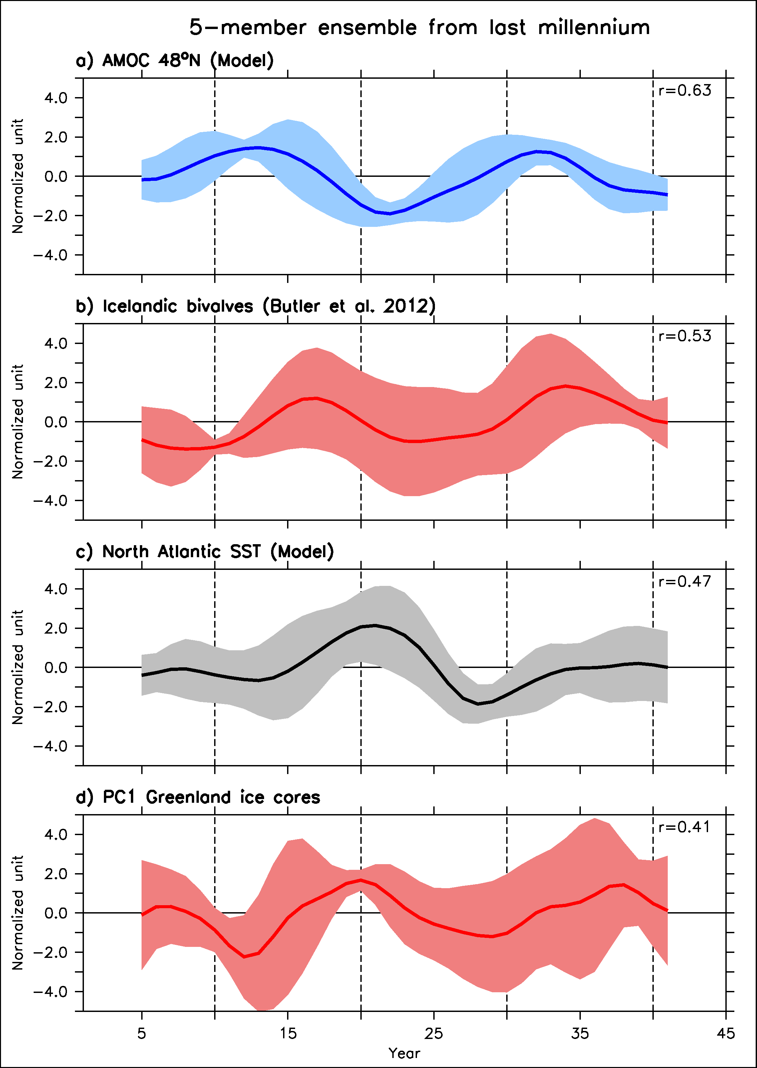
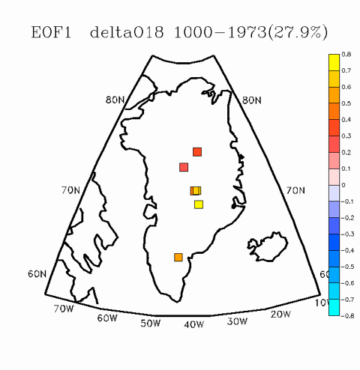
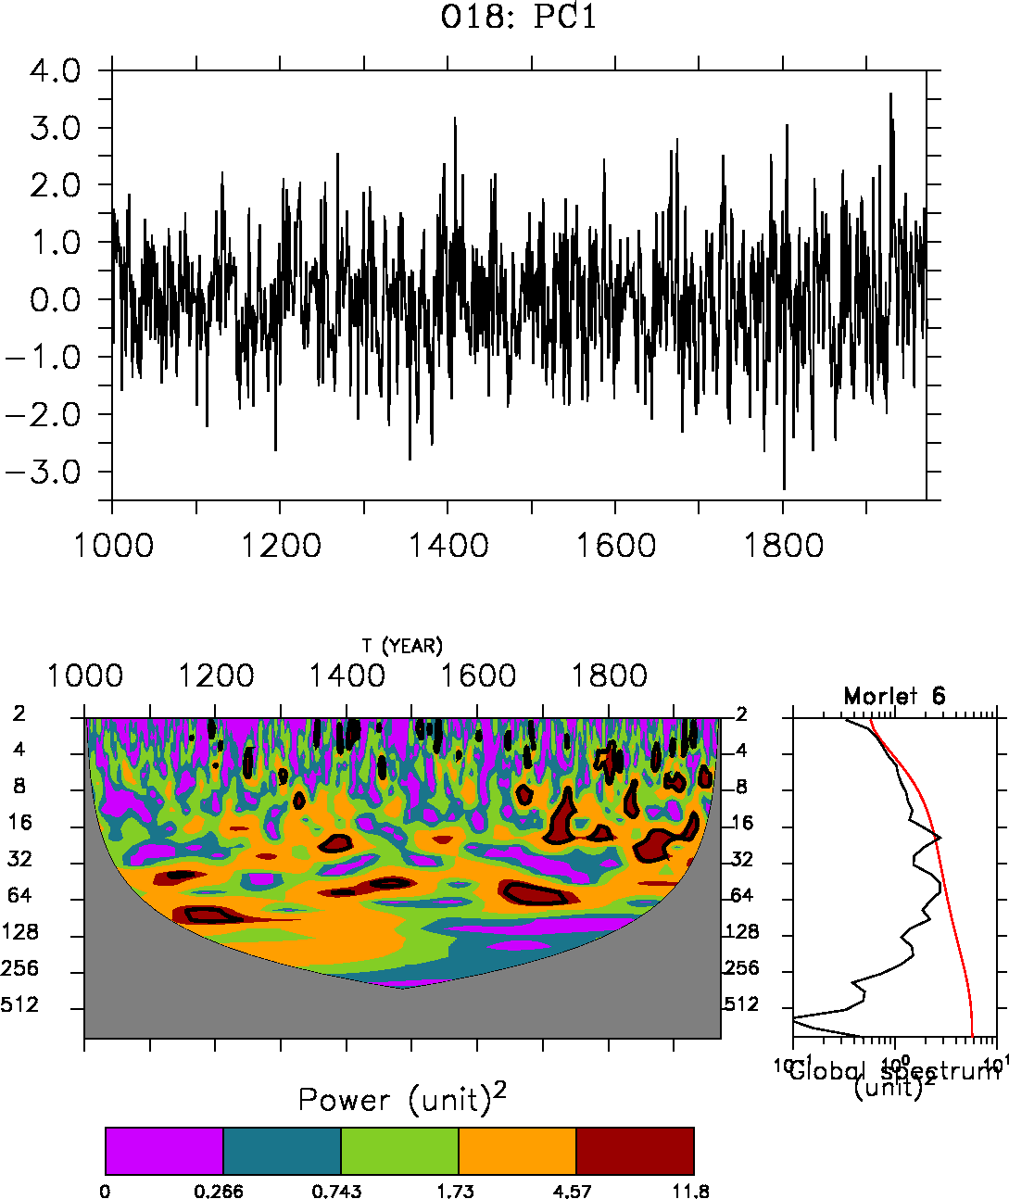
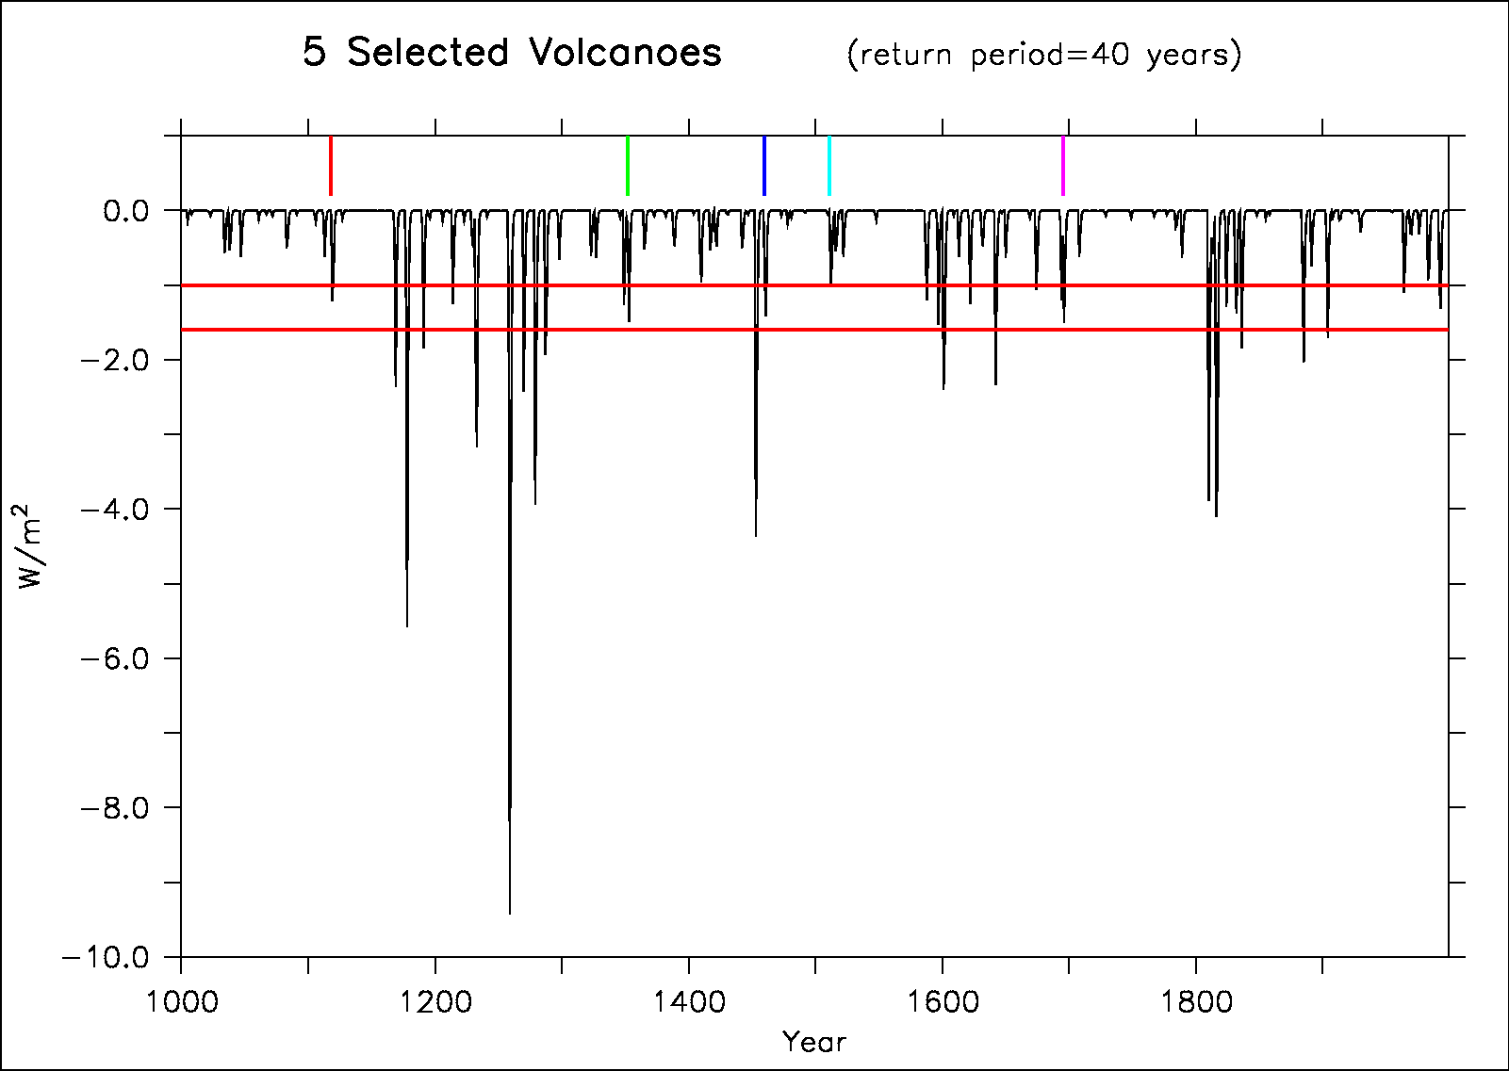
Decadal variations: incomings of GREENLAND project
Comparing high resolution Greenland data, Icelandic bivalves and last millennium simulations
Key scientific results: Pinatubo-like volcanic eruption reset a 20-yr variability in the North Atlantic
To be tested with new marine data from HAMOC?
Ortega et al., soumis

Slide 4
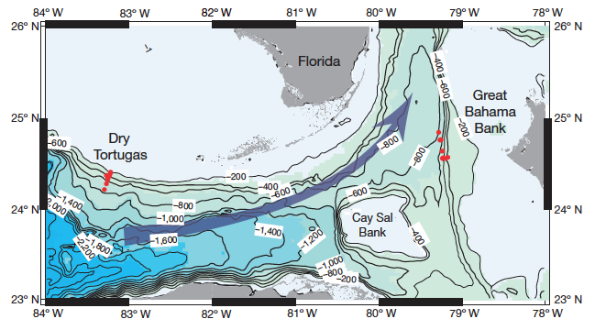
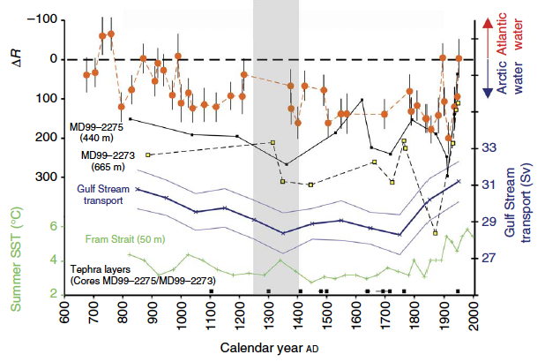
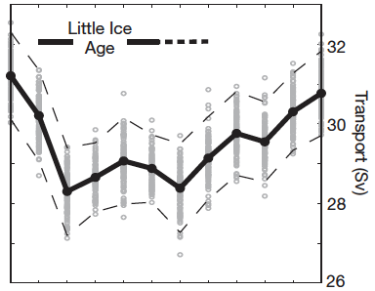
Last millennium: what causes LIA and MCA?
Schurer et al. (NG 2014): detection-attribution hardly find a solar signal in North Hemisphere reconstruction
A few proxies (Lund et al. 2006, Wanamaker et al. 2012) indicate that AMOC goes in line with these variations
Most climate simulations mainly show a weakening of the AMOC in response to solar forcing (Swingedouw et al. 2011)
A low freqency response to volcanoes (Miller et al. 2012)?
An internal mode of the AMOC (De Verdiere et al. 2007)?
Lund et al. 2006
Wanamaker et al. 2012

Slide 5
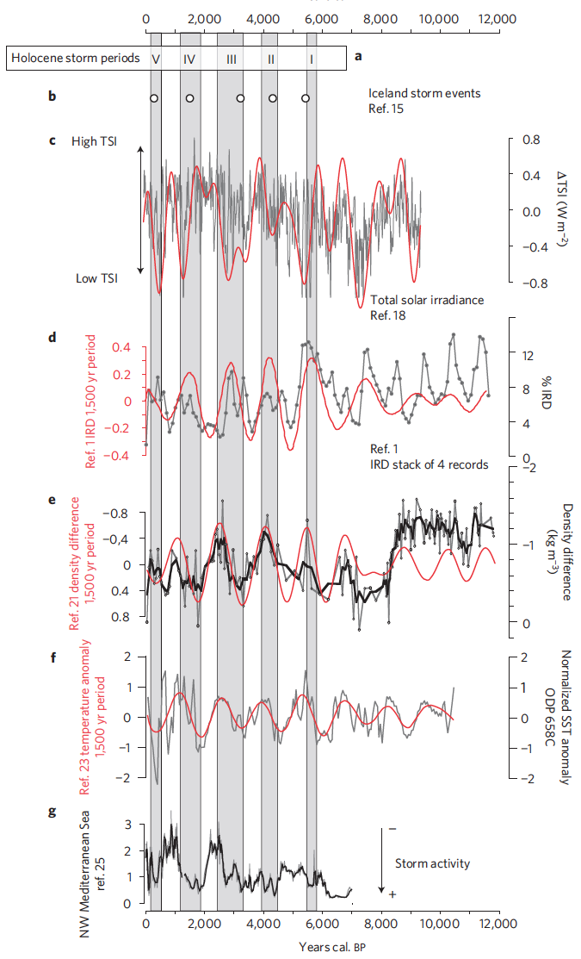
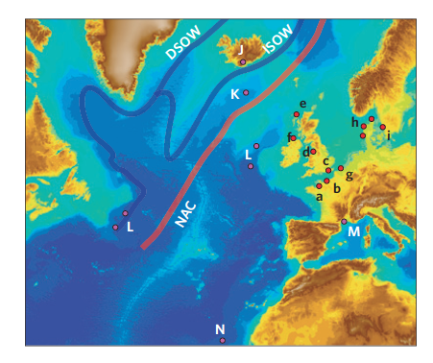
A 1.5 kyr cycle in the Atlantic Ocean?
More and more evidences
  Cf. compilation from Sorrel et al. (NG 2012)
Not due to solar forcing!
Internal AMOC variability?
Jackson et al. (2005)
Steinhilber et al. (2009)
Bond et al. (2001)
Thornalley et al. (2009)
De Menocal et al. (2001)
Sabatier et al. (2007)

Slide 6
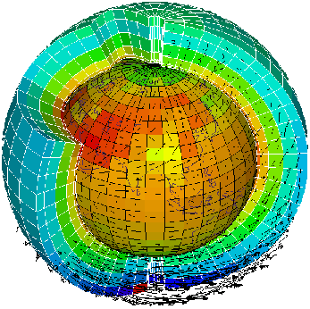

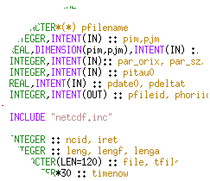
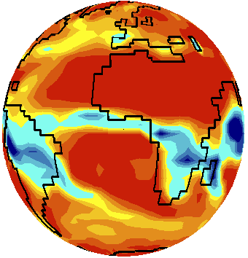
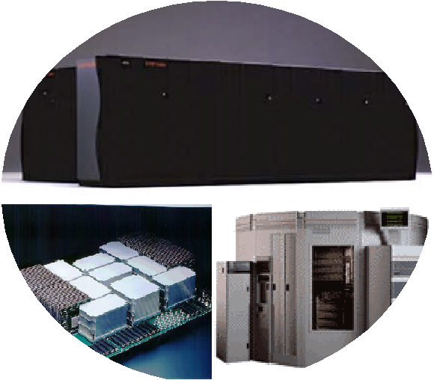
Long-term IPSL available simulation
IPSL-CM5A-LR model:
  Ocean: NEMO including PISCES
  Atmopshere LMDz
  Around 2 degree resolution
Last millennium simulation (850-2005)
2000 year at least under preindustrial conditions
Snapshot for a few key period of the Holocene (6kyr, 9kyr)
Transient simulation covering 6 to 2 kyr BP (issue with outputs)
Transient simulation with accelerated changes in insolation
Sensitivity experiments on MOW to be performed…

Slide 7
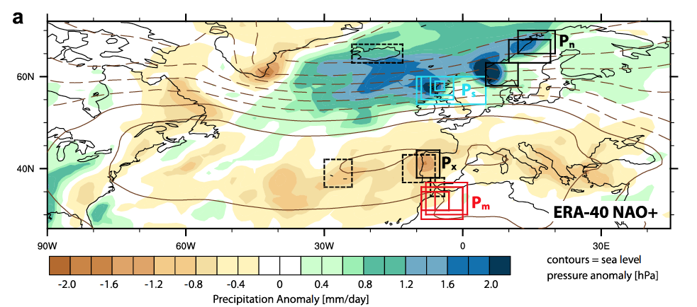
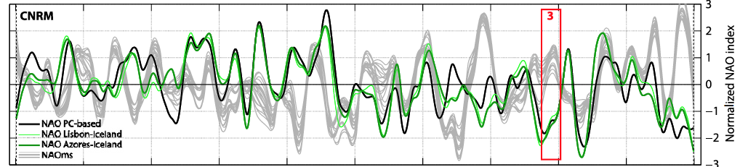
Interaction with data: pseudo-proxy approach
Pseudo-proxy: using the model world to see the link between a particular location and large-scale dynamics
Also possible with observations
Lehner et al. (2012) applied it to evaluate the Trouet et al. (2009) NAO reconstruction

Slide 8
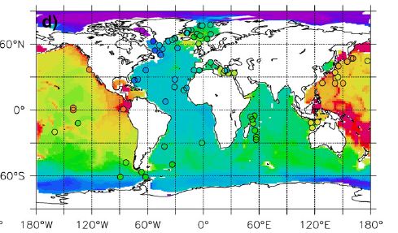
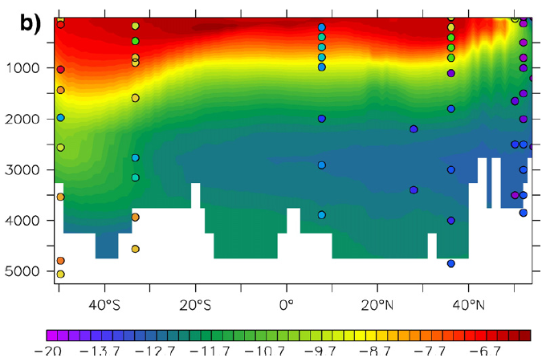
Interaction with data: simulating the proxy
Nd simulation within NEMO
PISCES including diatoms computation!
Use of ε_{Nd} and δ¹³C: off-line ocean tracers model developped by T. Arsouze et JC Dutay
Introduce it off line in selected simulation
Li/Mg, Pa/Th...?
Master internship under supervision of JC Dutay to be found
Arsouze et al. (2006)

Slide 9
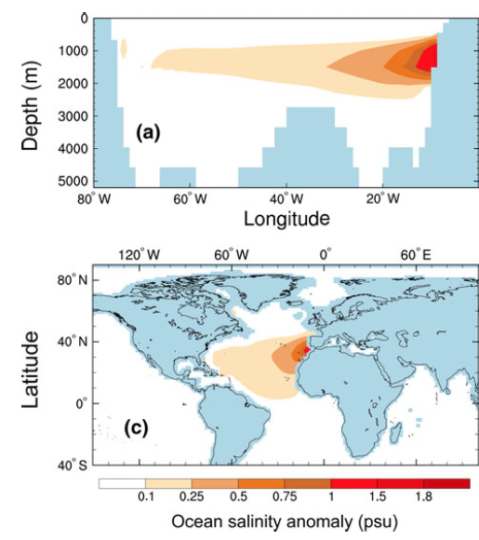
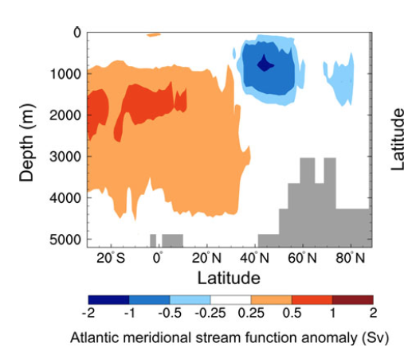
Sapropels period: an impact on the MOW?
A large freshwater from river Nile input around 6kyr
Collapse of MOW production
What is the impact on the AMOC and large scale oceanic circulation?
A study looked into this recently (among many others: Ivanovich et al. (2013) using HadCM3
Do similar experiments using IPSL-CM5A-LR under 6kyr climatic conditions
Anomalies with Gibraltar closed

Slide 10
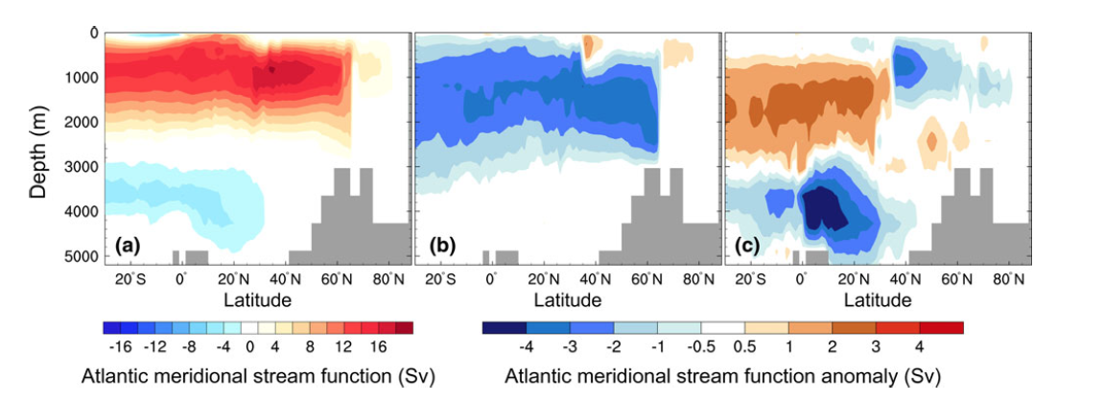
Freshwater in the Mediterranean era
Ivanovich et al. (2013)
  Freshening or salinizing the mediterranean has a larger impact because it affects more the whole circulation!
Control
Fresh Med’
Salty Med’

Slide 11
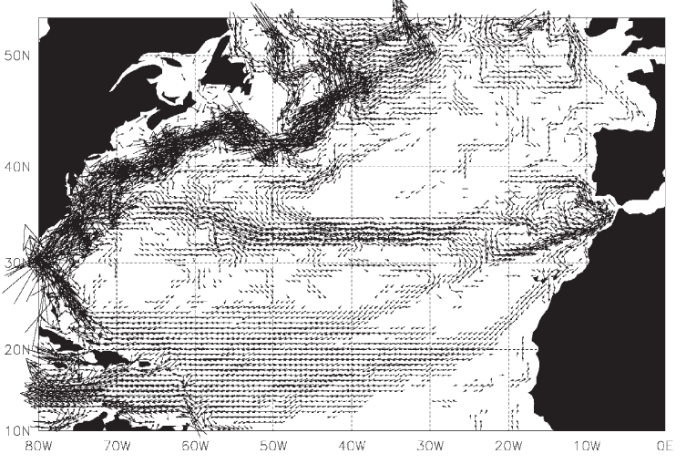
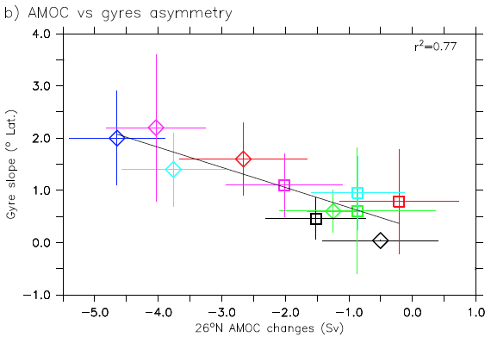
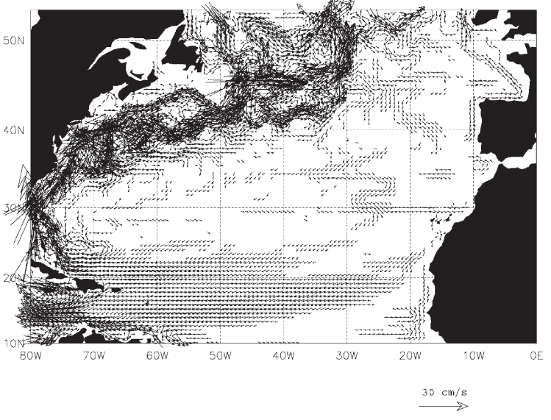
Impact of MOW on ocean circulation
New et al. (2001): using high resolution forced ocean model
the MOW is playing a big role on Azores Current!
A crucial player of AMOC sensitivity to freshwater input in multi-model ensemble?(Swingedouw et al. 2013)

Slide 12
Conclusions – main aims
Two-way interactions between paleodata and model:
  Pseudo-proxy approach to make the link between proxy location and large-scale dynamics
  Simulate proxy
Evaluate simulated low frequency of a complex climate model (IPSL-CM5-LR) and response to external forcing
Test a few hypotheses notably concerning link between MOW and gyres-AMOC

Slide 13
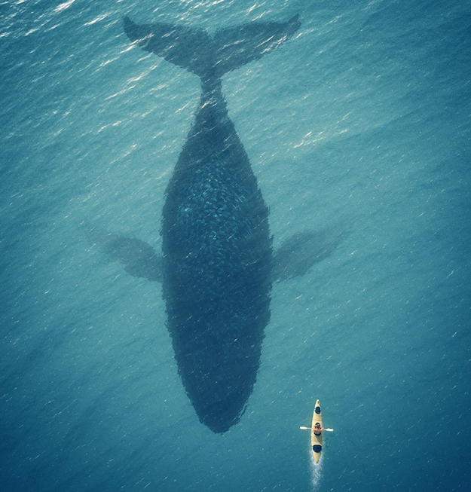
Conclusions
Thank’s for your attention!

Slide 14
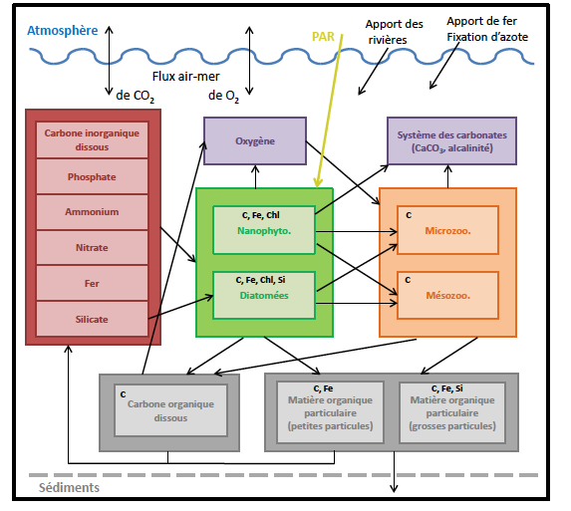
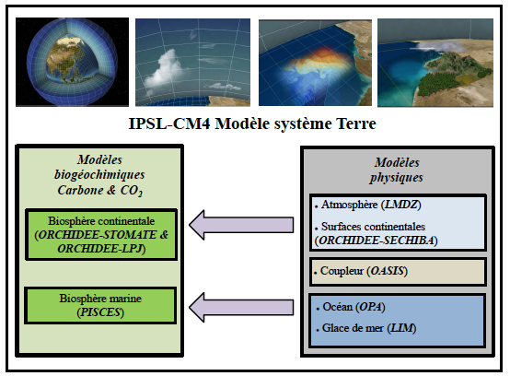
Long-term IPSL available simulation

