Slide 1

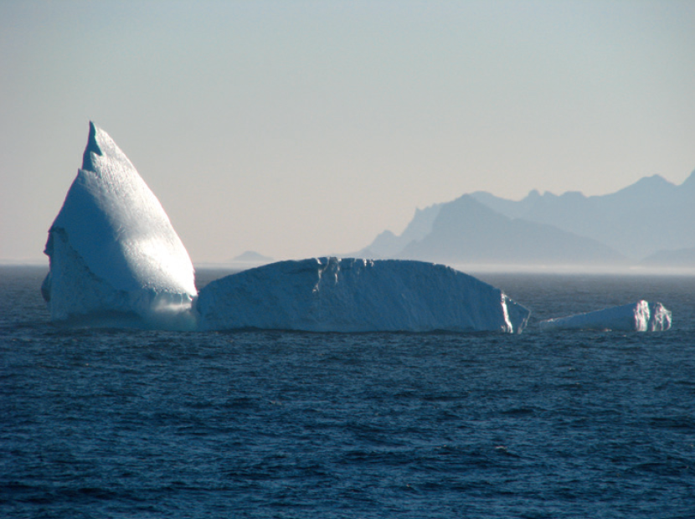

Abrupt changes in the North Atlantic: some fresh news
Ferron/OVIDE/IFREMER
Didier Swingedouw

Slide 2
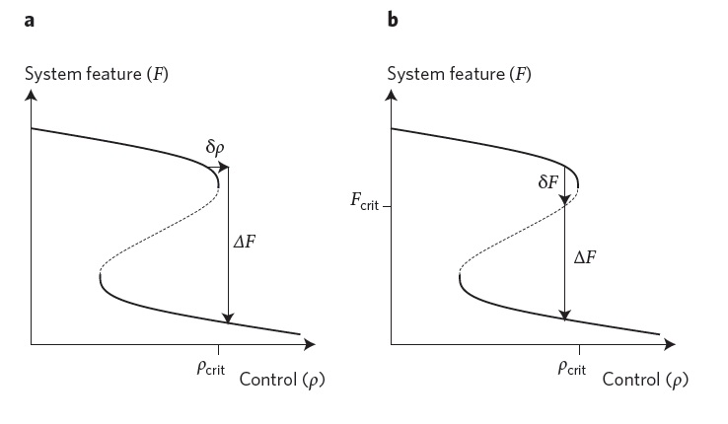
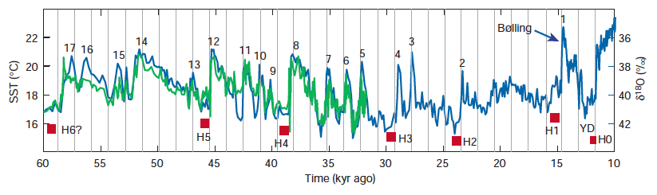
What is an abrupt climate change?
IPCC 2013: “it’s a large-scale change in the climate system that takes place over a few decades or less, persists for at least a few decades and causes substantial disruptions in human and natural systems”
A response faster than the external forcing causing it (Drijfhout et al. 2015)
Implies a non-linear system with different stable states and bifurcations
The North Atlantic is known to be highly non-linear in this respect
Lenton et al. (2011)
Rahmstorf (2002)

Slide 3
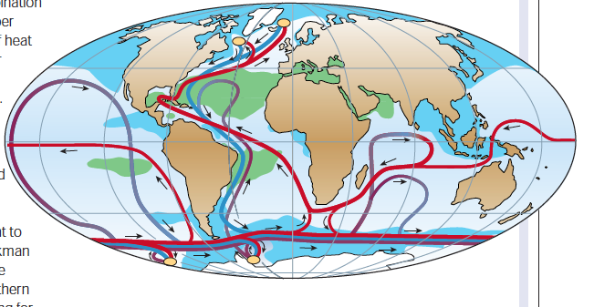
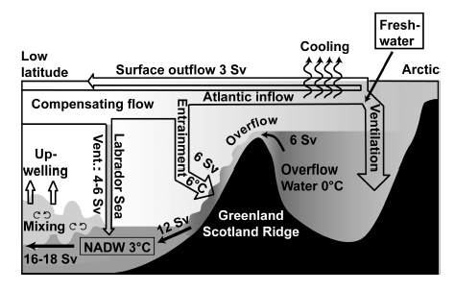
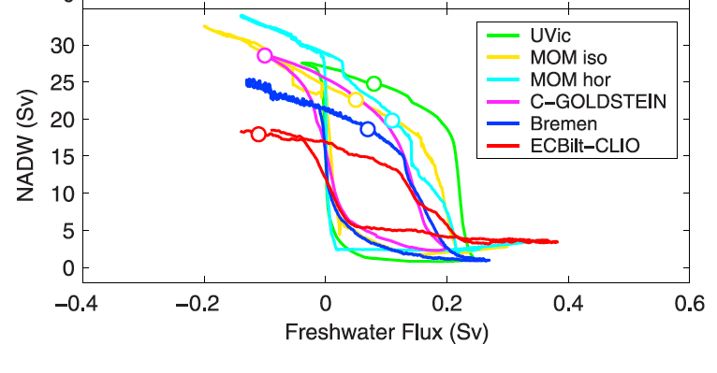
North Atlantic Dynamics
Rahmstorf (2002)
Cross-equatorial heat transport in the Atlantic
Due to deep water formation in the Nordic and Labrador Seas
Positive salinity transport feedback leading to bistability of the circulation system in response to freshwater release in the North Atlantic
freshwater
Quafasel (2007)
Rahmstorf et al. (2005)

Slide 4
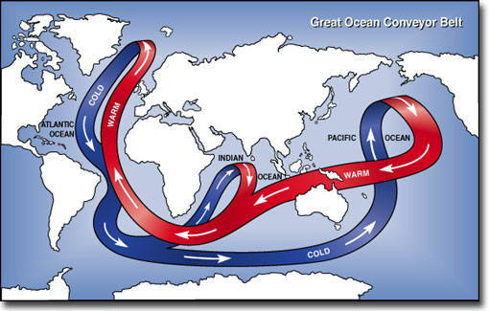
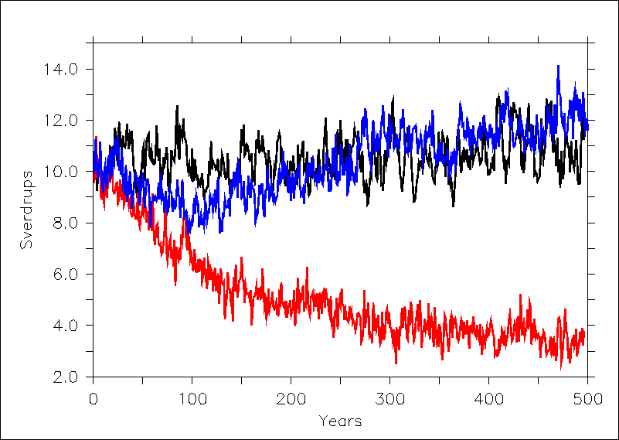
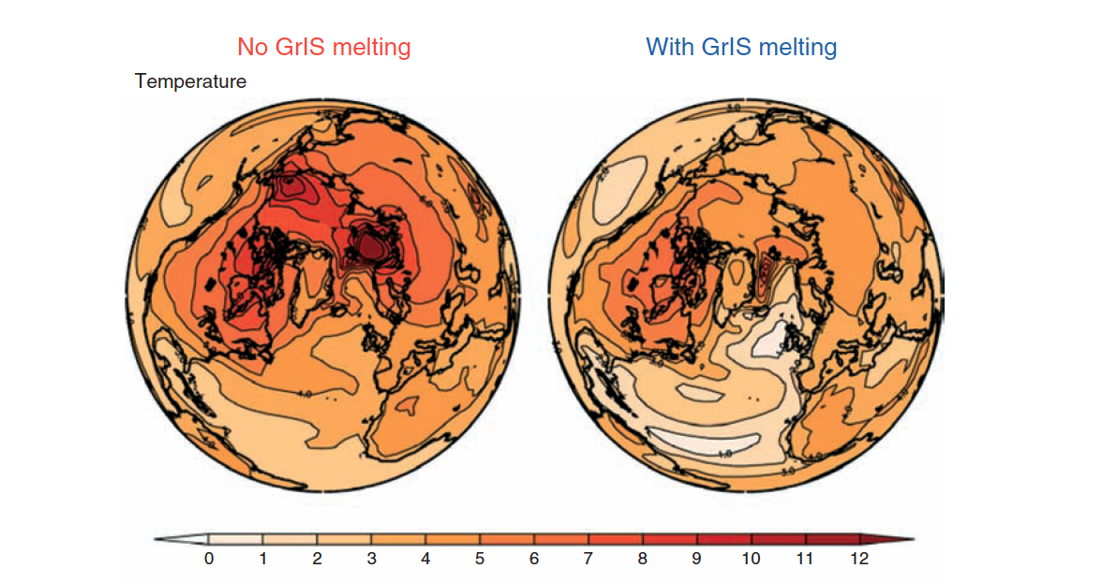
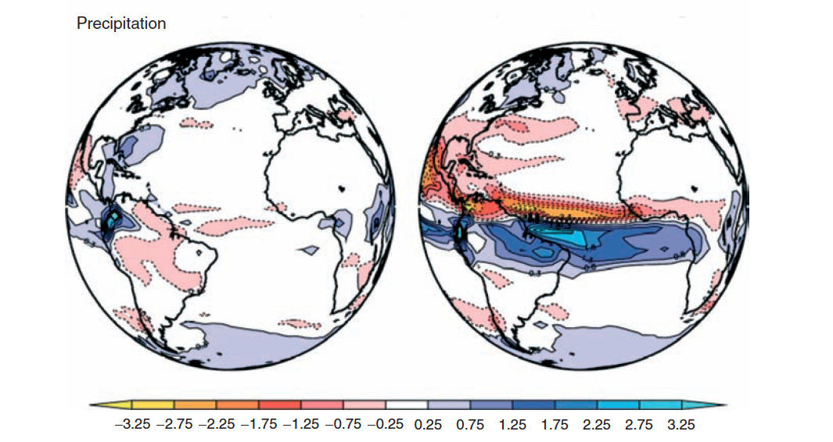
Climatic impact of an AMOC shift
No melting
CTL
Swingedouw et al., Clim. Dyn., 2007a, Masson-Delmotte et al., WIRE, 2012
No melting With melting
GIS melting
No melting With melting

Slide 5
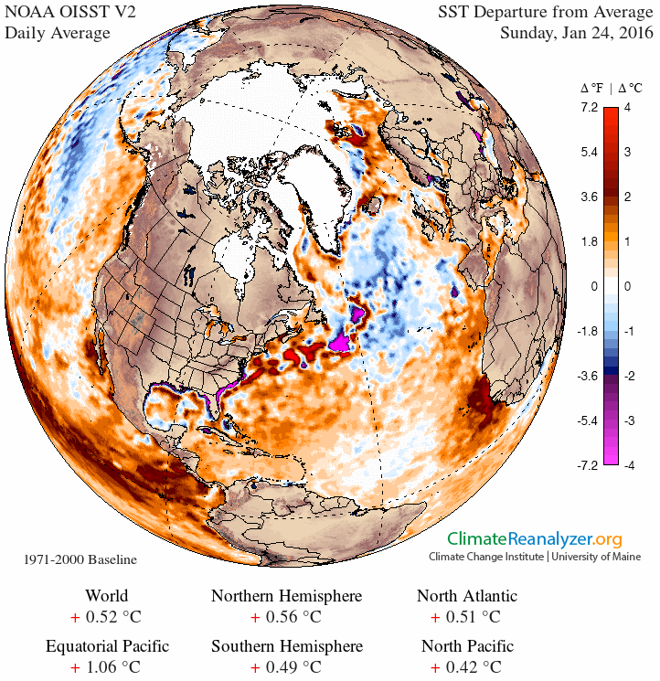
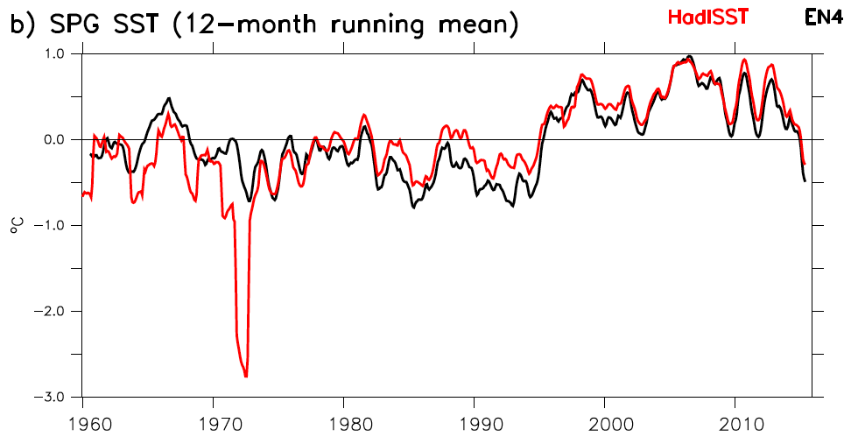
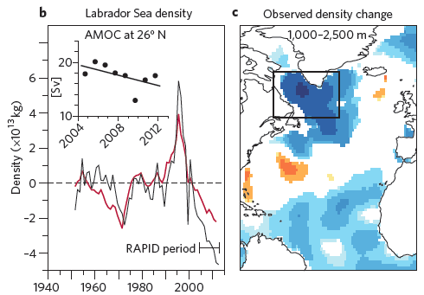
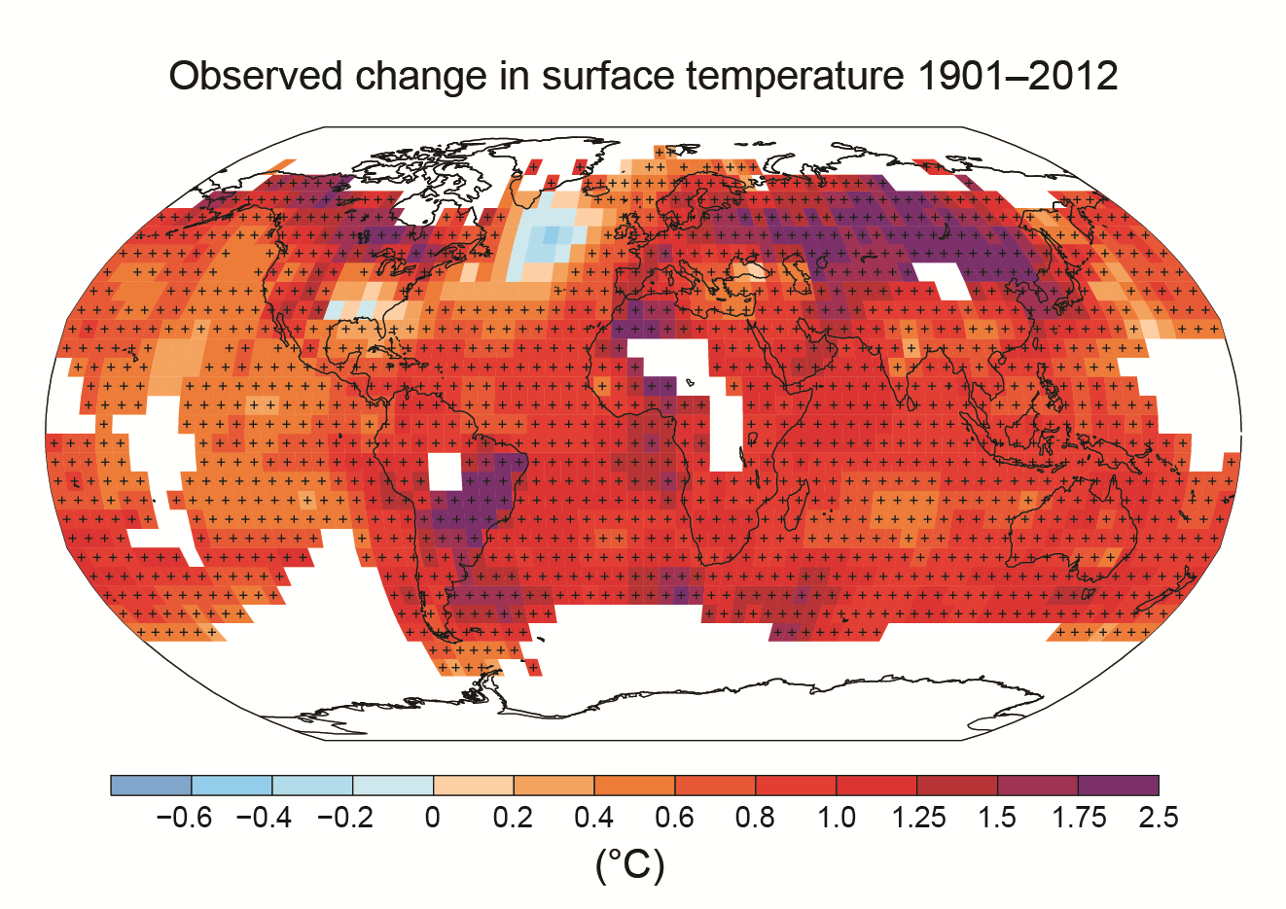
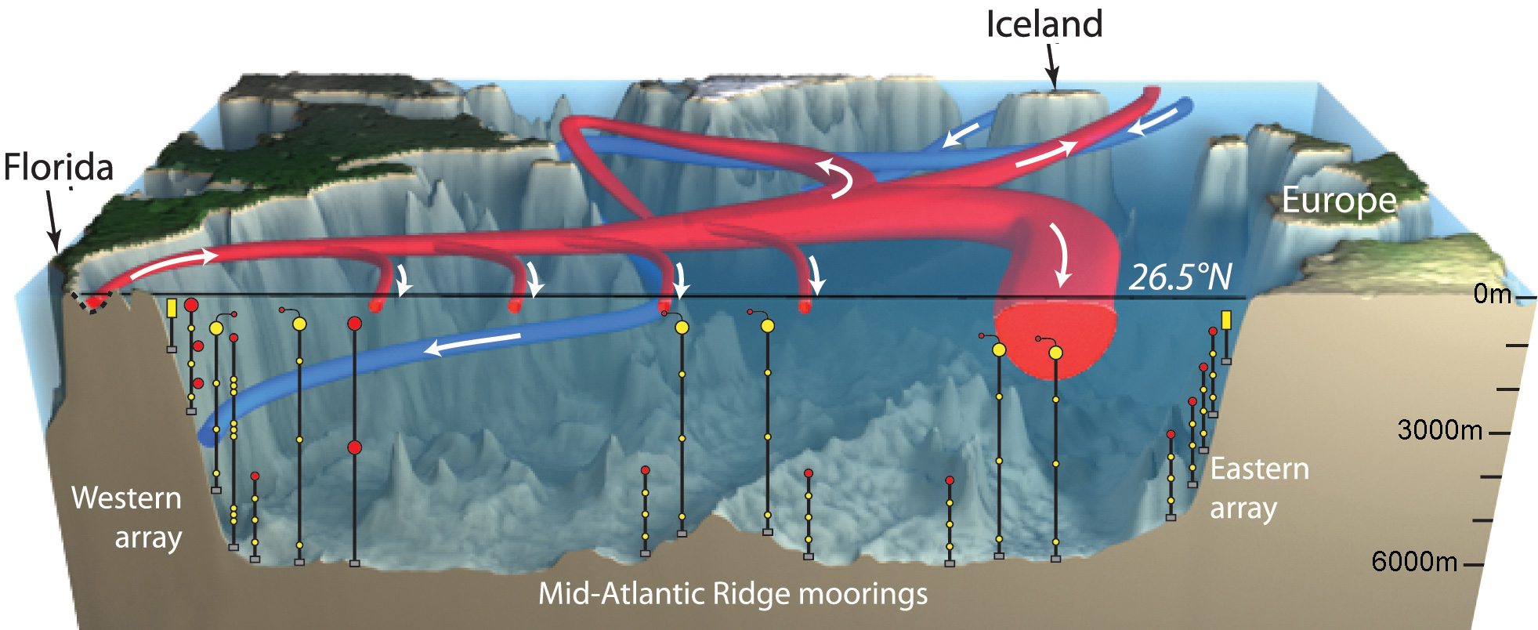
A cold blob in the Atlantic?
Abrupt cooling in the early 1970s, warming around 1995 and now large cooling
Link with AMOC weakening?
Natural variations can play a role (Swingedouw et al., Nat. Com., 2015)
RAPID array to measure the AMOC
Robson et al. (2014)

Slide 6
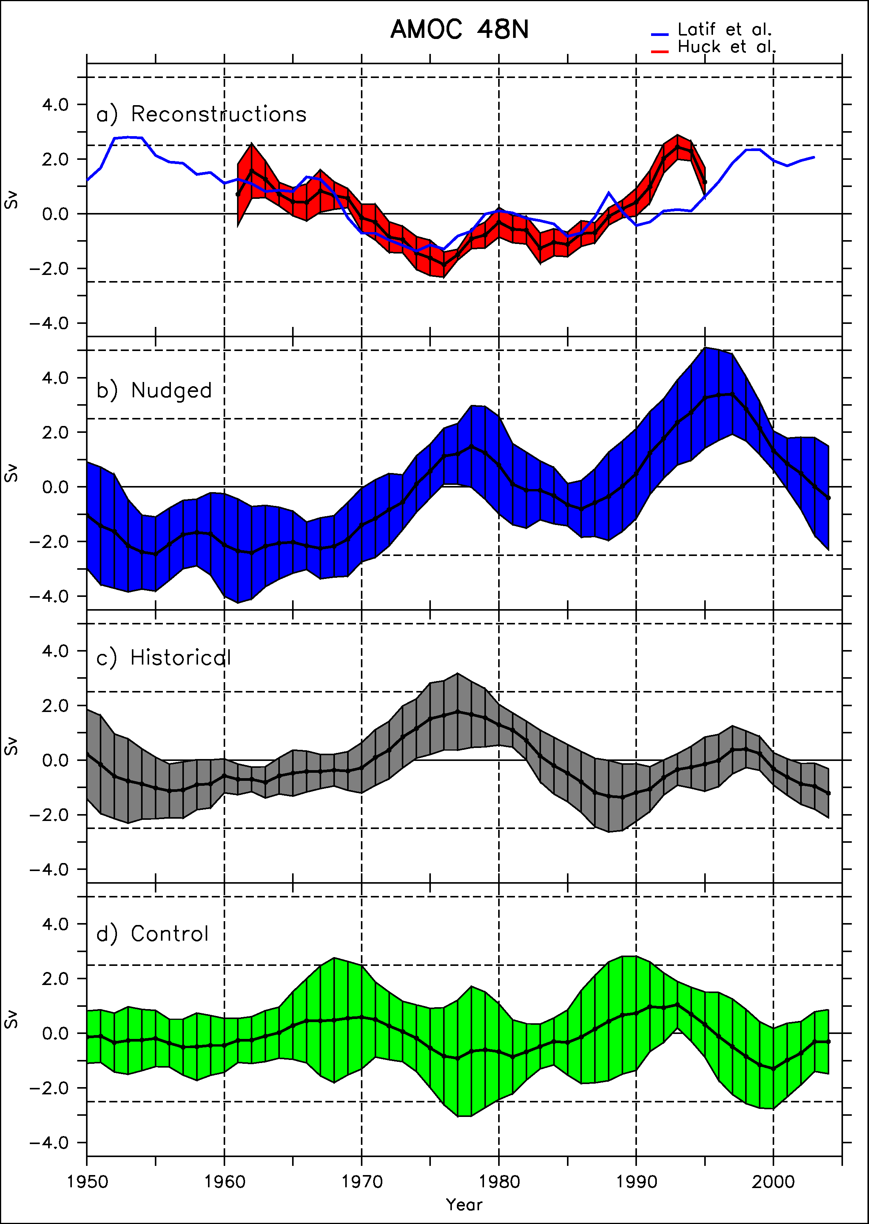
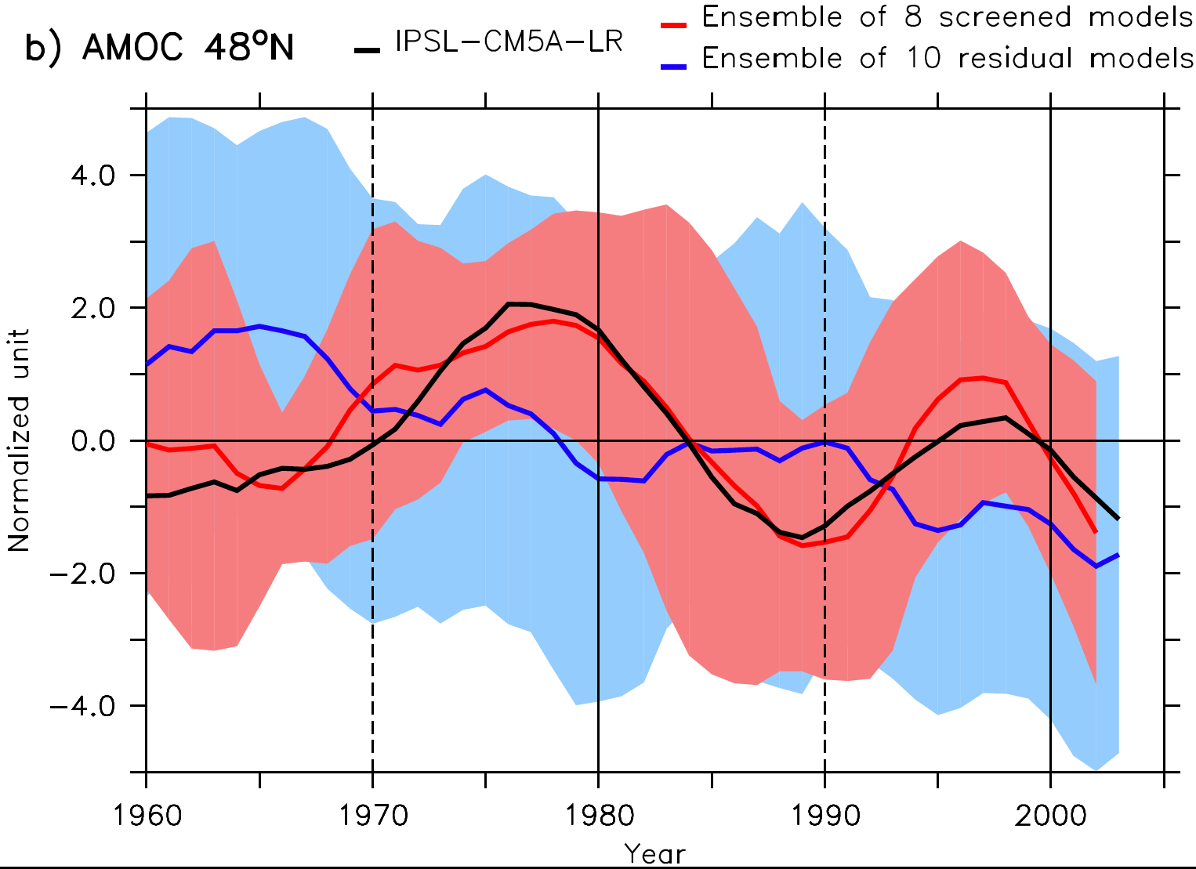
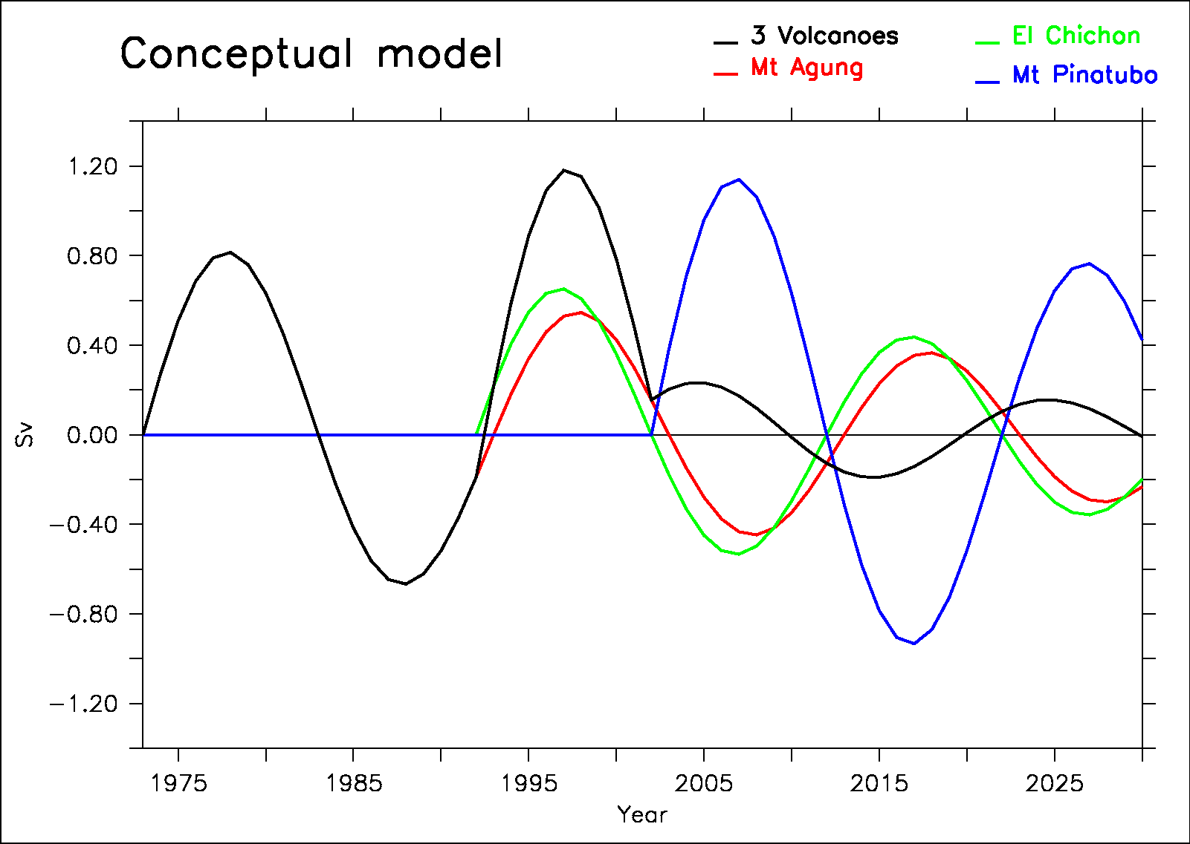
Natural variability of the AMOC
Reconstructions
Obs. (Huck et
Nudged
15 yrs
Historical
Swingedouw et al. 2015
Control
1963
Swingedouw et al. 2013b
Notes:
Mettre GSA instead?

Slide 7
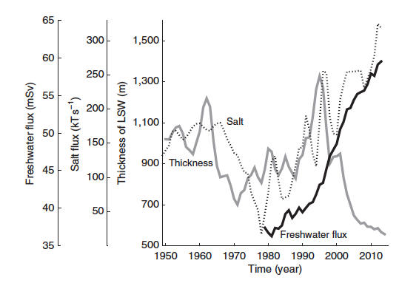
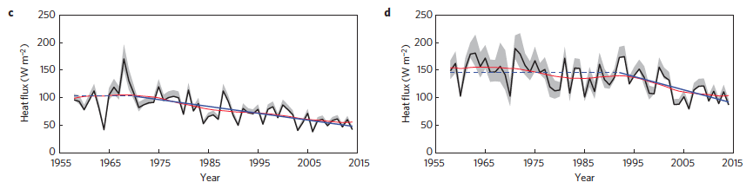
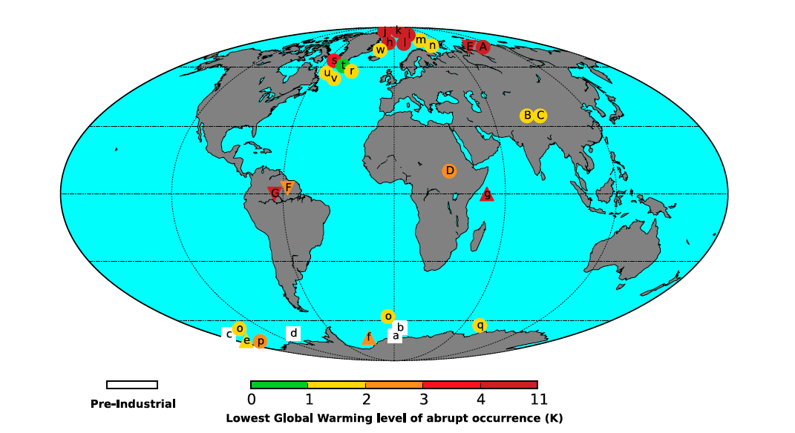
Recent trend in the convection sites
Labrador Sea variations
Long term decrease of the Labrador Sea waters (Yang et al., Nat. com. 2016)
Decrease of surface heat fluxes in the Nordic Seas (Moore et al., Nat. Clim. Change, 2015)
Future? Drijfhout et al. (PNAS 2015): lots of abrupt changes in CMIP5 models
Yang et al. (2016)
Nordic Seas heat flux variations
Moore et al. (2015)
Drijfhout et al. (2015)

Slide 8
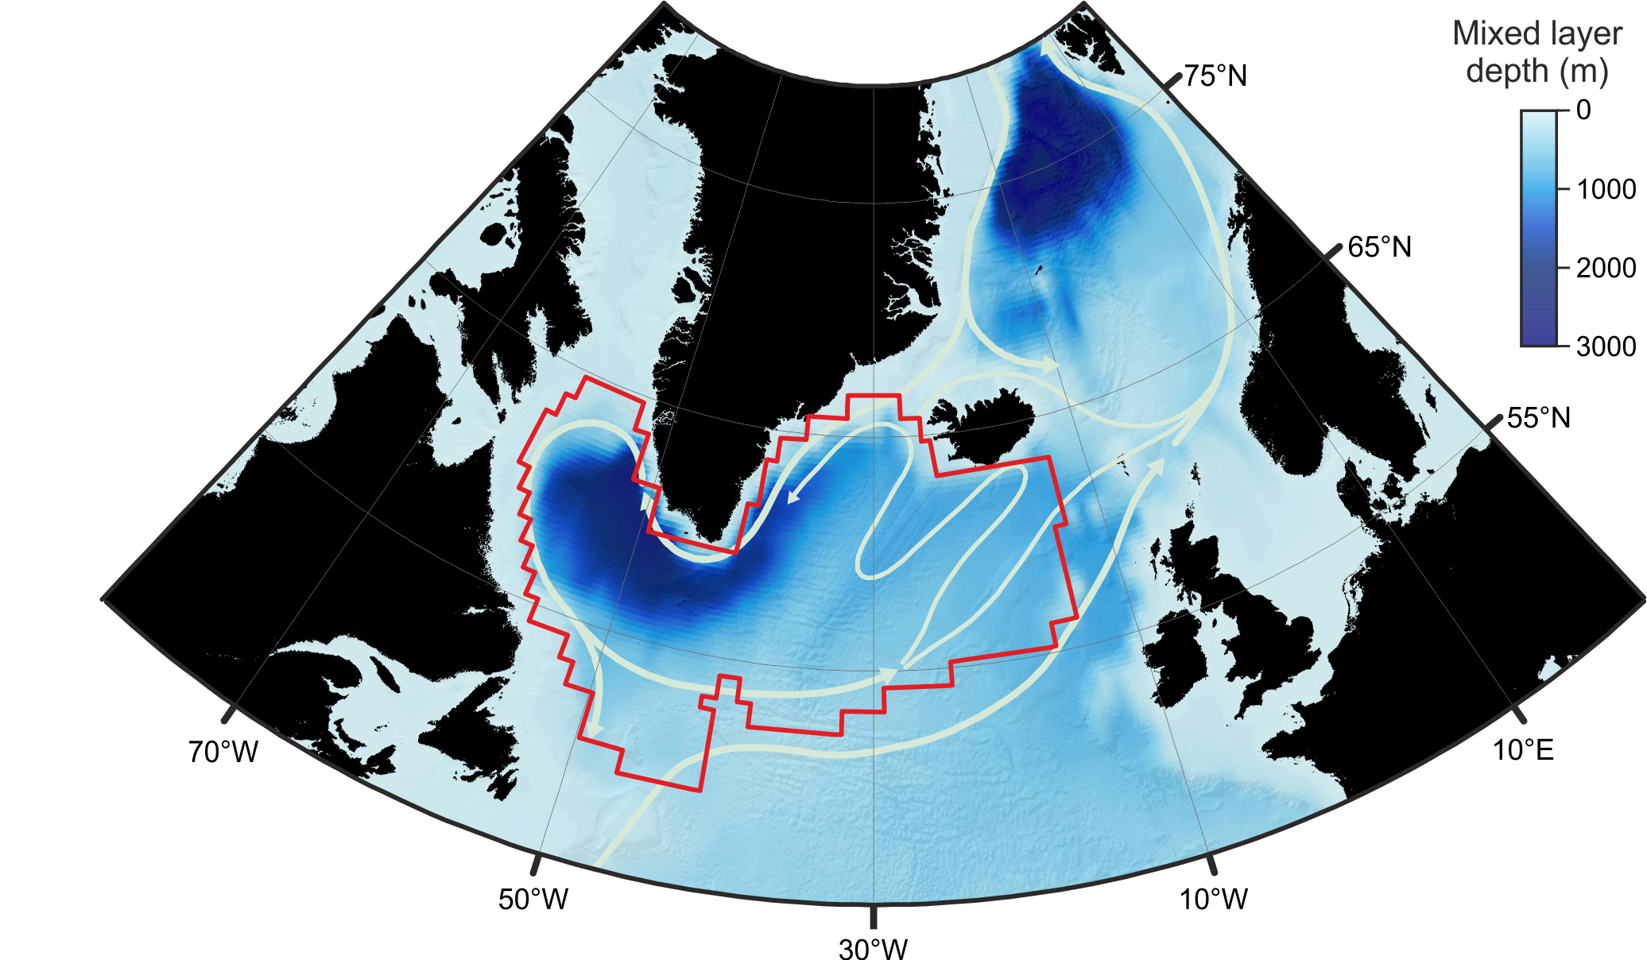
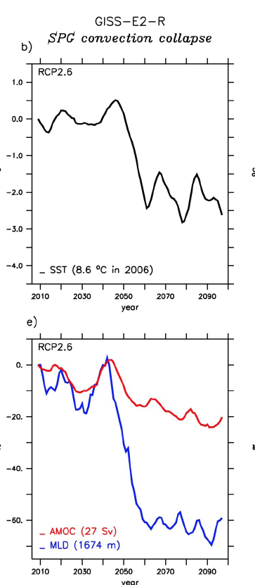
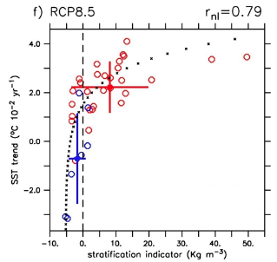
Possible abrupt changes in the North Atlantic?
Sgubin et al. (Nat. Com., in rev.)
Subpolar gyre (SPG) abrupt change rather than an AMOC rapid collapse
Models showing such abrupt changes have a better represented stratification in the SPG
From 17.5% chance of having in abrupt changes if we consider all models to 45.5% if we consider the 11 most skilled models for the representation of SPG stratification !

Slide 9
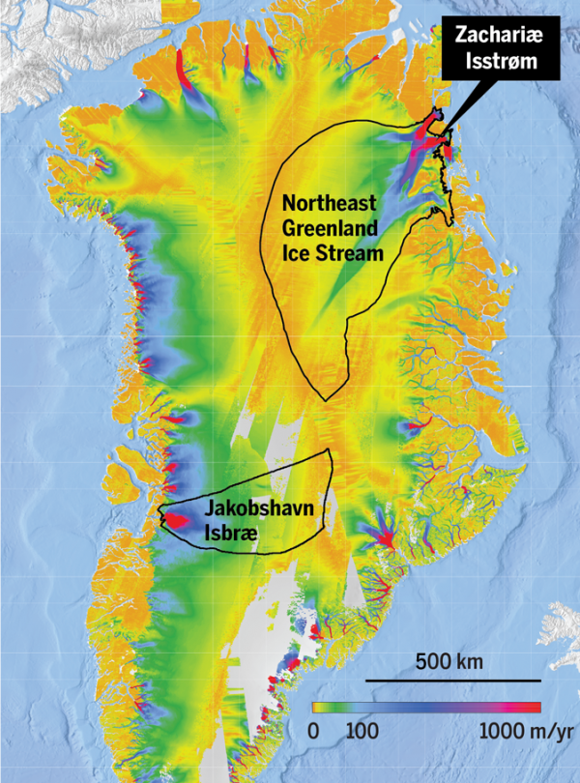
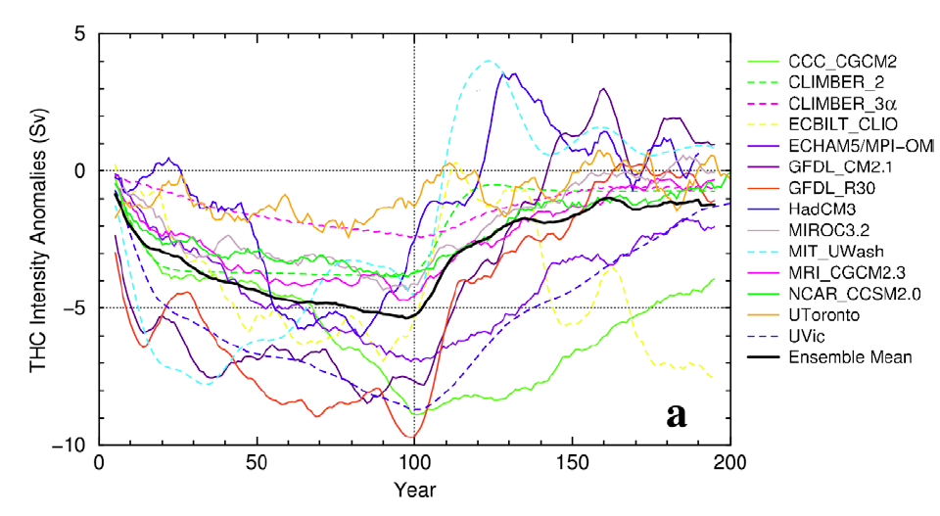
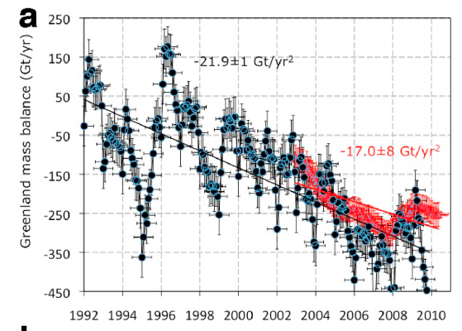
What about Greenland melting impact
A very rapid melting with more and more indication of massive mass loss (Rignot et al. 2001)
What impact could there be on the AMOC (and SPG)?
Large dispersion among climate models in response to a given freshwater release (Stouffer et al. 2006)
Mouginot et al. (2015)
Rignot et al. (2011)
Stouffer et al. (2006)

Slide 10
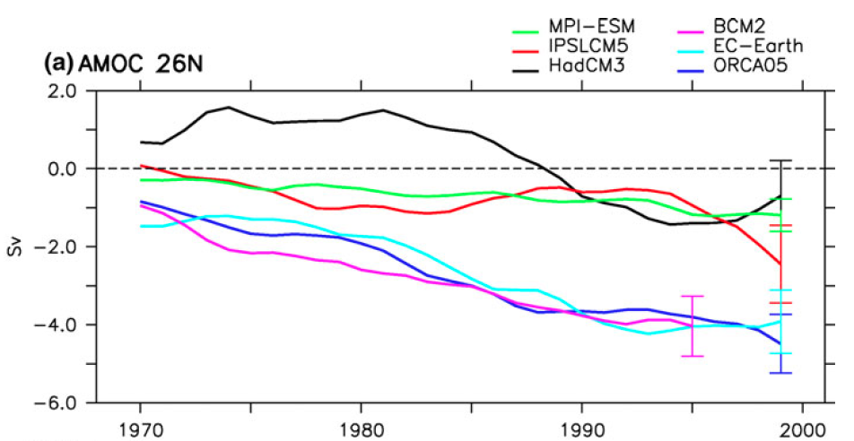

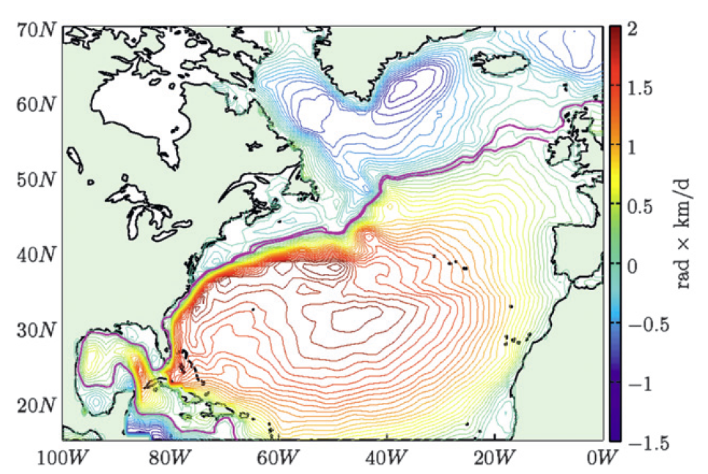
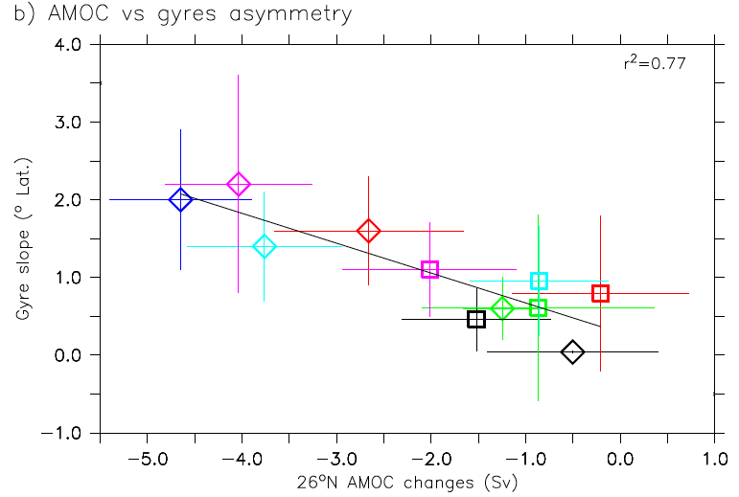
What causes this spread in climate models?
AMOC changes
Different freshwater leakage along the Canary current
AMOC changes vs gyre asymetry
Gyre asymetry (°lat)
AMOC changes (Sv)
Swingedouw et al., Clim. Dyn., 2013a

Slide 11
Can we better estimate the possibility of an abrupt change in the North Atlantic?
Lenton et al. (Nat. Com. 2011): to have a robust “early warning signal” from AMOC measurement (RAPID array…), we need to know at least 500 years of past AMOC variations
What is the exact sensitivity of the AMOC to a freshwater release?
Can paleo-ocean variations help to make progress on these questions?
What do we know from past rapid variability in the North Atlantic?
Are there new paradigms recently emerging?

Slide 12
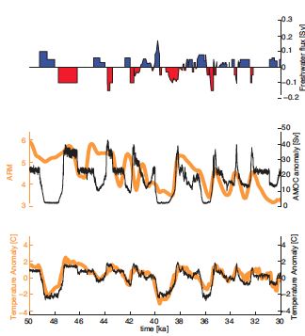
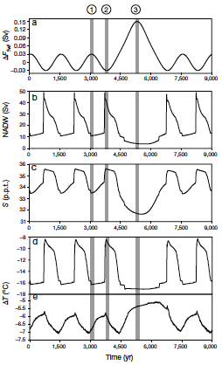
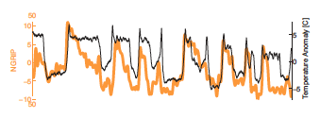
An explanation for stadial-interstadial variability?
Ganopolski et al. 2001
Ganopolski et al. (2001): freshwater variations can be a driver for AMOC and climate abrupt variations during glacial time
Menvielle et al. (2014): hindcasting the DO variations in a climate model (same paradigm but using “observed” freshwater forcing…)
What is causing freshwater forcing variations?
Menvielle et al. 2014

Slide 13
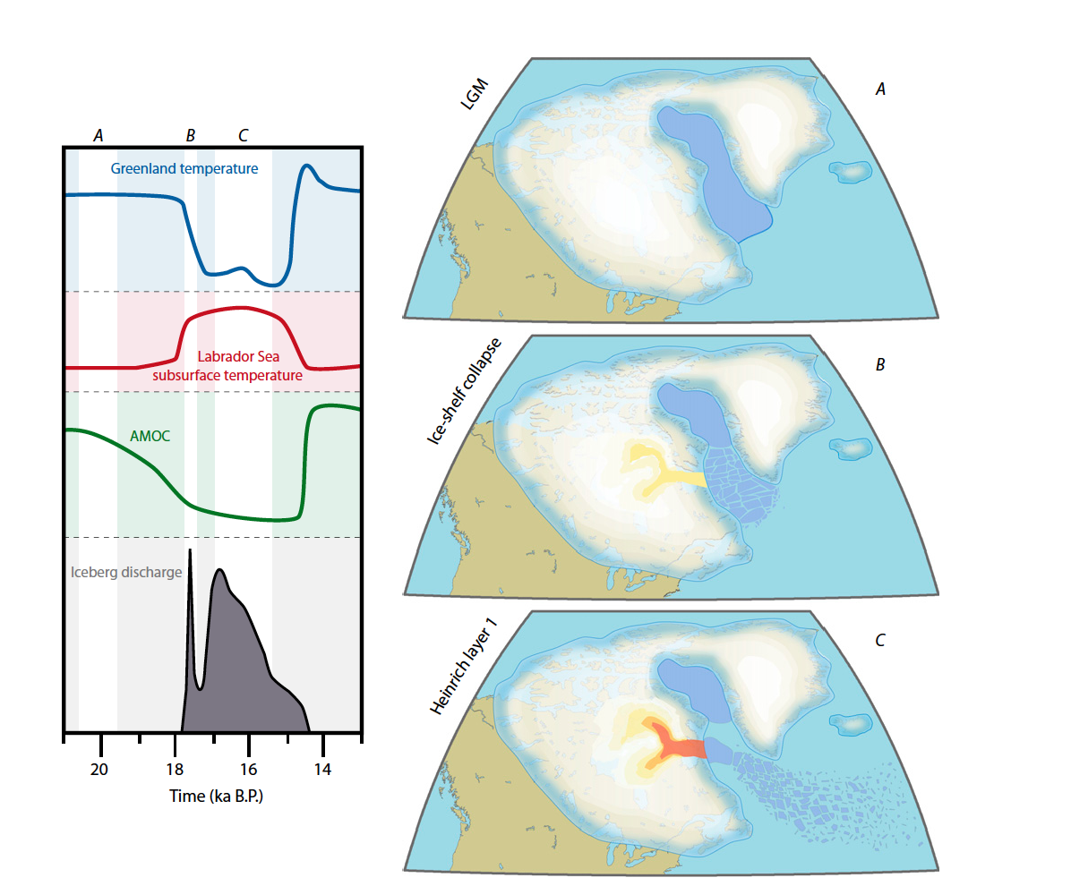
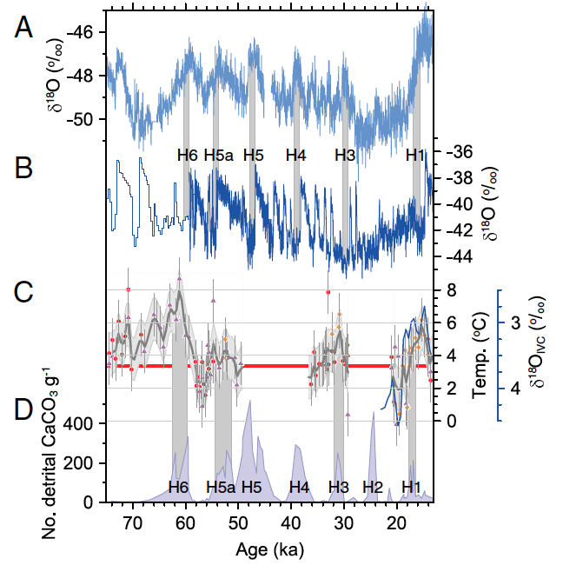
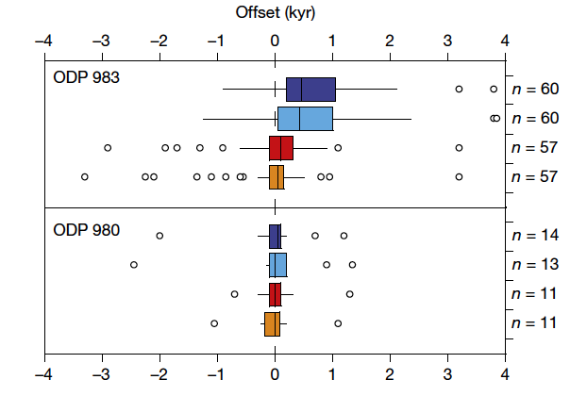
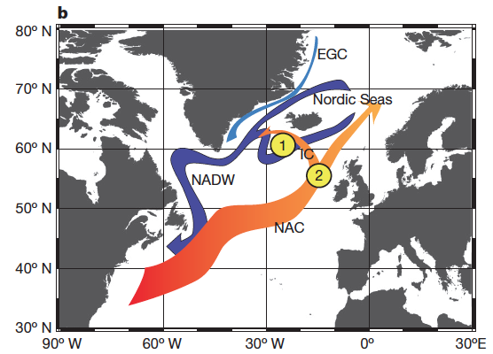
Heinrich events reloaded
Alvarez et al. 2011
Alvarez-Solas et al. (2011, 2013): subsurface warming can destabilize Laurentide ice sheet
Marcott et al. (2011): weakening of the AMOC 1000 years before Heinrich events (Mg/Ca data in the west Atlantic)
Confirmed by Barker et al. (2015)…
Marcott et al. 2011
Notes:
Barker: we suggest that—on the basis of our comparisons of ice-rafted debris and polar planktonic foraminifera— abrupt transitions to stadial conditions should be considered as a nonlinear response to more gradual cooling across the North Atlantic.

Slide 14
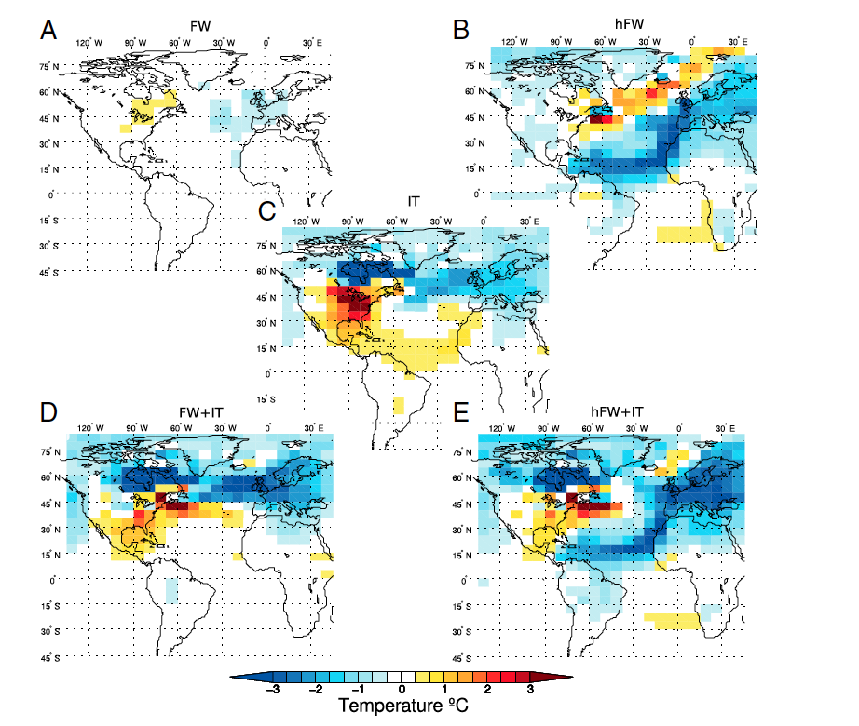
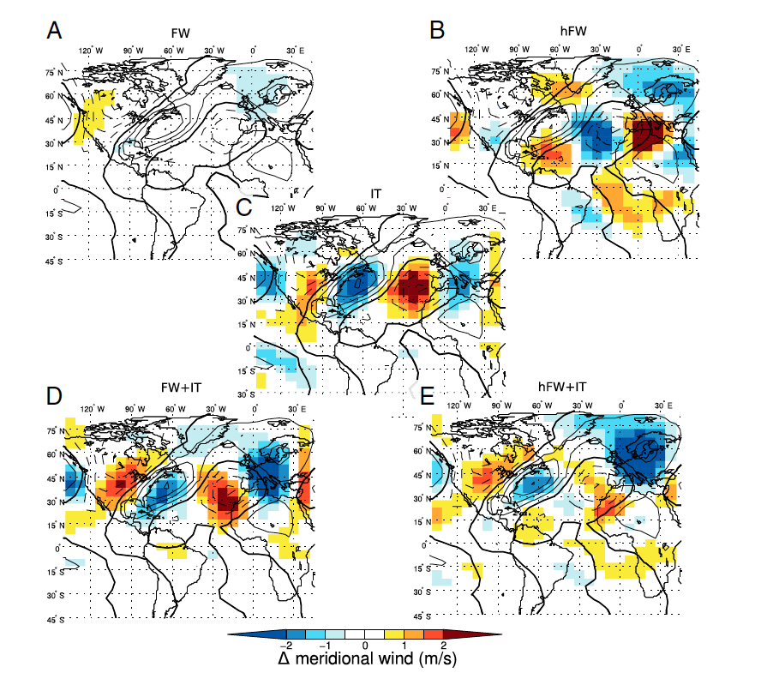
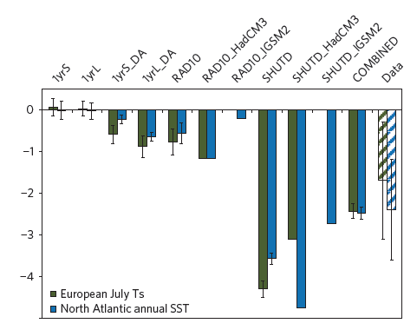
Only freshwater release and AMOC?
Topography effect following Heinrich events (Roberts et al. 2014 ; Zhang et al. 2014)
Other forcings for the Younger Dryas (Renssen et al. 2015)
Roberts et al. 2014
Renssen et al. 2015

Slide 15
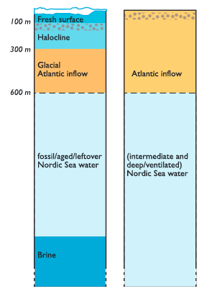
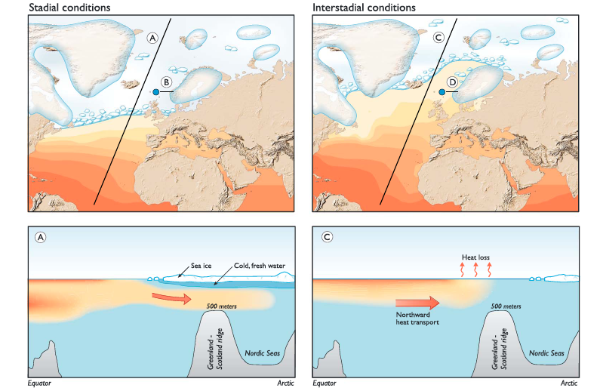
Nordic Seas as a driver of DO?
Can local changes in the Nordic Seas explain Dansgaard-Oeschger variability? (Singh et al. 2013)
Subsurface warming during stadial (Dokken et al. 2013)
Dokken et al. (2013)
BUT not very clear evidences concerning sign of the surface changes in the Nordic Seas up to now.
Notes:
we present a new, high-resolution multiproxy marine sediment core monitoring changes in the warm Atlantic inflow to the Nordic seas as well as in local sea ice cover and influx of ice-rafted debris
In contrast to previous studies, the freshwater input is found to be coincident with warm interstadials on Greenland and has a Fennoscandian rather than Laurentide source. Furthermore, the data suggest a different thermohaline structure for the
Nordic seas during cold stadials in which relatively warm Atlantic water circulates beneath a fresh surface layer and the presence of sea ice is inferred from benthic oxygen isotopes.
O18 foram planktonic qui est plutot subsurface (Wary)

Slide 16
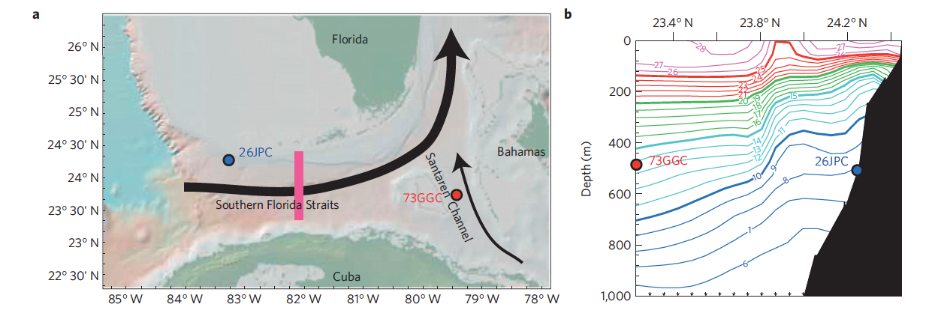
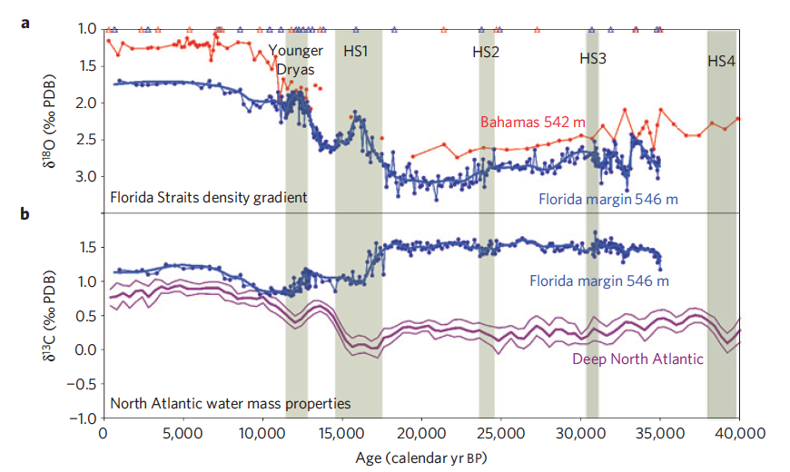
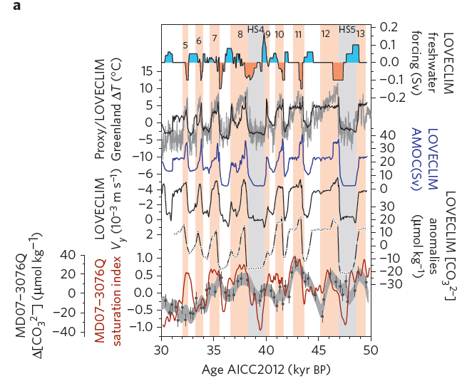
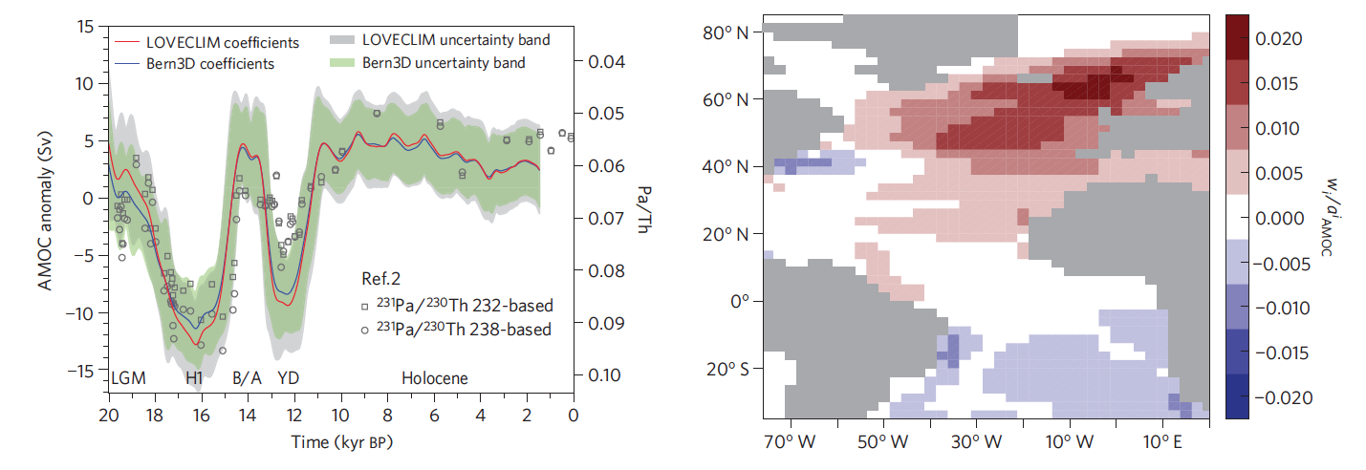
Reconstructing past AMOC variations
Lynch-Stieglitz et al. (2014)
Reconstruction of Gulf Stream (Lynch Stieglitz et al. 2014): not much change in its intensity for H2 and H3
South Atlantic: (Gottschalk et al. 2015) large intrusion of NADW for each interstadial
AMOC variations during deglaciation (Ritz et al. 2013)
Workshop in Boulder next May on AMOC reconstruction using paleo and present-day techniques
Gottschalk et al. (2015)
Ritz et al. 2013
Notes:
Gottshalk : we reconstruct bottom water [CO32-] variability from B/Ca ratios of benthic foraminifera and indicators of sedimentary dissolution, and use these reconstructions to infer the flow of northern-sourced deep water to the deep central sub-Antarctic Atlantic Ocean.
Ritz : we combine proxy reconstructions of sea surface and air temperatures and a global climate model to quantitatively estimate changes in the strength of the Atlantic meridional overturning circulation during the last glacial period

Slide 17
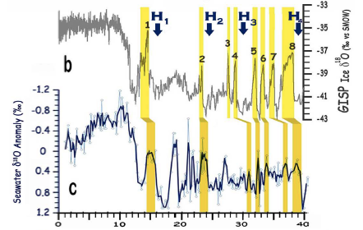
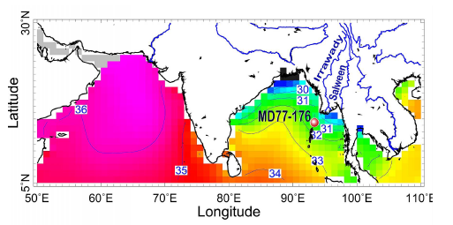
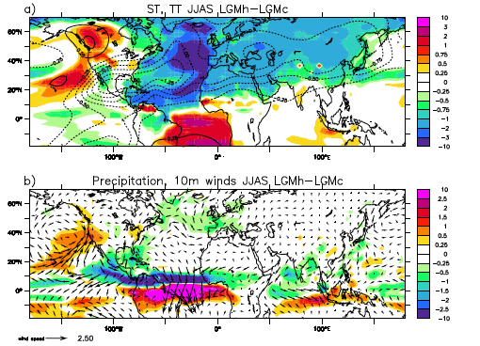
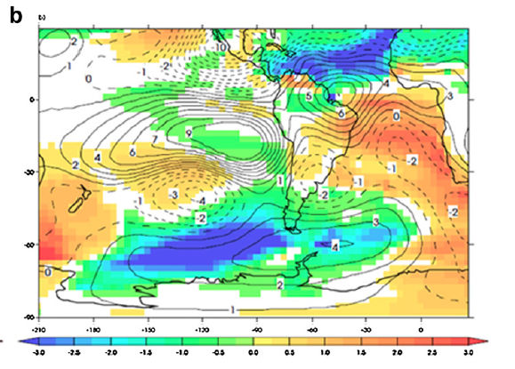
Teleconnections from the North Atlantic
Heinrich events can impact Asian monsoon (Marzin et al. 2013, Mohtadi et al. 2014)
With a signature on methane concentration through its impact on the ITCZ (Rhodes et al. 2015)
Seesaw mechanism: not so simple? (Capron et al. 2010, Landais et al. 2015)
Teleconnection from the North Pole to the South Pole through the tropics! (Buiron et al. 2012)
Marzin et al. (2013)
Surface temperature
Buiron et al. (2012)
Notes:
Marzin :
Oxygen isotope measurements (18O) were made on planktonic foraminifera Globigerinoides ruber
The changes over the tropical Atlantic are shown to be essential in triggering perturbations of the subtropical jet over Africa and Eurasia, that in turn affect the intensity of the Indian monsoon.

Slide 18

Freshwater impact on the Nordic Seas
Results from multi-model ensemble under present-day conditions (THOR European project)
Warming of the Nordic Seas through capping of the SPG and increase of surface current towards Nordic Seas
Wary et al. (in prep.)

Slide 19


Warm Nordic Seas during stadials?
Quantitative reconstructions from dinocyst assemblages (Wary et al., in prep.)
Notes:
Wary : we show, using quantitative reconstructions derived from dinocyst assemblages and conducted on four sediment cores from the southern Norwegian Sea

Slide 20
Conclusions
The on-going variations of the North Atlantic is worrying given paleo evidences of abrupt changes as well as from CMIP5 models.
Paleoclimate can be a compass to evaluate likeliness of crossing a threshold but we need quantified compilation for Dansgaard-Oeschger variability.
Hydrological budget of the North Atlantic is key, but complex for ice ages, with interactions between ocean circulation and ice shelves => coupled ice sheet climate models are required
Need for reconstruction of AMOC for paleo-time based on robust physical principles (it is already hard to reconstruct the present-day AMOC variations!)

Slide 21




Thank you!
didier.swingedouw@u-bordeaux1.fr

Slide 22

Dokken et al. 2013

